Slide 1
Victory for the GRE® Test PowerPoint Table of Contents
Verbal Reasoning: Completions
Verbal Reasoning: Reading
Quantitative Reasoning: Discrete Quantitative
Quantitative Reasoning: Numeric Entry
Quantitative Reasoning: Comparisons
Quantitative Reasoning: Data Interpretation
Analytical Writing

Slide 2
Verbal Reasoning: Completions Test Mechanics
21 • Verbal Reasoning: Completions
↖ Back to the Table of Contents
Notes:
Teacher’s Guide p. 49

Slide 3
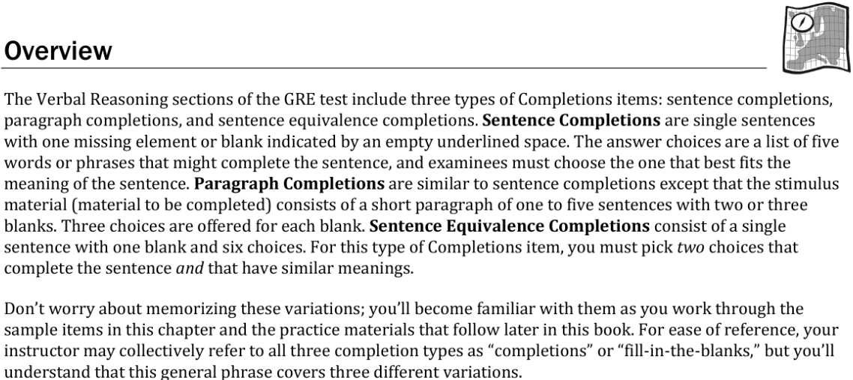
Verbal Reasoning: Completions Test Mechanics
21 • Verbal Reasoning: Completions
Notes:
Teacher’s Guide p. 51

Slide 4
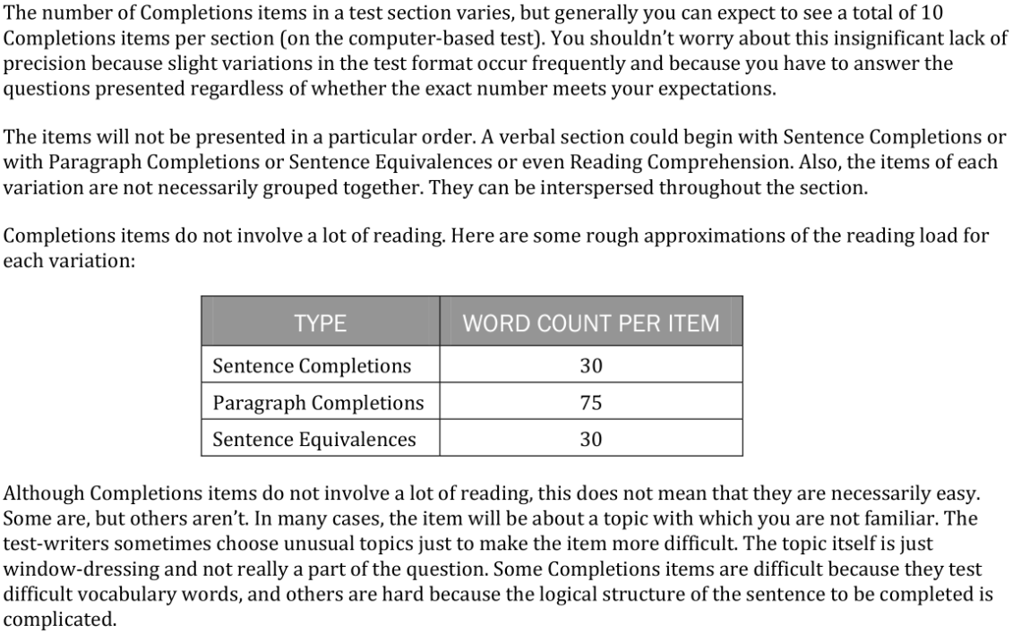
Verbal Reasoning: Completions Test Mechanics
21 • Verbal Reasoning: Completions
Notes:
Teacher’s Guide p. 51

Slide 5
Verbal Reasoning: Completions Anatomy Directions
22 • Verbal Reasoning: Completions
Notes:
Teacher’s Guide p. 53

Slide 6
Verbal Reasoning: Completions Anatomy Q1
22 • Verbal Reasoning: Completions
Notes:
Teacher’s Guide p. 53

Slide 7
Verbal Reasoning: Completions Anatomy Q2
22 • Verbal Reasoning: Completions
Notes:
Teacher’s Guide p. 53

Slide 8
Verbal Reasoning: Completions Anatomy Directions
22 • Verbal Reasoning: Completions
Notes:
Teacher’s Guide p. 53

Slide 9
Verbal Reasoning: Completions Anatomy Q3
22 • Verbal Reasoning: Completions
Notes:
Teacher’s Guide p. 53

Slide 10
Verbal Reasoning: Completions Anatomy Q4
23 • Verbal Reasoning: Completions
Notes:
Teacher’s Guide p. 54

Slide 11
Verbal Reasoning: Completions Anatomy Q5
23 • Verbal Reasoning: Completions
Notes:
Teacher’s Guide p. 54

Slide 12
Verbal Reasoning: Completions Anatomy Directions
23 • Verbal Reasoning: Completions
Notes:
Teacher’s Guide p. 54

Slide 13
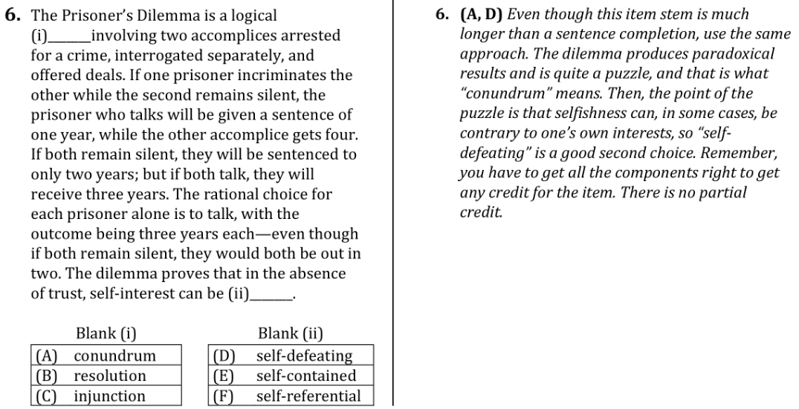
Verbal Reasoning: Completions Anatomy Q6
23 • Verbal Reasoning: Completions
Notes:
Teacher’s Guide p. 54

Slide 14
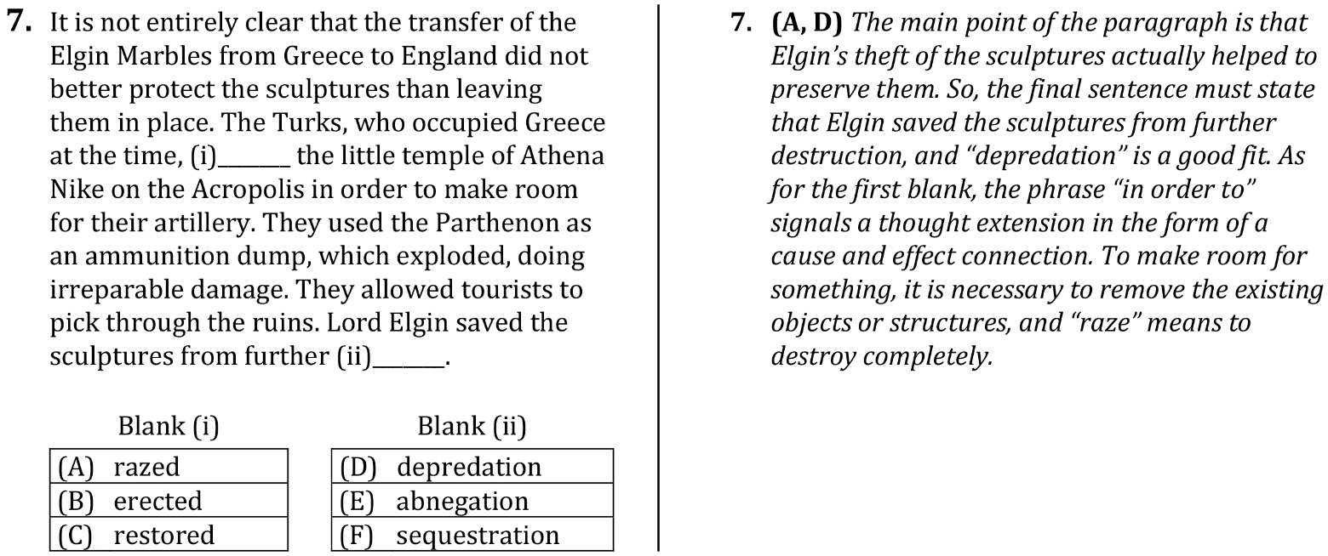
Verbal Reasoning: Completions Anatomy Q7
24 • Verbal Reasoning: Completions
Notes:
Teacher’s Guide p. 55

Slide 15
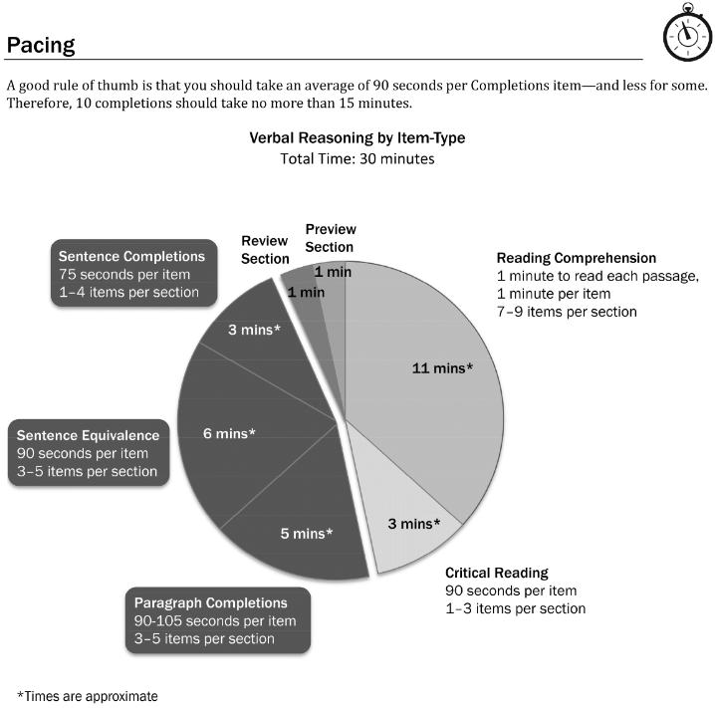
Verbal Reasoning: Completions Pacing
25 • Verbal Reasoning: Completions
Notes:
Teacher’s Guide p. 56

Slide 16
Verbal Reasoning: Completions Pacing
25 • Verbal Reasoning: Completions
Notes:
Teacher’s Guide p. 56

Slide 17
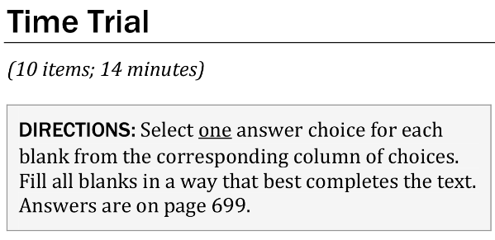
Verbal Reasoning: Completions Time Trial Directions
26 • Verbal Reasoning: Completions
Notes:
Teacher’s Guide p. 58

Slide 18
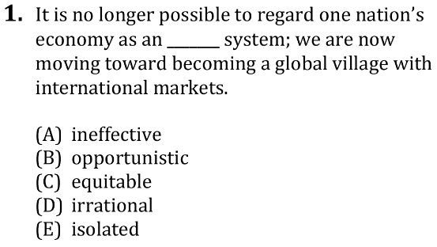
Verbal Reasoning: Completions Time Trial Q1
26 • Verbal Reasoning: Completions
Notes:
Teacher’s Guide p. 58

Slide 19
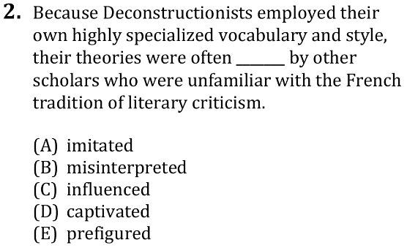
Verbal Reasoning: Completions Time Trial Q2
26 • Verbal Reasoning: Completions
Notes:
Teacher’s Guide p. 58

Slide 20
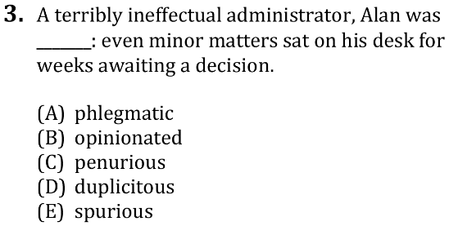
Verbal Reasoning: Completions Time Trial Q3
26 • Verbal Reasoning: Completions
Notes:
Teacher’s Guide p. 58

Slide 21
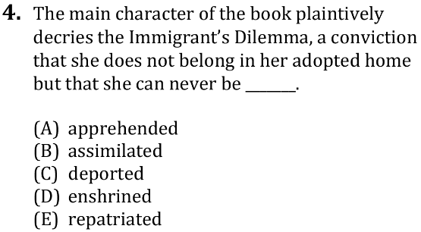
Verbal Reasoning: Completions Time Trial Q4
26 • Verbal Reasoning: Completions
Notes:
Teacher’s Guide p. 59

Slide 22
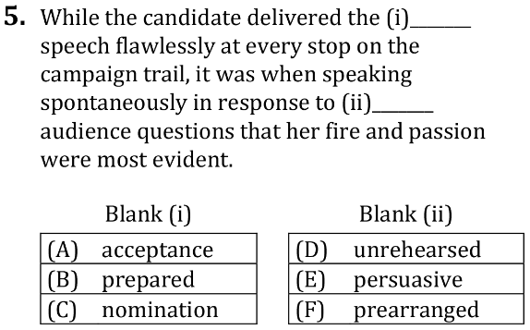
Verbal Reasoning: Completions Time Trial Q5
26 • Verbal Reasoning: Completions
Notes:
Teacher’s Guide p. 59

Slide 23
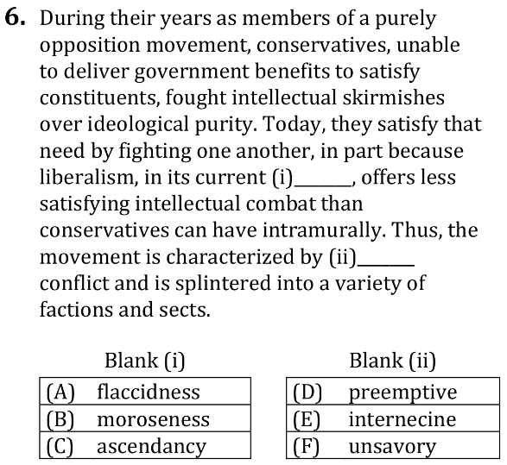
Verbal Reasoning: Completions Time Trial Q6
26 • Verbal Reasoning: Completions
Notes:
Teacher’s Guide p. 59

Slide 24
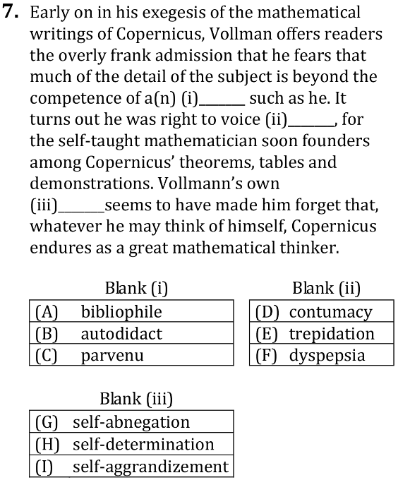
Verbal Reasoning: Completions Time Trial Q7
27 • Verbal Reasoning: Completions
Notes:
Teacher’s Guide p. 59

Slide 25
Verbal Reasoning: Completions Time Trial Directions
27 • Verbal Reasoning: Completions
Notes:
Teacher’s Guide p. 59

Slide 26
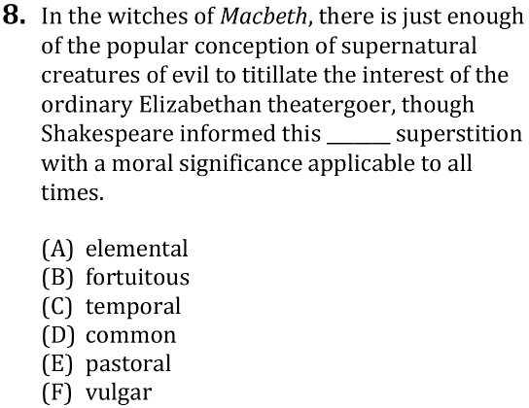
Verbal Reasoning: Completions Time Trial Q8
27 • Verbal Reasoning: Completions
Notes:
Teacher’s Guide p. 60

Slide 27
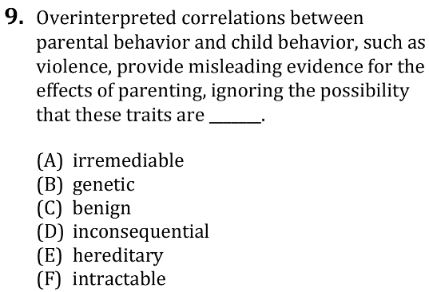
Verbal Reasoning: Completions Time Trial Q9
27 • Verbal Reasoning: Completions
Notes:
Teacher’s Guide p. 60

Slide 28
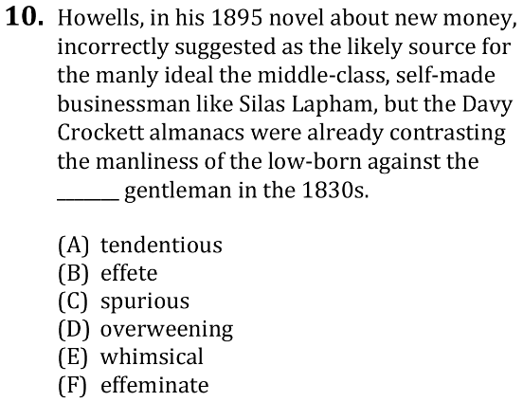
Verbal Reasoning: Completions Time Trial Q10
27 • Verbal Reasoning: Completions
Notes:
Teacher’s Guide p. 60

Slide 29
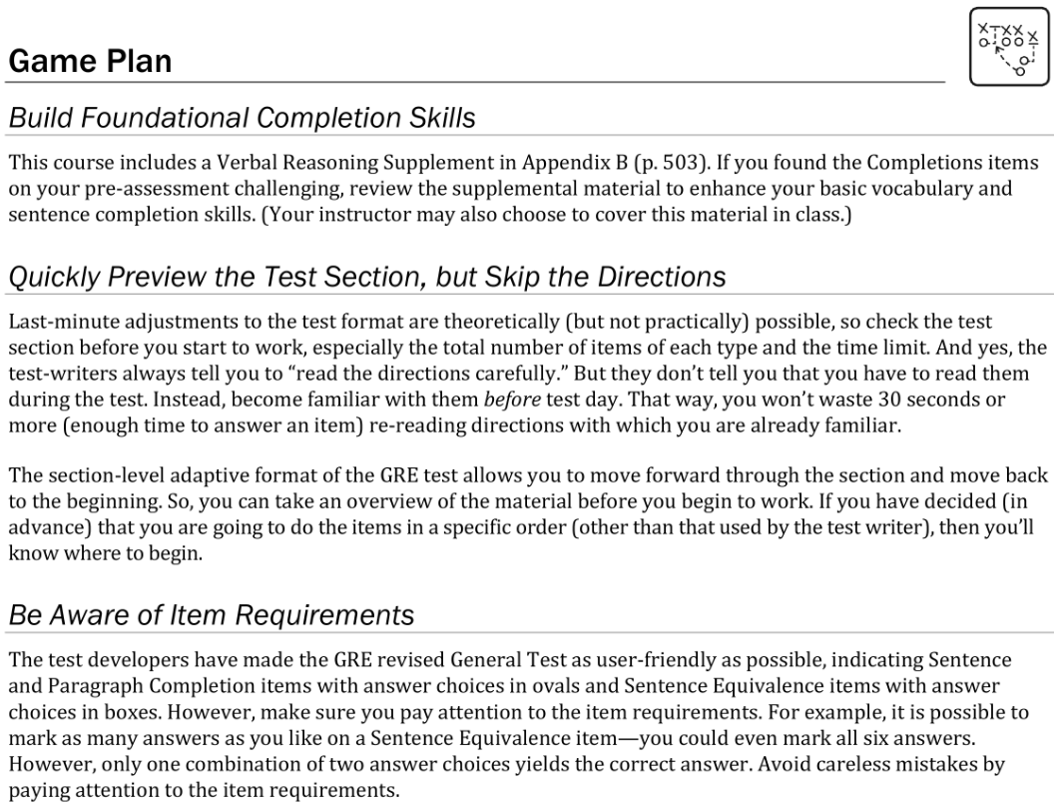
Verbal Reasoning: Completions Game Plan
28 • Verbal Reasoning: Completions
Notes:
Teacher’s Guide p. 61-62

Slide 30
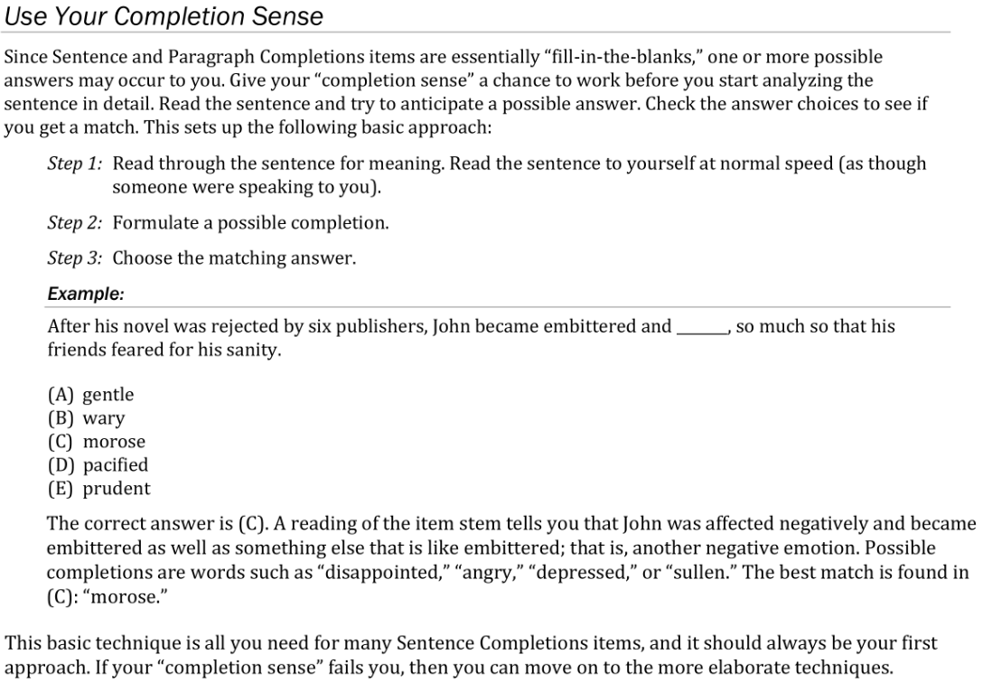
Verbal Reasoning: Completions Game Plan
28-29 • Verbal Reasoning: Completions
Notes:
Teacher’s Guide p. 61-62

Slide 31
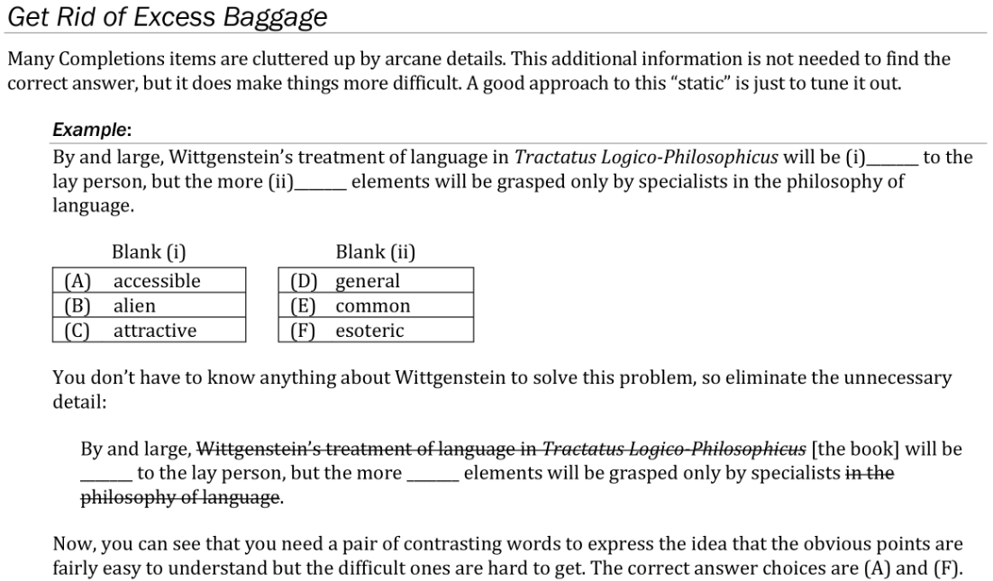
Verbal Reasoning: Completions Game Plan
29 • Verbal Reasoning: Completions
Notes:
Teacher’s Guide p. 63

Slide 32
Verbal Reasoning: Completions Game Plan
29 • Verbal Reasoning: Completions
Notes:
Teacher’s Guide p. 64

Slide 33
Verbal Reasoning: Completions Game Plan
30 • Verbal Reasoning: Completions
Notes:
Teacher’s Guide p. 64-65

Slide 34
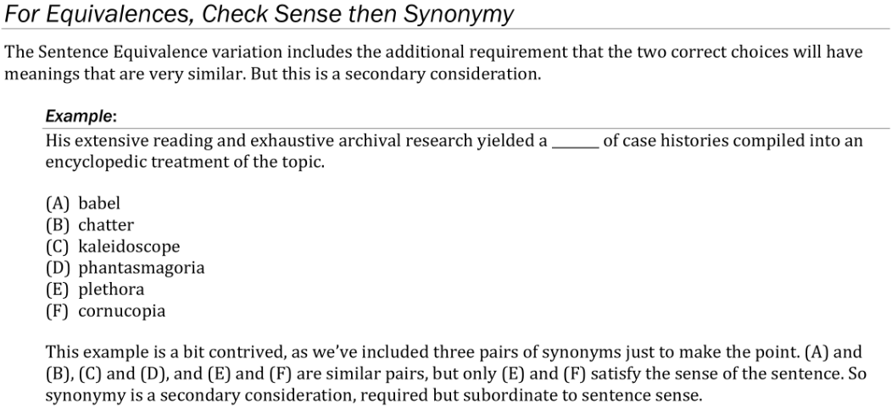
Verbal Reasoning: Completions Game Plan
30 • Verbal Reasoning: Completions
Notes:
Teacher’s Guide p. 65

Slide 35
Verbal Reasoning: Completions Game Plan
31 • Verbal Reasoning: Completions
Notes:
Teacher’s Guide p. 65-66

Slide 36
Verbal Reasoning: Completions Lesson Directions
33 • Verbal Reasoning: Completions
Notes:
Teacher’s Guide p. 68

Slide 37
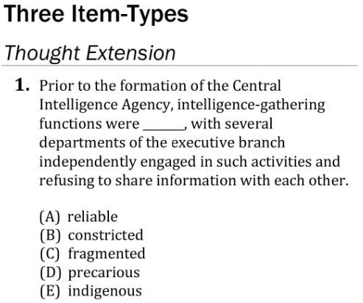
Verbal Reasoning: Completions Lesson Q1
33 • Verbal Reasoning: Completions
Notes:
Teacher’s Guide p. 68

Slide 38
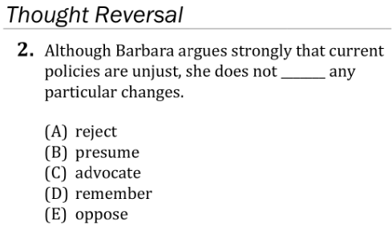
Verbal Reasoning: Completions Lesson Q2
33 • Verbal Reasoning: Completions
Notes:
Teacher’s Guide p. 69

Slide 39
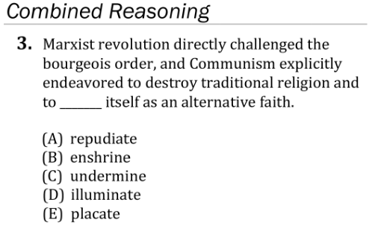
Verbal Reasoning: Completions Lesson Q3
33 • Verbal Reasoning: Completions
Notes:
Teacher’s Guide p. 69

Slide 40
Verbal Reasoning: Completions Lesson Q4
33 • Verbal Reasoning: Completions
Notes:
Teacher’s Guide p. 70

Slide 41
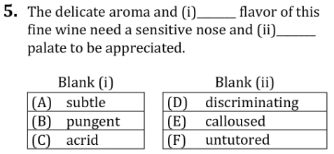
Verbal Reasoning: Completions Lesson Q5
33 • Verbal Reasoning: Completions
Notes:
Teacher’s Guide p. 70

Slide 42
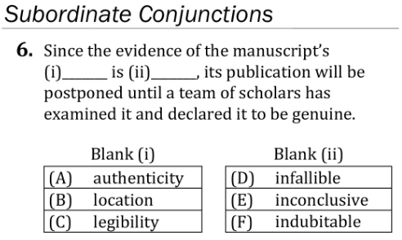
Verbal Reasoning: Completions Lesson Q6
34 • Verbal Reasoning: Completions
Notes:
Teacher’s Guide p. 71

Slide 43
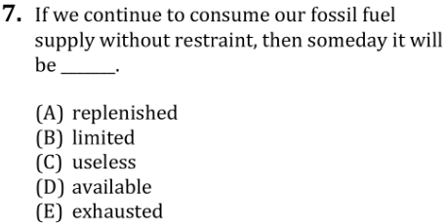
Verbal Reasoning: Completions Lesson Q7
34 • Verbal Reasoning: Completions
Notes:
Teacher’s Guide p. 71

Slide 44
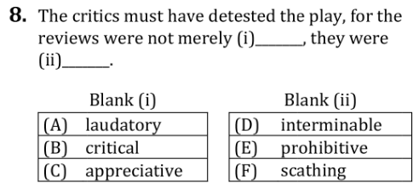
Verbal Reasoning: Completions Lesson Q8
34 • Verbal Reasoning: Completions
Notes:
Teacher’s Guide p. 71

Slide 45
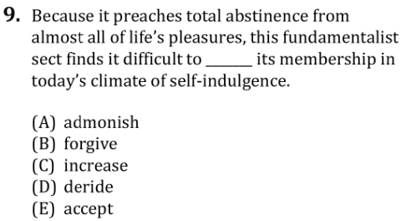
Verbal Reasoning: Completions Lesson Q9
34 • Verbal Reasoning: Completions
Notes:
Teacher’s Guide p. 71

Slide 46
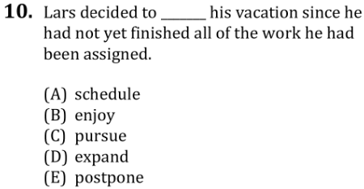
Verbal Reasoning: Completions Lesson Q10
34 • Verbal Reasoning: Completions
Notes:
Teacher’s Guide p. 72

Slide 47
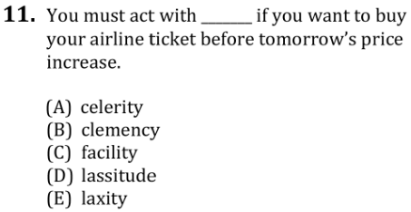
Verbal Reasoning: Completions Lesson Q11
34 • Verbal Reasoning: Completions
Notes:
Teacher’s Guide p. 72

Slide 48
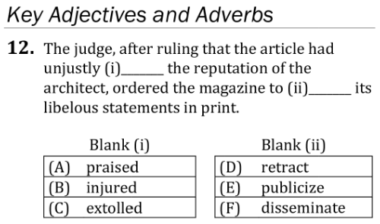
Verbal Reasoning: Completions Lesson Q12
34 • Verbal Reasoning: Completions
Notes:
Teacher’s Guide p. 72

Slide 49
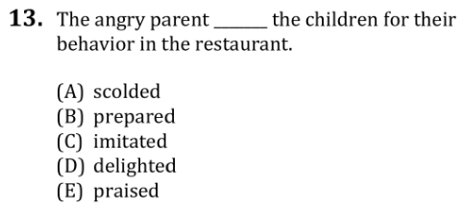
Verbal Reasoning: Completions Lesson Q13
34 • Verbal Reasoning: Completions
Notes:
Teacher’s Guide p. 73

Slide 50
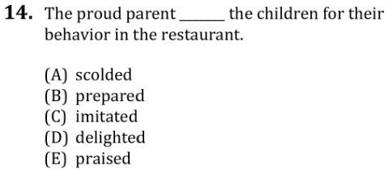
Verbal Reasoning: Completions Lesson Q14
34 • Verbal Reasoning: Completions
Notes:
Teacher’s Guide p. 73

Slide 51
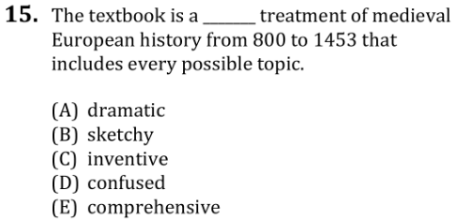
Verbal Reasoning: Completions Lesson Q15
34 • Verbal Reasoning: Completions
Notes:
Teacher’s Guide p. 73

Slide 52
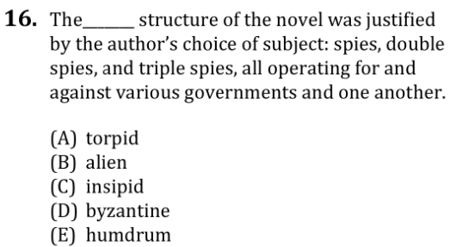
Verbal Reasoning: Completions Lesson Q16
35 • Verbal Reasoning: Completions
Notes:
Teacher’s Guide p. 73

Slide 53
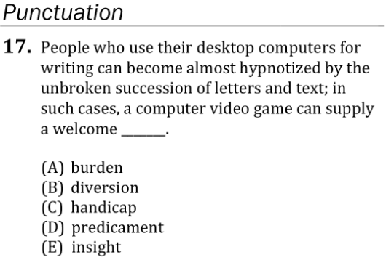
Verbal Reasoning: Completions Lesson Q17
35 • Verbal Reasoning: Completions
Notes:
Teacher’s Guide p. 74

Slide 54
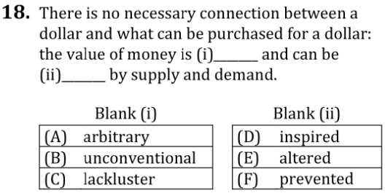
Verbal Reasoning: Completions Lesson Q18
35 • Verbal Reasoning: Completions
Notes:
Teacher’s Guide p. 74

Slide 55
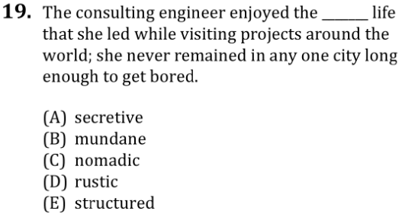
Verbal Reasoning: Completions Lesson Q19
35 • Verbal Reasoning: Completions
Notes:
Teacher’s Guide p. 74

Slide 56
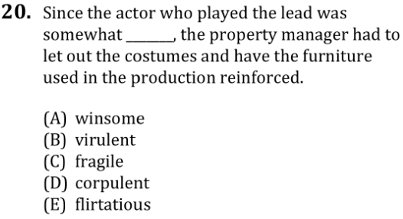
Verbal Reasoning: Completions Lesson Q20
35 • Verbal Reasoning: Completions
Notes:
Teacher’s Guide p. 74

Slide 57
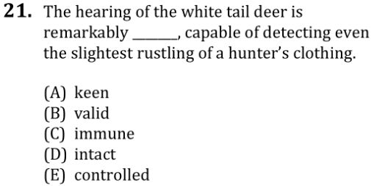
Verbal Reasoning: Completions Lesson Q21
35 • Verbal Reasoning: Completions
Notes:
Teacher’s Guide p. 75

Slide 58
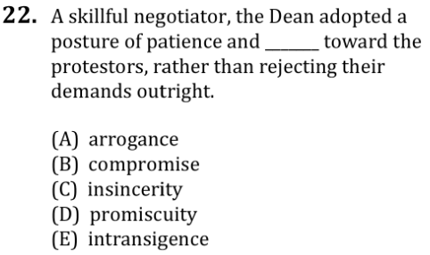
Verbal Reasoning: Completions Lesson Q22
35 • Verbal Reasoning: Completions
Notes:
Teacher’s Guide p. 75

Slide 59
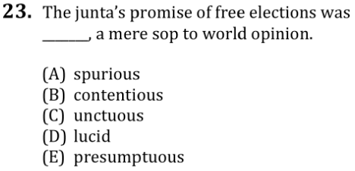
Verbal Reasoning: Completions Lesson Q23
35 • Verbal Reasoning: Completions
Notes:
Teacher’s Guide p. 75

Slide 60
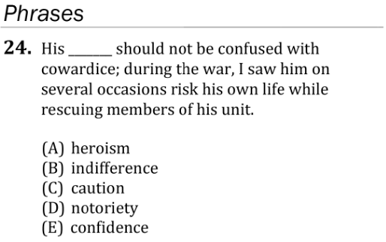
Verbal Reasoning: Completions Lesson Q24
36 • Verbal Reasoning: Completions
Notes:
Teacher’s Guide p. 76

Slide 61
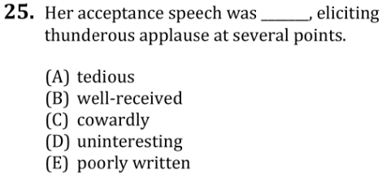
Verbal Reasoning: Completions Lesson Q25
36 • Verbal Reasoning: Completions
Notes:
Teacher’s Guide p. 76

Slide 62
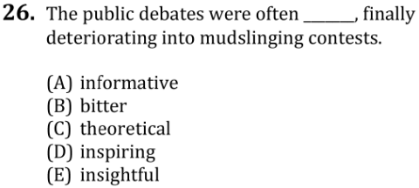
Verbal Reasoning: Completions Lesson Q26
36 • Verbal Reasoning: Completions
Notes:
Teacher’s Guide p. 76

Slide 63
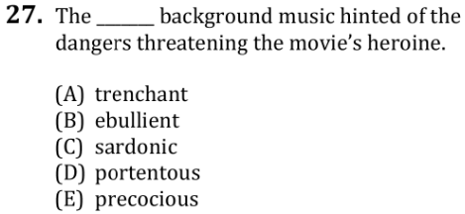
Verbal Reasoning: Completions Lesson Q27
36 • Verbal Reasoning: Completions
Notes:
Teacher’s Guide p. 76

Slide 64
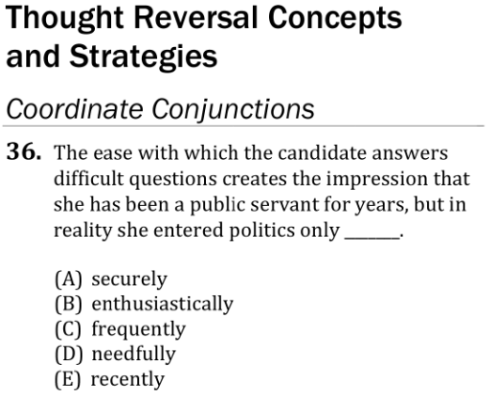
Verbal Reasoning: Completions Lesson Q36
37 • Verbal Reasoning: Completions
Notes:
Teacher’s Guide p. 79

Slide 65
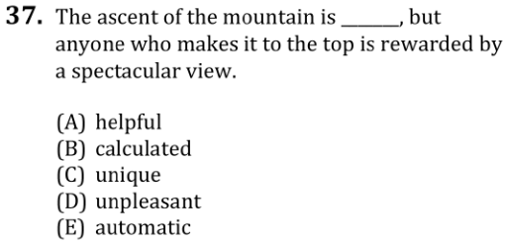
Verbal Reasoning: Completions Lesson Q37
37 • Verbal Reasoning: Completions
Notes:
Teacher’s Guide p. 79

Slide 66
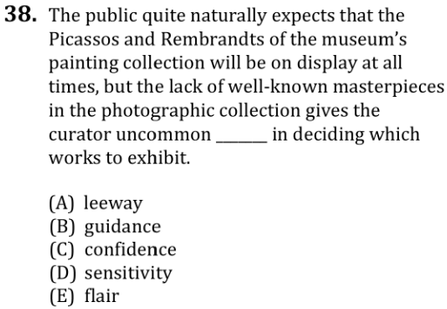
Verbal Reasoning: Completions Lesson Q38
37 • Verbal Reasoning: Completions
Notes:
Teacher’s Guide p. 79

Slide 67
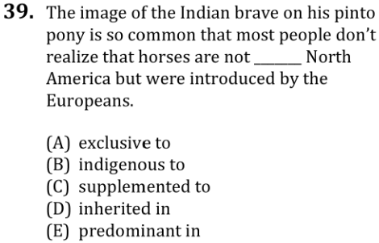
Verbal Reasoning: Completions Lesson Q39
37 • Verbal Reasoning: Completions
Notes:
Teacher’s Guide p. 80

Slide 68
Verbal Reasoning: Completions Lesson Q40
37 • Verbal Reasoning: Completions
Notes:
Teacher’s Guide p. 80

Slide 69
Verbal Reasoning: Completions Lesson Q41
37 • Verbal Reasoning: Completions
Notes:
Teacher’s Guide p. 80

Slide 70
Verbal Reasoning: Completions Lesson Q42
38 • Verbal Reasoning: Completions
Notes:
Teacher’s Guide p. 81

Slide 71
Verbal Reasoning: Completions Lesson Q43
38 • Verbal Reasoning: Completions
Notes:
Teacher’s Guide p. 81

Slide 72
Verbal Reasoning: Completions Lesson Q44
38 • Verbal Reasoning: Completions
Notes:
Teacher’s Guide p. 81

Slide 73
Verbal Reasoning: Completions Lesson Q45
38 • Verbal Reasoning: Completions
Notes:
Teacher’s Guide p. 82

Slide 74
Verbal Reasoning: Completions Lesson Q46
38 • Verbal Reasoning: Completions
Notes:
Teacher’s Guide p. 82

Slide 75
Verbal Reasoning: Completions Lesson Q47
38 • Verbal Reasoning: Completions
Notes:
Teacher’s Guide p. 82

Slide 76
Verbal Reasoning: Completions Lesson Q48
38 • Verbal Reasoning: Completions
Notes:
Teacher’s Guide p. 82

Slide 77
Verbal Reasoning: Completions Lesson Q49
38 • Verbal Reasoning: Completions
Notes:
Teacher’s Guide p. 83

Slide 78
Verbal Reasoning: Completions Lesson Q50
38 • Verbal Reasoning: Completions
Notes:
Teacher’s Guide p. 83

Slide 79
Verbal Reasoning: Completions Lesson Q51
39 • Verbal Reasoning: Completions
Notes:
Teacher’s Guide p. 83

Slide 80
Verbal Reasoning: Completions Lesson Q52
39 • Verbal Reasoning: Completions
Notes:
Teacher’s Guide p. 83

Slide 81
Verbal Reasoning: Completions Lesson Q53
39 • Verbal Reasoning: Completions
Notes:
Teacher’s Guide p. 84

Slide 82
Verbal Reasoning: Completions Lesson Q54
39 • Verbal Reasoning: Completions
Notes:
Teacher’s Guide p. 84

Slide 83
Verbal Reasoning: Completions Lesson Q55
39 • Verbal Reasoning: Completions
Notes:
Teacher’s Guide p. 84

Slide 84
Verbal Reasoning: Completions Lesson Q56
39 • Verbal Reasoning: Completions
Notes:
Teacher’s Guide p. 85

Slide 85
Verbal Reasoning: Completions Lesson Q57
39 • Verbal Reasoning: Completions
Notes:
Teacher’s Guide p. 85

Slide 86
Verbal Reasoning: Completions Lesson Q58
39 • Verbal Reasoning: Completions
Notes:
Teacher’s Guide p. 85

Slide 87
Verbal Reasoning: Completions Lesson Q61
40 • Verbal Reasoning: Completions
Notes:
Teacher’s Guide p. 87

Slide 88
Verbal Reasoning: Completions Lesson Q62
40 • Verbal Reasoning: Completions
Notes:
Teacher’s Guide p. 87

Slide 89
Verbal Reasoning: Completions Lesson Q63
40 • Verbal Reasoning: Completions
Notes:
Teacher’s Guide p. 87

Slide 90
Verbal Reasoning: Completions Lesson Q64
40 • Verbal Reasoning: Completions
Notes:
Teacher’s Guide p. 88

Slide 91
Verbal Reasoning: Completions Lesson Q65
40 • Verbal Reasoning: Completions
Notes:
Teacher’s Guide p. 88

Slide 92
Verbal Reasoning: Completions Lesson Q66
40 • Verbal Reasoning: Completions
Notes:
Teacher’s Guide p. 89

Slide 93
Verbal Reasoning: Completions Lesson Q67
41 • Verbal Reasoning: Completions
Notes:
Teacher’s Guide p. 89

Slide 94
Verbal Reasoning: Completions Lesson Q68
41 • Verbal Reasoning: Completions
Notes:
Teacher’s Guide p. 90

Slide 95
Verbal Reasoning: Completions Lesson Q69
41 • Verbal Reasoning: Completions
Notes:
Teacher’s Guide p. 90

Slide 96
Verbal Reasoning: Completions Lesson Q70
41 • Verbal Reasoning: Completions
Notes:
Teacher’s Guide p. 90

Slide 97
Verbal Reasoning: Completions Lesson Q71
41 • Verbal Reasoning: Completions
Notes:
Teacher’s Guide p. 91

Slide 98
Verbal Reasoning: Completions Lesson Q72
41 • Verbal Reasoning: Completions
Notes:
Teacher’s Guide p. 91

Slide 99
Verbal Reasoning: Completions Lesson Q73
42 • Verbal Reasoning: Completions
Notes:
Teacher’s Guide p. 92

Slide 100
Verbal Reasoning: Completions Lesson Q74
42 • Verbal Reasoning: Completions
Notes:
Teacher’s Guide p. 93

Slide 101
Verbal Reasoning: Completions Lesson Q75
42 • Verbal Reasoning: Completions
Notes:
Teacher’s Guide p. 93

Slide 102
Verbal Reasoning: Completions Lesson Q76
42 • Verbal Reasoning: Completions
Notes:
Teacher’s Guide p. 94

Slide 103
Verbal Reasoning: Completions Lesson Q77
43 • Verbal Reasoning: Completions
Notes:
Teacher’s Guide p. 94

Slide 104
Verbal Reasoning: Completions Lesson Q78
43 • Verbal Reasoning: Completions
Notes:
Teacher’s Guide p. 94

Slide 105
Verbal Reasoning: Completions Lesson Q79
43 • Verbal Reasoning: Completions
Notes:
Teacher’s Guide p. 95

Slide 106
Verbal Reasoning: Completions Lesson Directions
44 • Verbal Reasoning: Completions
Notes:
Teacher’s Guide p. 97

Slide 107
Verbal Reasoning: Completions Lesson Q86
44 • Verbal Reasoning: Completions
Notes:
Teacher’s Guide p. 97

Slide 108
Verbal Reasoning: Completions Lesson Q87
44 • Verbal Reasoning: Completions
Notes:
Teacher’s Guide p. 98

Slide 109
Verbal Reasoning: Completions Lesson Q88
44 • Verbal Reasoning: Completions
Notes:
Teacher’s Guide p. 98

Slide 110
Verbal Reasoning: Completions Lesson Q89
45 • Verbal Reasoning: Completions
Notes:
Teacher’s Guide p. 98

Slide 111
Verbal Reasoning: Completions Lesson Q90
45 • Verbal Reasoning: Completions
Notes:
Teacher’s Guide p. 98

Slide 112
Verbal Reasoning: Completions Lesson Q91
45 • Verbal Reasoning: Completions
Notes:
Teacher’s Guide p. 99

Slide 113
Verbal Reasoning: Completions Lesson Q92
45 • Verbal Reasoning: Completions
Notes:
Teacher’s Guide p. 99

Slide 114
Verbal Reasoning: Completions Lesson Q93
45 • Verbal Reasoning: Completions
Notes:
Teacher’s Guide p. 99

Slide 115
Verbal Reasoning: Completions Lesson Q94
45 • Verbal Reasoning: Completions
Notes:
Teacher’s Guide p. 99

Slide 116
Verbal Reasoning: Completions Lesson Q95
45 • Verbal Reasoning: Completions
Notes:
Teacher’s Guide p. 100

Slide 117
Verbal Reasoning: Completions Lesson Q96
45 • Verbal Reasoning: Completions
Notes:
Teacher’s Guide p. 100

Slide 118
Verbal Reasoning: Completions Quiz 1 Directions
47 • Verbal Reasoning: Completions
Notes:
Teacher’s Guide p. 103

Slide 119
Verbal Reasoning: Completions Quiz 1 Q1
47 • Verbal Reasoning: Completions
Notes:
Teacher’s Guide p. 103

Slide 120
Verbal Reasoning: Completions Quiz 1 Q2
47 • Verbal Reasoning: Completions
Notes:
Teacher’s Guide p. 103

Slide 121
Verbal Reasoning: Completions Quiz 1 Q3
47 • Verbal Reasoning: Completions
Notes:
Teacher’s Guide p. 103

Slide 122
Verbal Reasoning: Completions Quiz 1 Q4
47 • Verbal Reasoning: Completions
Notes:
Teacher’s Guide p. 104

Slide 123
Verbal Reasoning: Completions Quiz 1 Q5
47 • Verbal Reasoning: Completions
Notes:
Teacher’s Guide p. 104

Slide 124
Verbal Reasoning: Completions Quiz 1 Q6
47 • Verbal Reasoning: Completions
Notes:
Teacher’s Guide p. 104

Slide 125
Verbal Reasoning: Completions Quiz 1 Q7
47 • Verbal Reasoning: Completions
Notes:
Teacher’s Guide p. 104

Slide 126
Verbal Reasoning: Completions Quiz 1 Q8
48 • Verbal Reasoning: Completions
Notes:
Teacher’s Guide p. 105

Slide 127
Verbal Reasoning: Completions Quiz 1 Q9
48 • Verbal Reasoning: Completions
Notes:
Teacher’s Guide p. 105

Slide 128
Verbal Reasoning: Completions Quiz 1 Q10
48 • Verbal Reasoning: Completions
Notes:
Teacher’s Guide p. 105

Slide 129
Verbal Reasoning: Completions Quiz 1 Q11
48 • Verbal Reasoning: Completions
Notes:
Teacher’s Guide p. 106

Slide 130
Verbal Reasoning: Completions Quiz 1 Directions
48 • Verbal Reasoning: Completions
Notes:
Teacher’s Guide p. 106

Slide 131
Verbal Reasoning: Completions Quiz 1 Q12
48 • Verbal Reasoning: Completions
Notes:
Teacher’s Guide p. 106

Slide 132
Verbal Reasoning: Completions Quiz 1 Q13
48 • Verbal Reasoning: Completions
Notes:
Teacher’s Guide p. 106

Slide 133
Verbal Reasoning: Completions Quiz 1 Q14
48 • Verbal Reasoning: Completions
Notes:
Teacher’s Guide p. 107

Slide 134
Verbal Reasoning: Completions Quiz 1 Q15
48 • Verbal Reasoning: Completions
Notes:
Teacher’s Guide p. 107

Slide 135
Verbal Reasoning: Completions Quiz 2 Directions
49 • Verbal Reasoning: Completions
Notes:
Teacher’s Guide p. 108

Slide 136
Verbal Reasoning: Completions Quiz 2 Q1
49 • Verbal Reasoning: Completions
Notes:
Teacher’s Guide p. 108

Slide 137
Verbal Reasoning: Completions Quiz 2 Q2
49 • Verbal Reasoning: Completions
Notes:
Teacher’s Guide p. 108

Slide 138
Verbal Reasoning: Completions Quiz 2 Q3
49 • Verbal Reasoning: Completions
Notes:
Teacher’s Guide p. 108

Slide 139
Verbal Reasoning: Completions Quiz 2 Q4
49 • Verbal Reasoning: Completions
Notes:
Teacher’s Guide p. 108

Slide 140
Verbal Reasoning: Completions Quiz 2 Q5
49 • Verbal Reasoning: Completions
Notes:
Teacher’s Guide p. 109

Slide 141
Verbal Reasoning: Completions Quiz 2 Q6
49 • Verbal Reasoning: Completions
Notes:
Teacher’s Guide p. 109

Slide 142
Verbal Reasoning: Completions Quiz 2 Q7
49 • Verbal Reasoning: Completions
Notes:
Teacher’s Guide p. 109

Slide 143
Verbal Reasoning: Completions Quiz 2 Q8
49 • Verbal Reasoning: Completions
Notes:
Teacher’s Guide p. 110

Slide 144
Verbal Reasoning: Completions Quiz 2 Q9
50 • Verbal Reasoning: Completions
Notes:
Teacher’s Guide p. 110

Slide 145
Verbal Reasoning: Completions Quiz 2 Q10
50 • Verbal Reasoning: Completions
Notes:
Teacher’s Guide p. 110

Slide 146
Verbal Reasoning: Completions Quiz 2 Q11
50 • Verbal Reasoning: Completions
Notes:
Teacher’s Guide p. 111

Slide 147
Verbal Reasoning: Completions Quiz 2 Directions
50 • Verbal Reasoning: Completions
Notes:
Teacher’s Guide p. 111

Slide 148
Verbal Reasoning: Completions Quiz 2 Q12
50 • Verbal Reasoning: Completions
Notes:
Teacher’s Guide p. 111

Slide 149
Verbal Reasoning: Completions Quiz 2 Q13
50 • Verbal Reasoning: Completions
Notes:
Teacher’s Guide p. 111

Slide 150
Verbal Reasoning: Completions Quiz 2 Q14
50 • Verbal Reasoning: Completions
Notes:
Teacher’s Guide p. 111

Slide 151
Verbal Reasoning: Completions Quiz 2 Q15
51 • Verbal Reasoning: Completions
Notes:
Teacher’s Guide p. 112

Slide 152
Verbal Reasoning: Completions Quiz 3 Directions
52 • Verbal Reasoning: Completions
Notes:
Teacher’s Guide p. 113

Slide 153
Verbal Reasoning: Completions Quiz 3 Q1
52 • Verbal Reasoning: Completions
Notes:
Teacher’s Guide p. 113

Slide 154
Verbal Reasoning: Completions Quiz 3 Q2
52 • Verbal Reasoning: Completions
Notes:
Teacher’s Guide p. 113

Slide 155
Verbal Reasoning: Completions Quiz 3 Q3
52 • Verbal Reasoning: Completions
Notes:
Teacher’s Guide p. 113

Slide 156
Verbal Reasoning: Completions Quiz 3 Q4
52 • Verbal Reasoning: Completions
Notes:
Teacher’s Guide p. 114

Slide 157
Verbal Reasoning: Completions Quiz 3 Q5
52 • Verbal Reasoning: Completions
Notes:
Teacher’s Guide p. 114

Slide 158
Verbal Reasoning: Completions Quiz 3 Q6
52 • Verbal Reasoning: Completions
Notes:
Teacher’s Guide p. 114

Slide 159
Verbal Reasoning: Completions Quiz 3 Q7
52 • Verbal Reasoning: Completions
Notes:
Teacher’s Guide p. 114

Slide 160
Verbal Reasoning: Completions Quiz 3 Q8
52 • Verbal Reasoning: Completions
Notes:
Teacher’s Guide p. 115

Slide 161
Verbal Reasoning: Completions Quiz 3 Q9
52 • Verbal Reasoning: Completions
Notes:
Teacher’s Guide p. 115

Slide 162
Verbal Reasoning: Completions Quiz 3 Q10
53 • Verbal Reasoning: Completions
Notes:
Teacher’s Guide p. 115

Slide 163
Verbal Reasoning: Completions Quiz 3 Q11
53 • Verbal Reasoning: Completions
Notes:
Teacher’s Guide p. 115

Slide 164
Verbal Reasoning: Completions Quiz 3 Directions
53 • Verbal Reasoning: Completions
Notes:
Teacher’s Guide p. 115

Slide 165
Verbal Reasoning: Completions Quiz 3 Q12
53 • Verbal Reasoning: Completions
Notes:
Teacher’s Guide p. 116

Slide 166
Verbal Reasoning: Completions Quiz 3 Q13
53 • Verbal Reasoning: Completions
Notes:
Teacher’s Guide p. 116

Slide 167
Verbal Reasoning: Completions Quiz 3 Q14
53 • Verbal Reasoning: Completions
Notes:
Teacher’s Guide p. 116

Slide 168
Verbal Reasoning: Completions Quiz 3 Q15
53 • Verbal Reasoning: Completions
Notes:
Teacher’s Guide p. 117

Slide 169
Verbal Reasoning: Reading Test Mechanics
61 • Verbal Reasoning: Reading
↖ Back to the Table of Contents
Notes:
Teacher’s Guide p. 125

Slide 170
Verbal Reasoning: Reading Test Mechanics
61 • Verbal Reasoning: Reading
Notes:
Teacher’s Guide p. 127

Slide 171
Verbal Reasoning: Reading Test Mechanics
61 • Verbal Reasoning: Reading
Notes:
Teacher’s Guide p. 127

Slide 172
Verbal Reasoning: Reading Anatomy Passage
62 • Verbal Reasoning: Reading
Notes:
Teacher’s Guide p. 128

Slide 173
Verbal Reasoning: Reading Anatomy Passage
62 • Verbal Reasoning: Reading
Notes:
Teacher’s Guide p. 128

Slide 174
Verbal Reasoning: Reading Anatomy Q1
63 • Verbal Reasoning: Reading
Notes:
Teacher’s Guide p. 129

Slide 175
Verbal Reasoning: Reading Anatomy Q2
63 • Verbal Reasoning: Reading
Notes:
Teacher’s Guide p. 129

Slide 176
Verbal Reasoning: Reading Anatomy Passage
64 • Verbal Reasoning: Reading
Notes:
Teacher’s Guide p. 130

Slide 177
Verbal Reasoning: Reading Anatomy Q3
64 • Verbal Reasoning: Reading
Notes:
Teacher’s Guide p. 130

Slide 178
Verbal Reasoning: Reading Pacing
65 • Verbal Reasoning: Reading
Notes:
Teacher’s Guide p. 131-132

Slide 179
Verbal Reasoning: Reading Pacing
65 • Verbal Reasoning: Reading
Notes:
Teacher’s Guide p. 131-132

Slide 180
Verbal Reasoning: Reading Time Trial Directions
66 • Verbal Reasoning: Reading
Notes:
Teacher’s Guide p. 133

Slide 181
Verbal Reasoning: Reading Time Trial Passage
66 • Verbal Reasoning: Reading
Notes:
Teacher’s Guide p. 133

Slide 182
Verbal Reasoning: Reading Time Trial Passage
66 • Verbal Reasoning: Reading
Notes:
Teacher’s Guide p. 133

Slide 183
Verbal Reasoning: Reading Time Trial Passage
66 • Verbal Reasoning: Reading
Notes:
Teacher’s Guide p. 133

Slide 184
Verbal Reasoning: Reading Time Trial Q1
66 • Verbal Reasoning: Reading
Notes:
Teacher’s Guide p. 134

Slide 185
Verbal Reasoning: Reading Time Trial Q2
67 • Verbal Reasoning: Reading
Notes:
Teacher’s Guide p. 134

Slide 186
Verbal Reasoning: Reading Time Trial Q3
67 • Verbal Reasoning: Reading
Notes:
Teacher’s Guide p. 134

Slide 187
Verbal Reasoning: Reading Time Trial Passage
67 • Verbal Reasoning: Reading
Notes:
Teacher’s Guide p. 135

Slide 188
Verbal Reasoning: Reading Time Trial Q4
67 • Verbal Reasoning: Reading
Notes:
Teacher’s Guide p. 135

Slide 189
Verbal Reasoning: Reading Game Plan
68 • Verbal Reasoning: Reading
Notes:
Teacher’s Guide p. 136

Slide 190
Verbal Reasoning: Reading Game Plan
68 • Verbal Reasoning: Reading
Notes:
Teacher’s Guide p. 136

Slide 191
Verbal Reasoning: Reading Game Plan
68 • Verbal Reasoning: Reading
Notes:
Teacher’s Guide p. 137

Slide 192
Verbal Reasoning: Reading Game Plan
69 • Verbal Reasoning: Reading
Notes:
Teacher’s Guide p. 137

Slide 193
Verbal Reasoning: Reading Game Plan
69 • Verbal Reasoning: Reading
Notes:
Teacher’s Guide p. 137

Slide 194
Verbal Reasoning: Reading Game Plan
69 • Verbal Reasoning: Reading
Notes:
Teacher’s Guide p. 138

Slide 195
Verbal Reasoning: Reading Game Plan
70 • Verbal Reasoning: Reading
Notes:
Teacher’s Guide p. 138

Slide 196
Verbal Reasoning: Reading Game Plan
70 • Verbal Reasoning: Reading
Notes:
Teacher’s Guide p. 138

Slide 197
Verbal Reasoning: Reading Game Plan
70-71 • Verbal Reasoning: Reading
Notes:
Teacher’s Guide p. 139

Slide 198
Verbal Reasoning: Reading Game Plan
71 • Verbal Reasoning: Reading
Notes:
Teacher’s Guide p. 139

Slide 199
Verbal Reasoning: Reading Game Plan
71 • Verbal Reasoning: Reading
Notes:
Teacher’s Guide p. 140

Slide 200
Verbal Reasoning: Reading Lesson Directions
73 • Verbal Reasoning: Reading
Notes:
Teacher’s Guide p. 143

Slide 201
Verbal Reasoning: Reading Lesson Passage
73 • Verbal Reasoning: Reading
Notes:
Teacher’s Guide p. 147

Slide 202
Verbal Reasoning: Reading Lesson Passage
73 • Verbal Reasoning: Reading
Notes:
Teacher’s Guide p. 147-148

Slide 203
Verbal Reasoning: Reading Lesson Q1
74 • Verbal Reasoning: Reading
Notes:
Teacher’s Guide p. 148

Slide 204
Verbal Reasoning: Reading Lesson Q2
74 • Verbal Reasoning: Reading
Notes:
Teacher’s Guide p. 148

Slide 205
Verbal Reasoning: Reading Lesson Q3
74 • Verbal Reasoning: Reading
Notes:
Teacher’s Guide p. 149

Slide 206
Verbal Reasoning: Reading Lesson Q4
74 • Verbal Reasoning: Reading
Notes:
Teacher’s Guide p. 149

Slide 207
Verbal Reasoning: Reading Lesson Q5
74 • Verbal Reasoning: Reading
Notes:
Teacher’s Guide p. 149

Slide 208
Verbal Reasoning: Reading Lesson Q6
74 • Verbal Reasoning: Reading
Notes:
Teacher’s Guide p. 150

Slide 209
Verbal Reasoning: Reading Lesson Q7
75 • Verbal Reasoning: Reading
Notes:
Teacher’s Guide p. 150

Slide 210
Verbal Reasoning: Reading Lesson Q8
75 • Verbal Reasoning: Reading
Notes:
Teacher’s Guide p. 151

Slide 211
Verbal Reasoning: Reading Lesson Q9
75 • Verbal Reasoning: Reading
Notes:
Teacher’s Guide p. 151

Slide 212
Verbal Reasoning: Reading Lesson Q10
75 • Verbal Reasoning: Reading
Notes:
Teacher’s Guide p. 151

Slide 213
Verbal Reasoning: Reading Lesson Q11
75 • Verbal Reasoning: Reading
Notes:
Teacher’s Guide p. 152

Slide 214
Verbal Reasoning: Reading Lesson Q12
75 • Verbal Reasoning: Reading
Notes:
Teacher’s Guide p. 152

Slide 215
Verbal Reasoning: Reading Lesson Q13
75 • Verbal Reasoning: Reading
Notes:
Teacher’s Guide p. 152

Slide 216
Verbal Reasoning: Reading Lesson Q14
75 • Verbal Reasoning: Reading
Notes:
Teacher’s Guide p. 152

Slide 217
Verbal Reasoning: Reading Lesson Passage
76 • Verbal Reasoning: Reading
Notes:
Teacher’s Guide p. 153

Slide 218
Verbal Reasoning: Reading Lesson Passage
76 • Verbal Reasoning: Reading
Notes:
Teacher’s Guide p. 153

Slide 219
Verbal Reasoning: Reading Lesson Q15
76 • Verbal Reasoning: Reading
Notes:
Teacher’s Guide p. 154

Slide 220
Verbal Reasoning: Reading Lesson Q16
76 • Verbal Reasoning: Reading
Notes:
Teacher’s Guide p. 154

Slide 221
Verbal Reasoning: Reading Lesson Q17
77 • Verbal Reasoning: Reading
Notes:
Teacher’s Guide p. 154

Slide 222
Verbal Reasoning: Reading Lesson Q18
77 • Verbal Reasoning: Reading
Notes:
Teacher’s Guide p. 155

Slide 223
Verbal Reasoning: Reading Lesson Q19
77 • Verbal Reasoning: Reading
Notes:
Teacher’s Guide p. 155

Slide 224
Verbal Reasoning: Reading Lesson Q20
77 • Verbal Reasoning: Reading
Notes:
Teacher’s Guide p. 156

Slide 225
Verbal Reasoning: Reading Lesson Q21
77 • Verbal Reasoning: Reading
Notes:
Teacher’s Guide p. 156

Slide 226
Verbal Reasoning: Reading Lesson Q22
77 • Verbal Reasoning: Reading
Notes:
Teacher’s Guide p. 156

Slide 227
Verbal Reasoning: Reading Lesson Q23
78 • Verbal Reasoning: Reading
Notes:
Teacher’s Guide p. 157

Slide 228
Verbal Reasoning: Reading Lesson Q24
78 • Verbal Reasoning: Reading
Notes:
Teacher’s Guide p. 157

Slide 229
Verbal Reasoning: Reading Lesson Q25
78 • Verbal Reasoning: Reading
Notes:
Teacher’s Guide p. 158

Slide 230
Verbal Reasoning: Reading Lesson Q26
78 • Verbal Reasoning: Reading
Notes:
Teacher’s Guide p. 158

Slide 231
Verbal Reasoning: Reading Lesson Passage
78 • Verbal Reasoning: Reading
Notes:
Teacher’s Guide p. 159

Slide 232
Verbal Reasoning: Reading Lesson Passage
78-79 • Verbal Reasoning: Reading
Notes:
Teacher’s Guide p. 159

Slide 233
Verbal Reasoning: Reading Lesson Q27
79 • Verbal Reasoning: Reading
Notes:
Teacher’s Guide p. 160

Slide 234
Verbal Reasoning: Reading Lesson Q28
79 • Verbal Reasoning: Reading
Notes:
Teacher’s Guide p. 160

Slide 235
Verbal Reasoning: Reading Lesson Q29
79 • Verbal Reasoning: Reading
Notes:
Teacher’s Guide p. 160

Slide 236
Verbal Reasoning: Reading Lesson Q30
79 • Verbal Reasoning: Reading
Notes:
Teacher’s Guide p. 161

Slide 237
Verbal Reasoning: Reading Lesson Q31
80 • Verbal Reasoning: Reading
Notes:
Teacher’s Guide p. 161

Slide 238
Verbal Reasoning: Reading Lesson Q32
80 • Verbal Reasoning: Reading
Notes:
Teacher’s Guide p. 162

Slide 239
Verbal Reasoning: Reading Lesson Q33
80 • Verbal Reasoning: Reading
Notes:
Teacher’s Guide p. 162

Slide 240
Verbal Reasoning: Reading Lesson Q34
80 • Verbal Reasoning: Reading
Notes:
Teacher’s Guide p. 162

Slide 241
Verbal Reasoning: Reading Lesson Passage
80 • Verbal Reasoning: Reading
Notes:
Teacher’s Guide p. 163

Slide 242
Verbal Reasoning: Reading Lesson Passage
80-81 • Verbal Reasoning: Reading
Notes:
Teacher’s Guide p. 163

Slide 243
Verbal Reasoning: Reading Lesson Q35
81 • Verbal Reasoning: Reading
Notes:
Teacher’s Guide p. 164

Slide 244
Verbal Reasoning: Reading Lesson Q36
81 • Verbal Reasoning: Reading
Notes:
Teacher’s Guide p. 164

Slide 245
Verbal Reasoning: Reading Lesson Q37
81 • Verbal Reasoning: Reading
Notes:
Teacher’s Guide p. 164

Slide 246
Verbal Reasoning: Reading Lesson Q38
81 • Verbal Reasoning: Reading
Notes:
Teacher’s Guide p. 165

Slide 247
Verbal Reasoning: Reading Lesson Q39
81 • Verbal Reasoning: Reading
Notes:
Teacher’s Guide p. 165

Slide 248
Verbal Reasoning: Reading Lesson Q40
82 • Verbal Reasoning: Reading
Notes:
Teacher’s Guide p. 166

Slide 249
Verbal Reasoning: Reading Lesson Q41
82 • Verbal Reasoning: Reading
Notes:
Teacher’s Guide p. 166

Slide 250
Verbal Reasoning: Reading Lesson Q42
82 • Verbal Reasoning: Reading
Notes:
Teacher’s Guide p. 166

Slide 251
Verbal Reasoning: Reading Lesson Q43
82 • Verbal Reasoning: Reading
Notes:
Teacher’s Guide p. 167

Slide 252
Verbal Reasoning: Reading Lesson Passage
82 • Verbal Reasoning: Reading
Notes:
Teacher’s Guide p. 167

Slide 253
Verbal Reasoning: Reading Lesson Passage
82-83 • Verbal Reasoning: Reading
Notes:
Teacher’s Guide p. 167

Slide 254
Verbal Reasoning: Reading Lesson Passage
83 • Verbal Reasoning: Reading
Notes:
Teacher’s Guide p. 168

Slide 255
Verbal Reasoning: Reading Lesson Q44
83 • Verbal Reasoning: Reading
Notes:
Teacher’s Guide p. 168

Slide 256
Verbal Reasoning: Reading Lesson Q45
83 • Verbal Reasoning: Reading
Notes:
Teacher’s Guide p. 168

Slide 257
Verbal Reasoning: Reading Lesson Q46
83 • Verbal Reasoning: Reading
Notes:
Teacher’s Guide p. 169

Slide 258
Verbal Reasoning: Reading Lesson Q47
83 • Verbal Reasoning: Reading
Notes:
Teacher’s Guide p. 169

Slide 259
Verbal Reasoning: Reading Lesson Q48
83 • Verbal Reasoning: Reading
Notes:
Teacher’s Guide p. 169

Slide 260
Verbal Reasoning: Reading Lesson Q49
84 • Verbal Reasoning: Reading
Notes:
Teacher’s Guide p. 170

Slide 261
Verbal Reasoning: Reading Lesson Q50
84 • Verbal Reasoning: Reading
Notes:
Teacher’s Guide p. 170

Slide 262
Verbal Reasoning: Reading Lesson Passage
84 • Verbal Reasoning: Reading
Notes:
Teacher’s Guide p. 170-171

Slide 263
Verbal Reasoning: Reading Lesson Passage
84-85 • Verbal Reasoning: Reading
Notes:
Teacher’s Guide p. 171

Slide 264
Verbal Reasoning: Reading Lesson Q51
85 • Verbal Reasoning: Reading
Notes:
Teacher’s Guide p. 171

Slide 265
Verbal Reasoning: Reading Lesson Q52
85 • Verbal Reasoning: Reading
Notes:
Teacher’s Guide p. 171

Slide 266
Verbal Reasoning: Reading Lesson Q53
85 • Verbal Reasoning: Reading
Notes:
Teacher’s Guide p. 172

Slide 267
Verbal Reasoning: Reading Lesson Q54
85 • Verbal Reasoning: Reading
Notes:
Teacher’s Guide p. 172

Slide 268
Verbal Reasoning: Reading Lesson Q55
85 • Verbal Reasoning: Reading
Notes:
Teacher’s Guide p. 172

Slide 269
Verbal Reasoning: Reading Lesson Q56
85 • Verbal Reasoning: Reading
Notes:
Teacher’s Guide p. 173

Slide 270
Verbal Reasoning: Reading Lesson Q57
85 • Verbal Reasoning: Reading
Notes:
Teacher’s Guide p. 173

Slide 271
Verbal Reasoning: Reading Lesson Passage
86 • Verbal Reasoning: Reading
Notes:
Teacher’s Guide p. 173-174

Slide 272
Verbal Reasoning: Reading Lesson Passage
86 • Verbal Reasoning: Reading
Notes:
Teacher’s Guide p. 174

Slide 273
Verbal Reasoning: Reading Lesson Q58
86 • Verbal Reasoning: Reading
86 • Verbal Reasoning: Reading
Notes:
Teacher’s Guide p. 174

Slide 274
Verbal Reasoning: Reading Lesson Q59
86 • Verbal Reasoning: Reading
Notes:
Teacher’s Guide p. 174

Slide 275
Verbal Reasoning: Reading Lesson Q60
87 • Verbal Reasoning: Reading
Notes:
Teacher’s Guide p. 175

Slide 276
Verbal Reasoning: Reading Lesson Q61
87 • Verbal Reasoning: Reading
Notes:
Teacher’s Guide p. 175

Slide 277
Verbal Reasoning: Reading Lesson Q62
87 • Verbal Reasoning: Reading
Notes:
Teacher’s Guide p. 175

Slide 278
Verbal Reasoning: Reading Lesson Q63
87 • Verbal Reasoning: Reading
Notes:
Teacher’s Guide p. 176

Slide 279
Verbal Reasoning: Reading Lesson Q64
87 • Verbal Reasoning: Reading
Notes:
Teacher’s Guide p. 176

Slide 280
Verbal Reasoning: Reading Lesson Passage
88 • Verbal Reasoning: Reading
Notes:
Teacher’s Guide p. 176-177

Slide 281
Verbal Reasoning: Reading Lesson Passage
88 • Verbal Reasoning: Reading
Notes:
Teacher’s Guide p. 177

Slide 282
Verbal Reasoning: Reading Lesson Q65
88 • Verbal Reasoning: Reading
Notes:
Teacher’s Guide p. 177

Slide 283
Verbal Reasoning: Reading Lesson Q66
88 • Verbal Reasoning: Reading
Notes:
Teacher’s Guide p. 178

Slide 284
Verbal Reasoning: Reading Lesson Q67
88 • Verbal Reasoning: Reading
Notes:
Teacher’s Guide p. 178

Slide 285
Verbal Reasoning: Reading Lesson Q68
89 • Verbal Reasoning: Reading
Notes:
Teacher’s Guide p. 178

Slide 286
Verbal Reasoning: Reading Lesson Q69
89 • Verbal Reasoning: Reading
Notes:
Teacher’s Guide p. 179

Slide 287
Verbal Reasoning: Reading Lesson Q70
89 • Verbal Reasoning: Reading
Notes:
Teacher’s Guide p. 179

Slide 288
Verbal Reasoning: Reading Lesson Q71
89 • Verbal Reasoning: Reading
Notes:
Teacher’s Guide p. 179

Slide 289
Verbal Reasoning: Reading Lesson Q72
89 • Verbal Reasoning: Reading
Notes:
Teacher’s Guide p. 180

Slide 290
Verbal Reasoning: Reading Lesson Q73
89 • Verbal Reasoning: Reading
Notes:
Teacher’s Guide p. 180

Slide 291
Verbal Reasoning: Reading Lesson Passage
90 • Verbal Reasoning: Reading
Notes:
Teacher’s Guide p. 181

Slide 292
Verbal Reasoning: Reading Lesson Passage
90 • Verbal Reasoning: Reading
Notes:
Teacher’s Guide p. 181

Slide 293
Verbal Reasoning: Reading Lesson Q74
90 • Verbal Reasoning: Reading
Notes:
Teacher’s Guide p. 181

Slide 294
Verbal Reasoning: Reading Lesson Q75
90 • Verbal Reasoning: Reading
Notes:
Teacher’s Guide p. 182

Slide 295
Verbal Reasoning: Reading Lesson Q76
90 • Verbal Reasoning: Reading
Notes:
Teacher’s Guide p. 182

Slide 296
Verbal Reasoning: Reading Lesson Q77
91 • Verbal Reasoning: Reading
Notes:
Teacher’s Guide p. 183

Slide 297
Verbal Reasoning: Reading Lesson Q78
91 • Verbal Reasoning: Reading
Notes:
Teacher’s Guide p. 183

Slide 298
Verbal Reasoning: Reading Lesson Q79
91 • Verbal Reasoning: Reading
Notes:
Teacher’s Guide p. 183

Slide 299
Verbal Reasoning: Reading Lesson Q80
91 • Verbal Reasoning: Reading
Notes:
Teacher’s Guide p. 184

Slide 300
Verbal Reasoning: Reading Lesson Passage
91 • Verbal Reasoning: Reading
Notes:
Teacher’s Guide p. 184

Slide 301
Verbal Reasoning: Reading Lesson Passage
91-92 • Verbal Reasoning: Reading
Notes:
Teacher’s Guide p. 184-185

Slide 302
Verbal Reasoning: Reading Lesson Q81
92 • Verbal Reasoning: Reading
Notes:
Teacher’s Guide p. 185

Slide 303
Verbal Reasoning: Reading Lesson Q82
92 • Verbal Reasoning: Reading
Notes:
Teacher’s Guide p. 185

Slide 304
Verbal Reasoning: Reading Lesson Q83
92 • Verbal Reasoning: Reading
Notes:
Teacher’s Guide p. 186

Slide 305
Verbal Reasoning: Reading Lesson Q84
92 • Verbal Reasoning: Reading
Notes:
Teacher’s Guide p. 186

Slide 306
Verbal Reasoning: Reading Lesson Q85
93 • Verbal Reasoning: Reading
Notes:
Teacher’s Guide p. 186

Slide 307
Verbal Reasoning: Reading Lesson Q86
93 • Verbal Reasoning: Reading
Notes:
Teacher’s Guide p. 187

Slide 308
Verbal Reasoning: Reading Lesson Q87
93 • Verbal Reasoning: Reading
Notes:
Teacher’s Guide p. 187

Slide 309
Verbal Reasoning: Reading Lesson Q88
93 • Verbal Reasoning: Reading
Notes:
Teacher’s Guide p. 187

Slide 310
Verbal Reasoning: Reading Lesson Passage
94 • Verbal Reasoning: Reading
Notes:
Teacher’s Guide p. 188

Slide 311
Verbal Reasoning: Reading Lesson Passage
94 • Verbal Reasoning: Reading
Notes:
Teacher’s Guide p. 188

Slide 312
Verbal Reasoning: Reading Lesson Q89
94 • Verbal Reasoning: Reading
Notes:
Teacher’s Guide p. 188

Slide 313
Verbal Reasoning: Reading Lesson Q90
94 • Verbal Reasoning: Reading
Notes:
Teacher’s Guide p. 189

Slide 314
Verbal Reasoning: Reading Lesson Q91
95 • Verbal Reasoning: Reading
Notes:
Teacher’s Guide p. 189

Slide 315
Verbal Reasoning: Reading Lesson Q92
95 • Verbal Reasoning: Reading
Notes:
Teacher’s Guide p. 189

Slide 316
Verbal Reasoning: Reading Lesson Q93
95 • Verbal Reasoning: Reading
Notes:
Teacher’s Guide p. 190

Slide 317
Verbal Reasoning: Reading Lesson Q94
95 • Verbal Reasoning: Reading
Notes:
Teacher’s Guide p. 190

Slide 318
Verbal Reasoning: Reading Lesson Passage
96 • Verbal Reasoning: Reading
Notes:
Teacher’s Guide p. 190-191

Slide 319
Verbal Reasoning: Reading Lesson Passage
96 • Verbal Reasoning: Reading
Notes:
Teacher’s Guide p. 190-191

Slide 320
Verbal Reasoning: Reading Lesson Q95
96 • Verbal Reasoning: Reading
Notes:
Teacher’s Guide p. 191

Slide 321
Verbal Reasoning: Reading Lesson Q96
96 • Verbal Reasoning: Reading
Notes:
Teacher’s Guide p. 192

Slide 322
Verbal Reasoning: Reading Lesson Q97
97 • Verbal Reasoning: Reading
Notes:
Teacher’s Guide p. 192

Slide 323
Verbal Reasoning: Reading Lesson Q98
97 • Verbal Reasoning: Reading
Notes:
Teacher’s Guide p. 192

Slide 324
Verbal Reasoning: Reading Lesson Q99
97 • Verbal Reasoning: Reading
Notes:
Teacher’s Guide p. 193

Slide 325
Verbal Reasoning: Reading Lesson Q100
97 • Verbal Reasoning: Reading
Notes:
Teacher’s Guide p. 193

Slide 326
Verbal Reasoning: Reading Lesson Passage
98 • Verbal Reasoning: Reading
Notes:
Teacher’s Guide p. 194

Slide 327
Verbal Reasoning: Reading Lesson Passage
98 • Verbal Reasoning: Reading
Notes:
Teacher’s Guide p. 194

Slide 328
Verbal Reasoning: Reading Lesson Q101
98 • Verbal Reasoning: Reading
Notes:
Teacher’s Guide p. 195

Slide 329
Verbal Reasoning: Reading Lesson Q102
99 • Verbal Reasoning: Reading
Notes:
Teacher’s Guide p. 195

Slide 330
Verbal Reasoning: Reading Lesson Q103
99 • Verbal Reasoning: Reading
Notes:
Teacher’s Guide p. 196

Slide 331
Verbal Reasoning: Reading Lesson Q104
99 • Verbal Reasoning: Reading
Notes:
Teacher’s Guide p. 196

Slide 332
Verbal Reasoning: Reading Lesson Q105
99 • Verbal Reasoning: Reading
Notes:
Teacher’s Guide p. 196

Slide 333
Verbal Reasoning: Reading Lesson Q106
99 • Verbal Reasoning: Reading
Notes:
Teacher’s Guide p. 197

Slide 334
Verbal Reasoning: Reading Lesson Q107
99 • Verbal Reasoning: Reading
Notes:
Teacher’s Guide p. 197

Slide 335
Verbal Reasoning: Reading Lesson Passage
100 • Verbal Reasoning: Reading
Notes:
Teacher’s Guide p. 198

Slide 336
Verbal Reasoning: Reading Lesson Passage
100 • Verbal Reasoning: Reading
Notes:
Teacher’s Guide p. 198

Slide 337
Verbal Reasoning: Reading Lesson Passage
100 • Verbal Reasoning: Reading
Notes:
Teacher’s Guide p. 198

Slide 338
Verbal Reasoning: Reading Lesson Q108
100 • Verbal Reasoning: Reading
Notes:
Teacher’s Guide p. 199

Slide 339
Verbal Reasoning: Reading Lesson Q109
101 • Verbal Reasoning: Reading
Notes:
Teacher’s Guide p. 199

Slide 340
Verbal Reasoning: Reading Lesson Q110
101 • Verbal Reasoning: Reading
Notes:
Teacher’s Guide p. 200

Slide 341
Verbal Reasoning: Reading Lesson Q111
101 • Verbal Reasoning: Reading
Notes:
Teacher’s Guide p. 200

Slide 342
Verbal Reasoning: Reading Lesson Q112
101 • Verbal Reasoning: Reading
Notes:
Teacher’s Guide p. 200

Slide 343
Verbal Reasoning: Reading Lesson Q113
102 • Verbal Reasoning: Reading
Notes:
Teacher’s Guide p. 201

Slide 344
Verbal Reasoning: Reading Lesson Passage
102 • Verbal Reasoning: Reading
Notes:
Teacher’s Guide p. 202

Slide 345
Verbal Reasoning: Reading Lesson Passage
102-103 • Verbal Reasoning: Reading
Notes:
Teacher’s Guide p. 202

Slide 346
Verbal Reasoning: Reading Lesson Q114
103 • Verbal Reasoning: Reading
Notes:
Teacher’s Guide p. 203

Slide 347
Verbal Reasoning: Reading Lesson Q115
103 • Verbal Reasoning: Reading
Notes:
Teacher’s Guide p. 203

Slide 348
Verbal Reasoning: Reading Lesson Q116
103 • Verbal Reasoning: Reading
Notes:
Teacher’s Guide p. 203

Slide 349
Verbal Reasoning: Reading Lesson Q117
103 • Verbal Reasoning: Reading
Notes:
Teacher’s Guide p. 204

Slide 350
Verbal Reasoning: Reading Lesson Q118
104 • Verbal Reasoning: Reading
Notes:
Teacher’s Guide p. 204

Slide 351
Verbal Reasoning: Reading Lesson Q119
104 • Verbal Reasoning: Reading
Notes:
Teacher’s Guide p. 205

Slide 352
Verbal Reasoning: Reading Lesson Q153
114 • Verbal Reasoning: Reading
Notes:
Teacher’s Guide p. 221

Slide 353
Verbal Reasoning: Reading Lesson Q154
115 • Verbal Reasoning: Reading
Notes:
Teacher’s Guide p. 224

Slide 354
Verbal Reasoning: Reading Lesson Q155
115 • Verbal Reasoning: Reading
Notes:
Teacher’s Guide p. 225

Slide 355
Verbal Reasoning: Reading Lesson Q156
115 • Verbal Reasoning: Reading
Notes:
Teacher’s Guide p. 225

Slide 356
Verbal Reasoning: Reading Lesson Q157
116 • Verbal Reasoning: Reading
Notes:
Teacher’s Guide p. 226

Slide 357
Verbal Reasoning: Reading Lesson Q158
116 • Verbal Reasoning: Reading
Notes:
Teacher’s Guide p. 226

Slide 358
Verbal Reasoning: Reading Lesson Q159
117 • Verbal Reasoning: Reading
Notes:
Teacher’s Guide p. 227

Slide 359
Verbal Reasoning: Reading Lesson Q160
117 • Verbal Reasoning: Reading
Notes:
Teacher’s Guide p. 227

Slide 360
Verbal Reasoning: Reading Lesson Q163
118 • Verbal Reasoning: Reading
Notes:
Teacher’s Guide p. 230

Slide 361
Verbal Reasoning: Reading Lesson Q164
119 • Verbal Reasoning: Reading
Notes:
Teacher’s Guide p. 231

Slide 362
Verbal Reasoning: Reading Lesson Q165
119 • Verbal Reasoning: Reading
Notes:
Teacher’s Guide p. 231

Slide 363
Verbal Reasoning: Reading Lesson Q166
119 • Verbal Reasoning: Reading
Notes:
Teacher’s Guide p. 232

Slide 364
Verbal Reasoning: Reading Lesson Q167
120 • Verbal Reasoning: Reading
Notes:
Teacher’s Guide p. 232

Slide 365
Verbal Reasoning: Reading Lesson Q168
120 • Verbal Reasoning: Reading
Notes:
Teacher’s Guide p. 233

Slide 366
Verbal Reasoning: Reading Lesson Q169
121 • Verbal Reasoning: Reading
Notes:
Teacher’s Guide p. 233

Slide 367
Verbal Reasoning: Reading Lesson Q172
122 • Verbal Reasoning: Reading
Notes:
Teacher’s Guide p. 236

Slide 368
Verbal Reasoning: Reading Lesson Q173
123 • Verbal Reasoning: Reading
Notes:
Teacher’s Guide p. 236

Slide 369
Verbal Reasoning: Reading Lesson Q174
123 • Verbal Reasoning: Reading
Notes:
Teacher’s Guide p. 237

Slide 370
Verbal Reasoning: Reading Lesson Q175
124 • Verbal Reasoning: Reading
Notes:
Teacher’s Guide p. 238

Slide 371
Verbal Reasoning: Reading Lesson Q176
124 • Verbal Reasoning: Reading
Notes:
Teacher’s Guide p. 238

Slide 372
Verbal Reasoning: Reading Lesson Q177
125 • Verbal Reasoning: Reading
Notes:
Teacher’s Guide p. 239

Slide 373
Verbal Reasoning: Reading Lesson Q178
125 • Verbal Reasoning: Reading
Notes:
Teacher’s Guide p. 239

Slide 374
Verbal Reasoning: Reading Lesson Q179
126 • Verbal Reasoning: Reading
Notes:
Teacher’s Guide p. 240

Slide 375
Verbal Reasoning: Reading Lesson Q182
126 • Verbal Reasoning: Reading
Notes:
Teacher’s Guide p. 242

Slide 376
Verbal Reasoning: Reading Lesson Q183
127 • Verbal Reasoning: Reading
Notes:
Teacher’s Guide p. 242

Slide 377
Verbal Reasoning: Reading Lesson Q184
127 • Verbal Reasoning: Reading
Notes:
Teacher’s Guide p. 242

Slide 378
Verbal Reasoning: Reading Lesson Q185
128 • Verbal Reasoning: Reading
Notes:
Teacher’s Guide p. 243

Slide 379
Verbal Reasoning: Reading Lesson Q186
128 • Verbal Reasoning: Reading
Notes:
Teacher’s Guide p. 243

Slide 380
Verbal Reasoning: Reading Lesson Q187
129 • Verbal Reasoning: Reading
Notes:
Teacher’s Guide p. 244

Slide 381
Verbal Reasoning: Reading Lesson Q188
129 • Verbal Reasoning: Reading
Notes:
Teacher’s Guide p. 244

Slide 382
Verbal Reasoning: Reading Lesson Q189
129 • Verbal Reasoning: Reading
Notes:
Teacher’s Guide p. 245

Slide 383
Verbal Reasoning: Reading Lesson Q190
129 • Verbal Reasoning: Reading
Notes:
Teacher’s Guide p. 245

Slide 384
Verbal Reasoning: Reading Lesson Q191
130 • Verbal Reasoning: Reading
Notes:
Teacher’s Guide p. 246

Slide 385
Verbal Reasoning: Reading Lesson Q192
130 • Verbal Reasoning: Reading
Notes:
Teacher’s Guide p. 246

Slide 386
Verbal Reasoning: Reading Lesson Q193
130 • Verbal Reasoning: Reading
Notes:
Teacher’s Guide p. 247

Slide 387
Verbal Reasoning: Reading Lesson Q194
131 • Verbal Reasoning: Reading
Notes:
Teacher’s Guide p. 248

Slide 388
Verbal Reasoning: Reading Lesson Q195
131 • Verbal Reasoning: Reading
Notes:
Teacher’s Guide p. 248

Slide 389
Verbal Reasoning: Reading Lesson Q196
131 • Verbal Reasoning: Reading
Notes:
Teacher’s Guide p. 249

Slide 390
Verbal Reasoning: Reading Lesson Q197
132 • Verbal Reasoning: Reading
Notes:
Teacher’s Guide p. 250

Slide 391
Verbal Reasoning: Reading Lesson Q198
132 • Verbal Reasoning: Reading
Notes:
Teacher’s Guide p. 250

Slide 392
Verbal Reasoning: Reading Lesson Q199
132 • Verbal Reasoning: Reading
Notes:
Teacher’s Guide p. 251

Slide 393
Verbal Reasoning: Reading Lesson Q200
133 • Verbal Reasoning: Reading
Notes:
Teacher’s Guide p. 251

Slide 394
Verbal Reasoning: Reading Lesson Quiz 1 Directions
135 • Verbal Reasoning: Reading
Notes:
Teacher’s Guide p. 253

Slide 395
Verbal Reasoning: Reading Lesson Quiz 1 Passage
135 • Verbal Reasoning: Reading
Notes:
Teacher’s Guide p. 253

Slide 396
Verbal Reasoning: Reading Lesson Quiz 1 Q1
135 • Verbal Reasoning: Reading
Notes:
Teacher’s Guide p. 253

Slide 397
Verbal Reasoning: Reading Lesson Quiz 1 Q2
135 • Verbal Reasoning: Reading
Notes:
Teacher’s Guide p. 253

Slide 398
Verbal Reasoning: Reading Lesson Quiz 1 Passage
136 • Verbal Reasoning: Reading
Notes:
Teacher’s Guide p. 254

Slide 399
Verbal Reasoning: Reading Lesson Quiz 1 Q3
136 • Verbal Reasoning: Reading
Notes:
Teacher’s Guide p. 254

Slide 400
Verbal Reasoning: Reading Lesson Quiz 1 Q4
136 • Verbal Reasoning: Reading
Notes:
Teacher’s Guide p. 254

Slide 401
Verbal Reasoning: Reading Lesson Quiz 1 Passage
137 • Verbal Reasoning: Reading
Notes:
Teacher’s Guide p. 255

Slide 402
Verbal Reasoning: Reading Lesson Quiz 1 Q5
137 • Verbal Reasoning: Reading
Notes:
Teacher’s Guide p. 255

Slide 403
Verbal Reasoning: Reading Lesson Quiz 1 Q6
137 • Verbal Reasoning: Reading
Notes:
Teacher’s Guide p. 256

Slide 404
Verbal Reasoning: Reading Lesson Quiz 1 Q7
137 • Verbal Reasoning: Reading
Notes:
Teacher’s Guide p. 256

Slide 405
Verbal Reasoning: Reading Lesson Quiz 1 Q8
137 • Verbal Reasoning: Reading
Notes:
Teacher’s Guide p. 256

Slide 406
Verbal Reasoning: Reading Lesson Quiz 1 Q9
138 • Verbal Reasoning: Reading
Notes:
Teacher’s Guide p. 257

Slide 407
Verbal Reasoning: Reading Lesson Quiz 1 Q10
138 • Verbal Reasoning: Reading
Notes:
Teacher’s Guide p. 257

Slide 408
Verbal Reasoning: Reading Lesson Quiz 2 Directions
139 • Verbal Reasoning: Reading
Notes:
Teacher’s Guide p. 258

Slide 409
Verbal Reasoning: Reading Lesson Quiz 2 Passage
139 • Verbal Reasoning: Reading
Notes:
Teacher’s Guide p. 258

Slide 410
Verbal Reasoning: Reading Lesson Quiz 2 Q1
139 • Verbal Reasoning: Reading
Notes:
Teacher’s Guide p. 258

Slide 411
Verbal Reasoning: Reading Lesson Quiz 2 Q2
139 • Verbal Reasoning: Reading
Notes:
Teacher’s Guide p. 258

Slide 412
Verbal Reasoning: Reading Lesson Quiz 2 Q3
139 • Verbal Reasoning: Reading
Notes:
Teacher’s Guide p. 259

Slide 413
Verbal Reasoning: Reading Lesson Quiz 2 Passage
140 • Verbal Reasoning: Reading
Notes:
Teacher’s Guide p. 259

Slide 414
Verbal Reasoning: Reading Lesson Quiz 2 Q4
140 • Verbal Reasoning: Reading
Notes:
Teacher’s Guide p. 259

Slide 415
Verbal Reasoning: Reading Lesson Quiz 2 Q5
140 • Verbal Reasoning: Reading
Notes:
Teacher’s Guide p. 260

Slide 416
Verbal Reasoning: Reading Lesson Quiz 2 Passage
141 • Verbal Reasoning: Reading
Notes:
Teacher’s Guide p. 260

Slide 417
Verbal Reasoning: Reading Lesson Quiz 2 Q6
141 • Verbal Reasoning: Reading
Notes:
Teacher’s Guide p. 260

Slide 418
Verbal Reasoning: Reading Lesson Quiz 2 Q7
141 • Verbal Reasoning: Reading
Notes:
Teacher’s Guide p. 261

Slide 419
Verbal Reasoning: Reading Lesson Quiz 2 Q8
141 • Verbal Reasoning: Reading
Notes:
Teacher’s Guide p. 261

Slide 420
Verbal Reasoning: Reading Lesson Quiz 2 Q9
142 • Verbal Reasoning: Reading
Notes:
Teacher’s Guide p. 262

Slide 421
Verbal Reasoning: Reading Lesson Quiz 2 Q10
142 • Verbal Reasoning: Reading
Notes:
Teacher’s Guide p. 262

Slide 422
Verbal Reasoning: Reading Lesson Quiz 3 Directions
143 • Verbal Reasoning: Reading
Notes:
Teacher’s Guide p. 263

Slide 423
Verbal Reasoning: Reading Lesson Quiz 3 Passage
143 • Verbal Reasoning: Reading
Notes:
Teacher’s Guide p. 263

Slide 424
Verbal Reasoning: Reading Lesson Quiz 3 Q1
143 • Verbal Reasoning: Reading
Notes:
Teacher’s Guide p. 263

Slide 425
Verbal Reasoning: Reading Lesson Quiz 3 Q2
143 • Verbal Reasoning: Reading
Notes:
Teacher’s Guide p. 263

Slide 426
Verbal Reasoning: Reading Lesson Quiz 3 Q3
143 • Verbal Reasoning: Reading
Notes:
Teacher’s Guide p. 264

Slide 427
Verbal Reasoning: Reading Lesson Quiz 3 Q4
143 • Verbal Reasoning: Reading
Notes:
Teacher’s Guide p. 264

Slide 428
Verbal Reasoning: Reading Lesson Quiz 3 Passage
144 • Verbal Reasoning: Reading
Notes:
Teacher’s Guide p. 264

Slide 429
Verbal Reasoning: Reading Lesson Quiz 3 Q5
144 • Verbal Reasoning: Reading
Notes:
Teacher’s Guide p. 265

Slide 430
Verbal Reasoning: Reading Lesson Quiz 3 Q6
144 • Verbal Reasoning: Reading
Notes:
Teacher’s Guide p. 265

Slide 431
Verbal Reasoning: Reading Lesson Quiz 3 Q7
144 • Verbal Reasoning: Reading
Notes:
Teacher’s Guide p. 266

Slide 432
Verbal Reasoning: Reading Lesson Quiz 3 Q8
145 • Verbal Reasoning: Reading
Notes:
Teacher’s Guide p. 266

Slide 433
Verbal Reasoning: Reading Lesson Quiz 3 Q9
145 • Verbal Reasoning: Reading
Notes:
Teacher’s Guide p. 267

Slide 434
Verbal Reasoning: Reading Lesson Quiz 3 Q10
146 • Verbal Reasoning: Reading
Notes:
Teacher’s Guide p. 267

Slide 435
Quantitative Reasoning: Discrete Quantitative Test Mechanics
155 • Quantitative Reasoning: Discrete Quantitative
↖ Back to the Table of Contents
Notes:
Teacher’s Guide p. 273

Slide 436
Quantitative Reasoning: Discrete Quantitative Test Mechanics
155 • Quantitative Reasoning: Discrete Quantitative
Notes:
Teacher’s Guide p. 277

Slide 437
Quantitative Reasoning: Discrete Quantitative Test Mechanics
155 • Quantitative Reasoning: Discrete Quantitative
Notes:
Teacher’s Guide p. 277

Slide 438
Quantitative Reasoning: Discrete Quantitative Anatomy Directions
156 • Quantitative Reasoning: Discrete Quantitative
Notes:
Teacher’s Guide p. 278

Slide 439
Quantitative Reasoning: Discrete Quantitative Anatomy Q1
156 • Quantitative Reasoning: Discrete Quantitative
Notes:
Teacher’s Guide p. 278

Slide 440
Quantitative Reasoning: Discrete Quantitative Anatomy Q2
156 • Quantitative Reasoning: Discrete Quantitative
Notes:
Teacher’s Guide p. 279

Slide 441
Quantitative Reasoning: Discrete Quantitative Anatomy Q3
157 • Quantitative Reasoning: Discrete Quantitative
Notes:
Teacher’s Guide p. 279

Slide 442
Quantitative Reasoning: Discrete Quantitative Anatomy Q4
157 • Quantitative Reasoning: Discrete Quantitative
Notes:
Teacher’s Guide p. 279

Slide 443
Quantitative Reasoning: Discrete Quantitative Anatomy Q5
157 • Quantitative Reasoning: Discrete Quantitative
Notes:
Teacher’s Guide p. 280

Slide 444
Quantitative Reasoning: Discrete Quantitative Anatomy Text
158 • Quantitative Reasoning: Discrete Quantitative
Notes:
Teacher’s Guide p. 280

Slide 445
Quantitative Reasoning: Discrete Quantitative Pacing
159 • Quantitative Reasoning: Discrete Quantitative
Notes:
Teacher’s Guide p. 281

Slide 446
Quantitative Reasoning: Discrete Quantitative Pacing
159 • Quantitative Reasoning: Discrete Quantitative
Notes:
Teacher’s Guide p. 282

Slide 447
Quantitative Reasoning: Discrete Quantitative Time Trial Directions
160 • Quantitative Reasoning: Discrete Quantitative
Notes:
Teacher’s Guide p. 283

Slide 448
Quantitative Reasoning: Discrete Quantitative Time Trial Q1
160 • Quantitative Reasoning: Discrete Quantitative
Notes:
Teacher’s Guide p. 283

Slide 449
Quantitative Reasoning: Discrete Quantitative Time Trial Q2
160 • Quantitative Reasoning: Discrete Quantitative
Notes:
Teacher’s Guide p. 283

Slide 450
Quantitative Reasoning: Discrete Quantitative Time Trial Q3
160 • Quantitative Reasoning: Discrete Quantitative
Notes:
Teacher’s Guide p. 284

Slide 451
Quantitative Reasoning: Discrete Quantitative Time Trial Q4
160 • Quantitative Reasoning: Discrete Quantitative
Notes:
Teacher’s Guide p. 284

Slide 452
Quantitative Reasoning: Discrete Quantitative Time Trial Q5
160 • Quantitative Reasoning: Discrete Quantitative
Notes:
Teacher’s Guide p. 284

Slide 453
Quantitative Reasoning: Discrete Quantitative Game Plan
161 • Quantitative Reasoning: Discrete Quantitative
Notes:
Teacher’s Guide p. 286

Slide 454
Quantitative Reasoning: Discrete Quantitative Game Plan
161 • Quantitative Reasoning: Discrete Quantitative
Notes:
Teacher’s Guide p. 286

Slide 455
Quantitative Reasoning: Discrete Quantitative Game Plan
161-162 • Quantitative Reasoning: Discrete Quantitative
Notes:
Teacher’s Guide p. 286-287

Slide 456
Quantitative Reasoning: Discrete Quantitative Game Plan
162 • Quantitative Reasoning: Discrete Quantitative
Notes:
Teacher’s Guide p. 287-288

Slide 457
Quantitative Reasoning: Discrete Quantitative Game Plan
162 • Quantitative Reasoning: Discrete Quantitative
Notes:
Teacher’s Guide p. 288

Slide 458
Quantitative Reasoning: Discrete Quantitative Game Plan
163 • Quantitative Reasoning: Discrete Quantitative
Notes:
Teacher’s Guide p. 288-289

Slide 459
Quantitative Reasoning: Discrete Quantitative Game Plan
163 • Quantitative Reasoning: Discrete Quantitative
Notes:
Teacher’s Guide p. 289

Slide 460
Quantitative Reasoning: Discrete Quantitative Game Plan
163-164 • Quantitative Reasoning: Discrete Quantitative
Notes:
Teacher’s Guide p. 289-290

Slide 461
Quantitative Reasoning: Discrete Quantitative Game Plan
164 • Quantitative Reasoning: Discrete Quantitative
Notes:
Teacher’s Guide p. 290

Slide 462
Quantitative Reasoning: Discrete Quantitative Lesson Directions
165 • Quantitative Reasoning: Discrete Quantitative
Notes:
Teacher’s Guide p. 296

Slide 463
Quantitative Reasoning: Discrete Quantitative Lesson Q1
165 • Quantitative Reasoning: Discrete Quantitative
Notes:
Teacher’s Guide p. 297

Slide 464
Quantitative Reasoning: Discrete Quantitative Lesson Q2
165 • Quantitative Reasoning: Discrete Quantitative
Notes:
Teacher’s Guide p. 297

Slide 465
Quantitative Reasoning: Discrete Quantitative Lesson Q3
165 • Quantitative Reasoning: Discrete Quantitative
Notes:
Teacher’s Guide p. 297

Slide 466
Quantitative Reasoning: Discrete Quantitative Lesson Q4
165 • Quantitative Reasoning: Discrete Quantitative
Notes:
Teacher’s Guide p. 297

Slide 467
Quantitative Reasoning: Discrete Quantitative Lesson Q5
166 • Quantitative Reasoning: Discrete Quantitative
Notes:
Teacher’s Guide p. 298

Slide 468
Quantitative Reasoning: Discrete Quantitative Lesson Q6
166 • Quantitative Reasoning: Discrete Quantitative
Notes:
Teacher’s Guide p. 298

Slide 469
Quantitative Reasoning: Discrete Quantitative Lesson Q7
166 • Quantitative Reasoning: Discrete Quantitative
Notes:
Teacher’s Guide p. 298

Slide 470
Quantitative Reasoning: Discrete Quantitative Lesson Q8
166 • Quantitative Reasoning: Discrete Quantitative
Notes:
Teacher’s Guide p. 299

Slide 471
Quantitative Reasoning: Discrete Quantitative Lesson Q9
166 • Quantitative Reasoning: Discrete Quantitative
Notes:
Teacher’s Guide p. 299

Slide 472
Quantitative Reasoning: Discrete Quantitative Lesson Q10
166 • Quantitative Reasoning: Discrete Quantitative
Notes:
Teacher’s Guide p. 300

Slide 473
Quantitative Reasoning: Discrete Quantitative Lesson Q11-Q12
167 • Quantitative Reasoning: Discrete Quantitative
Notes:
Teacher’s Guide p. 300-301

Slide 474
Quantitative Reasoning: Discrete Quantitative Lesson Q13
167 • Quantitative Reasoning: Discrete Quantitative
Notes:
Teacher’s Guide p. 301

Slide 475
Quantitative Reasoning: Discrete Quantitative Lesson Q14
167 • Quantitative Reasoning: Discrete Quantitative
Notes:
Teacher’s Guide p. 302

Slide 476
Quantitative Reasoning: Discrete Quantitative Lesson Q15
167 • Quantitative Reasoning: Discrete Quantitative
Notes:
Teacher’s Guide p. 302

Slide 477
Quantitative Reasoning: Discrete Quantitative Lesson Q16
167 • Quantitative Reasoning: Discrete Quantitative
Notes:
Teacher’s Guide p. 302

Slide 478
Quantitative Reasoning: Discrete Quantitative Lesson Q17
168 • Quantitative Reasoning: Discrete Quantitative
Notes:
Teacher’s Guide p. 303

Slide 479
Quantitative Reasoning: Discrete Quantitative Lesson Q18
168 • Quantitative Reasoning: Discrete Quantitative
Notes:
Teacher’s Guide p. 303

Slide 480
Quantitative Reasoning: Discrete Quantitative Lesson Q19
168 • Quantitative Reasoning: Discrete Quantitative
Notes:
Teacher’s Guide p. 304

Slide 481
Quantitative Reasoning: Discrete Quantitative Lesson Q20
168 • Quantitative Reasoning: Discrete Quantitative
Notes:
Teacher’s Guide p. 305

Slide 482
Quantitative Reasoning: Discrete Quantitative Lesson Q21
168 • Quantitative Reasoning: Discrete Quantitative
Notes:
Teacher’s Guide p. 305

Slide 483
Quantitative Reasoning: Discrete Quantitative Lesson Q22
169 • Quantitative Reasoning: Discrete Quantitative
Notes:
Teacher’s Guide p. 305

Slide 484
Quantitative Reasoning: Discrete Quantitative Lesson Q23
169 • Quantitative Reasoning: Discrete Quantitative
Notes:
Teacher’s Guide p. 305

Slide 485
Quantitative Reasoning: Discrete Quantitative Lesson Q24
169 • Quantitative Reasoning: Discrete Quantitative
Notes:
Teacher’s Guide p. 306

Slide 486
Quantitative Reasoning: Discrete Quantitative Lesson Q25
169 • Quantitative Reasoning: Discrete Quantitative
Notes:
Teacher’s Guide p. 306

Slide 487
Quantitative Reasoning: Discrete Quantitative Lesson Q26
169 • Quantitative Reasoning: Discrete Quantitative
Notes:
Teacher’s Guide p. 306

Slide 488
Quantitative Reasoning: Discrete Quantitative Lesson Q27
169 • Quantitative Reasoning: Discrete Quantitative
Notes:
Teacher’s Guide p. 307

Slide 489
Quantitative Reasoning: Discrete Quantitative Lesson Q28
169 • Quantitative Reasoning: Discrete Quantitative
Notes:
Teacher’s Guide p. 307

Slide 490
Quantitative Reasoning: Discrete Quantitative Lesson Q29
169 • Quantitative Reasoning: Discrete Quantitative
Notes:
Teacher’s Guide p. 308

Slide 491
Quantitative Reasoning: Discrete Quantitative Lesson Q30
170 • Quantitative Reasoning: Discrete Quantitative
Notes:
Teacher’s Guide p. 308

Slide 492
Quantitative Reasoning: Discrete Quantitative Lesson Q31
170 • Quantitative Reasoning: Discrete Quantitative
Notes:
Teacher’s Guide p. 308

Slide 493
Quantitative Reasoning: Discrete Quantitative Lesson Q32
170 • Quantitative Reasoning: Discrete Quantitative
Notes:
Teacher’s Guide p. 309

Slide 494
Quantitative Reasoning: Discrete Quantitative Lesson Q33
170 • Quantitative Reasoning: Discrete Quantitative
Notes:
Teacher’s Guide p. 309

Slide 495
Quantitative Reasoning: Discrete Quantitative Lesson Q34
170 • Quantitative Reasoning: Discrete Quantitative
Notes:
Teacher’s Guide p. 310

Slide 496
Quantitative Reasoning: Discrete Quantitative Lesson Q35
170 • Quantitative Reasoning: Discrete Quantitative
Notes:
Teacher’s Guide p. 311

Slide 497
Quantitative Reasoning: Discrete Quantitative Lesson Q36
170 • Quantitative Reasoning: Discrete Quantitative
Notes:
Teacher’s Guide p. 312

Slide 498
Quantitative Reasoning: Discrete Quantitative Lesson Q37
171 • Quantitative Reasoning: Discrete Quantitative
Notes:
Teacher’s Guide p. 312

Slide 499
Quantitative Reasoning: Discrete Quantitative Lesson Q38
171 • Quantitative Reasoning: Discrete Quantitative
Notes:
Teacher’s Guide p. 312

Slide 500
Quantitative Reasoning: Discrete Quantitative Lesson Q39
171 • Quantitative Reasoning: Discrete Quantitative
Notes:
Teacher’s Guide p. 313

Slide 501
Quantitative Reasoning: Discrete Quantitative Lesson Q40
171 • Quantitative Reasoning: Discrete Quantitative
Notes:
Teacher’s Guide p. 313

Slide 502
Quantitative Reasoning: Discrete Quantitative Lesson Q41
171 • Quantitative Reasoning: Discrete Quantitative
Notes:
Teacher’s Guide p. 314

Slide 503
Quantitative Reasoning: Discrete Quantitative Lesson Q42
171 • Quantitative Reasoning: Discrete Quantitative
Notes:
Teacher’s Guide p. 314

Slide 504
Quantitative Reasoning: Discrete Quantitative Lesson Q43
171 • Quantitative Reasoning: Discrete Quantitative
Notes:
Teacher’s Guide p. 315

Slide 505
Quantitative Reasoning: Discrete Quantitative Lesson Q44
172 • Quantitative Reasoning: Discrete Quantitative
Notes:
Teacher’s Guide p. 315-316

Slide 506
Quantitative Reasoning: Discrete Quantitative Lesson Q45
172 • Quantitative Reasoning: Discrete Quantitative
Notes:
Teacher’s Guide p. 316

Slide 507
Quantitative Reasoning: Discrete Quantitative Lesson Q46
172 • Quantitative Reasoning: Discrete Quantitative
Notes:
Teacher’s Guide p. 316

Slide 508
Quantitative Reasoning: Discrete Quantitative Lesson Q49
172 • Quantitative Reasoning: Discrete Quantitative
Notes:
Teacher’s Guide p. 318

Slide 509
Quantitative Reasoning: Discrete Quantitative Lesson Q50
173 • Quantitative Reasoning: Discrete Quantitative
Notes:
Teacher’s Guide p. 318

Slide 510
Quantitative Reasoning: Discrete Quantitative Lesson Q51
173 • Quantitative Reasoning: Discrete Quantitative
Notes:
Teacher’s Guide p. 319

Slide 511
Quantitative Reasoning: Discrete Quantitative Lesson Q52
173 • Quantitative Reasoning: Discrete Quantitative
Notes:
Teacher’s Guide p. 319

Slide 512
Quantitative Reasoning: Discrete Quantitative Lesson Q53
173 • Quantitative Reasoning: Discrete Quantitative
Notes:
Teacher’s Guide p. 320

Slide 513
Quantitative Reasoning: Discrete Quantitative Lesson Q54
173 • Quantitative Reasoning: Discrete Quantitative
Notes:
Teacher’s Guide p. 320

Slide 514
Quantitative Reasoning: Discrete Quantitative Lesson Q55
173 • Quantitative Reasoning: Discrete Quantitative
Notes:
Teacher’s Guide p. 321

Slide 515
Quantitative Reasoning: Discrete Quantitative Lesson Q56
173 • Quantitative Reasoning: Discrete Quantitative
Notes:
Teacher’s Guide p. 322

Slide 516
Quantitative Reasoning: Discrete Quantitative Lesson Q57
173 • Quantitative Reasoning: Discrete Quantitative
Notes:
Teacher’s Guide p. 322

Slide 517
Quantitative Reasoning: Discrete Quantitative Lesson Q58
174 • Quantitative Reasoning: Discrete Quantitative
Notes:
Teacher’s Guide p. 322

Slide 518
Quantitative Reasoning: Discrete Quantitative Lesson Q59
174 • Quantitative Reasoning: Discrete Quantitative
Notes:
Teacher’s Guide p. 323

Slide 519
Quantitative Reasoning: Discrete Quantitative Lesson Q60
174 • Quantitative Reasoning: Discrete Quantitative
Notes:
Teacher’s Guide p. 323

Slide 520
Quantitative Reasoning: Discrete Quantitative Lesson Q64
174 • Quantitative Reasoning: Discrete Quantitative
Notes:
Teacher’s Guide p. 325

Slide 521
Quantitative Reasoning: Discrete Quantitative Lesson Q65
175 • Quantitative Reasoning: Discrete Quantitative
Notes:
Teacher’s Guide p. 325

Slide 522
Quantitative Reasoning: Discrete Quantitative Lesson Q71
175 • Quantitative Reasoning: Discrete Quantitative
Notes:
Teacher’s Guide p. 327

Slide 523
Quantitative Reasoning: Discrete Quantitative Lesson Q72
175 • Quantitative Reasoning: Discrete Quantitative
Notes:
Teacher’s Guide p. 328

Slide 524
Quantitative Reasoning: Discrete Quantitative Lesson Q73
175 • Quantitative Reasoning: Discrete Quantitative
Notes:
Teacher’s Guide p. 328

Slide 525
Quantitative Reasoning: Discrete Quantitative Lesson Q74
176 • Quantitative Reasoning: Discrete Quantitative
Notes:
Teacher’s Guide p. 329

Slide 526
Quantitative Reasoning: Discrete Quantitative Lesson Q75
176 • Quantitative Reasoning: Discrete Quantitative
Notes:
Teacher’s Guide p. 329

Slide 527
Quantitative Reasoning: Discrete Quantitative Lesson Q76
176 • Quantitative Reasoning: Discrete Quantitative
Notes:
Teacher’s Guide p. 330

Slide 528
Quantitative Reasoning: Discrete Quantitative Lesson Q77
176 • Quantitative Reasoning: Discrete Quantitative
Notes:
Teacher’s Guide p. 330

Slide 529
Quantitative Reasoning: Discrete Quantitative Lesson Q78
176 • Quantitative Reasoning: Discrete Quantitative
Notes:
Teacher’s Guide p. 331

Slide 530
Quantitative Reasoning: Discrete Quantitative Lesson Q79
176 • Quantitative Reasoning: Discrete Quantitative
Notes:
Teacher’s Guide p. 331

Slide 531
Quantitative Reasoning: Discrete Quantitative Lesson Q80
176 • Quantitative Reasoning: Discrete Quantitative
Notes:
Teacher’s Guide p. 331

Slide 532
Quantitative Reasoning: Discrete Quantitative Lesson Q81
177 • Quantitative Reasoning: Discrete Quantitative
Notes:
Teacher’s Guide p. 332

Slide 533
Quantitative Reasoning: Discrete Quantitative Lesson Q82
177 • Quantitative Reasoning: Discrete Quantitative
Notes:
Teacher’s Guide p. 332

Slide 534
Quantitative Reasoning: Discrete Quantitative Lesson Q83
177 • Quantitative Reasoning: Discrete Quantitative
Notes:
Teacher’s Guide p. 333

Slide 535
Quantitative Reasoning: Discrete Quantitative Lesson Q84
177 • Quantitative Reasoning: Discrete Quantitative
Notes:
Teacher’s Guide p. 333

Slide 536
Quantitative Reasoning: Discrete Quantitative Lesson Q85
177 • Quantitative Reasoning: Discrete Quantitative
Notes:
Teacher’s Guide p. 333

Slide 537
Quantitative Reasoning: Discrete Quantitative Lesson Q86
177 • Quantitative Reasoning: Discrete Quantitative
Notes:
Teacher’s Guide p. 334

Slide 538
Quantitative Reasoning: Discrete Quantitative Lesson Q87
177 • Quantitative Reasoning: Discrete Quantitative
Notes:
Teacher’s Guide p. 334

Slide 539
Quantitative Reasoning: Discrete Quantitative Lesson Q88
177 • Quantitative Reasoning: Discrete Quantitative
Notes:
Teacher’s Guide p. 335

Slide 540
Quantitative Reasoning: Discrete Quantitative Lesson Q89
178 • Quantitative Reasoning: Discrete Quantitative
Notes:
Teacher’s Guide p. 336

Slide 541
Quantitative Reasoning: Discrete Quantitative Lesson Q90
178 • Quantitative Reasoning: Discrete Quantitative
Notes:
Teacher’s Guide p. 337

Slide 542
Quantitative Reasoning: Discrete Quantitative Lesson Q91
178 • Quantitative Reasoning: Discrete Quantitative
Notes:
Teacher’s Guide p. 338

Slide 543
Quantitative Reasoning: Discrete Quantitative Lesson Q92
178 • Quantitative Reasoning: Discrete Quantitative
Notes:
Teacher’s Guide p. 338

Slide 544
Quantitative Reasoning: Discrete Quantitative Lesson Q93
179 • Quantitative Reasoning: Discrete Quantitative
Notes:
Teacher’s Guide p. 339

Slide 545
Quantitative Reasoning: Discrete Quantitative Lesson Q94
179 • Quantitative Reasoning: Discrete Quantitative
Notes:
Teacher’s Guide p. 341

Slide 546
Quantitative Reasoning: Discrete Quantitative Lesson Q95
180 • Quantitative Reasoning: Discrete Quantitative
Notes:
Teacher’s Guide p. 342

Slide 547
Quantitative Reasoning: Discrete Quantitative Lesson Q96
180 • Quantitative Reasoning: Discrete Quantitative
Notes:
Teacher’s Guide p. 343

Slide 548
Quantitative Reasoning: Discrete Quantitative Lesson Q97
180 • Quantitative Reasoning: Discrete Quantitative
Notes:
Teacher’s Guide p. 344

Slide 549
Quantitative Reasoning: Discrete Quantitative Lesson Q98
181 • Quantitative Reasoning: Discrete Quantitative
Notes:
Teacher’s Guide p. 345

Slide 550
Quantitative Reasoning: Discrete Quantitative Lesson Q99
181 • Quantitative Reasoning: Discrete Quantitative
Notes:
Teacher’s Guide p. 345

Slide 551
Quantitative Reasoning: Discrete Quantitative Lesson Q100
181 • Quantitative Reasoning: Discrete Quantitative
Notes:
Teacher’s Guide p. 345

Slide 552
Quantitative Reasoning: Discrete Quantitative Lesson Q101
181 • Quantitative Reasoning: Discrete Quantitative
Notes:
Teacher’s Guide p. 346

Slide 553
Quantitative Reasoning: Discrete Quantitative Lesson Q102
181 • Quantitative Reasoning: Discrete Quantitative
Notes:
Teacher’s Guide p. 347

Slide 554
Quantitative Reasoning: Discrete Quantitative Lesson Q103
181 • Quantitative Reasoning: Discrete Quantitative
Notes:
Teacher’s Guide p. 347

Slide 555
Quantitative Reasoning: Discrete Quantitative Lesson Q104
181 • Quantitative Reasoning: Discrete Quantitative
Notes:
Teacher’s Guide p. 347

Slide 556
Quantitative Reasoning: Discrete Quantitative Lesson Q105
181 • Quantitative Reasoning: Discrete Quantitative
Notes:
Teacher’s Guide p. 348

Slide 557
Quantitative Reasoning: Discrete Quantitative Lesson Q106
182 • Quantitative Reasoning: Discrete Quantitative
Notes:
Teacher’s Guide p. 348

Slide 558
Quantitative Reasoning: Discrete Quantitative Lesson Q107
182 • Quantitative Reasoning: Discrete Quantitative
Notes:
Teacher’s Guide p. 348

Slide 559
Quantitative Reasoning: Discrete Quantitative Lesson Q108
182 • Quantitative Reasoning: Discrete Quantitative
Notes:
Teacher’s Guide p. 349

Slide 560
Quantitative Reasoning: Discrete Quantitative Lesson Q109
182 • Quantitative Reasoning: Discrete Quantitative
Notes:
Teacher’s Guide p. 350

Slide 561
Quantitative Reasoning: Discrete Quantitative Lesson Q110
182 • Quantitative Reasoning: Discrete Quantitative
Notes:
Teacher’s Guide p. 350

Slide 562
Quantitative Reasoning: Discrete Quantitative Lesson Q111
183 • Quantitative Reasoning: Discrete Quantitative
Notes:
Teacher’s Guide p. 350

Slide 563
Quantitative Reasoning: Discrete Quantitative Lesson Q112
183 • Quantitative Reasoning: Discrete Quantitative
Notes:
Teacher’s Guide p. 351

Slide 564
Quantitative Reasoning: Discrete Quantitative Lesson Q113
183 • Quantitative Reasoning: Discrete Quantitative
Notes:
Teacher’s Guide p. 351

Slide 565
Quantitative Reasoning: Discrete Quantitative Lesson Q114
183 • Quantitative Reasoning: Discrete Quantitative
Notes:
Teacher’s Guide p. 352

Slide 566
Quantitative Reasoning: Discrete Quantitative Lesson Q115
184 • Quantitative Reasoning: Discrete Quantitative
Notes:
Teacher’s Guide p. 352

Slide 567
Quantitative Reasoning: Discrete Quantitative Lesson Q119
184 • Quantitative Reasoning: Discrete Quantitative
Notes:
Teacher’s Guide p. 355

Slide 568
Quantitative Reasoning: Discrete Quantitative Lesson Q120
185 • Quantitative Reasoning: Discrete Quantitative
Notes:
Teacher’s Guide p. 355

Slide 569
Quantitative Reasoning: Discrete Quantitative Lesson Q121
185 • Quantitative Reasoning: Discrete Quantitative
Notes:
Teacher’s Guide p. 356

Slide 570
Quantitative Reasoning: Discrete Quantitative Lesson Q122
185 • Quantitative Reasoning: Discrete Quantitative
Notes:
Teacher’s Guide p. 356

Slide 571
Quantitative Reasoning: Discrete Quantitative Lesson Q123
185 • Quantitative Reasoning: Discrete Quantitative
Notes:
Teacher’s Guide p. 356

Slide 572
Quantitative Reasoning: Discrete Quantitative Lesson Q124
185 • Quantitative Reasoning: Discrete Quantitative
Notes:
Teacher’s Guide p. 358

Slide 573
Quantitative Reasoning: Discrete Quantitative Lesson Q125
186 • Quantitative Reasoning: Discrete Quantitative
Notes:
Teacher’s Guide p. 358

Slide 574
Quantitative Reasoning: Discrete Quantitative Lesson Q128
186 • Quantitative Reasoning: Discrete Quantitative
Notes:
Teacher’s Guide p. 361

Slide 575
Quantitative Reasoning: Discrete Quantitative Lesson Q129
187 • Quantitative Reasoning: Discrete Quantitative
Notes:
Teacher’s Guide p. 361

Slide 576
Quantitative Reasoning: Discrete Quantitative Lesson Q130
187 • Quantitative Reasoning: Discrete Quantitative
Notes:
Teacher’s Guide p. 361

Slide 577
Quantitative Reasoning: Discrete Quantitative Lesson Q131
187 • Quantitative Reasoning: Discrete Quantitative
Notes:
Teacher’s Guide p. 362

Slide 578
Quantitative Reasoning: Discrete Quantitative Lesson Q132
187 • Quantitative Reasoning: Discrete Quantitative
Notes:
Teacher’s Guide p. 363

Slide 579
Quantitative Reasoning: Discrete Quantitative Lesson Q133
188 • Quantitative Reasoning: Discrete Quantitative
Notes:
Teacher’s Guide p. 364

Slide 580
Quantitative Reasoning: Discrete Quantitative Lesson Q134
188 • Quantitative Reasoning: Discrete Quantitative
Notes:
Teacher’s Guide p. 364

Slide 581
Quantitative Reasoning: Discrete Quantitative Lesson Q135
188 • Quantitative Reasoning: Discrete Quantitative
Notes:
Teacher’s Guide p. 365

Slide 582
Quantitative Reasoning: Discrete Quantitative Lesson Q136
188 • Quantitative Reasoning: Discrete Quantitative
Notes:
Teacher’s Guide p. 365

Slide 583
Quantitative Reasoning: Discrete Quantitative Lesson Q137
188 • Quantitative Reasoning: Discrete Quantitative
Notes:
Teacher’s Guide p. 366

Slide 584
Quantitative Reasoning: Discrete Quantitative Lesson Q138
189 • Quantitative Reasoning: Discrete Quantitative
Notes:
Teacher’s Guide p. 366

Slide 585
Quantitative Reasoning: Discrete Quantitative Lesson Q139
189 • Quantitative Reasoning: Discrete Quantitative
Notes:
Teacher’s Guide p. 367

Slide 586
Quantitative Reasoning: Discrete Quantitative Lesson Q140
189 • Quantitative Reasoning: Discrete Quantitative
Notes:
Teacher’s Guide p. 367

Slide 587
Quantitative Reasoning: Discrete Quantitative Lesson Q141
189 • Quantitative Reasoning: Discrete Quantitative
Notes:
Teacher’s Guide p. 368

Slide 588
Quantitative Reasoning: Discrete Quantitative Lesson Q142
189 • Quantitative Reasoning: Discrete Quantitative
Notes:
Teacher’s Guide p. 369

Slide 589
Quantitative Reasoning: Discrete Quantitative Lesson Q143
189 • Quantitative Reasoning: Discrete Quantitative
Notes:
Teacher’s Guide p. 370

Slide 590
Quantitative Reasoning: Discrete Quantitative Lesson Q144
190 • Quantitative Reasoning: Discrete Quantitative
Notes:
Teacher’s Guide p. 370

Slide 591
Quantitative Reasoning: Discrete Quantitative Lesson Q145
190 • Quantitative Reasoning: Discrete Quantitative
Notes:
Teacher’s Guide p. 371

Slide 592
Quantitative Reasoning: Discrete Quantitative Lesson Q146
190 • Quantitative Reasoning: Discrete Quantitative
Notes:
Teacher’s Guide p. 371

Slide 593
Quantitative Reasoning: Discrete Quantitative Lesson Q147
190 • Quantitative Reasoning: Discrete Quantitative
Notes:
Teacher’s Guide p. 371

Slide 594
Quantitative Reasoning: Discrete Quantitative Lesson Q148
190 • Quantitative Reasoning: Discrete Quantitative
Notes:
Teacher’s Guide p. 372

Slide 595
Quantitative Reasoning: Discrete Quantitative Lesson Q149
191 • Quantitative Reasoning: Discrete Quantitative
Notes:
Teacher’s Guide p. 372

Slide 596
Quantitative Reasoning: Discrete Quantitative Lesson Q150
191 • Quantitative Reasoning: Discrete Quantitative
Notes:
Teacher’s Guide p. 372

Slide 597
Quantitative Reasoning: Discrete Quantitative Quiz 1 Directions
193 • Quantitative Reasoning: Discrete Quantitative
Notes:
Teacher’s Guide p. 373

Slide 598
Quantitative Reasoning: Discrete Quantitative Quiz 1 Q1
193 • Quantitative Reasoning: Discrete Quantitative
Notes:
Teacher’s Guide p. 373

Slide 599
Quantitative Reasoning: Discrete Quantitative Quiz 1 Q2
193 • Quantitative Reasoning: Discrete Quantitative
Notes:
Teacher’s Guide p. 373

Slide 600
Quantitative Reasoning: Discrete Quantitative Quiz 1 Q3
193 • Quantitative Reasoning: Discrete Quantitative
Notes:
Teacher’s Guide p. 373

Slide 601
Quantitative Reasoning: Discrete Quantitative Quiz 1 Q4
193 • Quantitative Reasoning: Discrete Quantitative
Notes:
Teacher’s Guide p. 374

Slide 602
Quantitative Reasoning: Discrete Quantitative Quiz 1 Q5
194 • Quantitative Reasoning: Discrete Quantitative
Notes:
Teacher’s Guide p. 374

Slide 603
Quantitative Reasoning: Discrete Quantitative Quiz 1 Q6
194 • Quantitative Reasoning: Discrete Quantitative
Notes:
Teacher’s Guide p. 374

Slide 604
Quantitative Reasoning: Discrete Quantitative Quiz 1 Q7
194 • Quantitative Reasoning: Discrete Quantitative
Notes:
Teacher’s Guide p. 374

Slide 605
Quantitative Reasoning: Discrete Quantitative Quiz 1 Q8
194 • Quantitative Reasoning: Discrete Quantitative
Notes:
Teacher’s Guide p. 375

Slide 606
Quantitative Reasoning: Discrete Quantitative Quiz 1 Q9
194 • Quantitative Reasoning: Discrete Quantitative
Notes:
Teacher’s Guide p. 375

Slide 607
Quantitative Reasoning: Discrete Quantitative Quiz 1 Q10
194 • Quantitative Reasoning: Discrete Quantitative
Notes:
Teacher’s Guide p. 375

Slide 608
Quantitative Reasoning: Discrete Quantitative Quiz 2 Directions
195 • Quantitative Reasoning: Discrete Quantitative
Notes:
Teacher’s Guide p. 376

Slide 609
Quantitative Reasoning: Discrete Quantitative Quiz 2 Q1
195 • Quantitative Reasoning: Discrete Quantitative
Notes:
Teacher’s Guide p. 376

Slide 610
Quantitative Reasoning: Discrete Quantitative Quiz 2 Q2
195 • Quantitative Reasoning: Discrete Quantitative
Notes:
Teacher’s Guide p. 376

Slide 611
Quantitative Reasoning: Discrete Quantitative Quiz 2 Q3
195 • Quantitative Reasoning: Discrete Quantitative
Notes:
Teacher’s Guide p. 376

Slide 612
Quantitative Reasoning: Discrete Quantitative Quiz 2 Q4
195 • Quantitative Reasoning: Discrete Quantitative
Notes:
Teacher’s Guide p. 377

Slide 613
Quantitative Reasoning: Discrete Quantitative Quiz 2 Q5
195 • Quantitative Reasoning: Discrete Quantitative
Notes:
Teacher’s Guide p. 377

Slide 614
Quantitative Reasoning: Discrete Quantitative Quiz 2 Q6
196 • Quantitative Reasoning: Discrete Quantitative
Notes:
Teacher’s Guide p. 377

Slide 615
Quantitative Reasoning: Discrete Quantitative Quiz 2 Q7
196 • Quantitative Reasoning: Discrete Quantitative
Notes:
Teacher’s Guide p. 377

Slide 616
Quantitative Reasoning: Discrete Quantitative Quiz 2 Q8
196 • Quantitative Reasoning: Discrete Quantitative
Notes:
Teacher’s Guide p. 378

Slide 617
Quantitative Reasoning: Discrete Quantitative Quiz 2 Q9
196 • Quantitative Reasoning: Discrete Quantitative
Notes:
Teacher’s Guide p. 378

Slide 618
Quantitative Reasoning: Discrete Quantitative Quiz 2 Q10
196 • Quantitative Reasoning: Discrete Quantitative
Notes:
Teacher’s Guide p. 378

Slide 619
Quantitative Reasoning: Discrete Quantitative Quiz 3 Directions
197 • Quantitative Reasoning: Discrete Quantitative
Notes:
Teacher’s Guide p. 379

Slide 620
Quantitative Reasoning: Discrete Quantitative Quiz 3 Q1
197 • Quantitative Reasoning: Discrete Quantitative
Notes:
Teacher’s Guide p. 379

Slide 621
Quantitative Reasoning: Discrete Quantitative Quiz 3 Q2
197 • Quantitative Reasoning: Discrete Quantitative
Notes:
Teacher’s Guide p. 379

Slide 622
Quantitative Reasoning: Discrete Quantitative Quiz 3 Q3
197 • Quantitative Reasoning: Discrete Quantitative
Notes:
Teacher’s Guide p. 379

Slide 623
Quantitative Reasoning: Discrete Quantitative Quiz 3 Q4
197 • Quantitative Reasoning: Discrete Quantitative
Notes:
Teacher’s Guide p. 380

Slide 624
Quantitative Reasoning: Discrete Quantitative Quiz 3 Q5
197 • Quantitative Reasoning: Discrete Quantitative
Notes:
Teacher’s Guide p. 380

Slide 625
Quantitative Reasoning: Discrete Quantitative Quiz 3 Q6
198 • Quantitative Reasoning: Discrete Quantitative
Notes:
Teacher’s Guide p. 380

Slide 626
Quantitative Reasoning: Discrete Quantitative Quiz 3 Q7
198 • Quantitative Reasoning: Discrete Quantitative
Notes:
Teacher’s Guide p. 381

Slide 627
Quantitative Reasoning: Discrete Quantitative Quiz 3 Q8
198 • Quantitative Reasoning: Discrete Quantitative
Notes:
Teacher’s Guide p. 381

Slide 628
Quantitative Reasoning: Discrete Quantitative Quiz 3 Q9
198 • Quantitative Reasoning: Discrete Quantitative
Notes:
Teacher’s Guide p. 381

Slide 629
Quantitative Reasoning: Discrete Quantitative Quiz 3 Q10
198 • Quantitative Reasoning: Discrete Quantitative
Notes:
Teacher’s Guide p. 381

Slide 630
Quantitative Reasoning: Numeric Entry Test Mechanics
203 • Quantitative Reasoning: Numeric Entry
↖ Back to the Table of Contents
Notes:
Teacher’s Guide p. 387

Slide 631
Quantitative Reasoning: Numeric Entry Test Mechanics
203 • Quantitative Reasoning: Numeric Entry
Notes:
Teacher’s Guide p. 387

Slide 632
Quantitative Reasoning: Numeric Entry Anatomy Directions
204 • Quantitative Reasoning: Numeric Entry
Notes:
Teacher’s Guide p. 389

Slide 633
Quantitative Reasoning: Numeric Entry Anatomy Q1
204 • Quantitative Reasoning: Numeric Entry
Notes:
Teacher’s Guide p. 389

Slide 634
Quantitative Reasoning: Numeric Entry Anatomy Q2
204 • Quantitative Reasoning: Numeric Entry
Notes:
Teacher’s Guide p. 389

Slide 635
Quantitative Reasoning: Numeric Entry Anatomy Q3
204 • Quantitative Reasoning: Numeric Entry
Notes:
Teacher’s Guide p. 389

Slide 636
Quantitative Reasoning: Numeric Entry Anatomy Q4
205 • Quantitative Reasoning: Numeric Entry
Notes:
Teacher’s Guide p. 390

Slide 637
Quantitative Reasoning: Numeric Entry Pacing
206 • Quantitative Reasoning: Numeric Entry
Notes:
Teacher’s Guide p. 391

Slide 638
Quantitative Reasoning: Numeric Entry Pacing
206 • Quantitative Reasoning: Numeric Entry
Notes:
Teacher’s Guide p. 391

Slide 639
Quantitative Reasoning: Numeric Entry Time Trial Directions
207 • Quantitative Reasoning: Numeric Entry
Notes:
Teacher’s Guide p. 392

Slide 640
Quantitative Reasoning: Numeric Entry Time Trial Q1
207 • Quantitative Reasoning: Numeric Entry
Notes:
Teacher’s Guide p. 392

Slide 641
Quantitative Reasoning: Numeric Entry Time Trial Q2
207 • Quantitative Reasoning: Numeric Entry
Notes:
Teacher’s Guide p. 393

Slide 642
Quantitative Reasoning: Numeric Entry Time Trial Q3
207 • Quantitative Reasoning: Numeric Entry
Notes:
Teacher’s Guide p. 393

Slide 643
Quantitative Reasoning: Numeric Entry Time Trial Q4
207 • Quantitative Reasoning: Numeric Entry
Notes:
Teacher’s Guide p. 393

Slide 644
Quantitative Reasoning: Numeric Entry Time Trial Q5
207 • Quantitative Reasoning: Numeric Entry
Notes:
Teacher’s Guide p. 393

Slide 645
Quantitative Reasoning: Numeric Entry Game Plan
208 • Quantitative Reasoning: Numeric Entry
Notes:
Teacher’s Guide p. 394

Slide 646
Quantitative Reasoning: Numeric Entry Game Plan
208 • Quantitative Reasoning: Numeric Entry
Notes:
Teacher’s Guide p. 394-395

Slide 647
Quantitative Reasoning: Numeric Entry Lesson Directions
209 • Quantitative Reasoning: Numeric Entry
Notes:
Teacher’s Guide p. 397-398

Slide 648
Quantitative Reasoning: Numeric Entry Lesson Directions
209 • Quantitative Reasoning: Numeric Entry
Notes:
Teacher’s Guide p. 398

Slide 649
Quantitative Reasoning: Numeric Entry Lesson Q1
210 • Quantitative Reasoning: Numeric Entry
Notes:
Teacher’s Guide p. 398

Slide 650
Quantitative Reasoning: Numeric Entry Lesson Q2
210 • Quantitative Reasoning: Numeric Entry
Notes:
Teacher’s Guide p. 399

Slide 651
Quantitative Reasoning: Numeric Entry Lesson Q3
210 • Quantitative Reasoning: Numeric Entry
Notes:
Teacher’s Guide p. 399

Slide 652
Quantitative Reasoning: Numeric Entry Lesson Q4
210 • Quantitative Reasoning: Numeric Entry
Notes:
Teacher’s Guide p. 399

Slide 653
Quantitative Reasoning: Numeric Entry Lesson Q5
210 • Quantitative Reasoning: Numeric Entry
Notes:
Teacher’s Guide p. 399

Slide 654
Quantitative Reasoning: Numeric Entry Lesson Q6
210 • Quantitative Reasoning: Numeric Entry
Notes:
Teacher’s Guide p. 400

Slide 655
Quantitative Reasoning: Numeric Entry Lesson Q7
210 • Quantitative Reasoning: Numeric Entry
Notes:
Teacher’s Guide p. 400

Slide 656
Quantitative Reasoning: Numeric Entry Lesson Q8
210 • Quantitative Reasoning: Numeric Entry
Notes:
Teacher’s Guide p. 400

Slide 657
Quantitative Reasoning: Numeric Entry Lesson Q9
210 • Quantitative Reasoning: Numeric Entry
Notes:
Teacher’s Guide p. 401

Slide 658
Quantitative Reasoning: Numeric Entry Lesson Q10
210 • Quantitative Reasoning: Numeric Entry
Notes:
Teacher’s Guide p. 401

Slide 659
Quantitative Reasoning: Numeric Entry Lesson Q11
210 • Quantitative Reasoning: Numeric Entry
Notes:
Teacher’s Guide p. 401

Slide 660
Quantitative Reasoning: Numeric Entry Lesson Q12
211 • Quantitative Reasoning: Numeric Entry
Notes:
Teacher’s Guide p. 401

Slide 661
Quantitative Reasoning: Numeric Entry Lesson Q13
211 • Quantitative Reasoning: Numeric Entry
Notes:
Teacher’s Guide p. 401

Slide 662
Quantitative Reasoning: Numeric Entry Lesson Q14
211 • Quantitative Reasoning: Numeric Entry
Notes:
Teacher’s Guide p. 402

Slide 663
Quantitative Reasoning: Numeric Entry Lesson Q15
211 • Quantitative Reasoning: Numeric Entry
Notes:
Teacher’s Guide p. 402

Slide 664
Quantitative Reasoning: Numeric Entry Lesson Q16
211 • Quantitative Reasoning: Numeric Entry
Notes:
Teacher’s Guide p. 402

Slide 665
Quantitative Reasoning: Numeric Entry Lesson Q17
211 • Quantitative Reasoning: Numeric Entry
Notes:
Teacher’s Guide p. 402

Slide 666
Quantitative Reasoning: Numeric Entry Lesson Q18
211 • Quantitative Reasoning: Numeric Entry
Notes:
Teacher’s Guide p. 402

Slide 667
Quantitative Reasoning: Numeric Entry Lesson Q19
211 • Quantitative Reasoning: Numeric Entry
Notes:
Teacher’s Guide p. 402-403

Slide 668
Quantitative Reasoning: Numeric Entry Lesson Q20
211 • Quantitative Reasoning: Numeric Entry
Notes:
Teacher’s Guide p. 403

Slide 669
Quantitative Reasoning: Numeric Entry Lesson Q21
211 • Quantitative Reasoning: Numeric Entry
Notes:
Teacher’s Guide p. 403

Slide 670
Quantitative Reasoning: Numeric Entry Lesson Q22
212 • Quantitative Reasoning: Numeric Entry
Notes:
Teacher’s Guide p. 403

Slide 671
Quantitative Reasoning: Numeric Entry Lesson Q23
212 • Quantitative Reasoning: Numeric Entry
Notes:
Teacher’s Guide p. 403

Slide 672
Quantitative Reasoning: Numeric Entry Lesson Q24
212 • Quantitative Reasoning: Numeric Entry
Notes:
Teacher’s Guide p. 404

Slide 673
Quantitative Reasoning: Numeric Entry Lesson Q25
212 • Quantitative Reasoning: Numeric Entry
Notes:
Teacher’s Guide p. 404

Slide 674
Quantitative Reasoning: Numeric Entry Lesson Q26
212 • Quantitative Reasoning: Numeric Entry
Notes:
Teacher’s Guide p. 404

Slide 675
Quantitative Reasoning: Numeric Entry Lesson Q27
212 • Quantitative Reasoning: Numeric Entry
Notes:
Teacher’s Guide p. 405

Slide 676
Quantitative Reasoning: Numeric Entry Lesson Q28
213 • Quantitative Reasoning: Numeric Entry
Notes:
Teacher’s Guide p. 405

Slide 677
Quantitative Reasoning: Numeric Entry Lesson Q29
213 • Quantitative Reasoning: Numeric Entry
Notes:
Teacher’s Guide p. 405

Slide 678
Quantitative Reasoning: Numeric Entry Lesson Q30
213 • Quantitative Reasoning: Numeric Entry
Notes:
Teacher’s Guide p. 405

Slide 679
Quantitative Reasoning: Numeric Entry Lesson Q31
213 • Quantitative Reasoning: Numeric Entry
Notes:
Teacher’s Guide p. 405

Slide 680
Quantitative Reasoning: Numeric Entry Lesson Q32
213 • Quantitative Reasoning: Numeric Entry
Notes:
Teacher’s Guide p. 406

Slide 681
Quantitative Reasoning: Numeric Entry Lesson Q33
213 • Quantitative Reasoning: Numeric Entry
Notes:
Teacher’s Guide p. 406

Slide 682
Quantitative Reasoning: Numeric Entry Lesson Q34
213 • Quantitative Reasoning: Numeric Entry
Notes:
Teacher’s Guide p. 406

Slide 683
Quantitative Reasoning: Numeric Entry Lesson Q35
213 • Quantitative Reasoning: Numeric Entry
Notes:
Teacher’s Guide p. 407

Slide 684
Quantitative Reasoning: Numeric Entry Quiz 1 Directions
217 • Quantitative Reasoning: Numeric Entry
Notes:
Teacher’s Guide p. 413

Slide 685
Quantitative Reasoning: Numeric Entry Quiz 1 Q1
217 • Quantitative Reasoning: Numeric Entry
Notes:
Teacher’s Guide p. 413

Slide 686
Quantitative Reasoning: Numeric Entry Quiz 1 Q2
217 • Quantitative Reasoning: Numeric Entry
Notes:
Teacher’s Guide p. 413

Slide 687
Quantitative Reasoning: Numeric Entry Quiz 1 Q3
217 • Quantitative Reasoning: Numeric Entry
Notes:
Teacher’s Guide p. 413

Slide 688
Quantitative Reasoning: Numeric Entry Quiz 1 Q4
217 • Quantitative Reasoning: Numeric Entry
Notes:
Teacher’s Guide p. 413

Slide 689
Quantitative Reasoning: Numeric Entry Quiz 1 Q5
218 • Quantitative Reasoning: Numeric Entry
Notes:
Teacher’s Guide p. 414

Slide 690
Quantitative Reasoning: Numeric Entry Quiz 2 Directions
219 • Quantitative Reasoning: Numeric Entry
Notes:
Teacher’s Guide p. 415

Slide 691
Quantitative Reasoning: Numeric Entry Quiz 2 Q1
219 • Quantitative Reasoning: Numeric Entry
Notes:
Teacher’s Guide p. 415

Slide 692
Quantitative Reasoning: Numeric Entry Quiz 2 Q2
219 • Quantitative Reasoning: Numeric Entry
Notes:
Teacher’s Guide p. 415

Slide 693
Quantitative Reasoning: Numeric Entry Quiz 2 Q3
219 • Quantitative Reasoning: Numeric Entry
Notes:
Teacher’s Guide p. 415

Slide 694
Quantitative Reasoning: Numeric Entry Quiz 2 Q4
219 • Quantitative Reasoning: Numeric Entry
Notes:
Teacher’s Guide p. 415

Slide 695
Quantitative Reasoning: Numeric Entry Quiz 2 Q5
220 • Quantitative Reasoning: Numeric Entry
Notes:
Teacher’s Guide p. 416

Slide 696
Quantitative Reasoning: Numeric Entry Quiz 3 Directions
221 • Quantitative Reasoning: Numeric Entry
Notes:
Teacher’s Guide p. 417

Slide 697
Quantitative Reasoning: Numeric Entry Quiz 3 Q1
221 • Quantitative Reasoning: Numeric Entry
Notes:
Teacher’s Guide p. 417

Slide 698
Quantitative Reasoning: Numeric Entry Quiz 3 Q2
221 • Quantitative Reasoning: Numeric Entry
Notes:
Teacher’s Guide p. 417

Slide 699
Quantitative Reasoning: Numeric Entry Quiz 3 Q3
221 • Quantitative Reasoning: Numeric Entry
Notes:
Teacher’s Guide p. 417

Slide 700
Quantitative Reasoning: Numeric Entry Quiz 3 Q4
221 • Quantitative Reasoning: Numeric Entry
Notes:
Teacher’s Guide p. 417

Slide 701
Quantitative Reasoning: Numeric Entry Quiz 3 Q5
221 • Quantitative Reasoning: Numeric Entry
Notes:
Teacher’s Guide p. 417

Slide 702
Quantitative Reasoning: Comparisons Test Mechanics
227 • Quantitative Reasoning: Comparisons
↖ Back to the Table of Contents
Notes:
Teacher’s Guide p. 423

Slide 703
Quantitative Reasoning: Comparisons Test Mechanics
227 • Quantitative Reasoning: Comparisons
Notes:
Teacher’s Guide p. 423

Slide 704
Quantitative Reasoning: Comparisons Anatomy Directions
228 • Quantitative Reasoning: Comparisons
Notes:
Teacher’s Guide p. 424

Slide 705
Quantitative Reasoning: Comparisons Anatomy Q1
228 • Quantitative Reasoning: Comparisons
Notes:
Teacher’s Guide p. 424

Slide 706
Quantitative Reasoning: Comparisons Anatomy Q2
228 • Quantitative Reasoning: Comparisons
Notes:
Teacher’s Guide p. 424

Slide 707
Quantitative Reasoning: Comparisons Anatomy Q3
229 • Quantitative Reasoning: Comparisons
Notes:
Teacher’s Guide p. 425

Slide 708
Quantitative Reasoning: Comparisons Anatomy Q4
229 • Quantitative Reasoning: Comparisons
Notes:
Teacher’s Guide p. 426

Slide 709
Quantitative Reasoning: Comparisons Anatomy Q5
229 • Quantitative Reasoning: Comparisons
Notes:
Teacher’s Guide p. 426

Slide 710
Quantitative Reasoning: Comparisons Pacing
230 • Quantitative Reasoning: Comparisons
Notes:
Teacher’s Guide p. 427

Slide 711
Quantitative Reasoning: Comparisons Pacing
230 • Quantitative Reasoning: Comparisons
Notes:
Teacher’s Guide p. 427

Slide 712
Quantitative Reasoning: Comparisons Time Trial Directions
231 • Quantitative Reasoning: Comparisons
Notes:
Teacher’s Guide p. 428

Slide 713
Quantitative Reasoning: Comparisons Time Trial Q1
231 • Quantitative Reasoning: Comparisons
Notes:
Teacher’s Guide p. 428

Slide 714
Quantitative Reasoning: Comparisons Time Trial Q2
231 • Quantitative Reasoning: Comparisons
Notes:
Teacher’s Guide p. 428

Slide 715
Quantitative Reasoning: Comparisons Time Trial Q3
231 • Quantitative Reasoning: Comparisons
Notes:
Teacher’s Guide p. 428

Slide 716
Quantitative Reasoning: Comparisons Time Trial Q4
231 • Quantitative Reasoning: Comparisons
Notes:
Teacher’s Guide p. 428

Slide 717
Quantitative Reasoning: Comparisons Time Trial Q5
231 • Quantitative Reasoning: Comparisons
Notes:
Teacher’s Guide p. 429

Slide 718
Quantitative Reasoning: Comparisons Time Trial Q6
231 • Quantitative Reasoning: Comparisons
Notes:
Teacher’s Guide p. 429

Slide 719
Quantitative Reasoning: Comparisons Time Trial Q7
231 • Quantitative Reasoning: Comparisons
Notes:
Teacher’s Guide p. 429

Slide 720
Quantitative Reasoning: Comparisons Time Trial Q8
231 • Quantitative Reasoning: Comparisons
Notes:
Teacher’s Guide p. 429-430

Slide 721
Quantitative Reasoning: Comparisons Time Trial Q9
231 • Quantitative Reasoning: Comparisons
Notes:
Teacher’s Guide p. 430

Slide 722
Quantitative Reasoning: Comparisons Time Trial Q10
231 • Quantitative Reasoning: Comparisons
Notes:
Teacher’s Guide p. 430

Slide 723
Quantitative Reasoning: Comparisons Game Plan
232 • Quantitative Reasoning: Comparisons
Notes:
Teacher’s Guide p. 431

Slide 724
Quantitative Reasoning: Comparisons Game Plan
232 • Quantitative Reasoning: Comparisons
Notes:
Teacher’s Guide p. 431

Slide 725
Quantitative Reasoning: Comparisons Game Plan
233 • Quantitative Reasoning: Comparisons
Notes:
Teacher’s Guide p. 432

Slide 726
Quantitative Reasoning: Comparisons Game Plan
233 • Quantitative Reasoning: Comparisons
Notes:
Teacher’s Guide p. 432

Slide 727
Quantitative Reasoning: Comparisons Game Plan
233-234 • Quantitative Reasoning: Comparisons
Notes:
Teacher’s Guide p. 433-434

Slide 728
Quantitative Reasoning: Comparisons Game Plan
234 • Quantitative Reasoning: Comparisons
Notes:
Teacher’s Guide p. 434

Slide 729
Quantitative Reasoning: Comparisons Game Plan
234 • Quantitative Reasoning: Comparisons
Notes:
Teacher’s Guide p. 435

Slide 730
Quantitative Reasoning: Comparisons Lesson Directions
235 • Quantitative Reasoning: Comparisons
Notes:
Teacher’s Guide p. 437-438

Slide 731
Quantitative Reasoning: Comparisons Lesson Q1
235 • Quantitative Reasoning: Comparisons
Notes:
Teacher’s Guide p. 438

Slide 732
Quantitative Reasoning: Comparisons Lesson Q2
235 • Quantitative Reasoning: Comparisons
Notes:
Teacher’s Guide p. 438

Slide 733
Quantitative Reasoning: Comparisons Lesson Q3
235 • Quantitative Reasoning: Comparisons
Notes:
Teacher’s Guide p. 438

Slide 734
Quantitative Reasoning: Comparisons Lesson Q4
235 • Quantitative Reasoning: Comparisons
Notes:
Teacher’s Guide p. 439

Slide 735
Quantitative Reasoning: Comparisons Lesson Q5
235 • Quantitative Reasoning: Comparisons
Notes:
Teacher’s Guide p. 439

Slide 736
Quantitative Reasoning: Comparisons Lesson Q6
235 • Quantitative Reasoning: Comparisons
Notes:
Teacher’s Guide p. 439

Slide 737
Quantitative Reasoning: Comparisons Lesson Q7
235 • Quantitative Reasoning: Comparisons
Notes:
Teacher’s Guide p. 439

Slide 738
Quantitative Reasoning: Comparisons Lesson Directions
236 • Quantitative Reasoning: Comparisons
Notes:
Teacher’s Guide p. 438

Slide 739
Quantitative Reasoning: Comparisons Lesson Q8
236 • Quantitative Reasoning: Comparisons
Notes:
Teacher’s Guide p. 439

Slide 740
Quantitative Reasoning: Comparisons Lesson Q9
236 • Quantitative Reasoning: Comparisons
Notes:
Teacher’s Guide p. 440

Slide 741
Quantitative Reasoning: Comparisons Lesson Q10
236 • Quantitative Reasoning: Comparisons
Notes:
Teacher’s Guide p. 440

Slide 742
Quantitative Reasoning: Comparisons Lesson Q11
236 • Quantitative Reasoning: Comparisons
Notes:
Teacher’s Guide p. 440

Slide 743
Quantitative Reasoning: Comparisons Lesson Q12
236 • Quantitative Reasoning: Comparisons
Notes:
Teacher’s Guide p. 440-441

Slide 744
Quantitative Reasoning: Comparisons Lesson Q13
236 • Quantitative Reasoning: Comparisons
Notes:
Teacher’s Guide p. 441

Slide 745
Quantitative Reasoning: Comparisons Lesson Q14
236 • Quantitative Reasoning: Comparisons
Notes:
Teacher’s Guide p. 441

Slide 746
Quantitative Reasoning: Comparisons Lesson Q17
237 • Quantitative Reasoning: Comparisons
Notes:
Teacher’s Guide p. 442

Slide 747
Quantitative Reasoning: Comparisons Lesson Q18
237 • Quantitative Reasoning: Comparisons
Notes:
Teacher’s Guide p. 442

Slide 748
Quantitative Reasoning: Comparisons Lesson Q19
237 • Quantitative Reasoning: Comparisons
Notes:
Teacher’s Guide p. 442

Slide 749
Quantitative Reasoning: Comparisons Lesson Q20
237 • Quantitative Reasoning: Comparisons
Notes:
Teacher’s Guide p. 442

Slide 750
Quantitative Reasoning: Comparisons Lesson Q21
237 • Quantitative Reasoning: Comparisons
Notes:
Teacher’s Guide p. 443

Slide 751
Quantitative Reasoning: Comparisons Lesson Q22
237 • Quantitative Reasoning: Comparisons
Notes:
Teacher’s Guide p. 443

Slide 752
Quantitative Reasoning: Comparisons Lesson Q23
237 • Quantitative Reasoning: Comparisons
Notes:
Teacher’s Guide p. 443

Slide 753
Quantitative Reasoning: Comparisons Lesson Q24
237 • Quantitative Reasoning: Comparisons
Notes:
Teacher’s Guide p. 443

Slide 754
Quantitative Reasoning: Comparisons Lesson Q25
237 • Quantitative Reasoning: Comparisons
Notes:
Teacher’s Guide p. 444

Slide 755
Quantitative Reasoning: Comparisons Lesson Q26
237 • Quantitative Reasoning: Comparisons
Notes:
Teacher’s Guide p. 444

Slide 756
Quantitative Reasoning: Comparisons Lesson Q27
237 • Quantitative Reasoning: Comparisons
Notes:
Teacher’s Guide p. 444

Slide 757
Quantitative Reasoning: Comparisons Lesson Q28
237 • Quantitative Reasoning: Comparisons
Notes:
Teacher’s Guide p. 444

Slide 758
Quantitative Reasoning: Comparisons Lesson Q29
237 • Quantitative Reasoning: Comparisons
Notes:
Teacher’s Guide p. 444

Slide 759
Quantitative Reasoning: Comparisons Lesson Directions
238 • Quantitative Reasoning: Comparisons
Notes:
Teacher’s Guide p. 438

Slide 760
Quantitative Reasoning: Comparisons Lesson Q30
238 • Quantitative Reasoning: Comparisons
Notes:
Teacher’s Guide p. 444

Slide 761
Quantitative Reasoning: Comparisons Lesson Q31
238 • Quantitative Reasoning: Comparisons
Notes:
Teacher’s Guide p. 445

Slide 762
Quantitative Reasoning: Comparisons Lesson Q32
238 • Quantitative Reasoning: Comparisons
Notes:
Teacher’s Guide p. 445

Slide 763
Quantitative Reasoning: Comparisons Lesson Q33
238 • Quantitative Reasoning: Comparisons
Notes:
Teacher’s Guide p. 445

Slide 764
Quantitative Reasoning: Comparisons Lesson Q34
238 • Quantitative Reasoning: Comparisons
Notes:
Teacher’s Guide p. 445

Slide 765
Quantitative Reasoning: Comparisons Lesson Q35
238 • Quantitative Reasoning: Comparisons
Notes:
Teacher’s Guide p. 445

Slide 766
Quantitative Reasoning: Comparisons Lesson Q36
238 • Quantitative Reasoning: Comparisons
Notes:
Teacher’s Guide p. 445

Slide 767
Quantitative Reasoning: Comparisons Lesson Q37
238 • Quantitative Reasoning: Comparisons
Notes:
Teacher’s Guide p. 446

Slide 768
Quantitative Reasoning: Comparisons Lesson Q38
238 • Quantitative Reasoning: Comparisons
Notes:
Teacher’s Guide p. 446

Slide 769
Quantitative Reasoning: Comparisons Lesson Q39
238 • Quantitative Reasoning: Comparisons
Notes:
Teacher’s Guide p. 446

Slide 770
Quantitative Reasoning: Comparisons Lesson Q40
238 • Quantitative Reasoning: Comparisons
Notes:
Teacher’s Guide p. 446

Slide 771
Quantitative Reasoning: Comparisons Lesson Q41
238 • Quantitative Reasoning: Comparisons
Notes:
Teacher’s Guide p. 446

Slide 772
Quantitative Reasoning: Comparisons Lesson Q42
238 • Quantitative Reasoning: Comparisons
Notes:
Teacher’s Guide p. 446

Slide 773
Quantitative Reasoning: Comparisons Lesson Q43
238 • Quantitative Reasoning: Comparisons
Notes:
Teacher’s Guide p. 447

Slide 774
Quantitative Reasoning: Comparisons Lesson Q44
238 • Quantitative Reasoning: Comparisons
Notes:
Teacher’s Guide p. 447

Slide 775
Quantitative Reasoning: Comparisons Lesson Directions
239 • Quantitative Reasoning: Comparisons
Notes:
Teacher’s Guide p. 438

Slide 776
Quantitative Reasoning: Comparisons Lesson Q45
239 • Quantitative Reasoning: Comparisons
Notes:
Teacher’s Guide p. 447

Slide 777
Quantitative Reasoning: Comparisons Lesson Q56
240 • Quantitative Reasoning: Comparisons
Notes:
Teacher’s Guide p. 450

Slide 778
Quantitative Reasoning: Comparisons Lesson Q57
240 • Quantitative Reasoning: Comparisons
Notes:
Teacher’s Guide p. 450

Slide 779
Quantitative Reasoning: Comparisons Lesson Q58
240 • Quantitative Reasoning: Comparisons
Notes:
Teacher’s Guide p. 450

Slide 780
Quantitative Reasoning: Comparisons Lesson Q59
240 • Quantitative Reasoning: Comparisons
Notes:
Teacher’s Guide p. 450

Slide 781
Quantitative Reasoning: Comparisons Lesson Q60
240 • Quantitative Reasoning: Comparisons
Notes:
Teacher’s Guide p. 451

Slide 782
Quantitative Reasoning: Comparisons Lesson Q61
240 • Quantitative Reasoning: Comparisons
Notes:
Teacher’s Guide p. 451

Slide 783
Quantitative Reasoning: Comparisons Lesson Q62
240 • Quantitative Reasoning: Comparisons
Notes:
Teacher’s Guide p. 451

Slide 784
Quantitative Reasoning: Comparisons Lesson Q63
240 • Quantitative Reasoning: Comparisons
Notes:
Teacher’s Guide p. 451

Slide 785
Quantitative Reasoning: Comparisons Lesson Q64
240 • Quantitative Reasoning: Comparisons
Notes:
Teacher’s Guide p. 451

Slide 786
Quantitative Reasoning: Comparisons Lesson Q65
240 • Quantitative Reasoning: Comparisons
Notes:
Teacher’s Guide p. 452

Slide 787
Quantitative Reasoning: Comparisons Lesson Q66
240 • Quantitative Reasoning: Comparisons
Notes:
Teacher’s Guide p. 452

Slide 788
Quantitative Reasoning: Comparisons Lesson Directions
241 • Quantitative Reasoning: Comparisons
Notes:
Teacher’s Guide p. 438

Slide 789
Quantitative Reasoning: Comparisons Lesson Q67
241 • Quantitative Reasoning: Comparisons
Notes:
Teacher’s Guide p. 452

Slide 790
Quantitative Reasoning: Comparisons Lesson Q68
241 • Quantitative Reasoning: Comparisons
Notes:
Teacher’s Guide p. 452

Slide 791
Quantitative Reasoning: Comparisons Lesson Q69
241 • Quantitative Reasoning: Comparisons
Notes:
Teacher’s Guide p. 453

Slide 792
Quantitative Reasoning: Comparisons Lesson Q70
241 • Quantitative Reasoning: Comparisons
Notes:
Teacher’s Guide p. 453

Slide 793
Quantitative Reasoning: Comparisons Lesson Q71
241 • Quantitative Reasoning: Comparisons
Notes:
Teacher’s Guide p. 453

Slide 794
Quantitative Reasoning: Comparisons Lesson Q72
241 • Quantitative Reasoning: Comparisons
Notes:
Teacher’s Guide p. 454

Slide 795
Quantitative Reasoning: Comparisons Lesson Q73
241 • Quantitative Reasoning: Comparisons
Notes:
Teacher’s Guide p. 454

Slide 796
Quantitative Reasoning: Comparisons Lesson Q74
241 • Quantitative Reasoning: Comparisons
Notes:
Teacher’s Guide p. 454

Slide 797
Quantitative Reasoning: Comparisons Lesson Q75
241 • Quantitative Reasoning: Comparisons
Notes:
Teacher’s Guide p. 454

Slide 798
Quantitative Reasoning: Comparisons Lesson Q76
241 • Quantitative Reasoning: Comparisons
Notes:
Teacher’s Guide p. 455

Slide 799
Quantitative Reasoning: Comparisons Lesson Q77
241 • Quantitative Reasoning: Comparisons
Notes:
Teacher’s Guide p. 455

Slide 800
Quantitative Reasoning: Comparisons Lesson Q78
241 • Quantitative Reasoning: Comparisons
Notes:
Teacher’s Guide p. 455

Slide 801
Quantitative Reasoning: Comparisons Lesson Q79
241 • Quantitative Reasoning: Comparisons
Notes:
Teacher’s Guide p. 455

Slide 802
Quantitative Reasoning: Comparisons Lesson Q80
241 • Quantitative Reasoning: Comparisons
Notes:
Teacher’s Guide p. 455

Slide 803
Quantitative Reasoning: Comparisons Lesson Q81
241 • Quantitative Reasoning: Comparisons
Notes:
Teacher’s Guide p. 455

Slide 804
Quantitative Reasoning: Comparisons Lesson Directions
242 • Quantitative Reasoning: Comparisons
Notes:
Teacher’s Guide p. 438

Slide 805
Quantitative Reasoning: Comparisons Lesson Q82
242 • Quantitative Reasoning: Comparisons
Notes:
Teacher’s Guide p. 456

Slide 806
Quantitative Reasoning: Comparisons Lesson Q83
242 • Quantitative Reasoning: Comparisons
Notes:
Teacher’s Guide p. 456

Slide 807
Quantitative Reasoning: Comparisons Lesson Q84
242 • Quantitative Reasoning: Comparisons
Notes:
Teacher’s Guide p. 456

Slide 808
Quantitative Reasoning: Comparisons Lesson Q85
242 • Quantitative Reasoning: Comparisons
Notes:
Teacher’s Guide p. 457

Slide 809
Quantitative Reasoning: Comparisons Lesson Q86
242 • Quantitative Reasoning: Comparisons
Notes:
Teacher’s Guide p. 457

Slide 810
Quantitative Reasoning: Comparisons Lesson Q91
242 • Quantitative Reasoning: Comparisons
Notes:
Teacher’s Guide p. 458

Slide 811
Quantitative Reasoning: Comparisons Lesson Q92
242 • Quantitative Reasoning: Comparisons
Notes:
Teacher’s Guide p. 458

Slide 812
Quantitative Reasoning: Comparisons Lesson Q93
242 • Quantitative Reasoning: Comparisons
Notes:
Teacher’s Guide p. 458

Slide 813
Quantitative Reasoning: Comparisons Lesson Q94
242 • Quantitative Reasoning: Comparisons
Notes:
Teacher’s Guide p. 459

Slide 814
Quantitative Reasoning: Comparisons Lesson Q95
242 • Quantitative Reasoning: Comparisons
Notes:
Teacher’s Guide p. 459

Slide 815
Quantitative Reasoning: Comparisons Lesson Directions
243 • Quantitative Reasoning: Comparisons
Notes:
Teacher’s Guide p. 438

Slide 816
Quantitative Reasoning: Comparisons Lesson Q96
243 • Quantitative Reasoning: Comparisons
Notes:
Teacher’s Guide p. 459

Slide 817
Quantitative Reasoning: Comparisons Lesson Q97
243 • Quantitative Reasoning: Comparisons
Notes:
Teacher’s Guide p. 460

Slide 818
Quantitative Reasoning: Comparisons Lesson Q98
243 • Quantitative Reasoning: Comparisons
Notes:
Teacher’s Guide p. 460

Slide 819
Quantitative Reasoning: Comparisons Lesson Q99
243 • Quantitative Reasoning: Comparisons
Notes:
Teacher’s Guide p. 460

Slide 820
Quantitative Reasoning: Comparisons Lesson Q100
243 • Quantitative Reasoning: Comparisons
Notes:
Teacher’s Guide p. 460

Slide 821
Quantitative Reasoning: Comparisons Lesson Q101
243 • Quantitative Reasoning: Comparisons
Notes:
Teacher’s Guide p. 461

Slide 822
Quantitative Reasoning: Comparisons Lesson Q102
243 • Quantitative Reasoning: Comparisons
Notes:
Teacher’s Guide p. 461

Slide 823
Quantitative Reasoning: Comparisons Lesson Directions
244 • Quantitative Reasoning: Comparisons
Notes:
Teacher’s Guide p. 438

Slide 824
Quantitative Reasoning: Comparisons Lesson Q103
244 • Quantitative Reasoning: Comparisons
Notes:
Teacher’s Guide p. 461

Slide 825
Quantitative Reasoning: Comparisons Lesson Q104
244 • Quantitative Reasoning: Comparisons
Notes:
Teacher’s Guide p. 462

Slide 826
Quantitative Reasoning: Comparisons Lesson Q105
244 • Quantitative Reasoning: Comparisons
Notes:
Teacher’s Guide p. 462

Slide 827
Quantitative Reasoning: Comparisons Lesson Q106
244 • Quantitative Reasoning: Comparisons
Notes:
Teacher’s Guide p. 462

Slide 828
Quantitative Reasoning: Comparisons Lesson Q107
244 • Quantitative Reasoning: Comparisons
Notes:
Teacher’s Guide p. 462

Slide 829
Quantitative Reasoning: Comparisons Lesson Q108
244 • Quantitative Reasoning: Comparisons
Notes:
Teacher’s Guide p. 463

Slide 830
Quantitative Reasoning: Comparisons Lesson Q109
244 • Quantitative Reasoning: Comparisons
Notes:
Teacher’s Guide p. 463

Slide 831
Quantitative Reasoning: Comparisons Lesson Directions
245 • Quantitative Reasoning: Comparisons
Notes:
Teacher’s Guide p. 438

Slide 832
Quantitative Reasoning: Comparisons Lesson Q110
245 • Quantitative Reasoning: Comparisons
Notes:
Teacher’s Guide p. 463

Slide 833
Quantitative Reasoning: Comparisons Lesson Q111
245 • Quantitative Reasoning: Comparisons
Notes:
Teacher’s Guide p. 463

Slide 834
Quantitative Reasoning: Comparisons Lesson Q112
245 • Quantitative Reasoning: Comparisons
Notes:
Teacher’s Guide p. 464

Slide 835
Quantitative Reasoning: Comparisons Lesson Q113
245 • Quantitative Reasoning: Comparisons
Notes:
Teacher’s Guide p. 464

Slide 836
Quantitative Reasoning: Comparisons Lesson Q114
245 • Quantitative Reasoning: Comparisons
Notes:
Teacher’s Guide p. 464

Slide 837
Quantitative Reasoning: Comparisons Lesson Q115
245 • Quantitative Reasoning: Comparisons
Notes:
Teacher’s Guide p. 465

Slide 838
Quantitative Reasoning: Comparisons Lesson Q116
245 • Quantitative Reasoning: Comparisons
Notes:
Teacher’s Guide p. 465

Slide 839
Quantitative Reasoning: Comparisons Lesson Directions
246 • Quantitative Reasoning: Comparisons
Notes:
Teacher’s Guide p. 438

Slide 840
Quantitative Reasoning: Comparisons Lesson Q117
246 • Quantitative Reasoning: Comparisons
Notes:
Teacher’s Guide p. 465

Slide 841
Quantitative Reasoning: Comparisons Lesson Q125
247 • Quantitative Reasoning: Comparisons
Notes:
Teacher’s Guide p. 468

Slide 842
Quantitative Reasoning: Comparisons Lesson Q126
247 • Quantitative Reasoning: Comparisons
Notes:
Teacher’s Guide p. 468

Slide 843
Quantitative Reasoning: Comparisons Lesson Q127
247 • Quantitative Reasoning: Comparisons
Notes:
Teacher’s Guide p. 468

Slide 844
Quantitative Reasoning: Comparisons Lesson Q128
247 • Quantitative Reasoning: Comparisons
Notes:
Teacher’s Guide p. 469

Slide 845
Quantitative Reasoning: Comparisons Lesson Q129
247 • Quantitative Reasoning: Comparisons
Notes:
Teacher’s Guide p. 469

Slide 846
Quantitative Reasoning: Comparisons Lesson Directions
248 • Quantitative Reasoning: Comparisons
Notes:
Teacher’s Guide p. 438

Slide 847
Quantitative Reasoning: Comparisons Lesson Q130
248 • Quantitative Reasoning: Comparisons
Notes:
Teacher’s Guide p. 470

Slide 848
Quantitative Reasoning: Comparisons Lesson Q131
248 • Quantitative Reasoning: Comparisons
Notes:
Teacher’s Guide p. 470

Slide 849
Quantitative Reasoning: Comparisons Lesson Q132
248 • Quantitative Reasoning: Comparisons
Notes:
Teacher’s Guide p. 470

Slide 850
Quantitative Reasoning: Comparisons Lesson Q133
248 • Quantitative Reasoning: Comparisons
Notes:
Teacher’s Guide p. 471

Slide 851
Quantitative Reasoning: Comparisons Lesson Q134
248 • Quantitative Reasoning: Comparisons
Notes:
Teacher’s Guide p. 471

Slide 852
Quantitative Reasoning: Comparisons Lesson Q135
248 • Quantitative Reasoning: Comparisons
Notes:
Teacher’s Guide p. 472

Slide 853
Quantitative Reasoning: Comparisons Lesson Directions
249 • Quantitative Reasoning: Comparisons
Notes:
Teacher’s Guide p. 438

Slide 854
Quantitative Reasoning: Comparisons Lesson Q136
249 • Quantitative Reasoning: Comparisons
Notes:
Teacher’s Guide p. 472

Slide 855
Quantitative Reasoning: Comparisons Lesson Q140
249 • Quantitative Reasoning: Comparisons
Notes:
Teacher’s Guide p. 474

Slide 856
Quantitative Reasoning: Comparisons Lesson Q141
249 • Quantitative Reasoning: Comparisons
Notes:
Teacher’s Guide p. 474

Slide 857
Quantitative Reasoning: Comparisons Lesson Directions
250 • Quantitative Reasoning: Comparisons
Notes:
Teacher’s Guide p. 438

Slide 858
Quantitative Reasoning: Comparisons Lesson Q142
250 • Quantitative Reasoning: Comparisons
Notes:
Teacher’s Guide p. 474

Slide 859
Quantitative Reasoning: Comparisons Lesson Q143
250 • Quantitative Reasoning: Comparisons
Notes:
Teacher’s Guide p. 474

Slide 860
Quantitative Reasoning: Comparisons Lesson Q144
250 • Quantitative Reasoning: Comparisons
Notes:
Teacher’s Guide p. 475

Slide 861
Quantitative Reasoning: Comparisons Lesson Q145
250 • Quantitative Reasoning: Comparisons
Notes:
Teacher’s Guide p. 475

Slide 862
Quantitative Reasoning: Comparisons Lesson Q146
250 • Quantitative Reasoning: Comparisons
Notes:
Teacher’s Guide p. 475

Slide 863
Quantitative Reasoning: Comparisons Lesson Q147
250 • Quantitative Reasoning: Comparisons
Notes:
Teacher’s Guide p. 475

Slide 864
Quantitative Reasoning: Comparisons Lesson Q148
250 • Quantitative Reasoning: Comparisons
Notes:
Teacher’s Guide p. 476

Slide 865
Quantitative Reasoning: Comparisons Lesson Q149
250 • Quantitative Reasoning: Comparisons
Notes:
Teacher’s Guide p. 476

Slide 866
Quantitative Reasoning: Comparisons Lesson Q150
250 • Quantitative Reasoning: Comparisons
Notes:
Teacher’s Guide p. 477

Slide 867
Quantitative Reasoning: Comparison Quiz 1 Directions
251 • Quantitative Reasoning: Comparisons
Notes:
Teacher’s Guide p. 479

Slide 868
Quantitative Reasoning: Comparison Quiz 1 Q1
251 • Quantitative Reasoning: Comparisons
Notes:
Teacher’s Guide p. 479

Slide 869
Quantitative Reasoning: Comparison Quiz 1 Q2
251 • Quantitative Reasoning: Comparisons
Notes:
Teacher’s Guide p. 479

Slide 870
Quantitative Reasoning: Comparison Quiz 1 Q3
251 • Quantitative Reasoning: Comparisons
Notes:
Teacher’s Guide p. 480

Slide 871
Quantitative Reasoning: Comparison Quiz 1 Q4
251 • Quantitative Reasoning: Comparisons
Notes:
Teacher’s Guide p. 480

Slide 872
Quantitative Reasoning: Comparison Quiz 1 Q5
251 • Quantitative Reasoning: Comparisons
Notes:
Teacher’s Guide p. 480

Slide 873
Quantitative Reasoning: Comparison Quiz 1 Q6
251 • Quantitative Reasoning: Comparisons
Notes:
Teacher’s Guide p. 480

Slide 874
Quantitative Reasoning: Comparisons Quiz Directions
252 • Quantitative Reasoning: Comparisons
Notes:
Teacher’s Guide p. 438

Slide 875
Quantitative Reasoning: Comparisons Quiz 1 Q7
252 • Quantitative Reasoning: Comparisons
Notes:
Teacher’s Guide p. 480

Slide 876
Quantitative Reasoning: Comparisons Quiz 1 Q8
252 • Quantitative Reasoning: Comparisons
Notes:
Teacher’s Guide p. 480

Slide 877
Quantitative Reasoning: Comparisons Quiz 1 Q9
252 • Quantitative Reasoning: Comparisons
Notes:
Teacher’s Guide p. 481

Slide 878
Quantitative Reasoning: Comparisons Quiz 1 Q10
252 • Quantitative Reasoning: Comparisons
Notes:
Teacher’s Guide p. 481

Slide 879
Quantitative Reasoning: Comparisons Quiz 2 Directions
253 • Quantitative Reasoning: Comparisons
Notes:
Teacher’s Guide p. 482

Slide 880
Quantitative Reasoning: Comparisons Quiz 2 Q1
253 • Quantitative Reasoning: Comparisons
Notes:
Teacher’s Guide p. 482

Slide 881
Quantitative Reasoning: Comparisons Quiz 2 Q2
253 • Quantitative Reasoning: Comparisons
Notes:
Teacher’s Guide p. 482

Slide 882
Quantitative Reasoning: Comparisons Quiz 2 Q3
253 • Quantitative Reasoning: Comparisons
Notes:
Teacher’s Guide p. 482

Slide 883
Quantitative Reasoning: Comparisons Quiz 2 Q4
253 • Quantitative Reasoning: Comparisons
Notes:
Teacher’s Guide p. 482

Slide 884
Quantitative Reasoning: Comparisons Quiz 2 Q5
253 • Quantitative Reasoning: Comparisons
Notes:
Teacher’s Guide p. 483

Slide 885
Quantitative Reasoning: Comparisons Quiz 2 Q6
253 • Quantitative Reasoning: Comparisons
Notes:
Teacher’s Guide p. 483

Slide 886
Quantitative Reasoning: Comparisons Quiz 2 Q7
253 • Quantitative Reasoning: Comparisons
Notes:
Teacher’s Guide p. 483

Slide 887
Quantitative Reasoning: Comparisons Quiz 2 Q8
253 • Quantitative Reasoning: Comparisons
Notes:
Teacher’s Guide p. 483

Slide 888
Quantitative Reasoning: Comparisons Quiz 2 Q9
253 • Quantitative Reasoning: Comparisons
Notes:
Teacher’s Guide p. 483

Slide 889
Quantitative Reasoning: Comparisons Quiz 2 Q10
253 • Quantitative Reasoning: Comparisons
Notes:
Teacher’s Guide p. 484

Slide 890
Quantitative Reasoning: Comparisons Quiz 3 Directions
254 • Quantitative Reasoning: Comparisons
Notes:
Teacher’s Guide p. 485

Slide 891
Quantitative Reasoning: Comparisons Quiz 3 Q1
254 • Quantitative Reasoning: Comparisons
Notes:
Teacher’s Guide p. 485

Slide 892
Quantitative Reasoning: Comparisons Quiz 3 Q2
254 • Quantitative Reasoning: Comparisons
Notes:
Teacher’s Guide p. 485

Slide 893
Quantitative Reasoning: Comparisons Quiz 3 Q3
254 • Quantitative Reasoning: Comparisons
Notes:
Teacher’s Guide p. 485

Slide 894
Quantitative Reasoning: Comparisons Quiz 3 Q4
254 • Quantitative Reasoning: Comparisons
Notes:
Teacher’s Guide p. 485

Slide 895
Quantitative Reasoning: Comparisons Quiz 3 Q5
254 • Quantitative Reasoning: Comparisons
Notes:
Teacher’s Guide p. 486

Slide 896
Quantitative Reasoning: Comparisons Quiz 3 Q6
254 • Quantitative Reasoning: Comparisons
Notes:
Teacher’s Guide p. 486

Slide 897
Quantitative Reasoning: Comparisons Quiz 3 Q7
254 • Quantitative Reasoning: Comparisons
Notes:
Teacher’s Guide p. 486

Slide 898
Quantitative Reasoning: Comparisons Quiz Directions
255 • Quantitative Reasoning: Comparisons
Notes:
Teacher’s Guide p. 438

Slide 899
Quantitative Reasoning: Comparisons Quiz 3 Q8
255 • Quantitative Reasoning: Comparisons
Notes:
Teacher’s Guide p. 486

Slide 900
Quantitative Reasoning: Comparisons Quiz 3 Q9
255 • Quantitative Reasoning: Comparisons
Notes:
Teacher’s Guide p. 487

Slide 901
Quantitative Reasoning: Comparisons Quiz 3 Q10
255 • Quantitative Reasoning: Comparisons
Notes:
Teacher’s Guide p. 487

Slide 902
Quantitative Reasoning: Data Interpretation Test Mechanics
261 • Quantitative Reasoning: Data Interpretation
↖ Back to the Table of Contents
Notes:
Teacher’s Guide p. 493

Slide 903
Quantitative Reasoning: Data Interpretation Test Mechanics
261 • Quantitative Reasoning: Data Interpretation
Notes:
Teacher’s Guide p. 493

Slide 904
Quantitative Reasoning: Data Interpretation Anatomy Directions
262 • Quantitative Reasoning: Data Interpretation
Notes:
Teacher’s Guide p. 494

Slide 905
Quantitative Reasoning: Data Interpretation Anatomy Q1
262 • Quantitative Reasoning: Data Interpretation
Notes:
Teacher’s Guide p. 494

Slide 906
Quantitative Reasoning: Data Interpretation Anatomy Q2
262 • Quantitative Reasoning: Data Interpretation
Notes:
Teacher’s Guide p. 494

Slide 907
Quantitative Reasoning: Data Interpretation Anatomy Q3
262 • Quantitative Reasoning: Data Interpretation
Notes:
Teacher’s Guide p. 494

Slide 908
Quantitative Reasoning: Data Interpretation Pacing
263 • Quantitative Reasoning: Data Interpretation
Notes:
Teacher’s Guide p. 495

Slide 909
Quantitative Reasoning: Data Interpretation Pacing
263 • Quantitative Reasoning: Data Interpretation
Notes:
Teacher’s Guide p. 495

Slide 910
Quantitative Reasoning: Data Interpretation Time Trial Directions
264 • Quantitative Reasoning: Data Interpretation
Notes:
Teacher’s Guide p. 496

Slide 911
Quantitative Reasoning: Data Interpretation Time Trial Q1
264 • Quantitative Reasoning: Data Interpretation
Notes:
Teacher’s Guide p. 496

Slide 912
Quantitative Reasoning: Data Interpretation Time Trial Q2
264 • Quantitative Reasoning: Data Interpretation
Notes:
Teacher’s Guide p. 496

Slide 913
Quantitative Reasoning: Data Interpretation Time Trial Q3
264 • Quantitative Reasoning: Data Interpretation
Notes:
Teacher’s Guide p. 497

Slide 914
Quantitative Reasoning: Data Interpretation Time Trial Q4
265 • Quantitative Reasoning: Data Interpretation
Notes:
Teacher’s Guide p. 497

Slide 915
Quantitative Reasoning: Data Interpretation Time Trial Q5
265 • Quantitative Reasoning: Data Interpretation
Notes:
Teacher’s Guide p. 497

Slide 916
Quantitative Reasoning: Data Interpretation Game Plan
266 • Quantitative Reasoning: Data Interpretation
Notes:
Teacher’s Guide p. 498

Slide 917
Quantitative Reasoning: Data Interpretation Game Plan
266 • Quantitative Reasoning: Data Interpretation
Notes:
Teacher’s Guide p. 498

Slide 918
Quantitative Reasoning: Data Interpretation Game Plan
267 • Quantitative Reasoning: Data Interpretation
Notes:
Teacher’s Guide p. 499

Slide 919
Quantitative Reasoning: Data Interpretation Game Plan
268 • Quantitative Reasoning: Data Interpretation
Notes:
Teacher’s Guide p. 500

Slide 920
Quantitative Reasoning: Data Interpretation Game Plan
268 • Quantitative Reasoning: Data Interpretation
Notes:
Teacher’s Guide p. 500

Slide 921
Quantitative Reasoning: Data Interpretation Game Plan
269 • Quantitative Reasoning: Data Interpretation
Notes:
Teacher’s Guide p. 501

Slide 922
Quantitative Reasoning: Data Interpretation Game Plan
269 • Quantitative Reasoning: Data Interpretation
Notes:
Teacher’s Guide p. 501

Slide 923
Quantitative Reasoning: Data Interpretation Game Plan
270 • Quantitative Reasoning: Data Interpretation
Notes:
Teacher’s Guide p. 502

Slide 924
Quantitative Reasoning: Data Interpretation Game Plan
270 • Quantitative Reasoning: Data Interpretation
Notes:
Teacher’s Guide p. 502

Slide 925
Quantitative Reasoning: Data Interpretation Lesson Directions
271 • Quantitative Reasoning: Data Interpretation
Notes:
Teacher’s Guide p. 503

Slide 926
Quantitative Reasoning: Data Interpretation Lesson Item Q1-Q4
271 • Quantitative Reasoning: Data Interpretation
Notes:
Teacher’s Guide p. 505

Slide 927
Quantitative Reasoning: Data Interpretation Lesson Q1
271 • Quantitative Reasoning: Data Interpretation
Notes:
Teacher’s Guide p. 505

Slide 928
Quantitative Reasoning: Data Interpretation Lesson Q2
271 • Quantitative Reasoning: Data Interpretation
Notes:
Teacher’s Guide p. 506

Slide 929
Quantitative Reasoning: Data Interpretation Lesson Q3
271 • Quantitative Reasoning: Data Interpretation
Notes:
Teacher’s Guide p. 506

Slide 930
Quantitative Reasoning: Data Interpretation Lesson Q4
271 • Quantitative Reasoning: Data Interpretation
Notes:
Teacher’s Guide p. 506

Slide 931
Quantitative Reasoning: Data Interpretation Lesson Item Q5-Q9
272 • Quantitative Reasoning: Data Interpretation
Notes:
Teacher’s Guide p. 507

Slide 932
Quantitative Reasoning: Data Interpretation Lesson Q5
272 • Quantitative Reasoning: Data Interpretation
Notes:
Teacher’s Guide p. 507

Slide 933
Quantitative Reasoning: Data Interpretation Lesson Q6
272 • Quantitative Reasoning: Data Interpretation
Notes:
Teacher’s Guide p. 508

Slide 934
Quantitative Reasoning: Data Interpretation Lesson Q7
272 • Quantitative Reasoning: Data Interpretation
Notes:
Teacher’s Guide p. 508

Slide 935
Quantitative Reasoning: Data Interpretation Lesson Q8
272 • Quantitative Reasoning: Data Interpretation
Notes:
Teacher’s Guide p. 508

Slide 936
Quantitative Reasoning: Data Interpretation Lesson Q9
273 • Quantitative Reasoning: Data Interpretation
Notes:
Teacher’s Guide p. 509

Slide 937
Quantitative Reasoning: Data Interpretation Lesson Q10
273 • Quantitative Reasoning: Data Interpretation
Notes:
Teacher’s Guide p. 509

Slide 938
Quantitative Reasoning: Data Interpretation Lesson Item Q11-Q15
273 • Quantitative Reasoning: Data Interpretation
Notes:
Teacher’s Guide p. 510

Slide 939
Quantitative Reasoning: Data Interpretation Lesson Q11
273 • Quantitative Reasoning: Data Interpretation
Notes:
Teacher’s Guide p. 510

Slide 940
Quantitative Reasoning: Data Interpretation Lesson Q12
273 • Quantitative Reasoning: Data Interpretation
Notes:
Teacher’s Guide p. 510

Slide 941
Quantitative Reasoning: Data Interpretation Lesson Q13
273 • Quantitative Reasoning: Data Interpretation
Notes:
Teacher’s Guide p. 510

Slide 942
Quantitative Reasoning: Data Interpretation Lesson Q14
274 • Quantitative Reasoning: Data Interpretation
Notes:
Teacher’s Guide p. 511

Slide 943
Quantitative Reasoning: Data Interpretation Lesson Q15
274 • Quantitative Reasoning: Data Interpretation
Notes:
Teacher’s Guide p. 511

Slide 944
Quantitative Reasoning: Data Interpretation Lesson Item Q16-Q18
274 • Quantitative Reasoning: Data Interpretation
Notes:
Teacher’s Guide p. 512

Slide 945
Quantitative Reasoning: Data Interpretation Lesson Q16
274 • Quantitative Reasoning: Data Interpretation
Notes:
Teacher’s Guide p. 512

Slide 946
Quantitative Reasoning: Data Interpretation Lesson Q17
274 • Quantitative Reasoning: Data Interpretation
Notes:
Teacher’s Guide p. 512

Slide 947
Quantitative Reasoning: Data Interpretation Lesson Q18
274 • Quantitative Reasoning: Data Interpretation
Notes:
Teacher’s Guide p. 512

Slide 948
Quantitative Reasoning: Data Interpretation Lesson Item Q19-Q21
275 • Quantitative Reasoning: Data Interpretation
Notes:
Teacher’s Guide p. 513

Slide 949
Quantitative Reasoning: Data Interpretation Lesson Q19
275 • Quantitative Reasoning: Data Interpretation
Notes:
Teacher’s Guide p. 513

Slide 950
Quantitative Reasoning: Data Interpretation Lesson Q20
275 • Quantitative Reasoning: Data Interpretation
Notes:
Teacher’s Guide p. 513

Slide 951
Quantitative Reasoning: Data Interpretation Lesson Q21
275 • Quantitative Reasoning: Data Interpretation
Notes:
Teacher’s Guide p. 513

Slide 952
Quantitative Reasoning: Data Interpretation Lesson Item Q25-Q29
277 • Quantitative Reasoning: Data Interpretation
Notes:
Teacher’s Guide p. 515

Slide 953
Quantitative Reasoning: Data Interpretation Lesson Q25
277 • Quantitative Reasoning: Data Interpretation
Notes:
Teacher’s Guide p. 515

Slide 954
Quantitative Reasoning: Data Interpretation Lesson Q26
277 • Quantitative Reasoning: Data Interpretation
Notes:
Teacher’s Guide p. 516

Slide 955
Quantitative Reasoning: Data Interpretation Lesson Q27
277 • Quantitative Reasoning: Data Interpretation
Notes:
Teacher’s Guide p. 516

Slide 956
Quantitative Reasoning: Data Interpretation Lesson Q28
277 • Quantitative Reasoning: Data Interpretation
Notes:
Teacher’s Guide p. 516

Slide 957
Quantitative Reasoning: Data Interpretation Lesson Q29
277 • Quantitative Reasoning: Data Interpretation
Notes:
Teacher’s Guide p. 516

Slide 958
Quantitative Reasoning: Data Interpretation Lesson Item Q30-Q32
278 • Quantitative Reasoning: Data Interpretation
Notes:
Teacher’s Guide p. 517

Slide 959
Quantitative Reasoning: Data Interpretation Lesson Q30
278 • Quantitative Reasoning: Data Interpretation
Notes:
Teacher’s Guide p. 517

Slide 960
Quantitative Reasoning: Data Interpretation Lesson Q31
278 • Quantitative Reasoning: Data Interpretation
Notes:
Teacher’s Guide p. 518

Slide 961
Quantitative Reasoning: Data Interpretation Lesson Q32
278 • Quantitative Reasoning: Data Interpretation
Notes:
Teacher’s Guide p. 518

Slide 962
Quantitative Reasoning: Data Interpretation Lesson Item Q39-Q43
281 • Quantitative Reasoning: Data Interpretation
Notes:
Teacher’s Guide p. 521

Slide 963
Quantitative Reasoning: Data Interpretation Lesson Q39
281 • Quantitative Reasoning: Data Interpretation
Notes:
Teacher’s Guide p. 522

Slide 964
Quantitative Reasoning: Data Interpretation Lesson Q40
281 • Quantitative Reasoning: Data Interpretation
Notes:
Teacher’s Guide p. 522

Slide 965
Quantitative Reasoning: Data Interpretation Lesson Q41
281 • Quantitative Reasoning: Data Interpretation
Notes:
Teacher’s Guide p. 522

Slide 966
Quantitative Reasoning: Data Interpretation Lesson Q42
281 • Quantitative Reasoning: Data Interpretation
Notes:
Teacher’s Guide p. 522

Slide 967
Quantitative Reasoning: Data Interpretation Lesson Q43
281 • Quantitative Reasoning: Data Interpretation
Notes:
Teacher’s Guide p. 523

Slide 968
Quantitative Reasoning: Data Interpretation Lesson Item Q44-Q48
282 • Quantitative Reasoning: Data Interpretation
Notes:
Teacher’s Guide p. 523

Slide 969
Quantitative Reasoning: Data Interpretation Lesson Q44
282 • Quantitative Reasoning: Data Interpretation
Notes:
Teacher’s Guide p. 523

Slide 970
Quantitative Reasoning: Data Interpretation Lesson Q45
282 • Quantitative Reasoning: Data Interpretation
Notes:
Teacher’s Guide p. 524

Slide 971
Quantitative Reasoning: Data Interpretation Lesson Q46
282 • Quantitative Reasoning: Data Interpretation
Notes:
Teacher’s Guide p. 524

Slide 972
Quantitative Reasoning: Data Interpretation Lesson Q47
282 • Quantitative Reasoning: Data Interpretation
Notes:
Teacher’s Guide p. 524

Slide 973
Quantitative Reasoning: Data Interpretation Lesson Q48
282 • Quantitative Reasoning: Data Interpretation
Notes:
Teacher’s Guide p. 524

Slide 974
Quantitative Reasoning: Data Interpretation Lesson Item Q49-Q51
283 • Quantitative Reasoning: Data Interpretation
Notes:
Teacher’s Guide p. 525

Slide 975
Quantitative Reasoning: Data Interpretation Lesson Q49
283 • Quantitative Reasoning: Data Interpretation
Notes:
Teacher’s Guide p. 526

Slide 976
Quantitative Reasoning: Data Interpretation Lesson Q50
283 • Quantitative Reasoning: Data Interpretation
Notes:
Teacher’s Guide p. 526

Slide 977
Quantitative Reasoning: Data Interpretation Lesson Q51
283 • Quantitative Reasoning: Data Interpretation
Notes:
Teacher’s Guide p. 526

Slide 978
Quantitative Reasoning: Data Interpretation Lesson Item Q57-Q59
285 • Quantitative Reasoning: Data Interpretation
Notes:
Teacher’s Guide p. 528-529

Slide 979
Quantitative Reasoning: Data Interpretation Lesson Q57
285 • Quantitative Reasoning: Data Interpretation
Notes:
Teacher’s Guide p. 529

Slide 980
Quantitative Reasoning: Data Interpretation Lesson Q58
285 • Quantitative Reasoning: Data Interpretation
Notes:
Teacher’s Guide p. 529

Slide 981
Quantitative Reasoning: Data Interpretation Lesson Q59
285 • Quantitative Reasoning: Data Interpretation
Notes:
Teacher’s Guide p. 530

Slide 982
Quantitative Reasoning: Data Interpretation Lesson Item Q60-Q62
286 • Quantitative Reasoning: Data Interpretation
Notes:
Teacher’s Guide p. 531

Slide 983
Quantitative Reasoning: Data Interpretation Lesson Q60
286 • Quantitative Reasoning: Data Interpretation
Notes:
Teacher’s Guide p. 531

Slide 984
Quantitative Reasoning: Data Interpretation Lesson Q61
286 • Quantitative Reasoning: Data Interpretation
Notes:
Teacher’s Guide p. 531

Slide 985
Quantitative Reasoning: Data Interpretation Lesson Q62
286 • Quantitative Reasoning: Data Interpretation
Notes:
Teacher’s Guide p. 532

Slide 986
Quantitative Reasoning: Data Interpretation Lesson Item Q63-Q64
287 • Quantitative Reasoning: Data Interpretation
Notes:
Teacher’s Guide p. 532-533

Slide 987
Quantitative Reasoning: Data Interpretation Lesson Q63
287 • Quantitative Reasoning: Data Interpretation
Notes:
Teacher’s Guide p. 533

Slide 988
Quantitative Reasoning: Data Interpretation Lesson Q64
287 • Quantitative Reasoning: Data Interpretation
Notes:
Teacher’s Guide p. 533

Slide 989
Quantitative Reasoning: Data Interpretation Lesson Item Q65-Q66
288 • Quantitative Reasoning: Data Interpretation
Notes:
Teacher’s Guide p. 534

Slide 990
Quantitative Reasoning: Data Interpretation Lesson Q65
288 • Quantitative Reasoning: Data Interpretation
Notes:
Teacher’s Guide p. 534

Slide 991
Quantitative Reasoning: Data Interpretation Lesson Q66
288 • Quantitative Reasoning: Data Interpretation
Notes:
Teacher’s Guide p. 534

Slide 992
Quantitative Reasoning: Data Interpretation Lesson Item Q67-Q69
289 • Quantitative Reasoning: Data Interpretation
Notes:
Teacher’s Guide p. 535-536

Slide 993
Quantitative Reasoning: Data Interpretation Lesson Q67
289 • Quantitative Reasoning: Data Interpretation
Notes:
Teacher’s Guide p. 536

Slide 994
Quantitative Reasoning: Data Interpretation Lesson Q68
289 • Quantitative Reasoning: Data Interpretation
Notes:
Teacher’s Guide p. 537

Slide 995
Quantitative Reasoning: Data Interpretation Lesson Q69
289 • Quantitative Reasoning: Data Interpretation
Notes:
Teacher’s Guide p. 537

Slide 996
Quantitative Reasoning: Data Interpretation Lesson Item Q70-Q72
290 • Quantitative Reasoning: Data Interpretation
Notes:
Teacher’s Guide p. 537

Slide 997
Quantitative Reasoning: Data Interpretation Lesson Q70
290 • Quantitative Reasoning: Data Interpretation
Notes:
Teacher’s Guide p. 538

Slide 998
Quantitative Reasoning: Data Interpretation Lesson Q71
290 • Quantitative Reasoning: Data Interpretation
Notes:
Teacher’s Guide p. 538

Slide 999
Quantitative Reasoning: Data Interpretation Lesson Q72
290 • Quantitative Reasoning: Data Interpretation
Notes:
Teacher’s Guide p. 538

Slide 1000
Quantitative Reasoning: Data Interpretation Lesson Q73
291 • Quantitative Reasoning: Data Interpretation
Notes:
Teacher’s Guide p. 539

Slide 1001
Quantitative Reasoning: Data Interpretation Quiz Directions
293 • Quantitative Reasoning: Data Interpretation
Notes:
Teacher’s Guide p. 541

Slide 1002
Quantitative Reasoning: Data Interpretation Quiz 1 Item Q1-Q5
293 • Quantitative Reasoning: Data Interpretation
Notes:
Teacher’s Guide p. 541

Slide 1003
Quantitative Reasoning: Data Interpretation Quiz 1 Q1
293 • Quantitative Reasoning: Data Interpretation
Notes:
Teacher’s Guide p. 541

Slide 1004
Quantitative Reasoning: Data Interpretation Quiz 1 Q2
293 • Quantitative Reasoning: Data Interpretation
Notes:
Teacher’s Guide p. 542

Slide 1005
Quantitative Reasoning: Data Interpretation Quiz 1 Q3
294 • Quantitative Reasoning: Data Interpretation
Notes:
Teacher’s Guide p. 542

Slide 1006
Quantitative Reasoning: Data Interpretation Quiz 1 Q4
294 • Quantitative Reasoning: Data Interpretation
Notes:
Teacher’s Guide p. 542

Slide 1007
Quantitative Reasoning: Data Interpretation Quiz 1 Q5
294 • Quantitative Reasoning: Data Interpretation
Notes:
Teacher’s Guide p. 542

Slide 1008
Quantitative Reasoning: Data Interpretation Quiz 2 Item Q1-Q5
295 • Quantitative Reasoning: Data Interpretation
Notes:
Teacher’s Guide p. 543

Slide 1009
Quantitative Reasoning: Data Interpretation Quiz 2 Q1
295 • Quantitative Reasoning: Data Interpretation
Notes:
Teacher’s Guide p. 543

Slide 1010
Quantitative Reasoning: Data Interpretation Quiz 2 Q2
295 • Quantitative Reasoning: Data Interpretation
Notes:
Teacher’s Guide p. 543

Slide 1011
Quantitative Reasoning: Data Interpretation Quiz 2 Q3
295 • Quantitative Reasoning: Data Interpretation
Notes:
Teacher’s Guide p. 544

Slide 1012
Quantitative Reasoning: Data Interpretation Quiz 2 Q4
295 • Quantitative Reasoning: Data Interpretation
Notes:
Teacher’s Guide p. 544

Slide 1013
Quantitative Reasoning: Data Interpretation Quiz 2 Q5
295 • Quantitative Reasoning: Data Interpretation
Notes:
Teacher’s Guide p. 544

Slide 1014
Quantitative Reasoning: Data Interpretation Quiz 3 Item Q1-Q5
296 • Quantitative Reasoning: Data Interpretation
Notes:
Teacher’s Guide p. 545

Slide 1015
Quantitative Reasoning: Data Interpretation Quiz 3 Q1
296 • Quantitative Reasoning: Data Interpretation
Notes:
Teacher’s Guide p. 545

Slide 1016
Quantitative Reasoning: Data Interpretation Quiz 3 Q2
296 • Quantitative Reasoning: Data Interpretation
Notes:
Teacher’s Guide p. 545

Slide 1017
Quantitative Reasoning: Data Interpretation Quiz 3 Q3
296 • Quantitative Reasoning: Data Interpretation
Notes:
Teacher’s Guide p. 546

Slide 1018
Quantitative Reasoning: Data Interpretation Quiz 3 Q4
296 • Quantitative Reasoning: Data Interpretation
Notes:
Teacher’s Guide p. 546

Slide 1019
Quantitative Reasoning: Data Interpretation Quiz 3 Q5
296 • Quantitative Reasoning: Data Interpretation
Notes:
Teacher’s Guide p. 546

Slide 1020
Analytical Writing Test Mechanics
301 • Analytical Writing
↖ Back to the Table of Contents

Slide 1021
Analytical Writing Test Mechanics
301 • Analytical Writing
Notes:
Teacher’s Guide p. 551

Slide 1022
Analytical Writing Test Mechanics
301 • Analytical Writing
Notes:
Teacher’s Guide p. 551

Slide 1023
Analytical Writing Anatomy
302 • Analytical Writing
Notes:
Teacher’s Guide p. 552

Slide 1024
Analytical Writing Anatomy
302 • Analytical Writing
Notes:
Teacher’s Guide p. 552

Slide 1025
Analytical Writing Anatomy
302 • Analytical Writing
Notes:
Teacher’s Guide p. 552-553

Slide 1026
Analytical Writing Anatomy
303 • Analytical Writing
Notes:
Teacher’s Guide p. 553

Slide 1027
Analytical Writing Anatomy
303 • Analytical Writing
Notes:
Teacher’s Guide p. 553

Slide 1028
Analytical Writing Anatomy
303 • Analytical Writing
Notes:
Teacher’s Guide p. 554

Slide 1029
Analytical Writing Anatomy
304 • Analytical Writing
Notes:
Teacher’s Guide p. 554

Slide 1030
Analytical Writing Pacing
305 • Analytical Writing
Notes:
Teacher’s Guide p. 555

Slide 1031
Analytical Writing Pacing
305 • Analytical Writing
Notes:
Teacher’s Guide p. 555

Slide 1032
Analytical Writing Pacing
305 • Analytical Writing
Notes:
Teacher’s Guide p. 555

Slide 1033
Analytical Writing Time Trial Directions
306 • Analytical Writing
Notes:
Teacher’s Guide p. 556

Slide 1034
Analytical Writing Time Trial Directions
306 • Analytical Writing
Notes:
Teacher’s Guide p. 556

Slide 1035
Analytical Writing Game Plan
307 • Analytical Writing
Notes:
Teacher’s Guide p. 557

Slide 1036
Analytical Writing Game Plan
307 • Analytical Writing
Notes:
Teacher’s Guide p. 557

Slide 1037
Analytical Writing Lesson Directions
309 • Analytical Writing
Notes:
Teacher’s Guide p. 565

Slide 1038
Analytical Writing Lesson Q15
310 • Analytical Writing
Notes:
Teacher’s Guide p. 568

Slide 1039
Analytical Writing Lesson Q16
310 • Analytical Writing
Notes:
Teacher’s Guide p. 568

Slide 1040
Analytical Writing Lesson Q17
310 • Analytical Writing
Notes:
Teacher’s Guide p. 569

Slide 1041
Analytical Writing Lesson Q18
310 • Analytical Writing
Notes:
Teacher’s Guide p. 569

Slide 1042
Analytical Writing Lesson Q19
310 • Analytical Writing
Notes:
Teacher’s Guide p. 569

Slide 1043
Analytical Writing Lesson Q20
310 • Analytical Writing
Notes:
Teacher’s Guide p. 569

Slide 1044
Analytical Writing Lesson Q21
310 • Analytical Writing
Notes:
Teacher’s Guide p. 570

Slide 1045
Analytical Writing Lesson Q22
310 • Analytical Writing
Notes:
Teacher’s Guide p. 570

Slide 1046
Analytical Writing Lesson Q23
311 • Analytical Writing
Notes:
Teacher’s Guide p. 570

Slide 1047
Analytical Writing Lesson Q24
311 • Analytical Writing
Notes:
Teacher’s Guide p. 570

Slide 1048
Analytical Writing Lesson Q25
311 • Analytical Writing
Notes:
Teacher’s Guide p. 571

Slide 1049
Analytical Writing Lesson Q26
311 • Analytical Writing
Notes:
Teacher’s Guide p. 571

Slide 1050
Analytical Writing Lesson Q27
311 • Analytical Writing
Notes:
Teacher’s Guide p. 571

Slide 1051
Analytical Writing Lesson Q28
311 • Analytical Writing
Notes:
Teacher’s Guide p. 571

Slide 1052
Analytical Writing Lesson Q29
311 • Analytical Writing
Notes:
Teacher’s Guide p. 572

Slide 1053
Analytical Writing Lesson Q30
311 • Analytical Writing
Notes:
Teacher’s Guide p. 572

Slide 1054
Analytical Writing Lesson Q31
311 • Analytical Writing
Notes:
Teacher’s Guide p. 572

Slide 1055
Analytical Writing Lesson Q32
311 • Analytical Writing
Notes:
Teacher’s Guide p. 572

Slide 1056
Analytical Writing Lesson Q33
311 • Analytical Writing
Notes:
Teacher’s Guide p. 572

Slide 1057
Analytical Writing Lesson Q34
311 • Analytical Writing
Notes:
Teacher’s Guide p. 573

Slide 1058
Analytical Writing Lesson Q35
312 • Analytical Writing
Notes:
Teacher’s Guide p. 573

Slide 1059
Analytical Writing Lesson Q36
312 • Analytical Writing
Notes:
Teacher’s Guide p. 574

Slide 1060
Analytical Writing Concepts
313 • Analytical Writing
Notes:
Teacher’s Guide p. 574

Slide 1061
Analytical Writing Concepts
313 • Analytical Writing
Notes:
Teacher’s Guide p. 575

Slide 1062
Analytical Writing Concepts
314 • Analytical Writing
Notes:
Teacher’s Guide p. 579

Slide 1063
Analytical Writing Concepts
314 • Analytical Writing
Notes:
Teacher’s Guide p. 580

Slide 1064
Analytical Writing Strategies Directions
315 • Analytical Writing
Notes:
Teacher’s Guide p. 584

Slide 1065
Analytical Writing Strategies Q37
315 • Analytical Writing
Notes:
Teacher’s Guide p. 585

Slide 1066
Analytical Writing Strategies Q38
315 •Analytical Writing
Notes:
Teacher’s Guide p. 585

Slide 1067
Analytical Writing Strategies Q39
315 • Analytical Writing
Notes:
Teacher’s Guide p. 585

Slide 1068
Analytical Writing Strategies Q40
315 • Analytical Writing
Notes:
Teacher’s Guide p. 586

Slide 1069
Analytical Writing Strategies Q41
316 • Analytical Writing
Notes:
Teacher’s Guide p. 586

Slide 1070
Analytical Writing Strategies Q42
316 • Analytical Writing
Notes:
Teacher’s Guide p. 586

Slide 1071
Analytical Writing Strategies Q43
316 • Analytical Writing
Notes:
Teacher’s Guide p. 586

Slide 1072
Analytical Writing Strategies Q44
316 • Analytical Writing
Notes:
Teacher’s Guide p. 587

Slide 1073
Analytical Writing Strategies Q45
316 • Analytical Writing
Notes:
Teacher’s Guide p. 587

Slide 1074
Analytical Writing Strategies Q46
316 • Analytical Writing
Notes:
Teacher’s Guide p. 587

