Slide 1
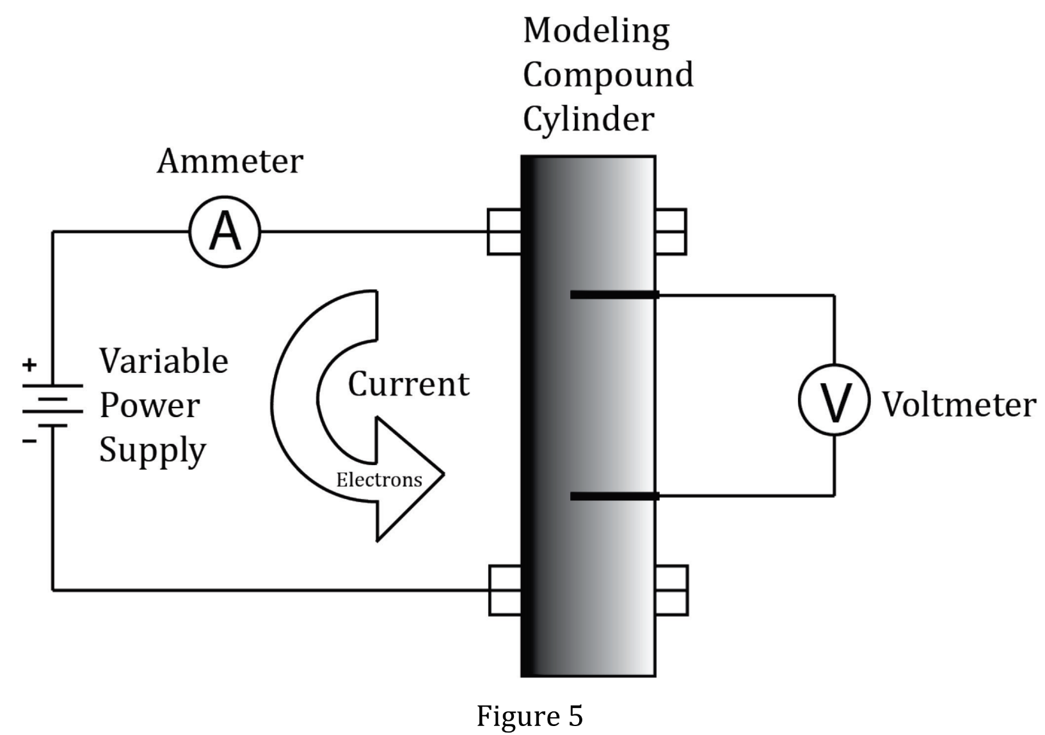
Notes:
Select an alternative method to test a hypothesis; Determine whether information supports or contradicts a hypothesis or conclusion; Determine the effect of new information on a model. Level: Advanced Skill Group: Evaluation of Models

Slide 2
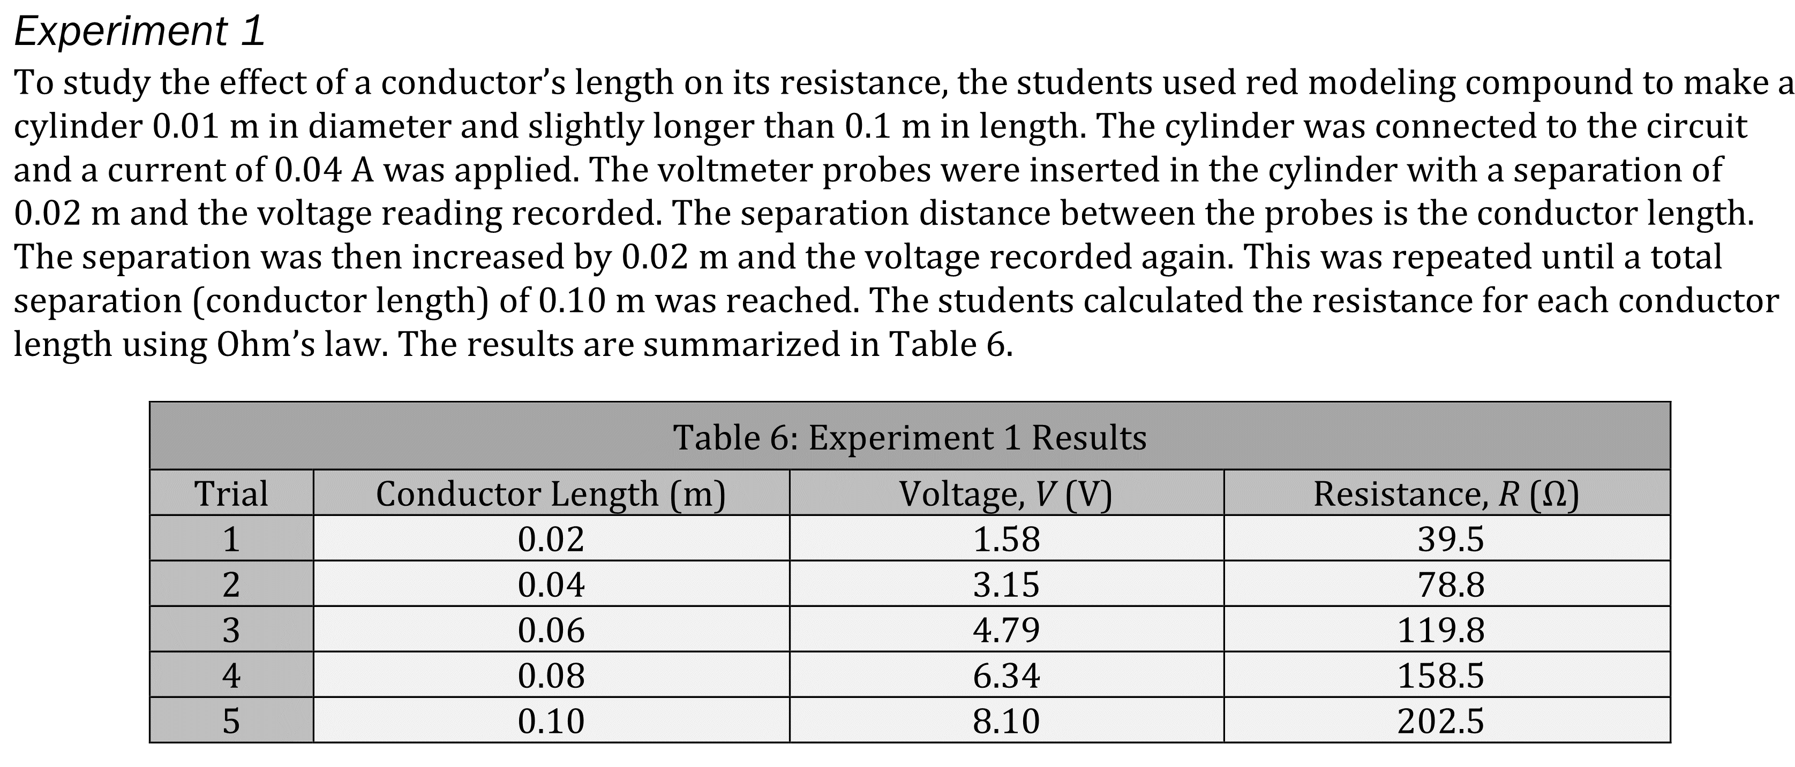
Notes:
Select an alternative method to test a hypothesis; Determine whether information supports or contradicts a hypothesis or conclusion; Determine the effect of new information on a model. Level: Advanced Skill Group: Evaluation of Models

Slide 3
Notes:
Select an alternative method to test a hypothesis; Determine whether information supports or contradicts a hypothesis or conclusion; Determine the effect of new information on a model. Level: Advanced Skill Group: Evaluation of Models

Slide 4
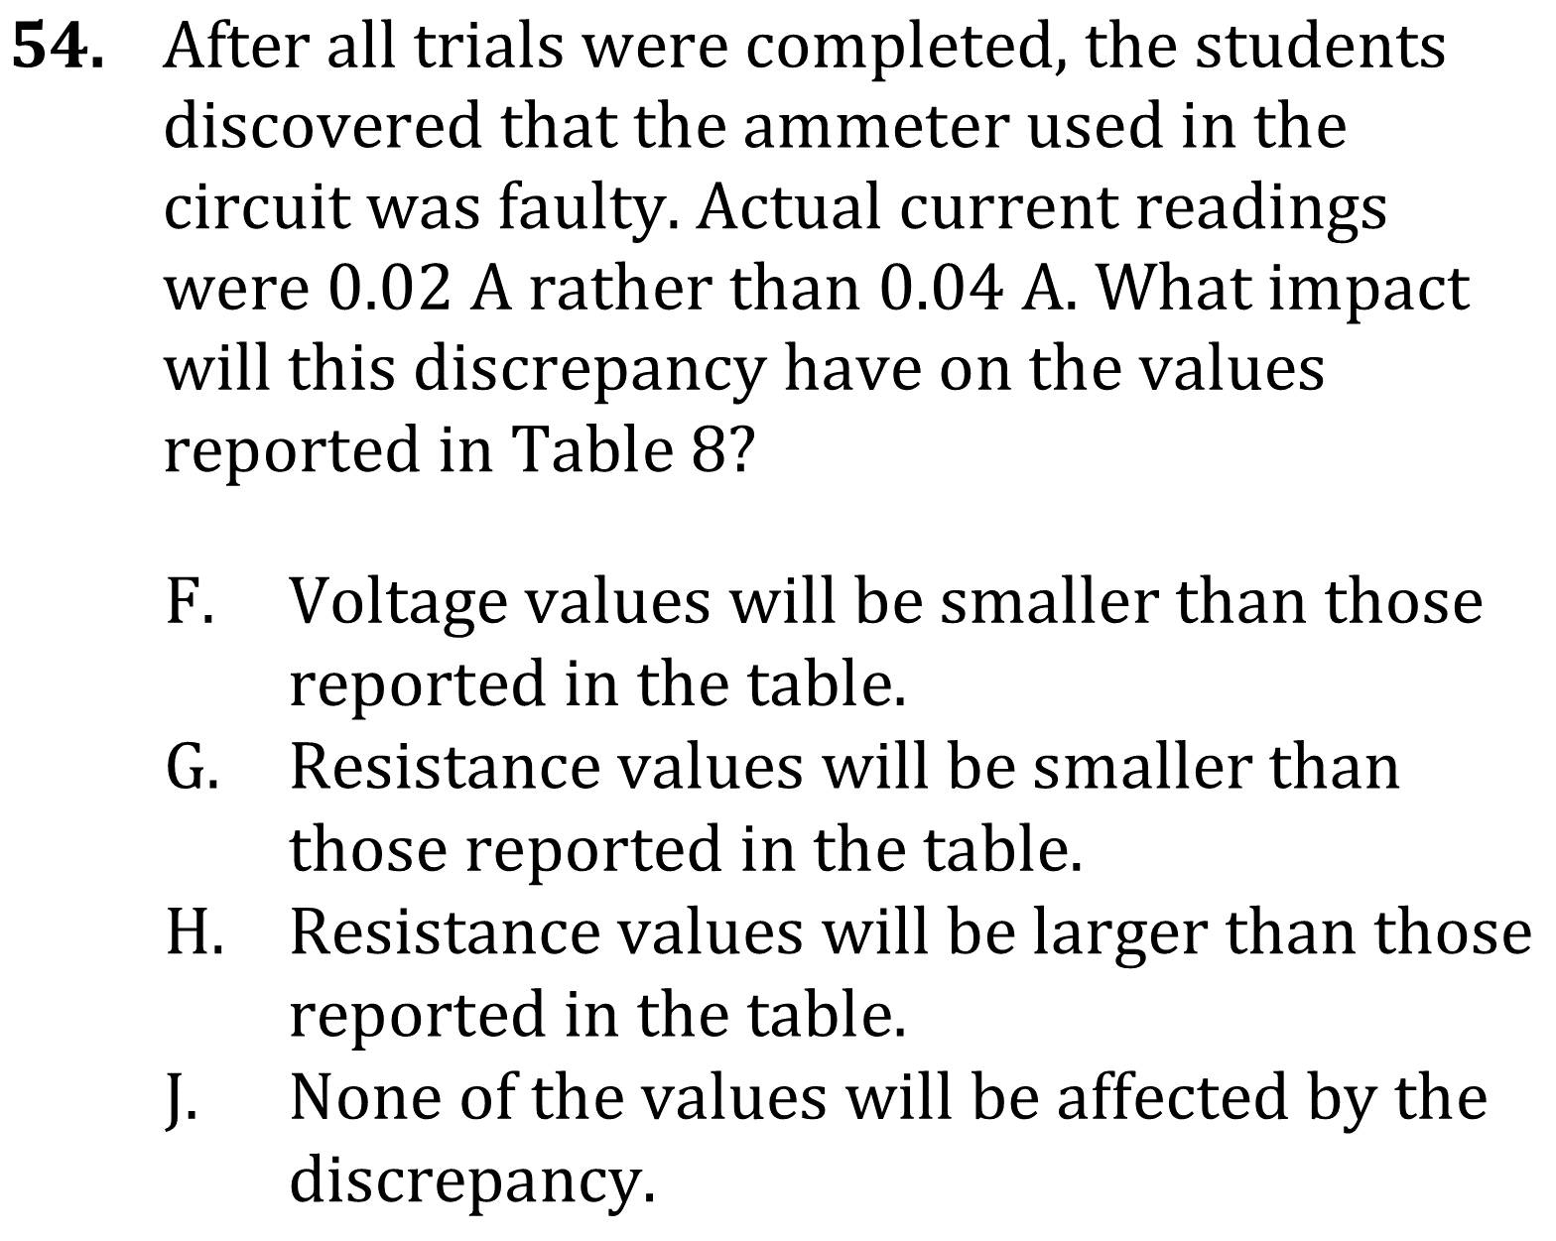
Notes:
Select an alternative method to test a hypothesis; Determine whether information supports or contradicts a hypothesis or conclusion; Determine the effect of new information on a model. Level: Advanced Skill Group: Evaluation of Models

Slide 5
Notes:
Select an alternative method to test a hypothesis; Determine whether information supports or contradicts a hypothesis or conclusion; Determine the effect of new information on a model. Level: Advanced Skill Group: Evaluation of Models

Slide 6
Notes:
Select an alternative method to test a hypothesis; Determine whether information supports or contradicts a hypothesis or conclusion; Determine the effect of new information on a model. Level: Advanced Skill Group: Evaluation of Models

Slide 7
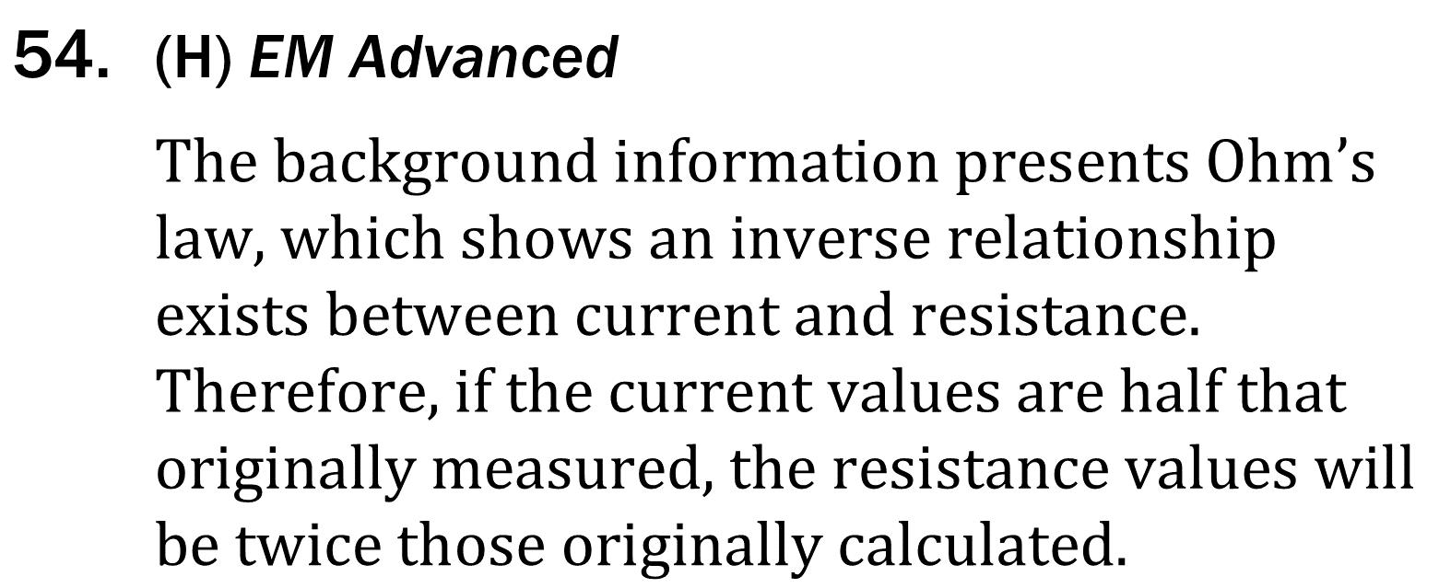
Notes:
Select an alternative method to test a hypothesis; Determine whether information supports or contradicts a hypothesis or conclusion; Determine the effect of new information on a model. Level: Advanced Skill Group: Evaluation of Models

Slide 8
Notes:
Select an alternative method to test a hypothesis; Determine whether information supports or contradicts a hypothesis or conclusion; Determine the effect of new information on a model. Level: Advanced Skill Group: Evaluation of Models

Slide 9
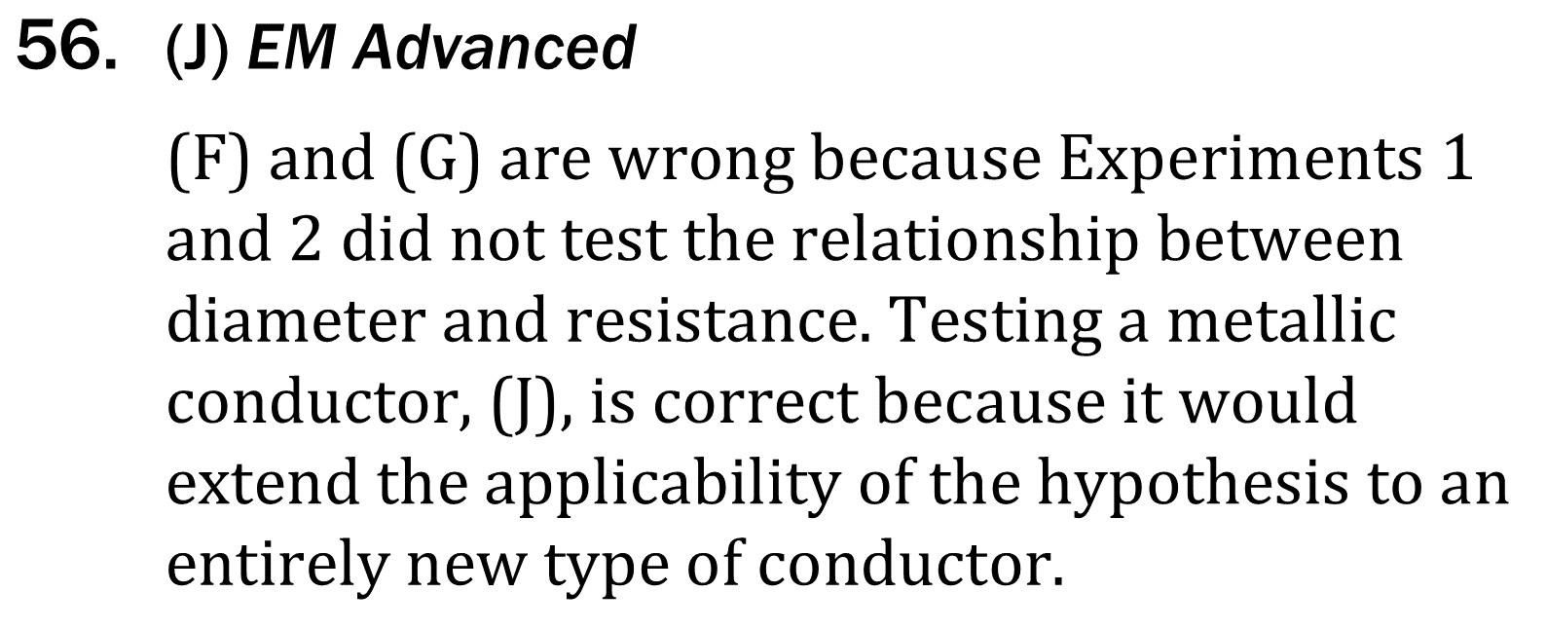
Notes:
Select an alternative method to test a hypothesis; Determine whether information supports or contradicts a hypothesis or conclusion; Determine the effect of new information on a model. Level: Advanced Skill Group: Evaluation of Models

