Slide 1
Comma usage
Directions: Add the necessary commas.

Slide 2
Comma usage
Directions: Add the necessary commas.

Slide 3
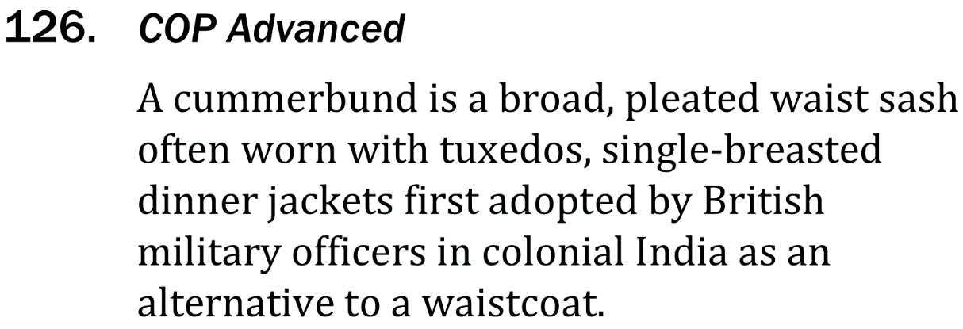
Comma usage

Slide 4
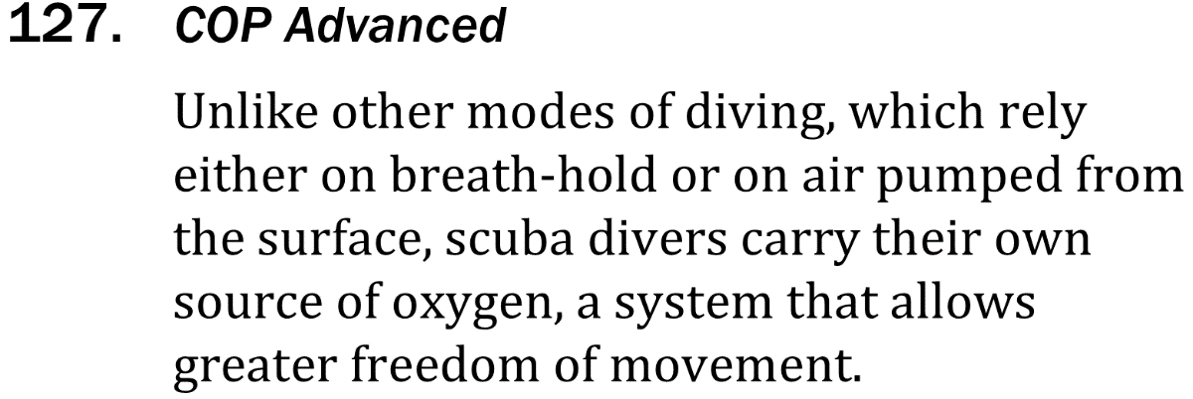
Comma usage

