Slide 1
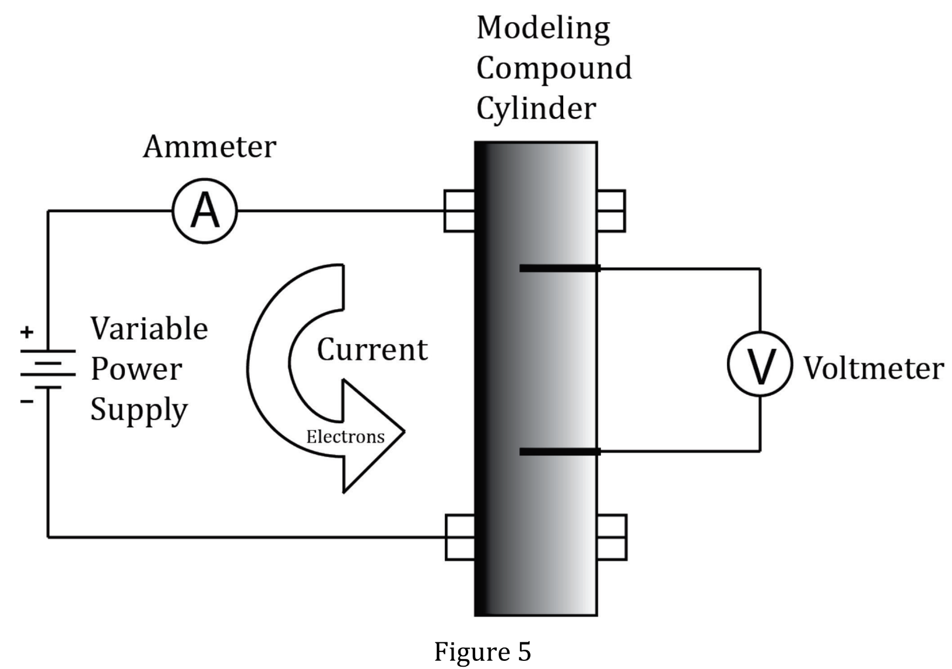
Notes:
Understand the relationship between variables in more complex data presentations. Level: Advanced Skill Group: Evaluation of Models

Slide 2
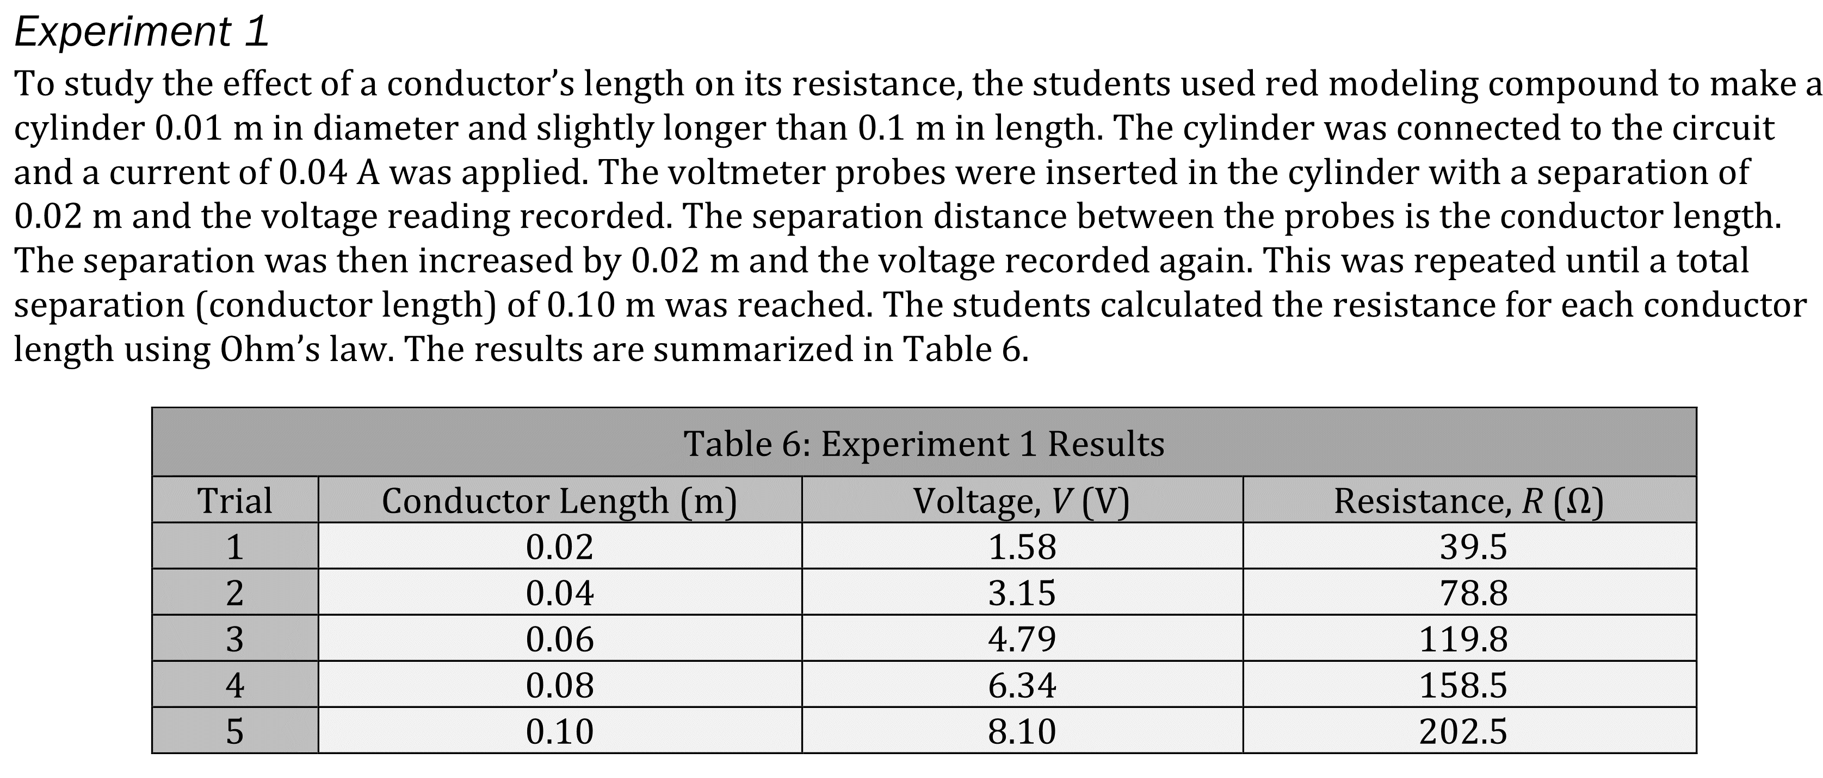
Notes:
Understand the relationship between variables in more complex data presentations. Level: Advanced Skill Group: Evaluation of Models

Slide 3
Notes:
Understand the relationship between variables in more complex data presentations. Level: Advanced Skill Group: Evaluation of Models

Slide 4
Notes:
Understand the relationship between variables in more complex data presentations. Level: Advanced Skill Group: Evaluation of Models

Slide 5
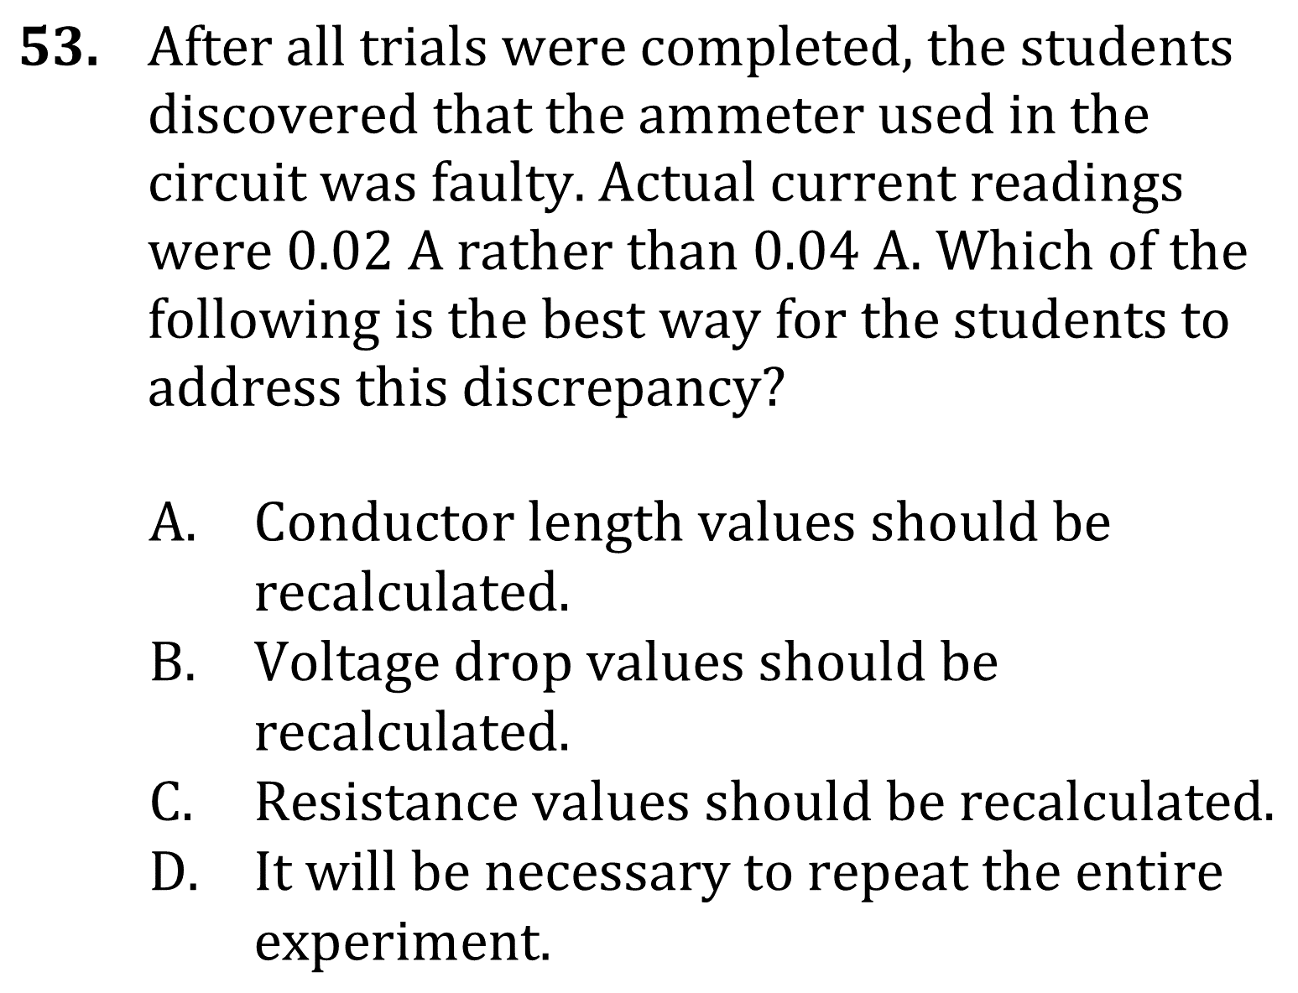
Notes:
Understand the relationship between variables in more complex data presentations. Level: Advanced Skill Group: Evaluation of Models

Slide 6
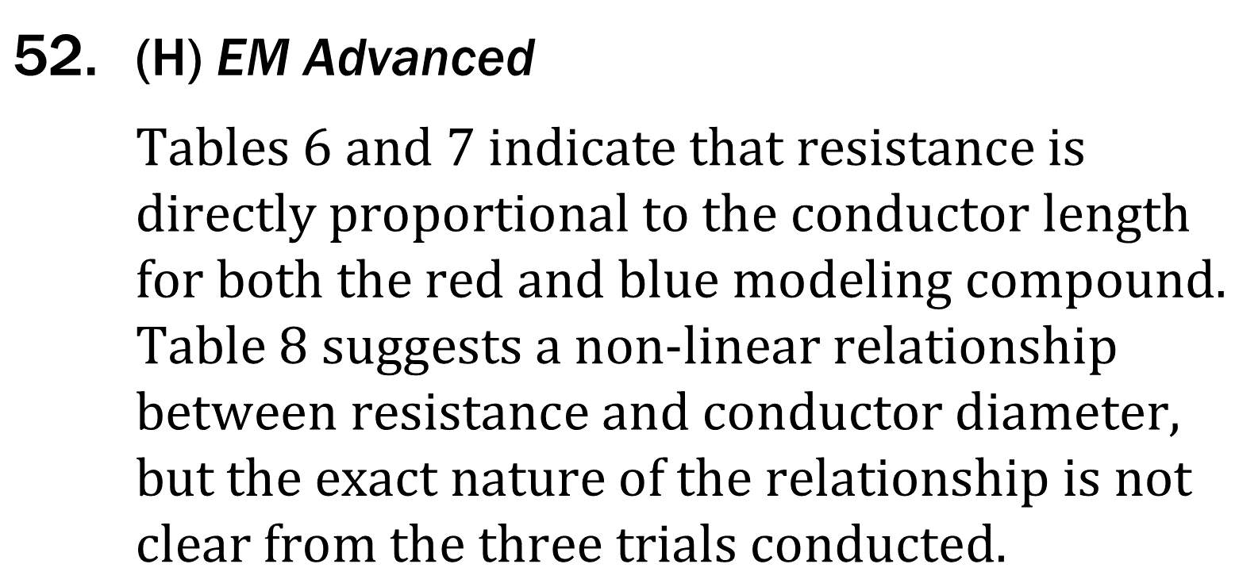
Notes:
Understand the relationship between variables in more complex data presentations. Level: Advanced Skill Group: Evaluation of Models

Slide 7
Notes:
Understand the relationship between variables in more complex data presentations. Level: Advanced Skill Group: Evaluation of Models

