Slide 1
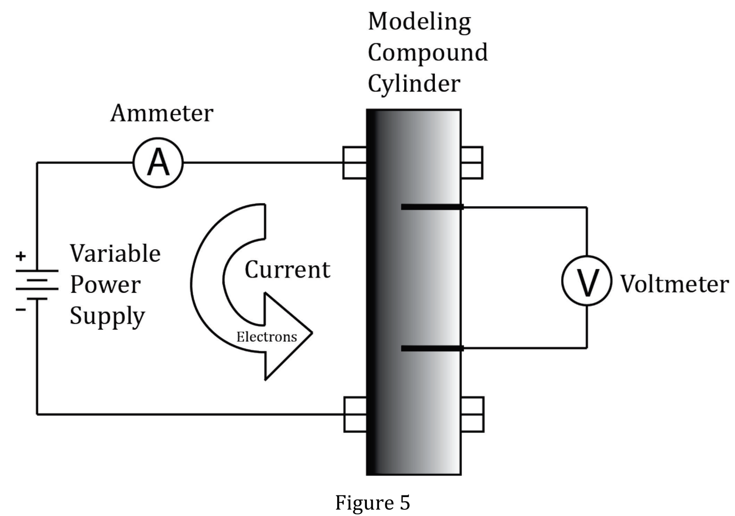
Notes:
Understand the relationship between variable in more complex data presentations. Level: Advanced Skill Group: Evaluation of Models

Slide 2
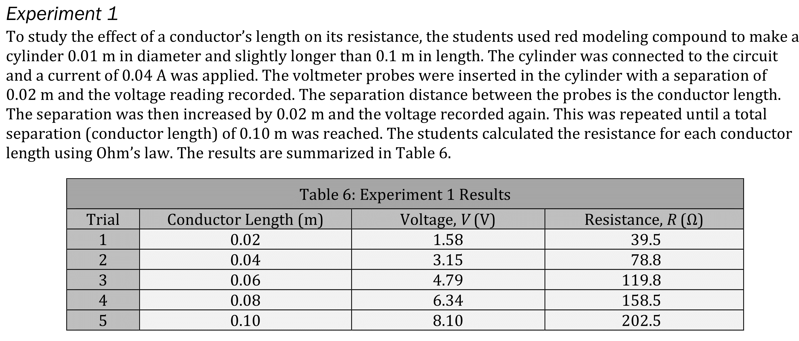
Notes:
Understand the relationship between variable in more complex data presentations. Level: Advanced Skill Group: Evaluation of Models

Slide 3
Notes:
Understand the relationship between variable in more complex data presentations. Level: Advanced Skill Group: Evaluation of Models

Slide 4
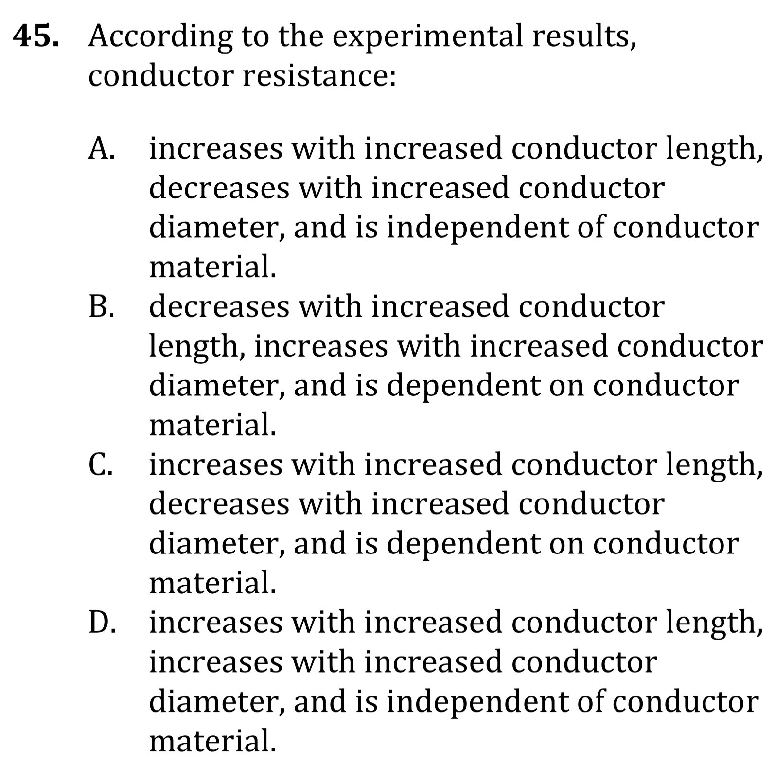
Notes:
Understand the relationship between variable in more complex data presentations. Level: Advanced Skill Group: Evaluation of Models

Slide 5
Notes:
Understand the relationship between variable in more complex data presentations. Level: Advanced Skill Group: Evaluation of Models

Slide 6
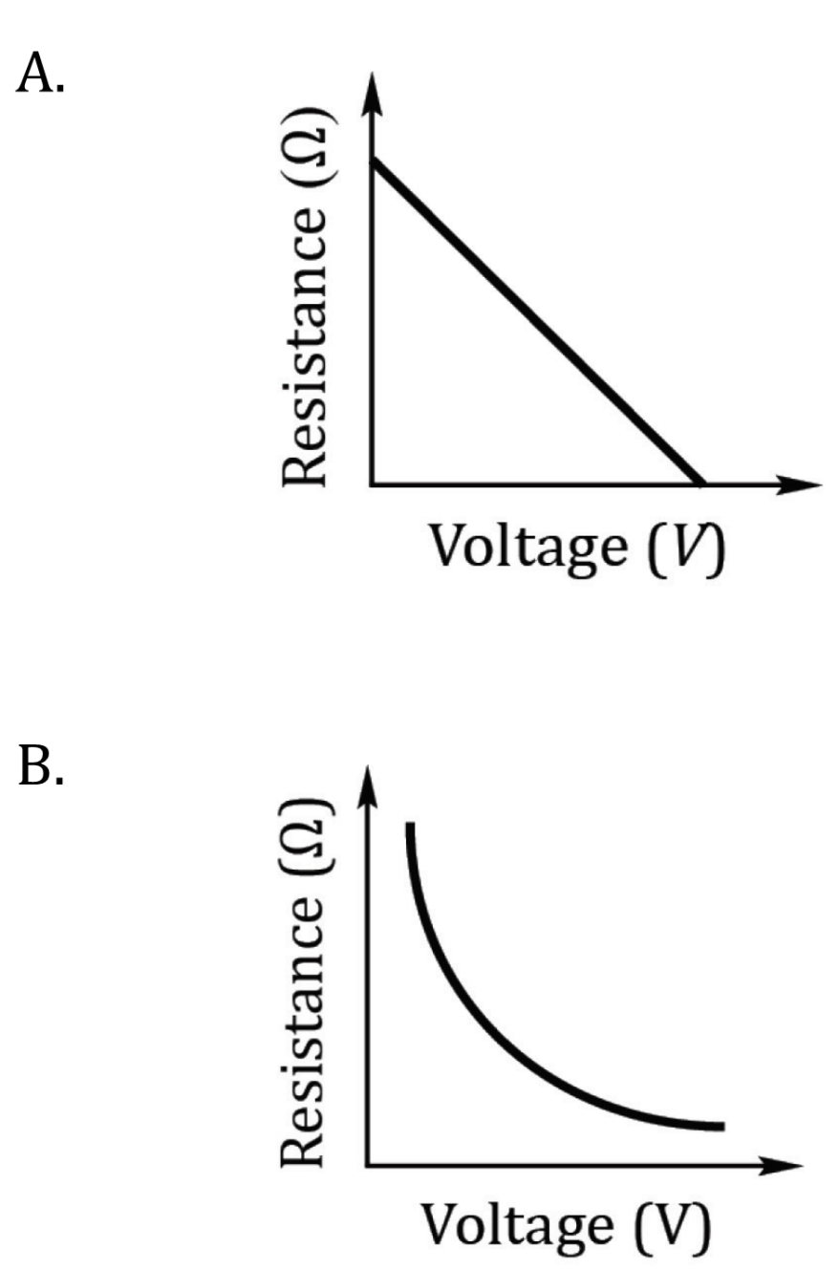
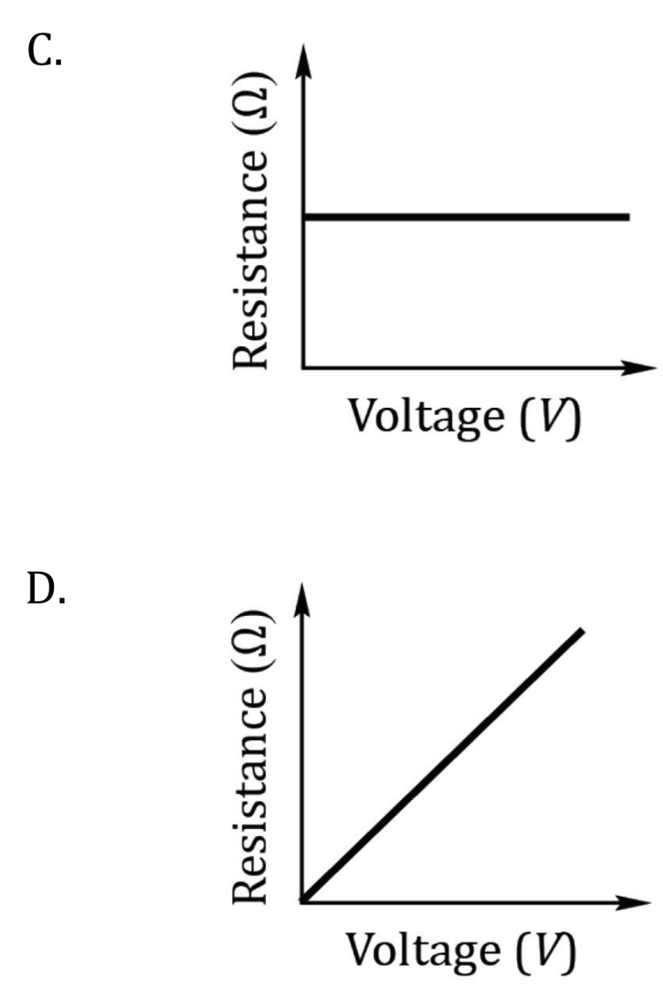
Notes:
Understand the relationship between variable in more complex data presentations. Level: Advanced Skill Group: Evaluation of Models

Slide 7
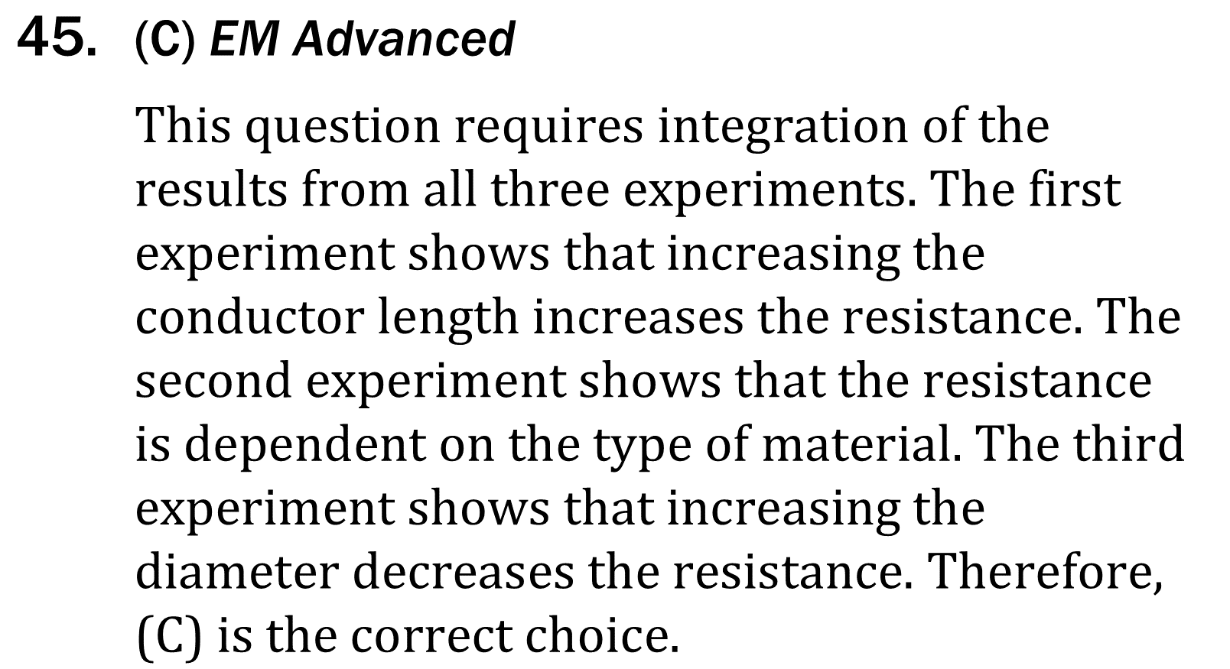
Notes:
Understand the relationship between variable in more complex data presentations. Level: Advanced Skill Group: Evaluation of Models

Slide 8
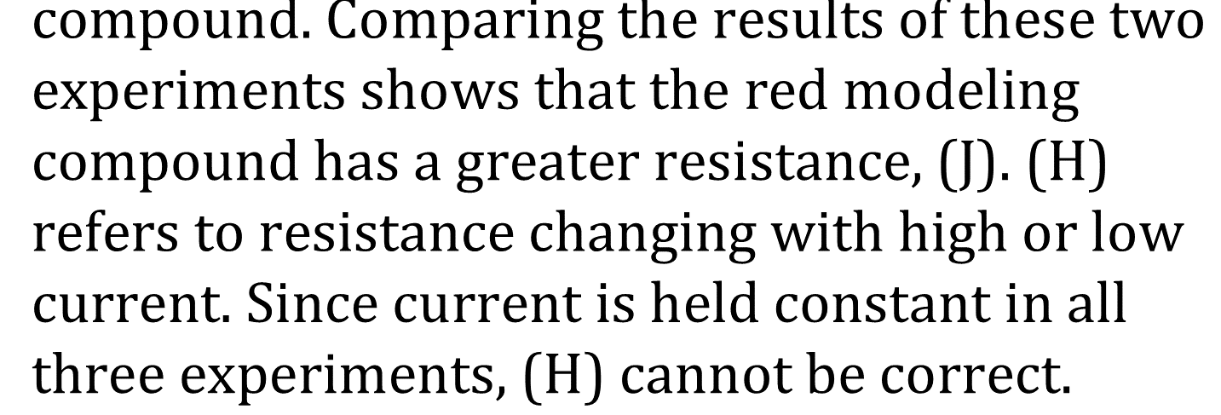
Notes:
Understand the relationship between variable in more complex data presentations. Level: Advanced Skill Group: Evaluation of Models

Slide 9
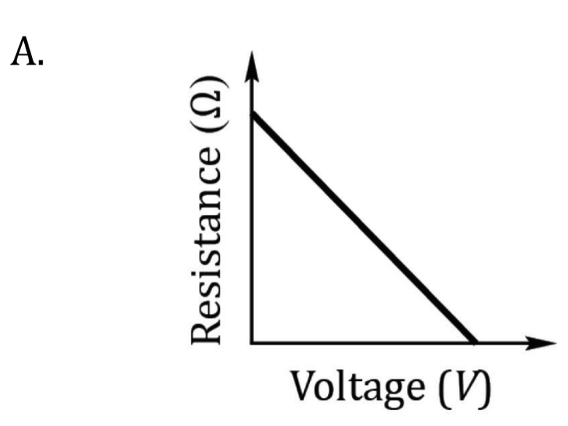
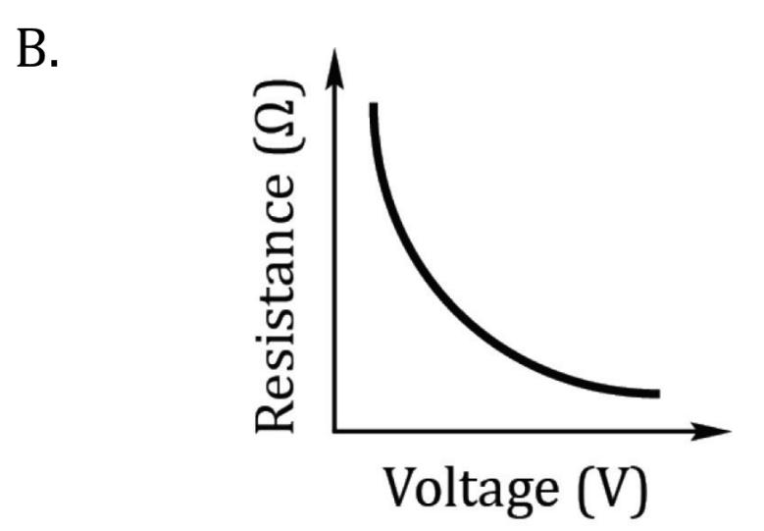
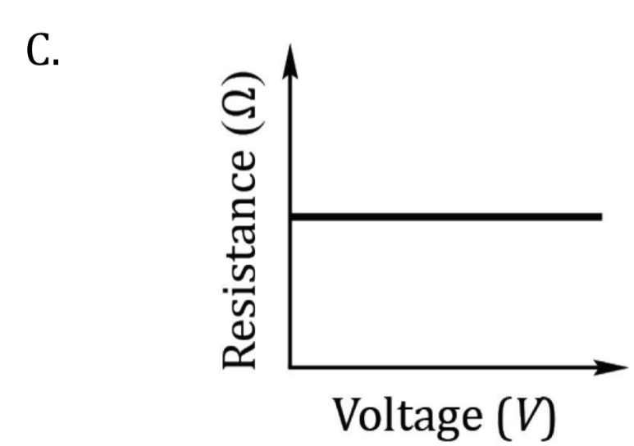
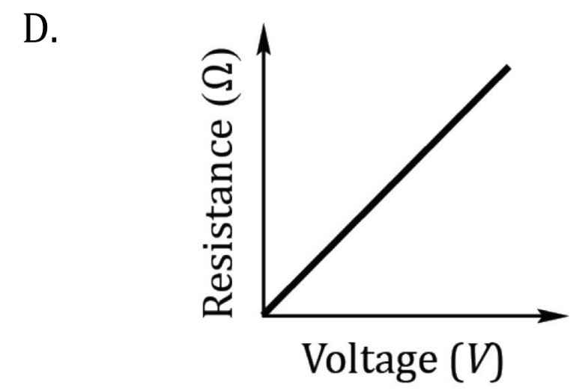
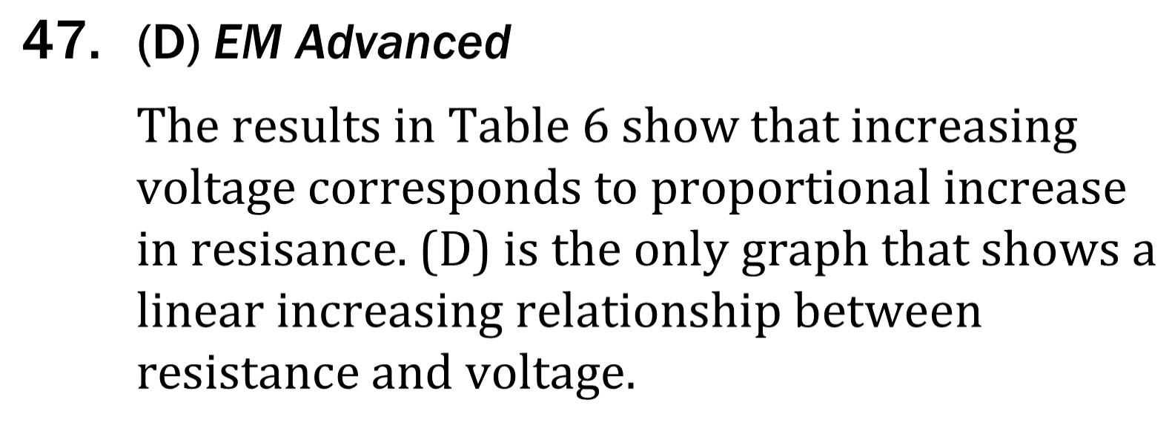
Notes:
Understand the relationship between variable in more complex data presentations. Level: Advanced Skill Group: Evaluation of Models

