Slide 1
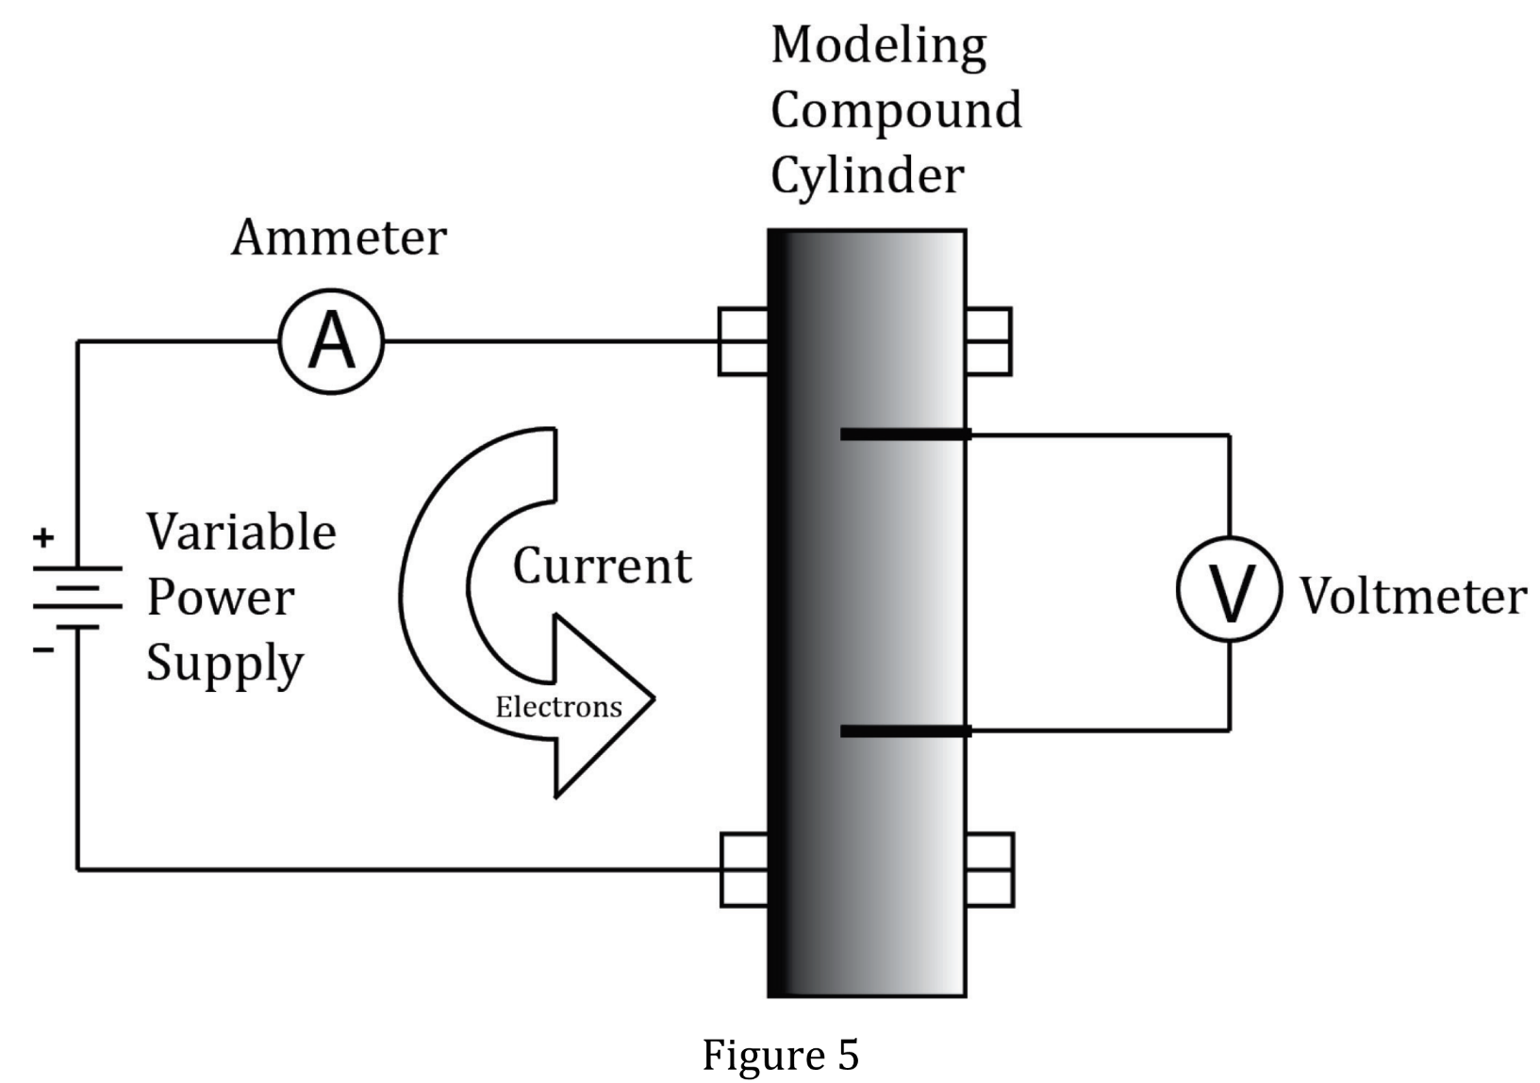
Notes:
Understand the relationship between variable in more complex data presentations. Level: Advanced Skill Group: Evaluation of Models

Slide 2
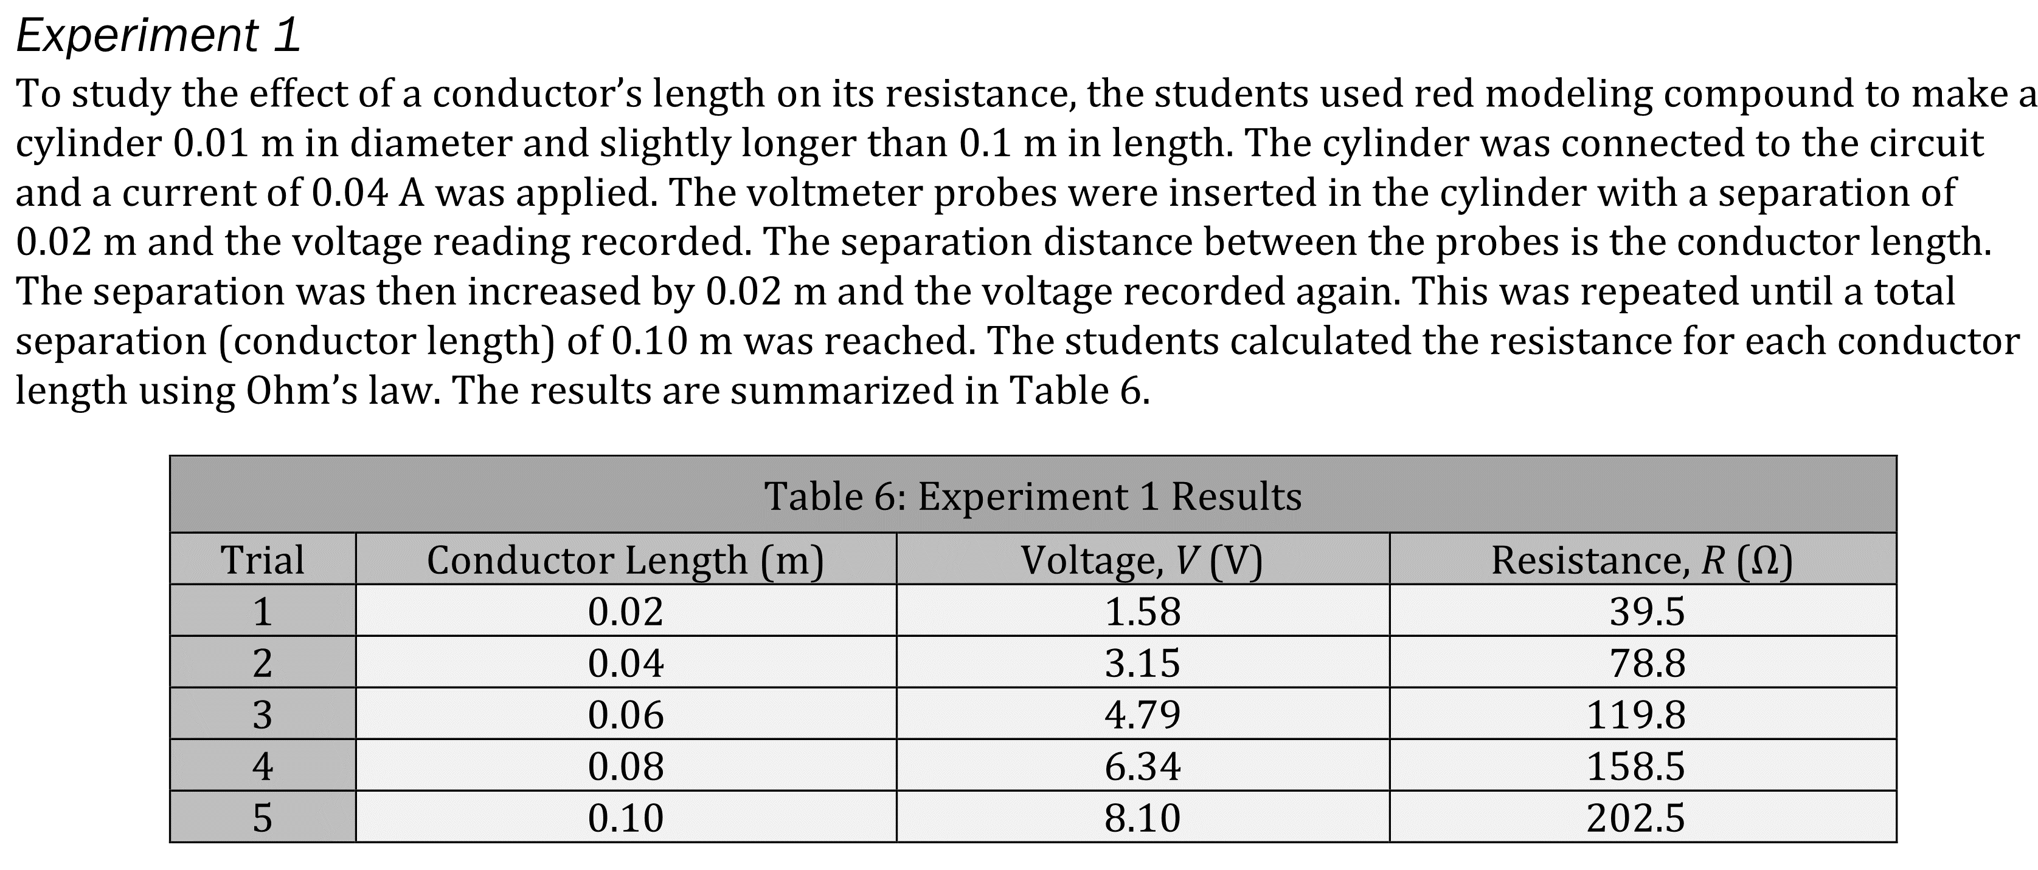
Notes:
Understand the relationship between variable in more complex data presentations. Level: Advanced Skill Group: Evaluation of Models

Slide 3
Notes:
Understand the relationship between variable in more complex data presentations. Level: Advanced Skill Group: Evaluation of Models

Slide 4
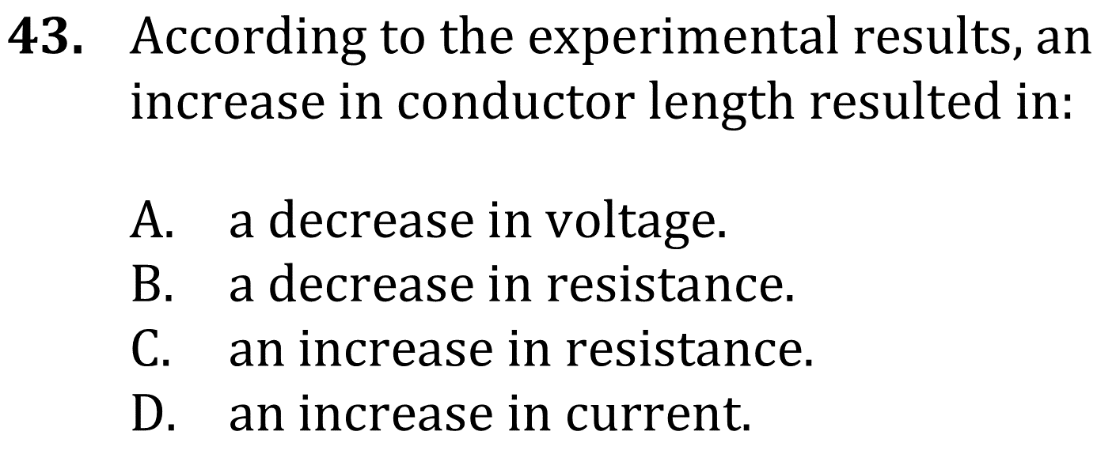
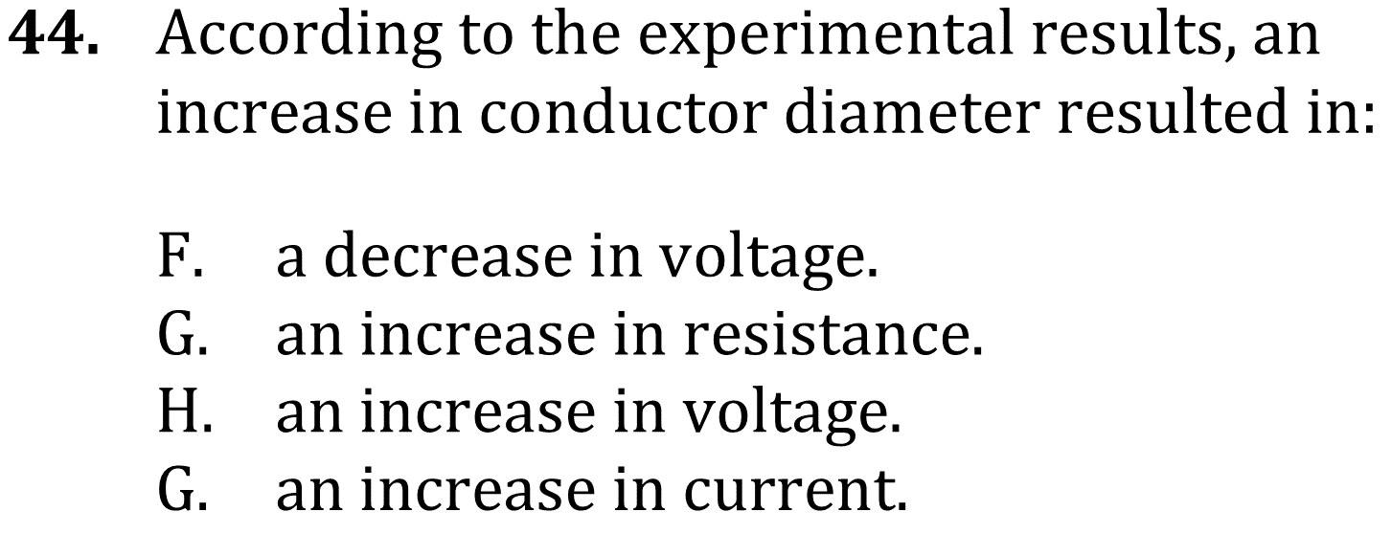
Notes:
Understand the relationship between variable in more complex data presentations. Level: Advanced Skill Group: Evaluation of Models

Slide 5
Notes:
Understand the relationship between variable in more complex data presentations. Level: Advanced Skill Group: Evaluation of Models

Slide 6
Notes:
Understand the relationship between variable in more complex data presentations. Level: Advanced Skill Group: Evaluation of Models

