Slide 1
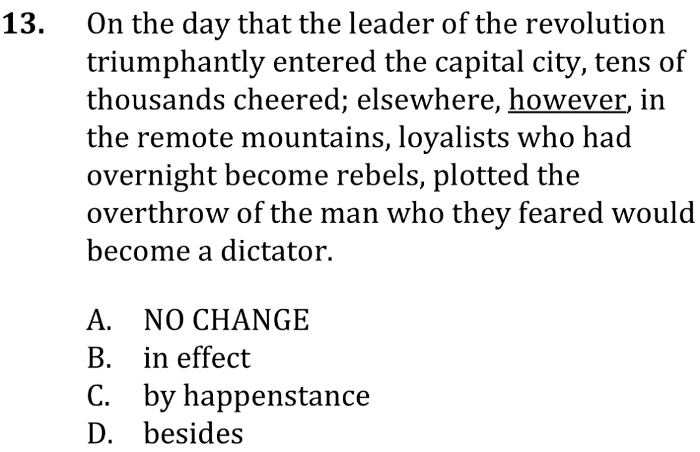
Using Conjunctive adverbs

Slide 2
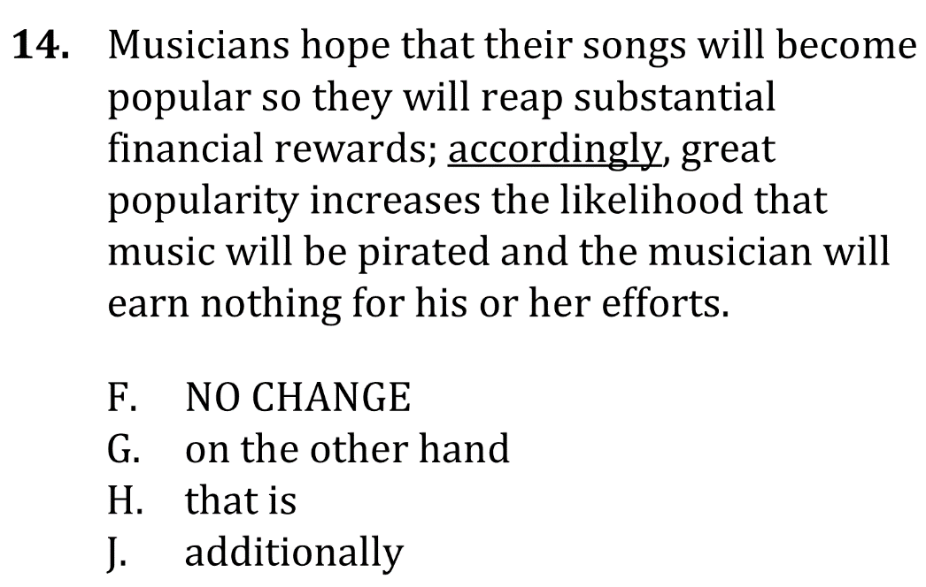
Using conjunctive adverbs

Slide 3
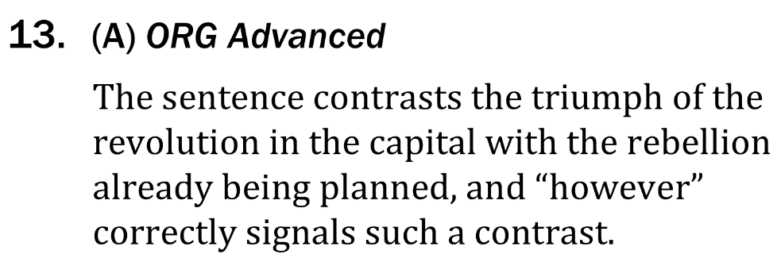
Using conjunctive adverbs

Slide 4
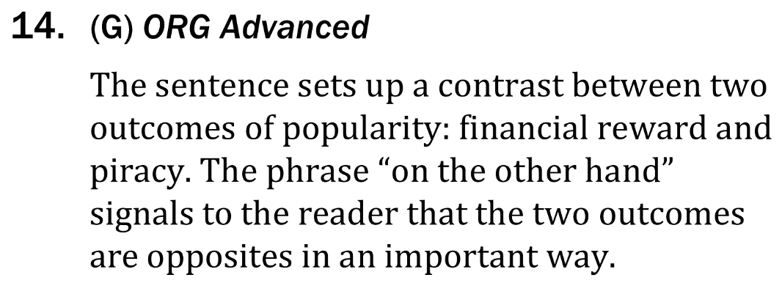
Using conjunctive adverbs

