Slide 1
Geometric Sequences

Slide 2
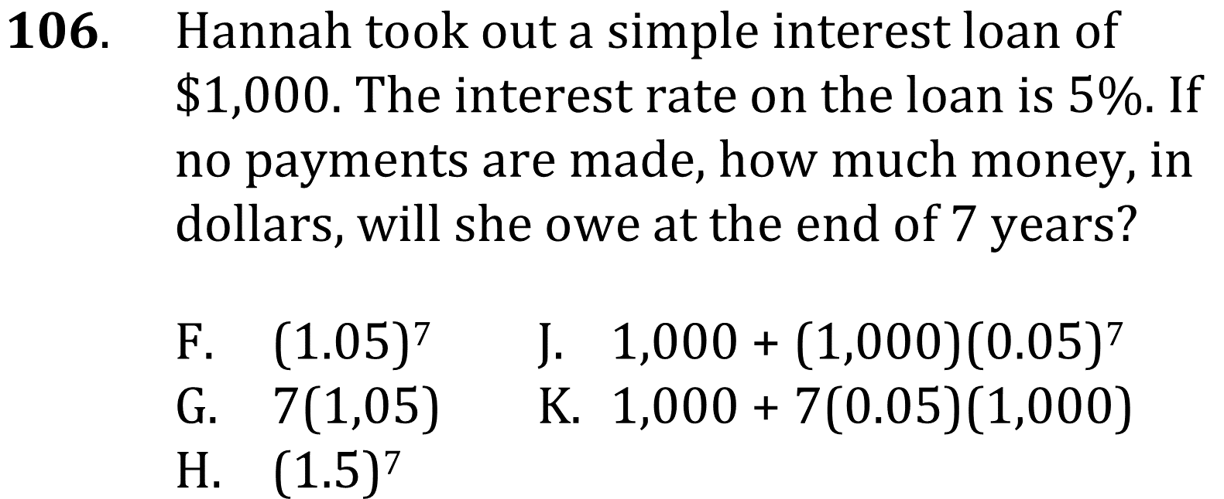
Geometric Sequences

Slide 3
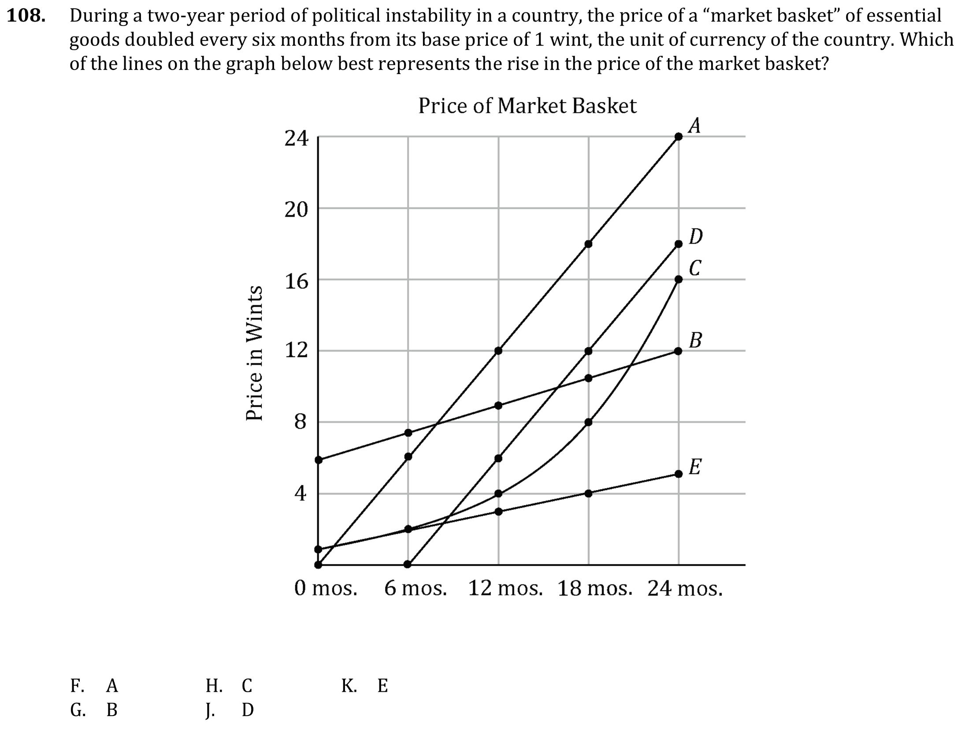
Geometric Sequences

Slide 4
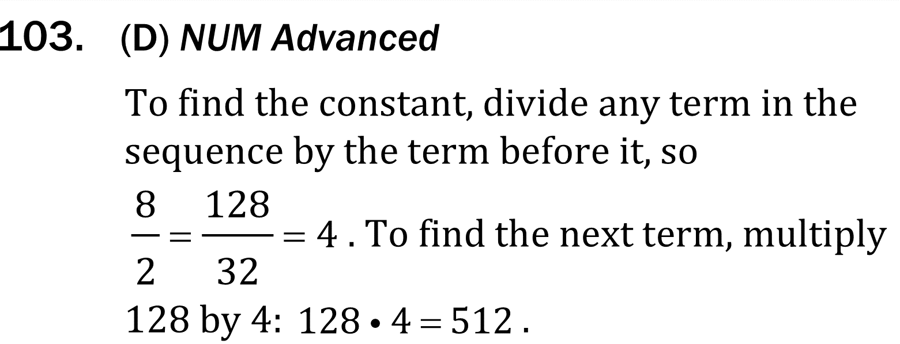
Geometric Sequences

Slide 5
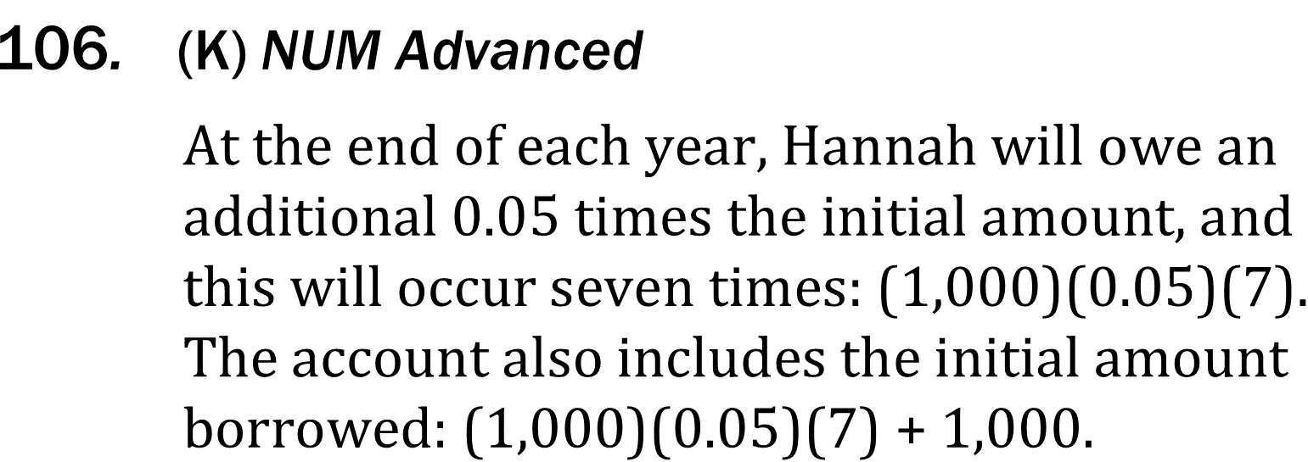
Geometric Sequences

Slide 6
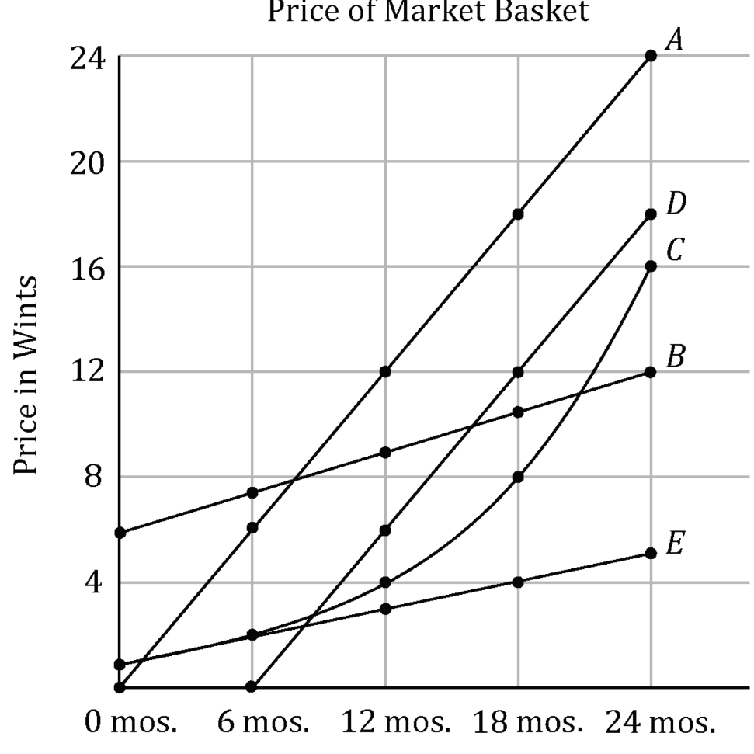
Geometric Sequences

