Slide 1
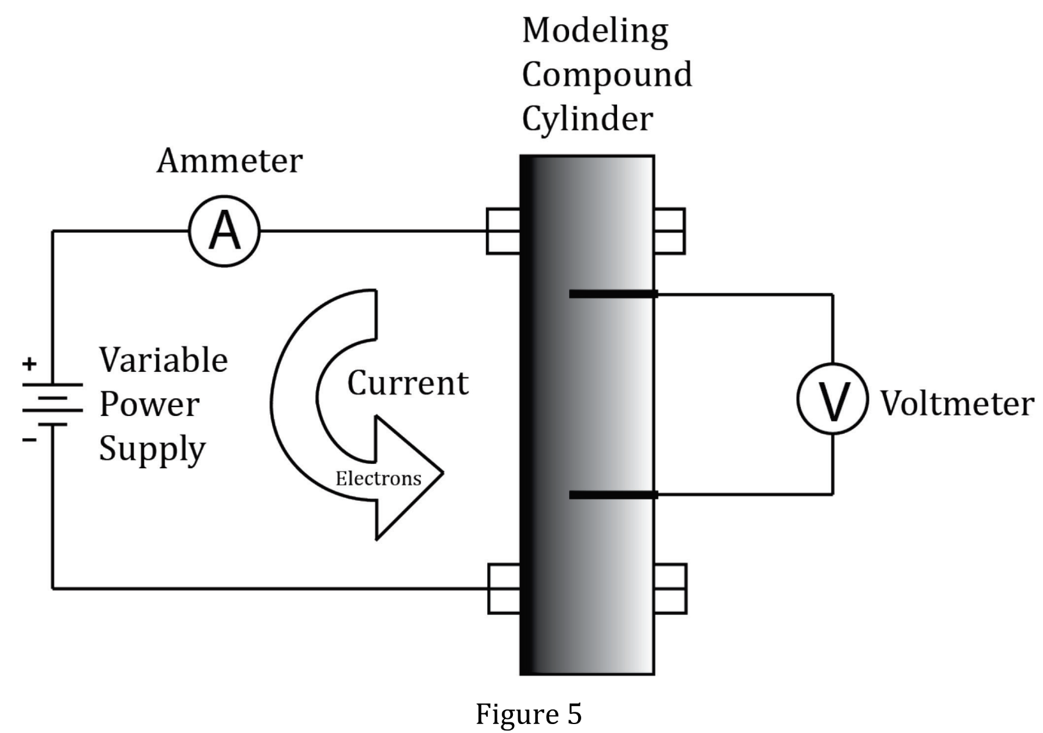
Notes:
Read and interpret data in more complex data presentations. Level: Advanced Skill Group: Interpretation of Data

Slide 2
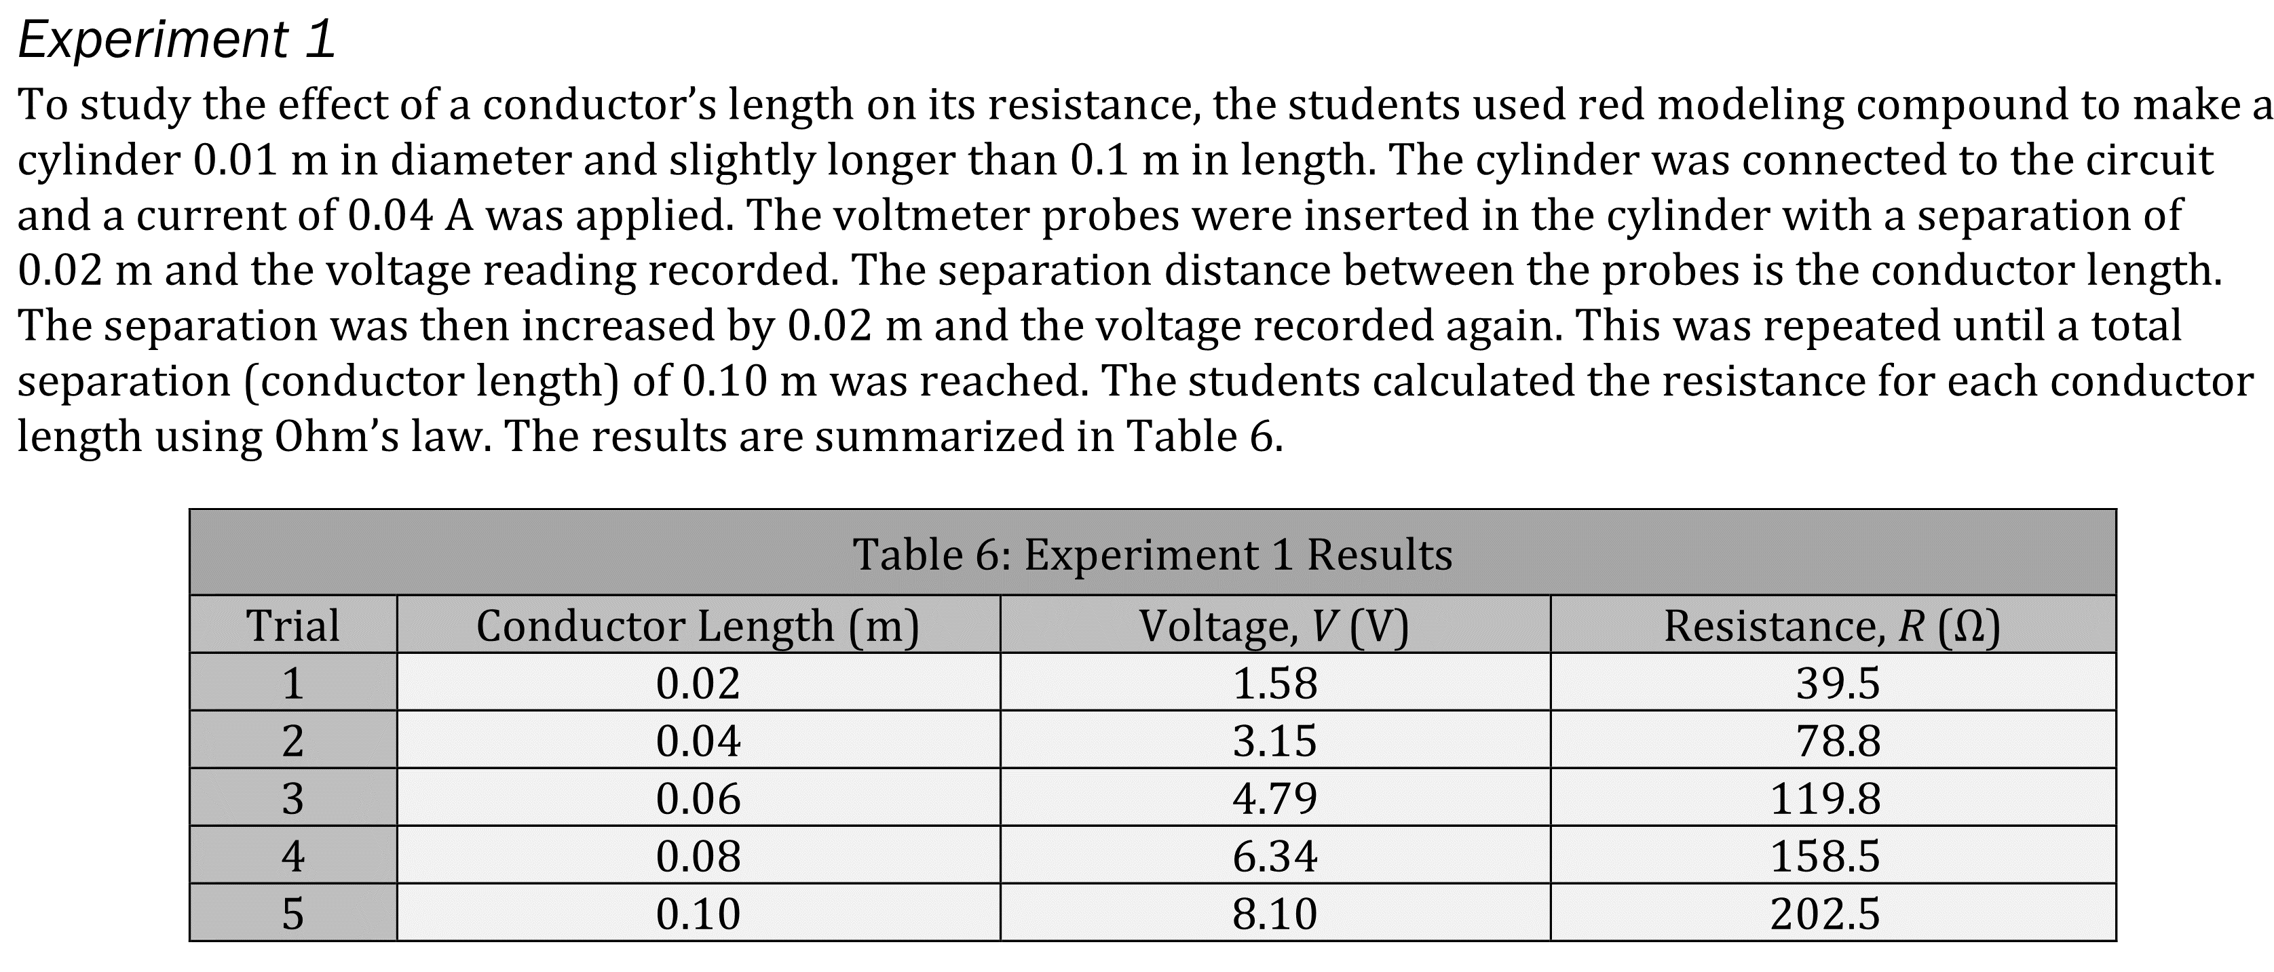
Notes:
Read and interpret data in more complex data presentations. Level: Advanced Skill Group: Interpretation of Data

Slide 3
Notes:
Read and interpret data in more complex data presentations. Level: Advanced Skill Group: Interpretation of Data

Slide 4
Notes:
Read and interpret data in more complex data presentations. Level: Advanced Skill Group: Interpretation of Data

Slide 5
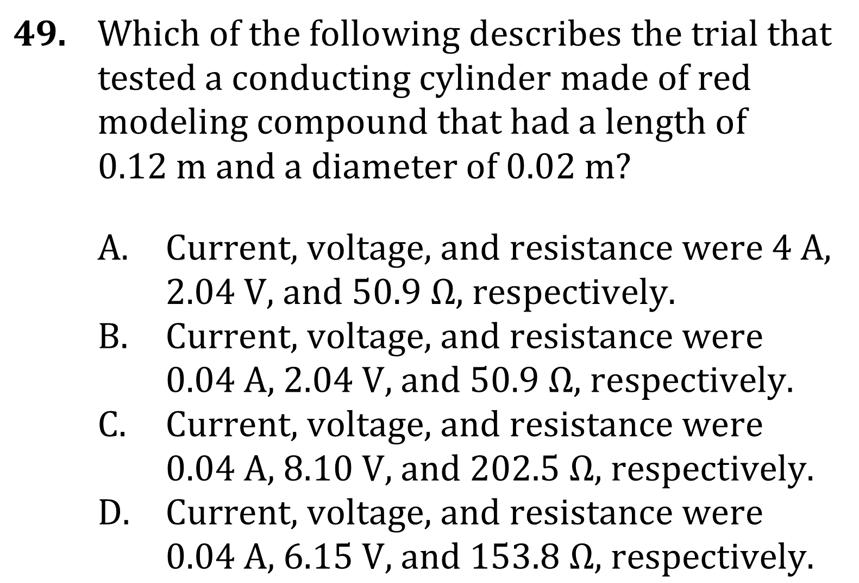
Notes:
Read and interpret data in more complex data presentations. Level: Advanced Skill Group: Interpretation of Data

Slide 6
Notes:
Read and interpret data in more complex data presentations. Level: Advanced Skill Group: Interpretation of Data

Slide 7
Notes:
Read and interpret data in more complex data presentations. Level: Advanced Skill Group: Interpretation of Data

