Slide 1
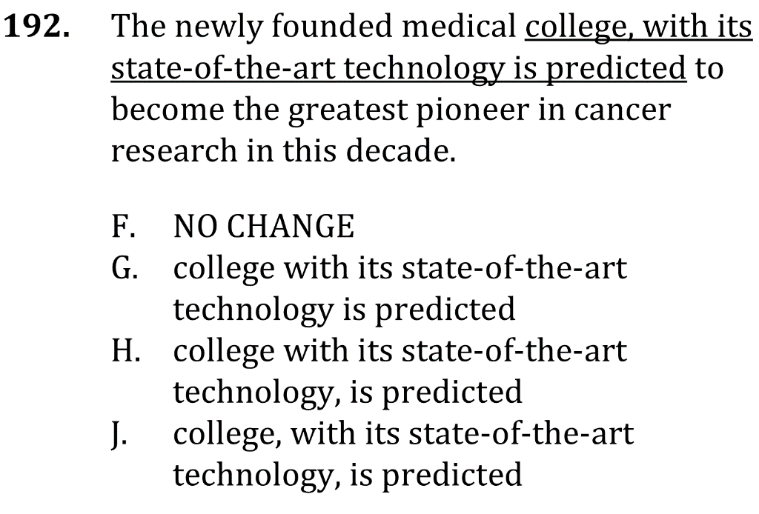
commas and parenthetical phrases

Slide 2
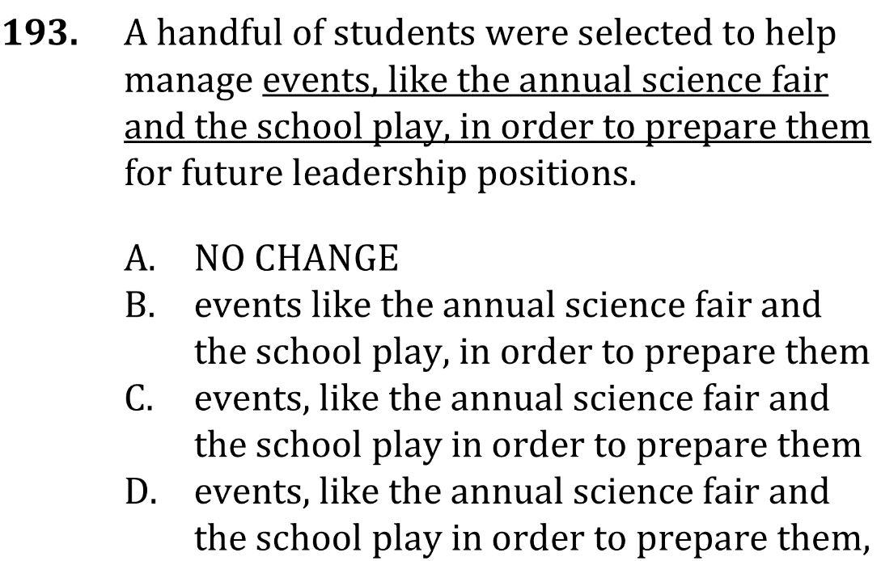
commas and parenthetical phrases

Slide 3
commas and parenthetical phrases

Slide 4
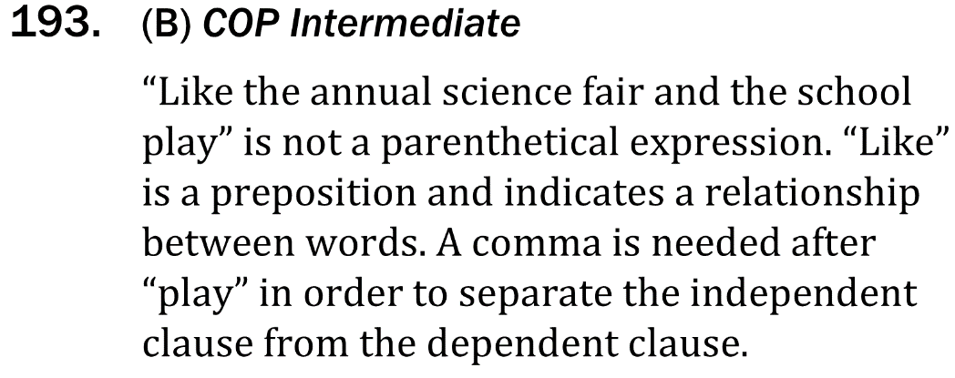
commas and parenthetical phrases

