Slide 1
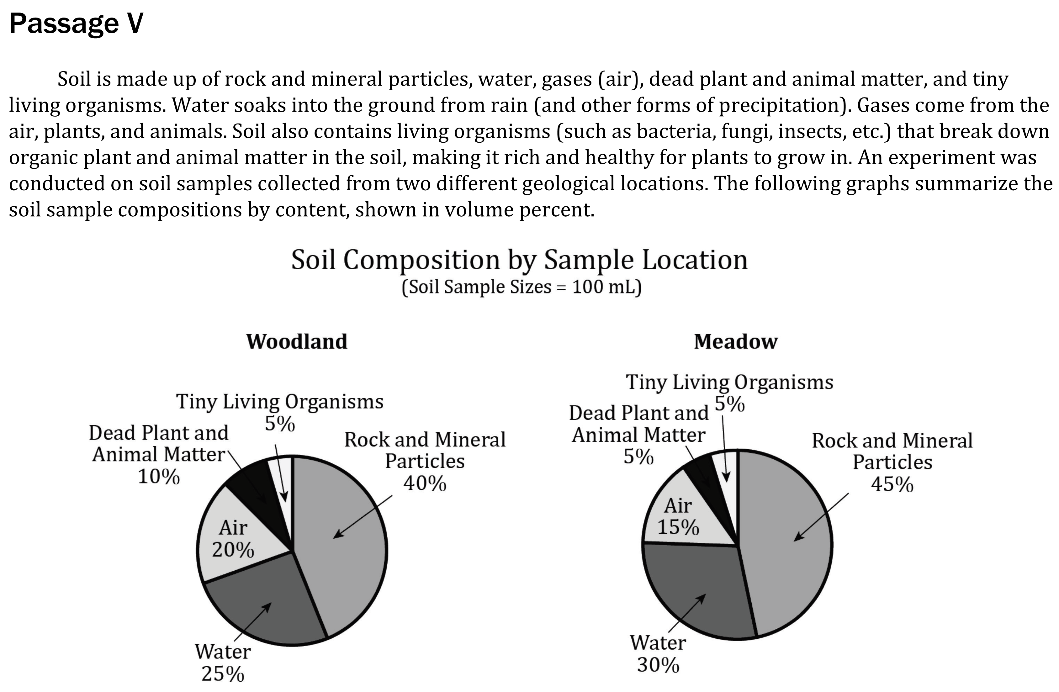
Notes:
Use a simple presentation of data to identify one two or more pieces of data either numerical of non-numerical. Level: Basic Skill Group: Interpretation of Data

Slide 2
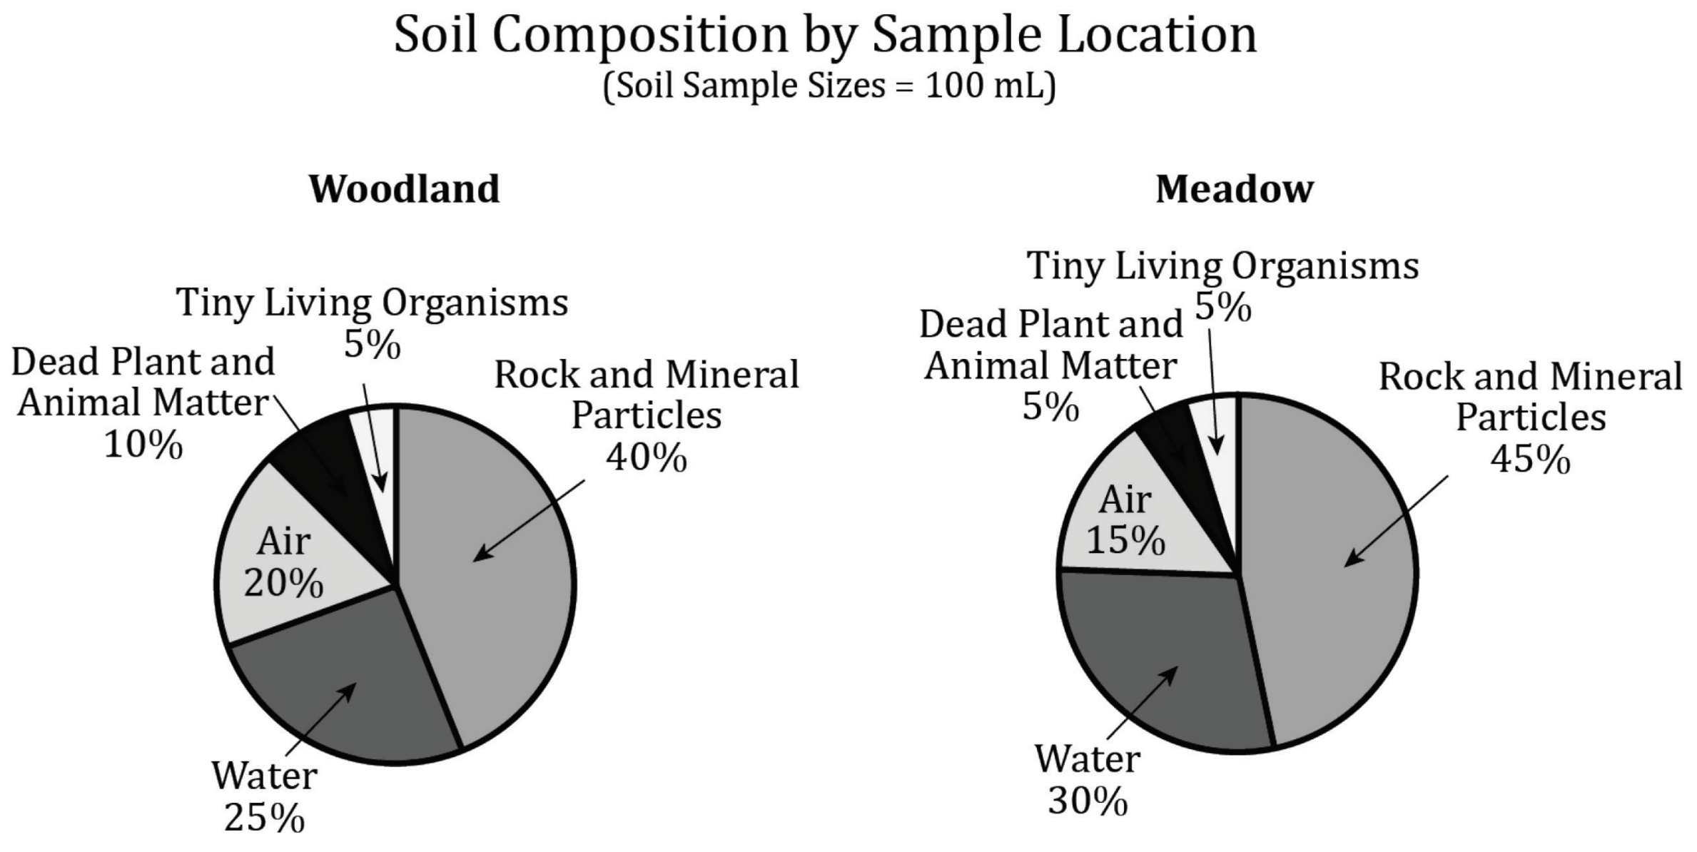
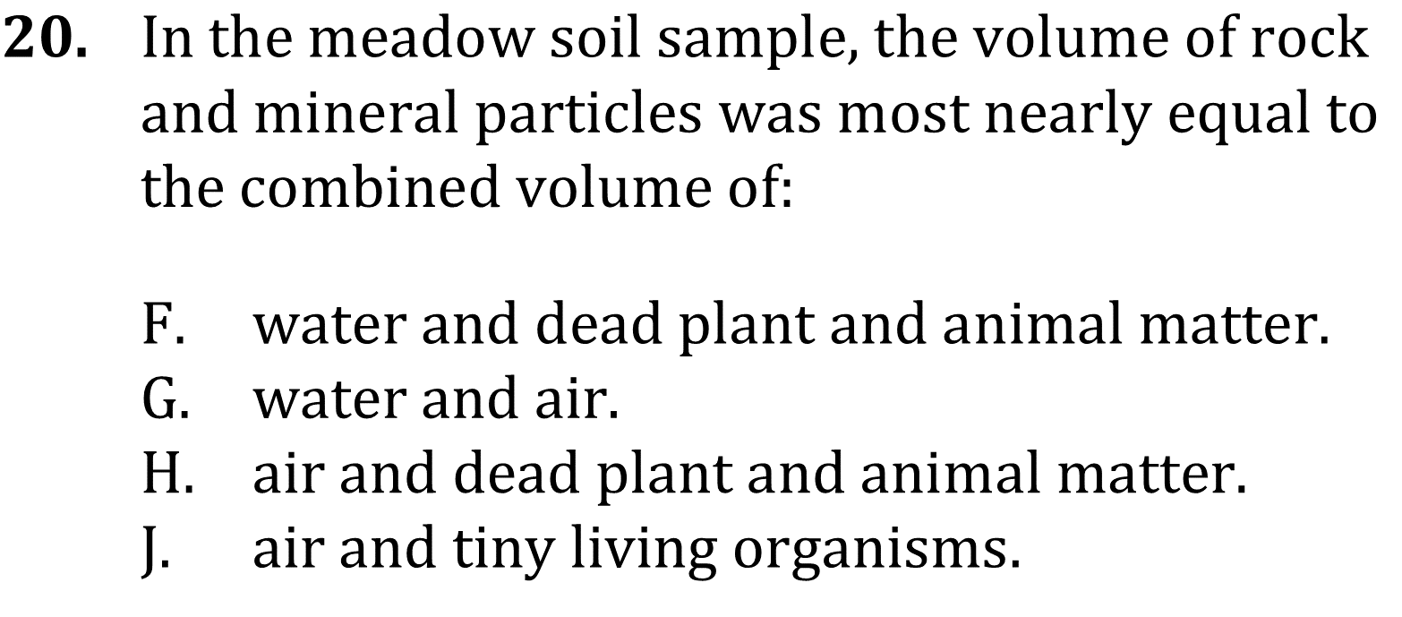
Notes:
Use a simple presentation of data to identify one two or more pieces of data either numerical of non-numerical. Level: Basic Skill Group: Interpretation of Data

Slide 3
Notes:
Use a simple presentation of data to identify one two or more pieces of data either numerical of non-numerical. Level: Basic Skill Group: Interpretation of Data

Slide 4
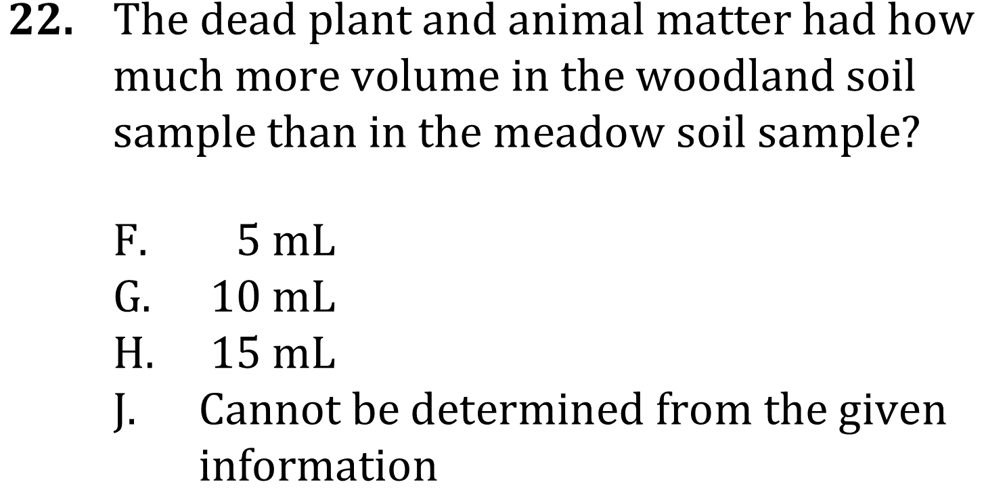
Notes:
Use a simple presentation of data to identify one two or more pieces of data either numerical of non-numerical. Level: Basic Skill Group: Interpretation of Data

Slide 5
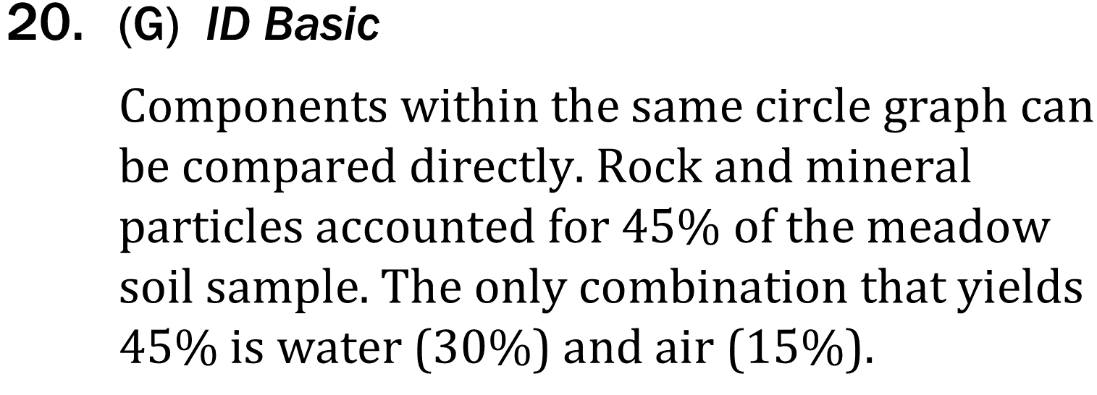
Notes:
Use a simple presentation of data to identify one two or more pieces of data either numerical of non-numerical. Level: Basic Skill Group: Interpretation of Data

Slide 6
Notes:
Use a simple presentation of data to identify one two or more pieces of data either numerical of non-numerical. Level: Basic Skill Group: Interpretation of Data

Slide 7
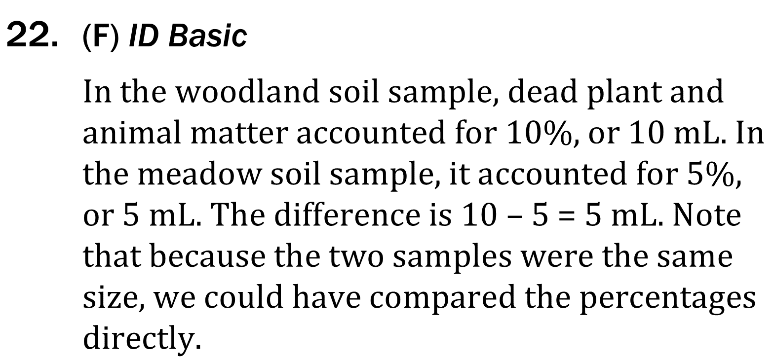
Notes:
Use a simple presentation of data to identify one two or more pieces of data either numerical of non-numerical. Level: Basic Skill Group: Interpretation of Data

