Slide 1
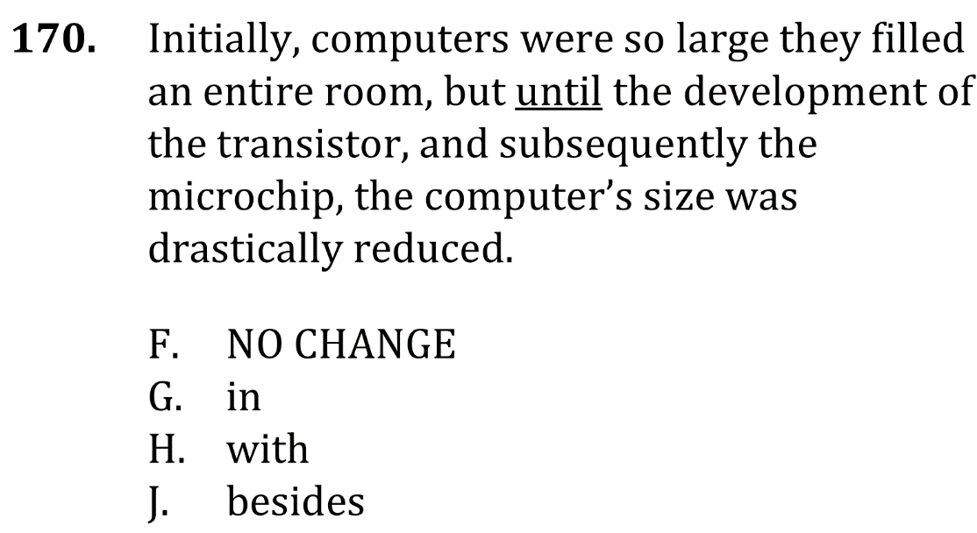
Delete unnecessary commas

Slide 2
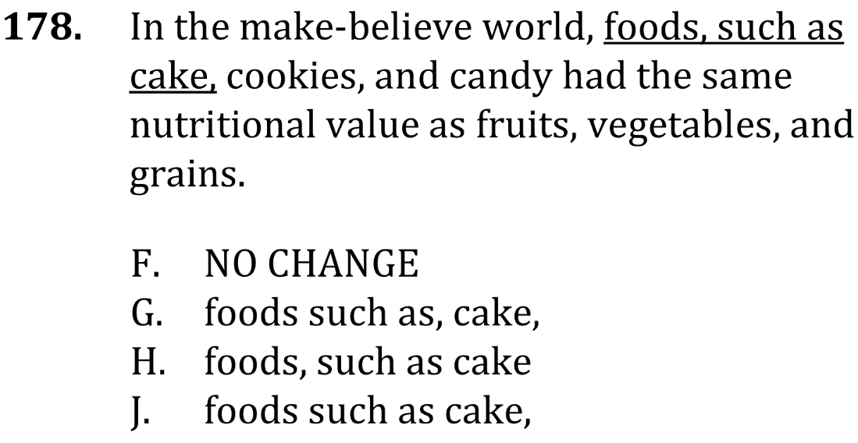
Delete unnecessary commas

Slide 3
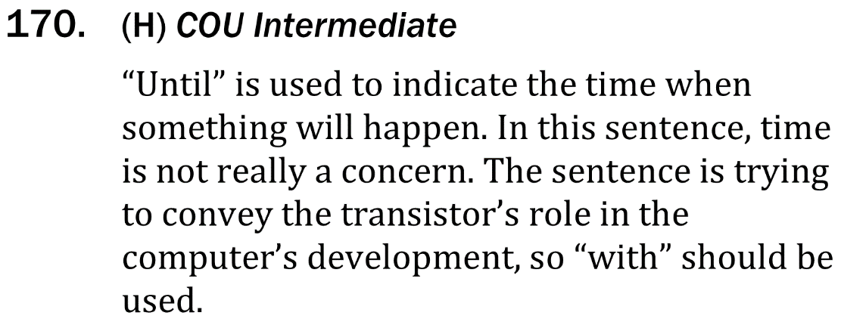
Delete unnecessary commas

Slide 4
Delete unnecessary commas

