Slide 1
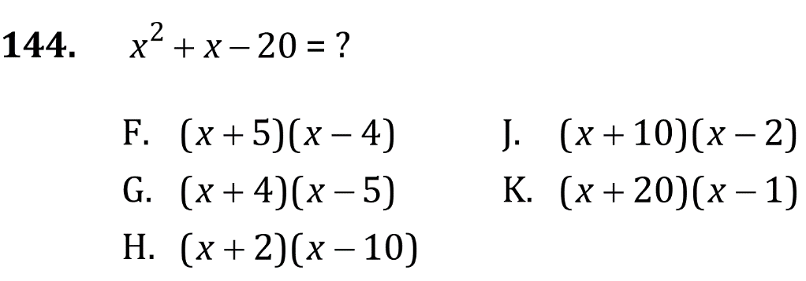
Factoring

Slide 2
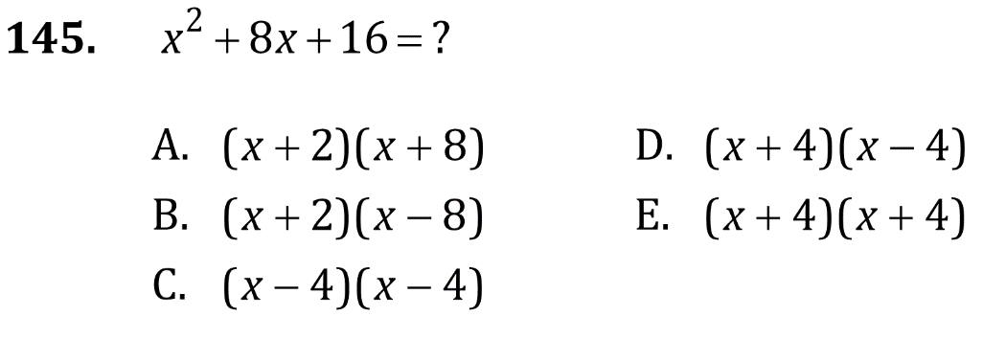
Factoring

Slide 3
Factoring

Slide 4
Factoring

Slide 5
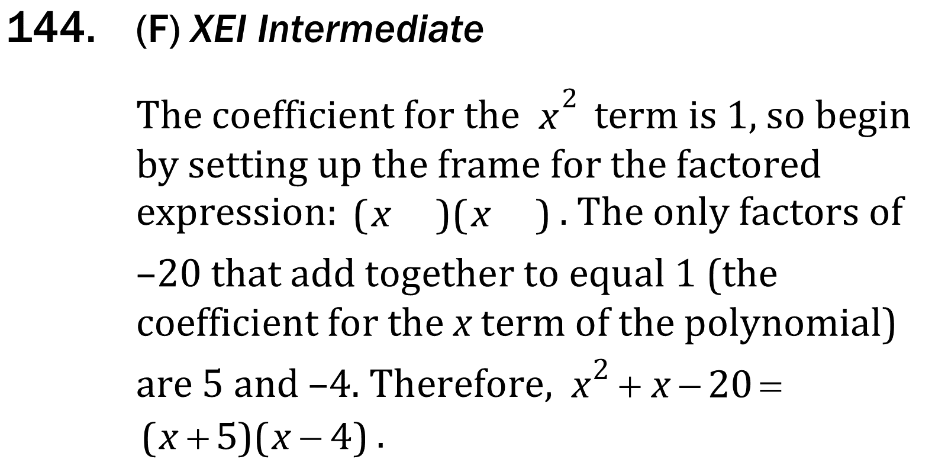
Factoring

Slide 6
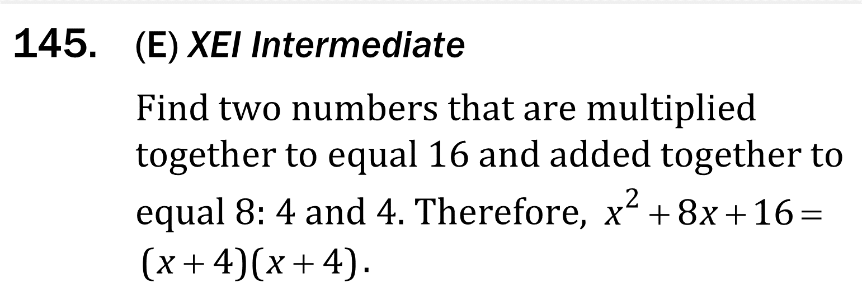
Factoring

Slide 7
Factoring

Slide 8
Factoring

