Slide 1
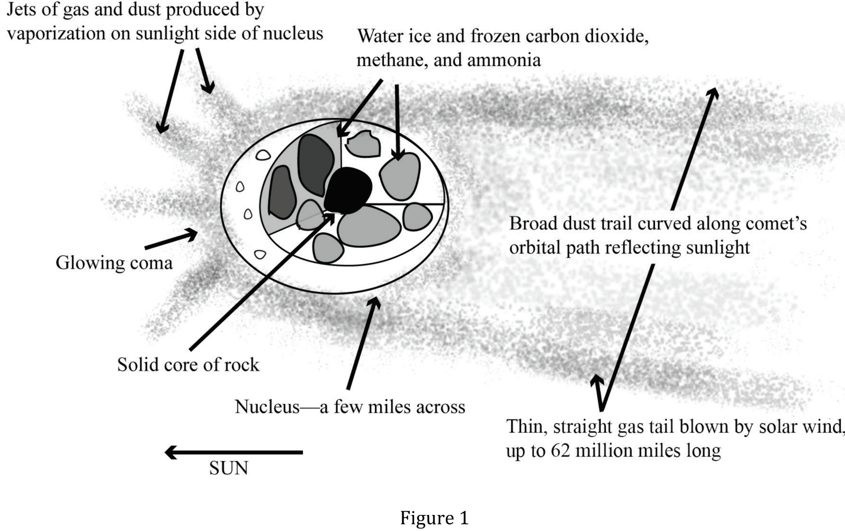
Notes:
Read and interpret data in more complex data presentations; Identify key issues or assumptions in a model. Level: Advanced Skill Group: Interpretation of Data

Slide 2
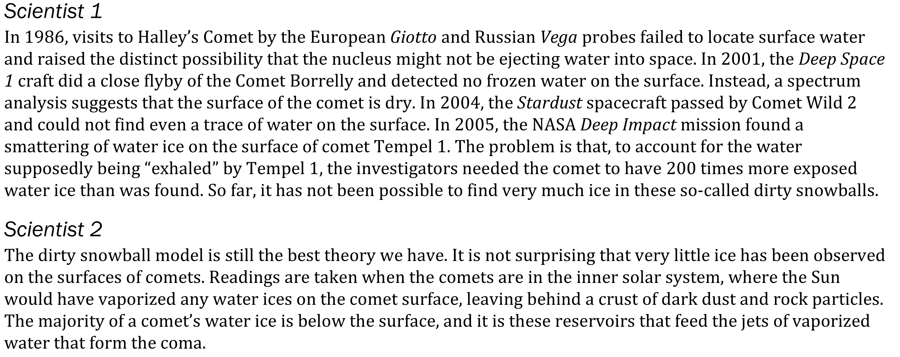
Notes:
Read and interpret data in more complex data presentations; Identify key issues or assumptions in a model. Level: Advanced Skill Group: Interpretation of Data

Slide 3
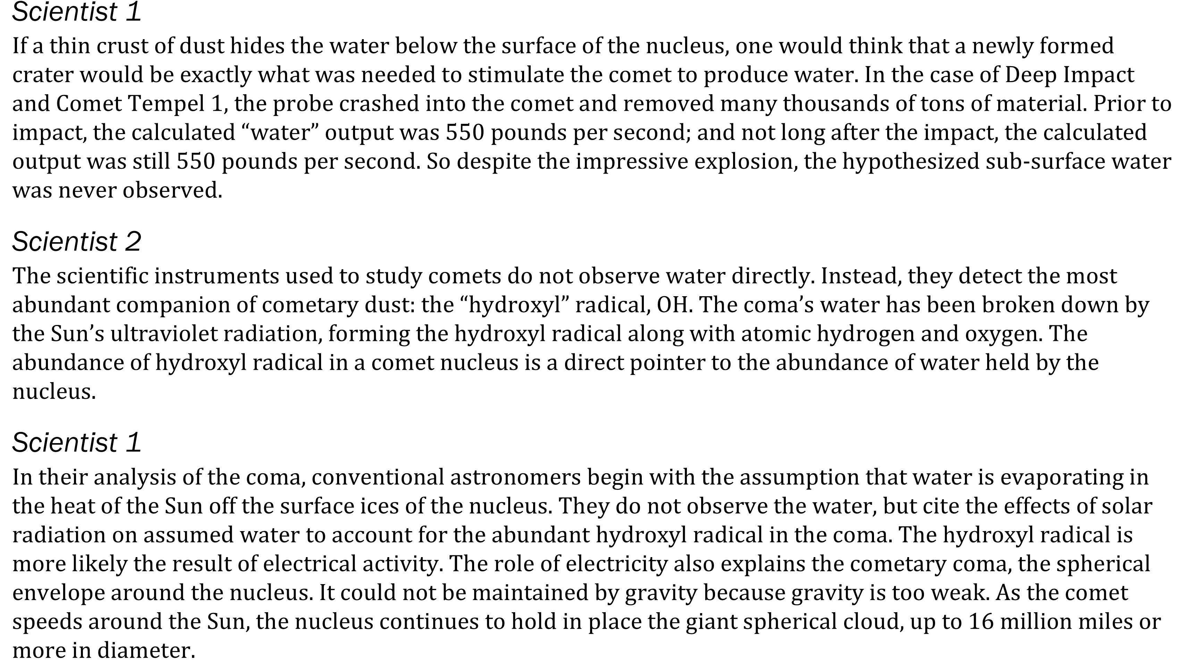
Notes:
Read and interpret data in more complex data presentations; Identify key issues or assumptions in a model. Level: Advanced Skill Group: Interpretation of Data

Slide 4
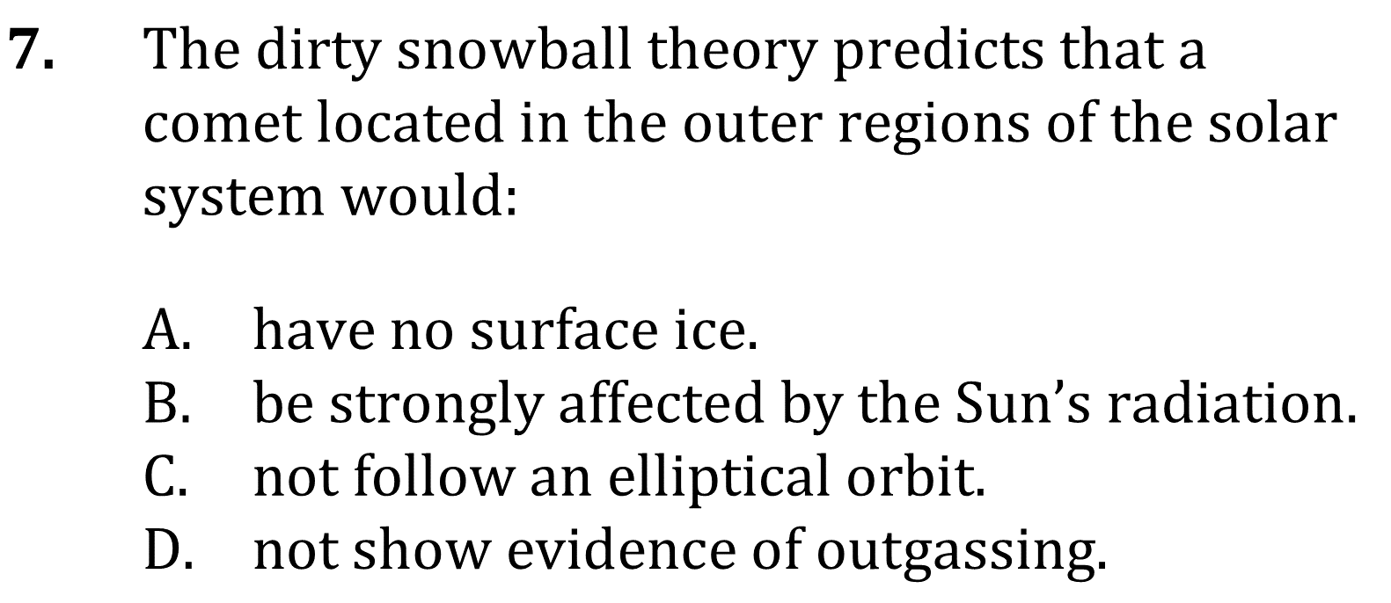
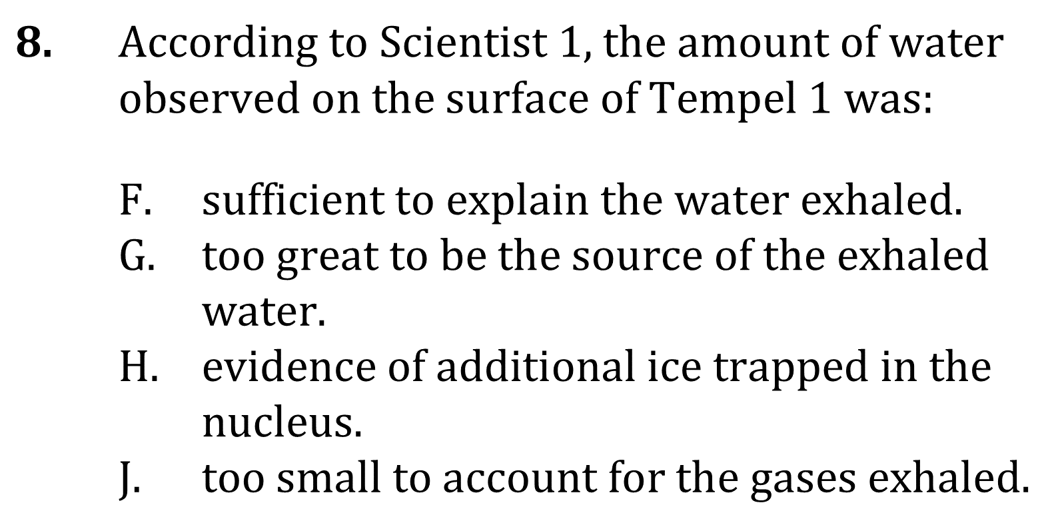
Notes:
Read and interpret data in more complex data presentations; Identify key issues or assumptions in a model. Level: Advanced Skill Group: Interpretation of Data

Slide 5
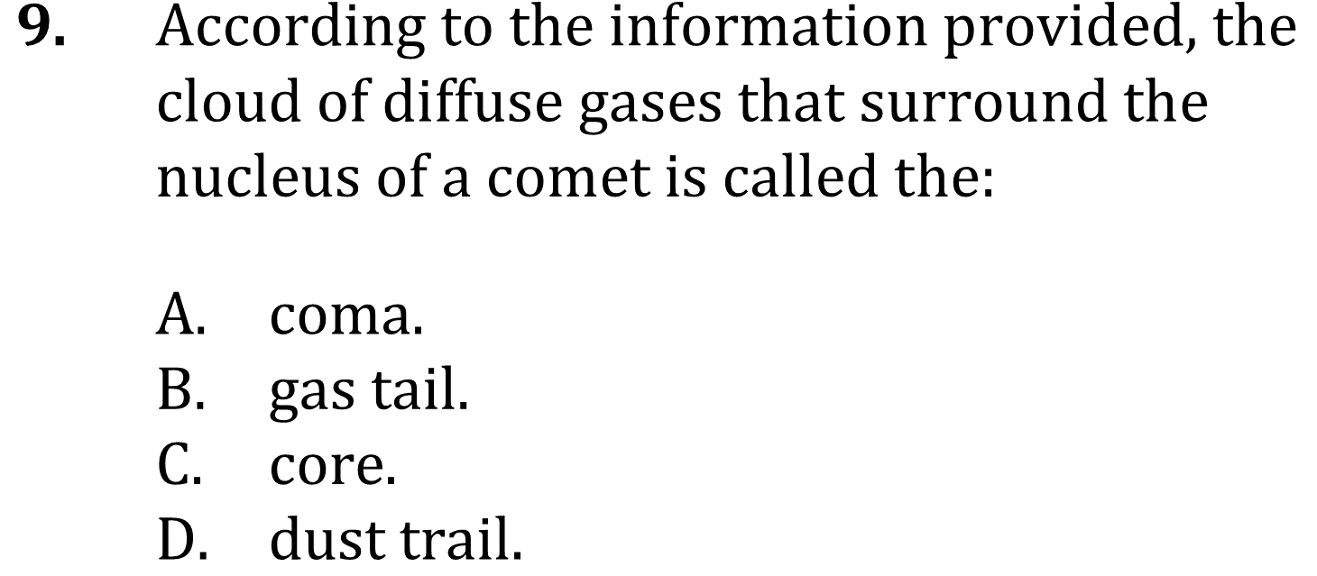
Notes:
Read and interpret data in more complex data presentations; Identify key issues or assumptions in a model. Level: Advanced Skill Group: Interpretation of Data

Slide 6
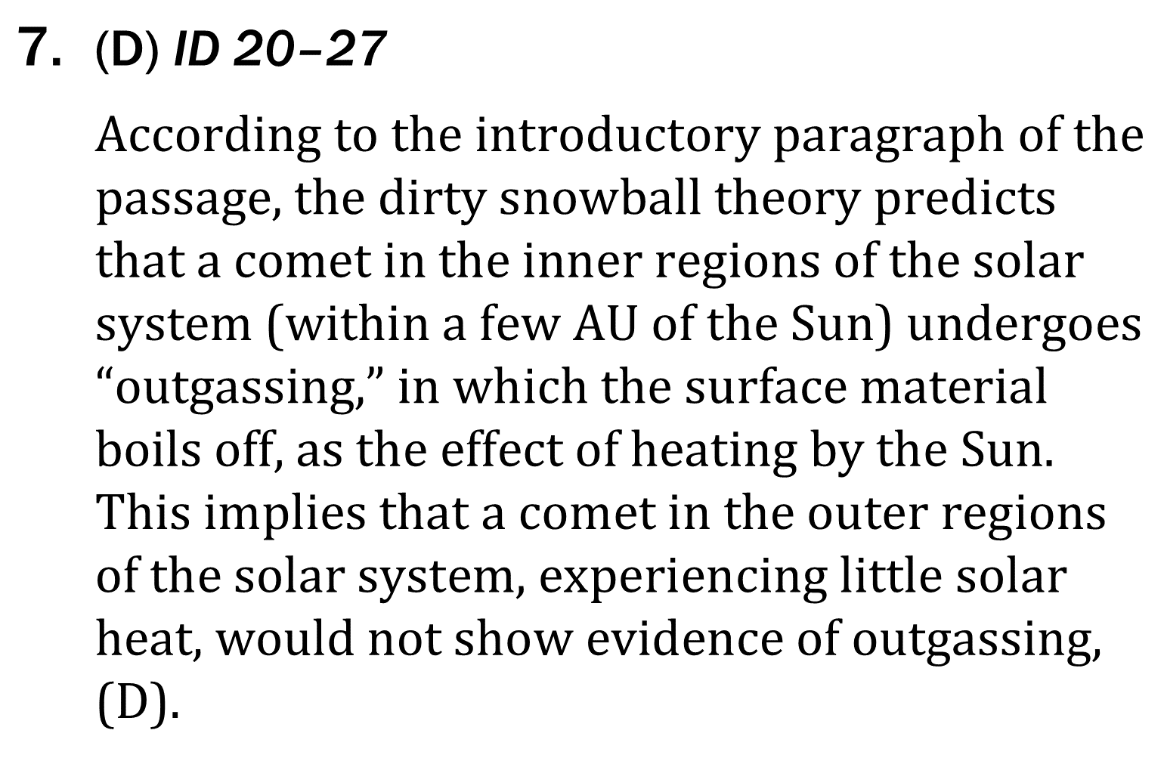
ID Advanced
Notes:
Read and interpret data in more complex data presentations; Identify key issues or assumptions in a model. Level: Advanced Skill Group: Interpretation of Data

Slide 7
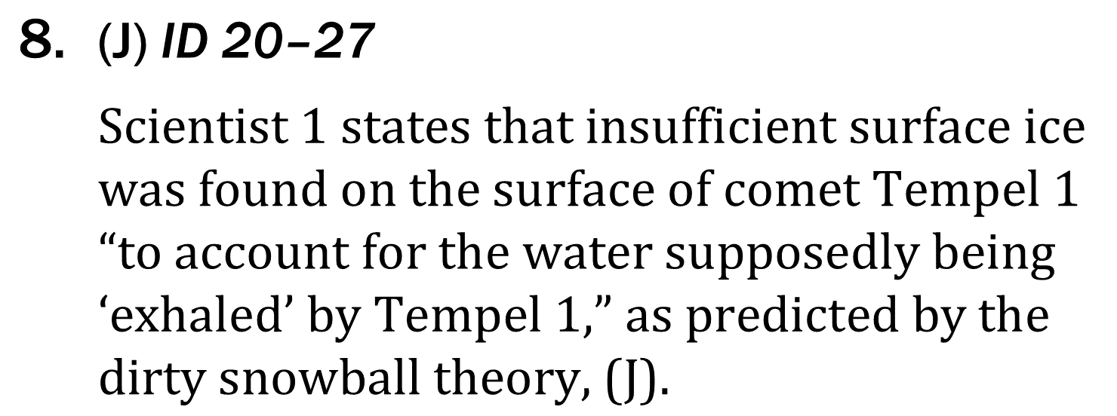
ID Advanced
Notes:
Read and interpret data in more complex data presentations; Identify key issues or assumptions in a model. Level: Advanced Skill Group: Interpretation of Data

Slide 8
ID Advanced
Notes:
Read and interpret data in more complex data presentations; Identify key issues or assumptions in a model. Level: Advanced Skill Group: Interpretation of Data

