Slide 1
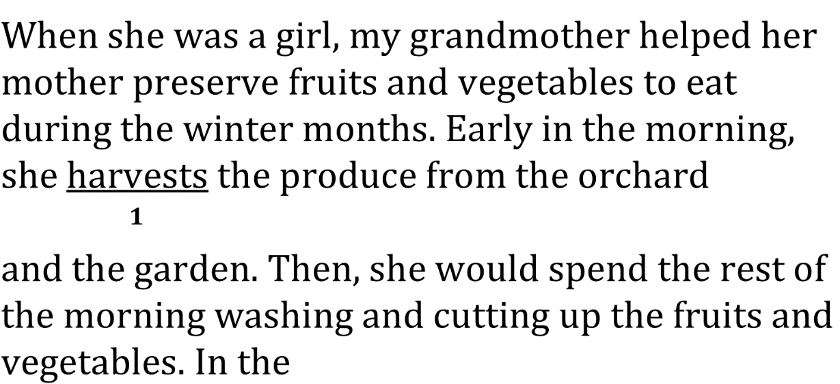
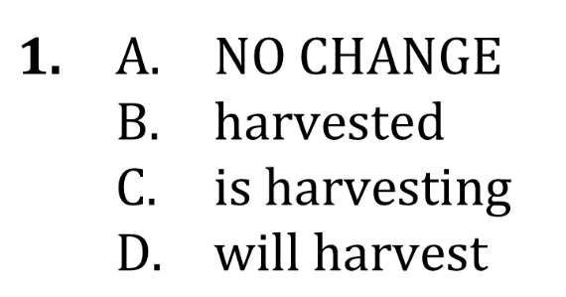
Use Correct Verb Tense and Pronoun person

Slide 2
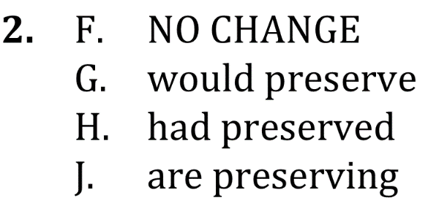
Use Correct Verb Tense and Pronoun person

Slide 3
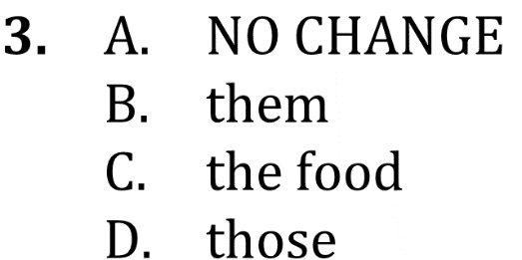
Use Correct Verb Tense and Pronoun person

Slide 4
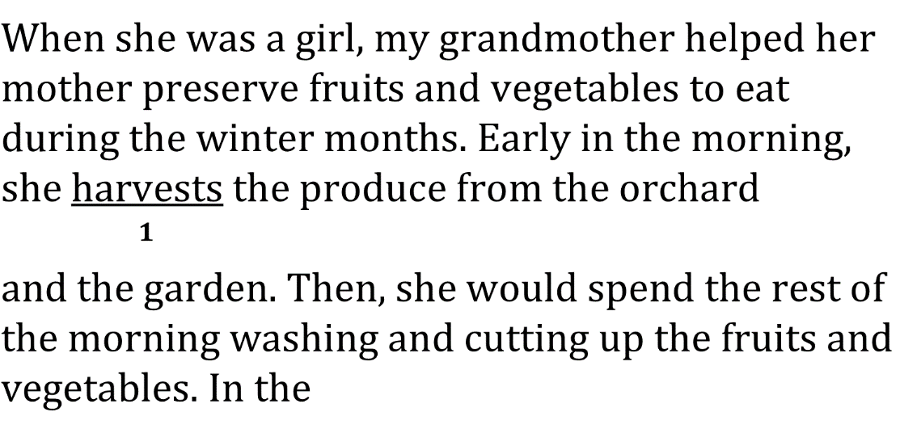
Use Correct Verb Tense and Pronoun person

Slide 5
Use Correct Verb Tense and Pronoun person

Slide 6
Use Correct Verb Tense and Pronoun person

