Slide 1
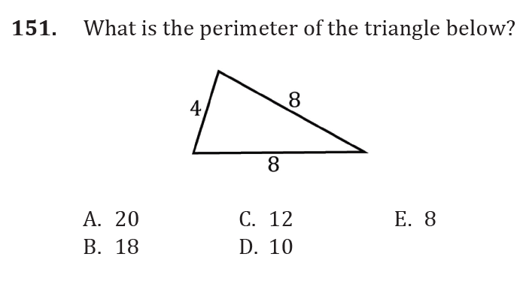
Perimeter and Area

Slide 2
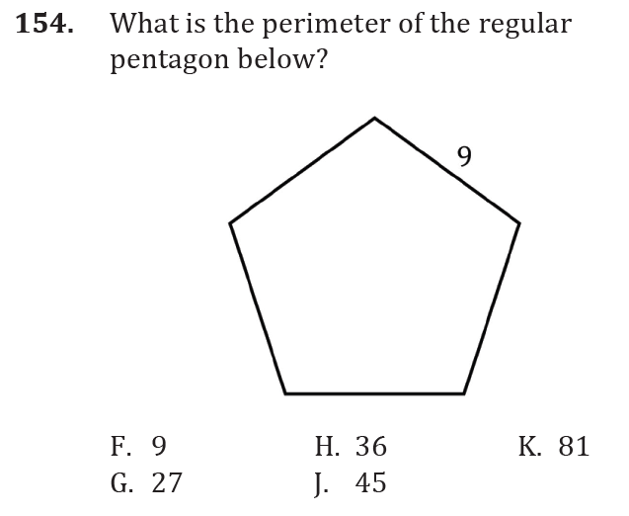
Perimeter and Area

Slide 3
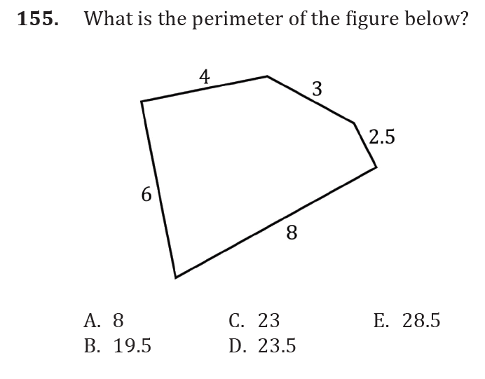
Perimeter and Area

Slide 4
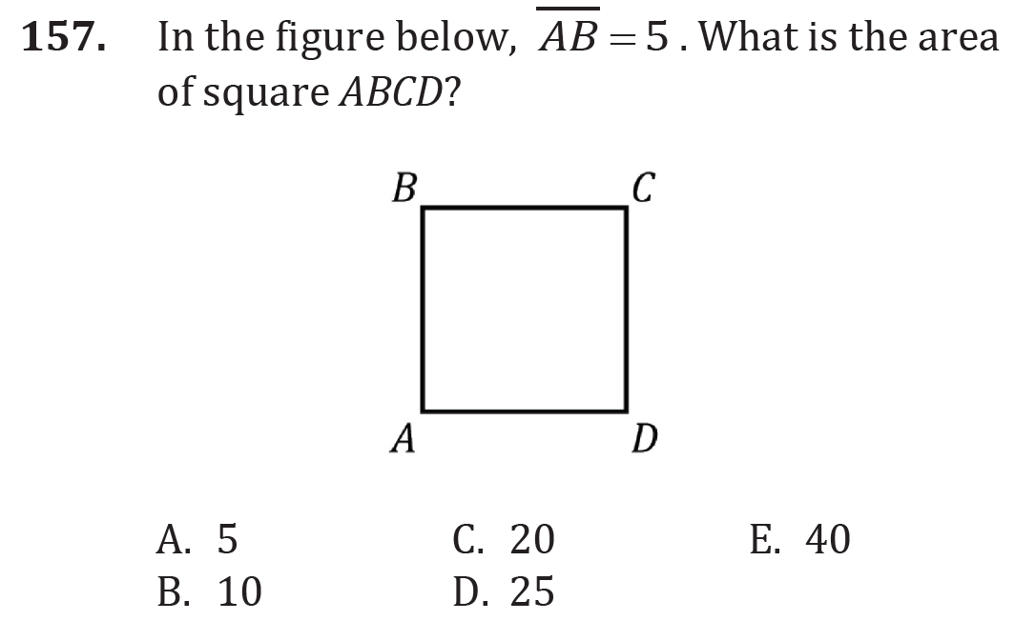
Perimeter and Area

Slide 5
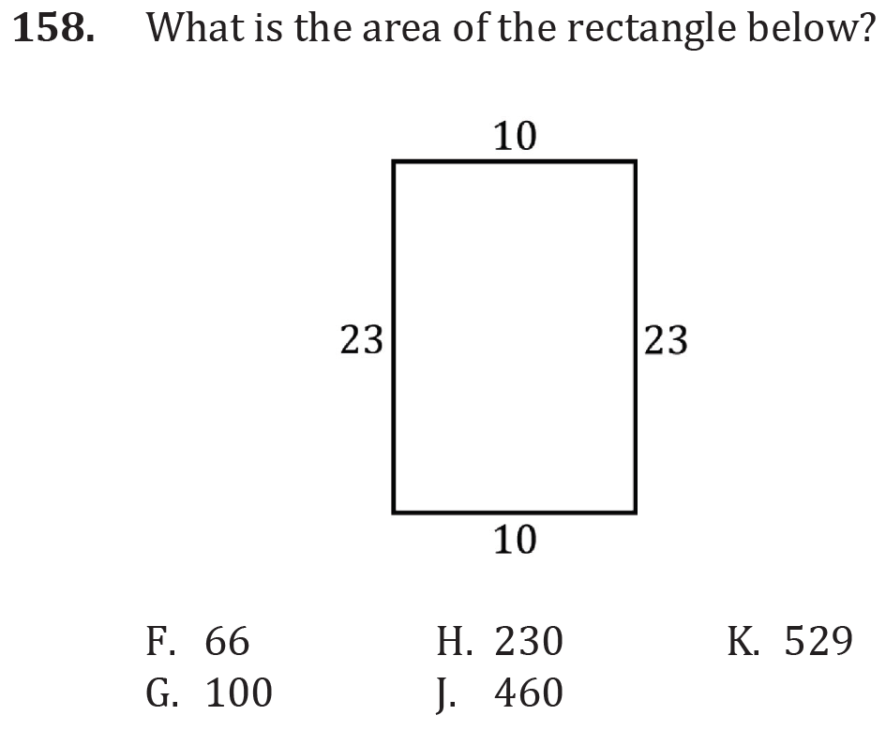
Perimeter and Area

Slide 6
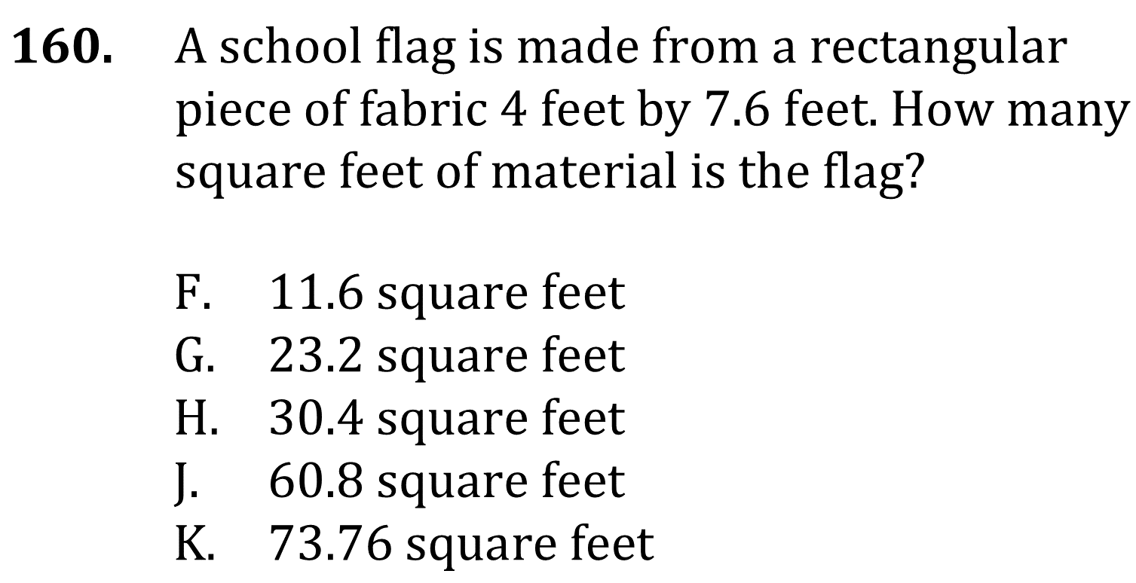
Perimeter and Area

Slide 7
Perimeter and Area

Slide 8
Perimeter and Area

Slide 9
Perimeter and Area

Slide 10
Perimeter and Area

Slide 11
Perimeter and Area

Slide 12
Perimeter and Area

