Slide 1
Notes:
Compare and contrast models; Determine whether information supports or contradicts a hypothesis or conclusion. Level: Advanced Skill Group: Interpretation of Data

Slide 2
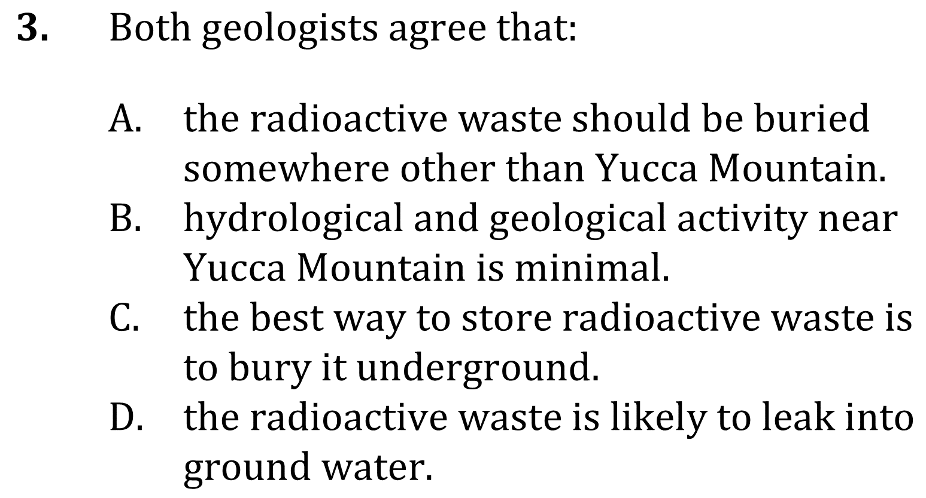
Notes:
Compare and contrast models; Determine whether information supports or contradicts a hypothesis or conclusion. Level: Advanced Skill Group: Interpretation of Data

Slide 3
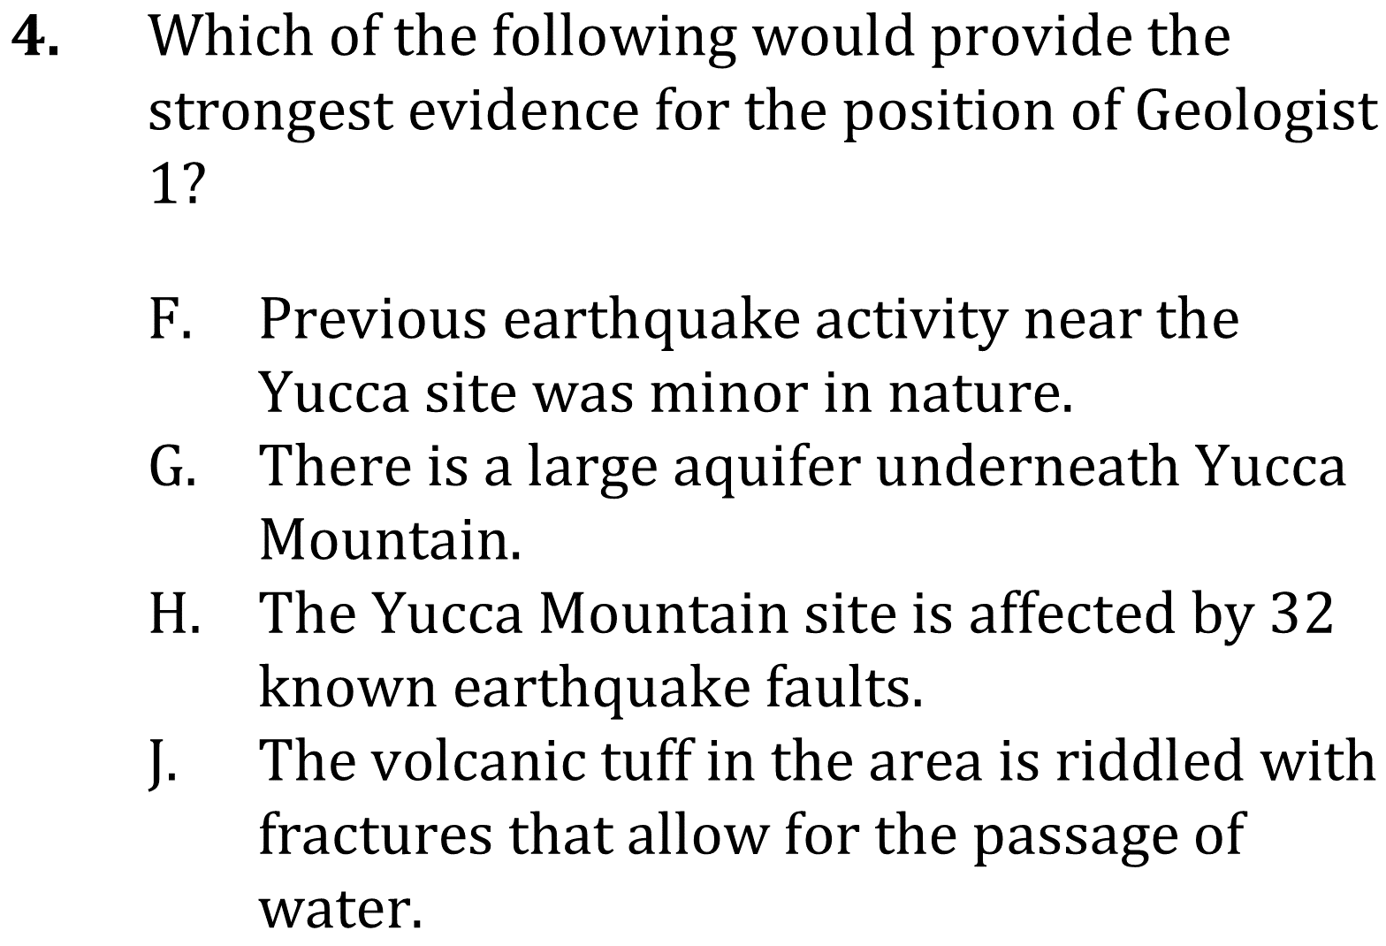
Notes:
Compare and contrast models; Determine whether information supports or contradicts a hypothesis or conclusion. Level: Advanced Skill Group: Interpretation of Data

Slide 4
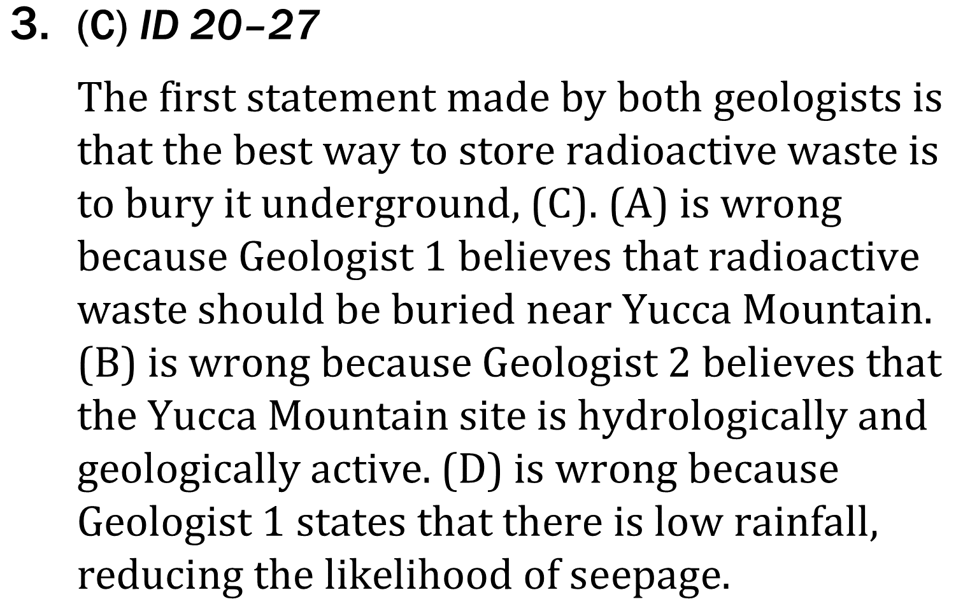
ID Advanced
Notes:
Compare and contrast models; Determine whether information supports or contradicts a hypothesis or conclusion. Level: Advanced Skill Group: Interpretation of Data

Slide 5
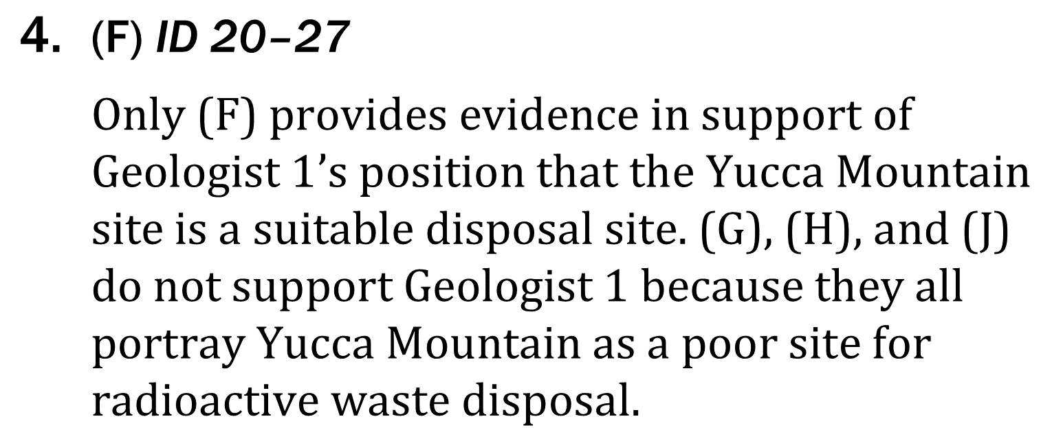
ID Advanced
Notes:
Compare and contrast models; Determine whether information supports or contradicts a hypothesis or conclusion. Level: Advanced Skill Group: Interpretation of Data

