Slide 1
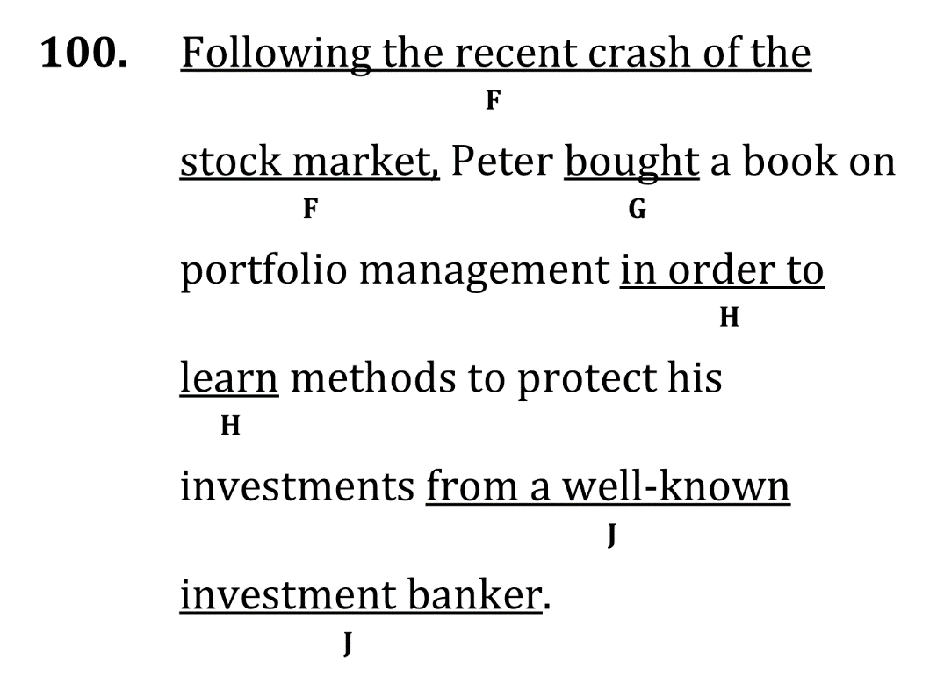
eliminate fragments and correct misplaced modifiers

Slide 2
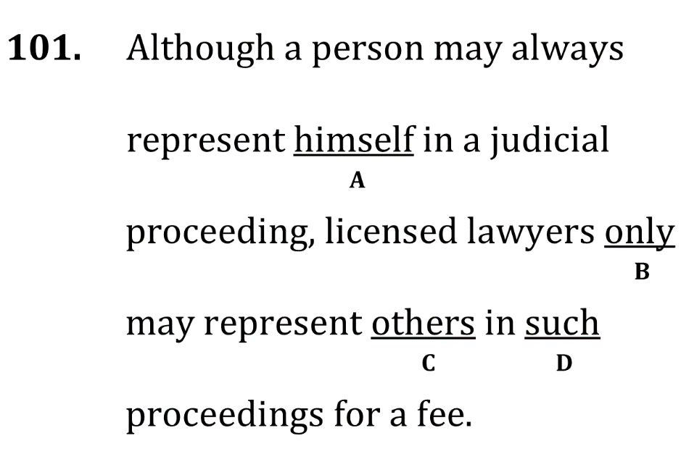
eliminate fragments and correct misplaced modifiers

Slide 3
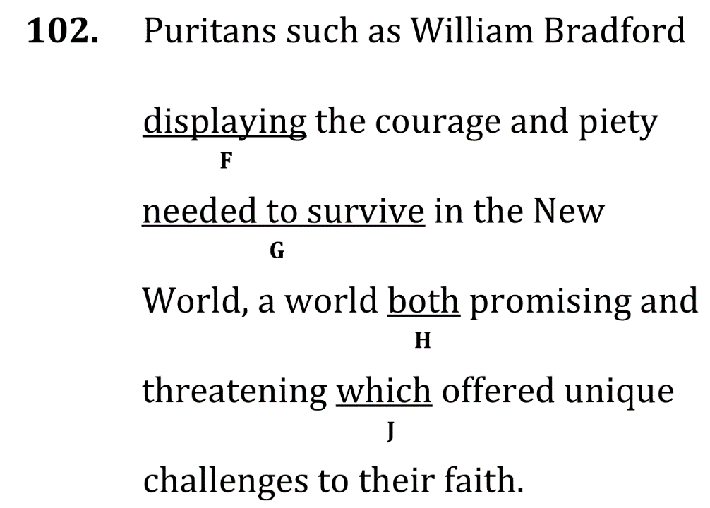
eliminate fragments and correct misplaced modifiers

Slide 4
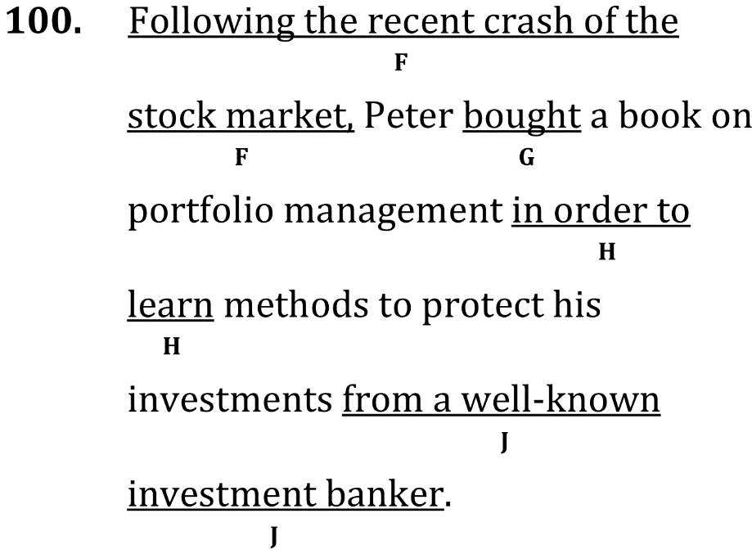
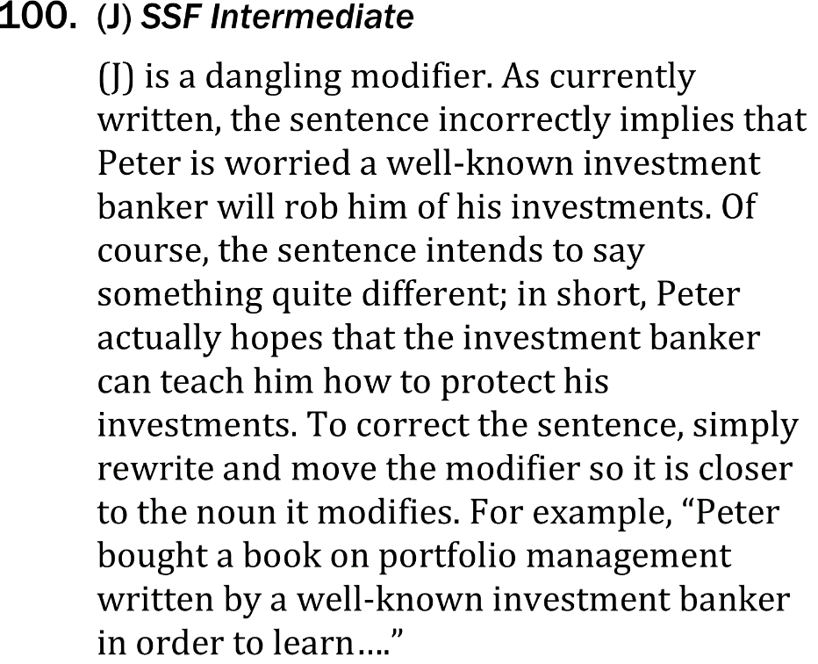
eliminate fragments and correct misplaced modifiers

Slide 5
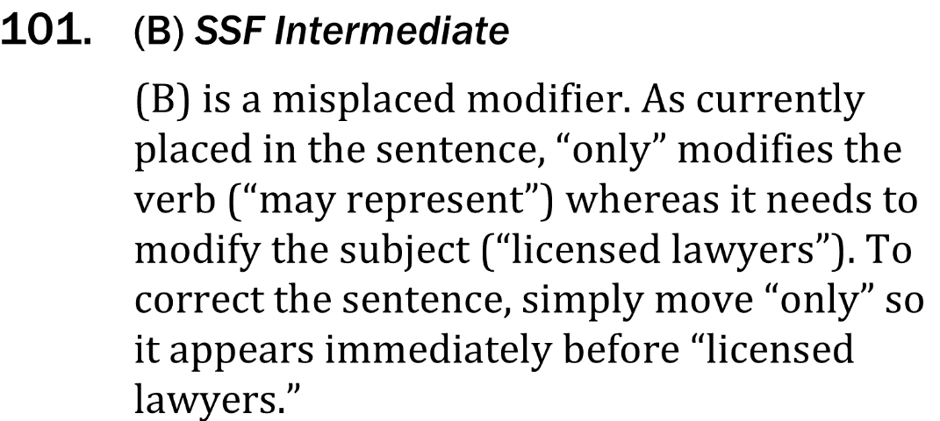
eliminate fragments and correct misplaced modifiers

Slide 6
eliminate fragments and correct misplaced modifiers

