Slide 1
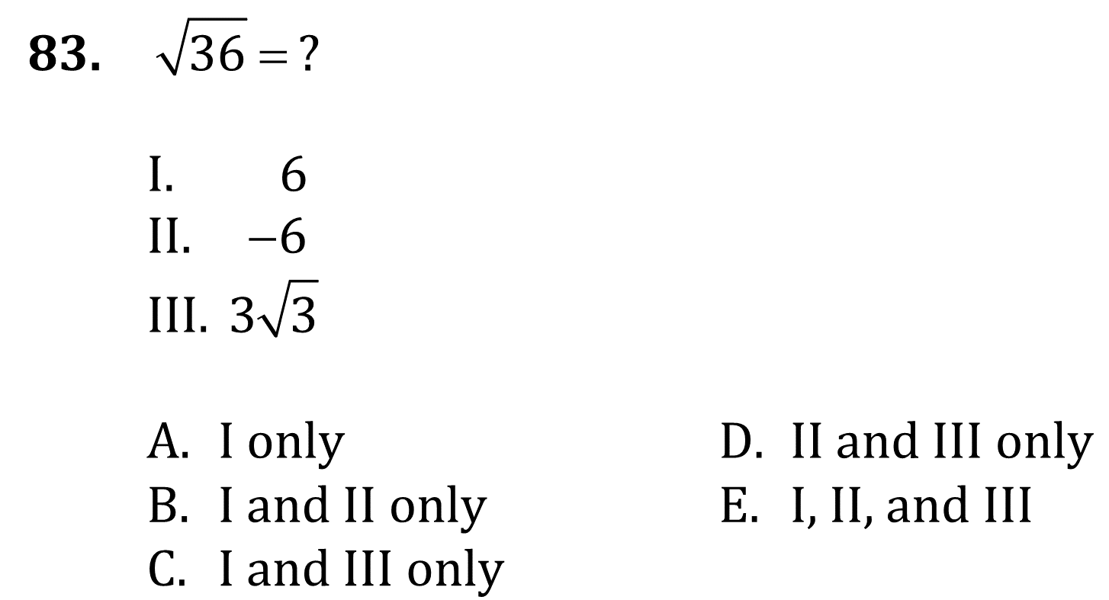
Exponents and Radicals

Slide 2
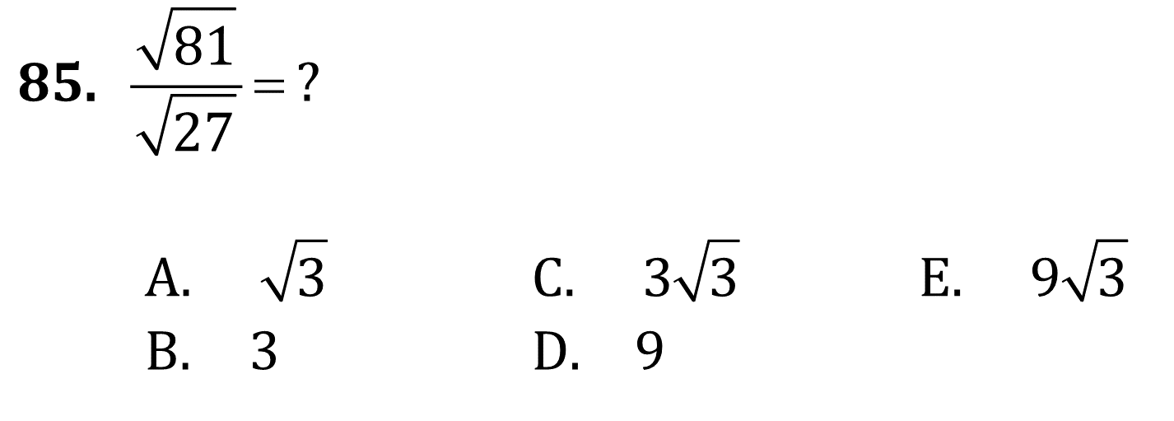
Exponents and Radicals

Slide 3
Exponents and Radicals

Slide 4
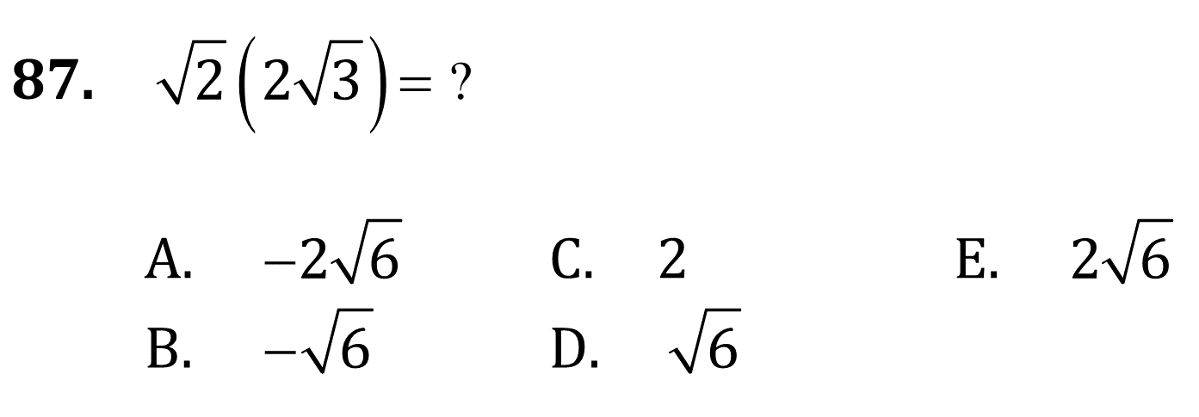
Exponents and Radicals

Slide 5
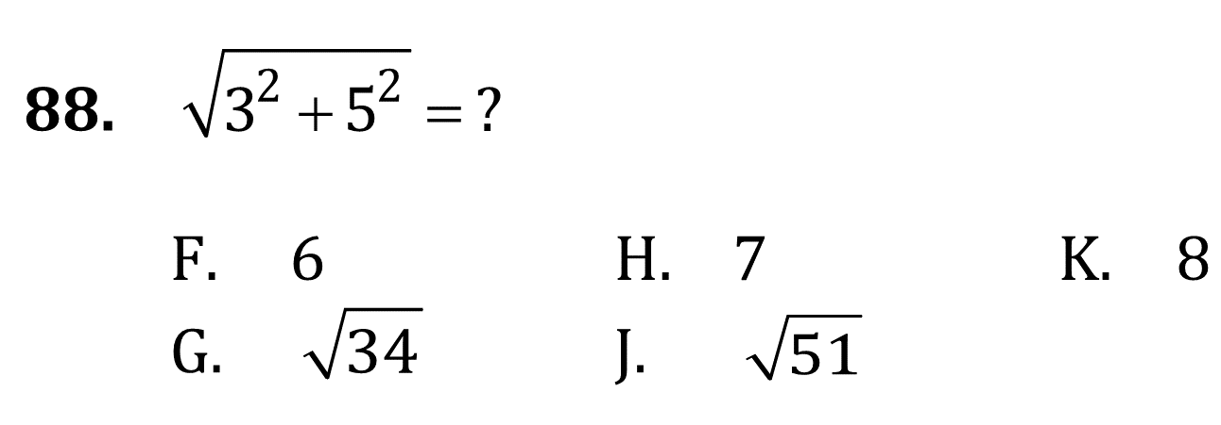
Exponents and Radicals

Slide 6
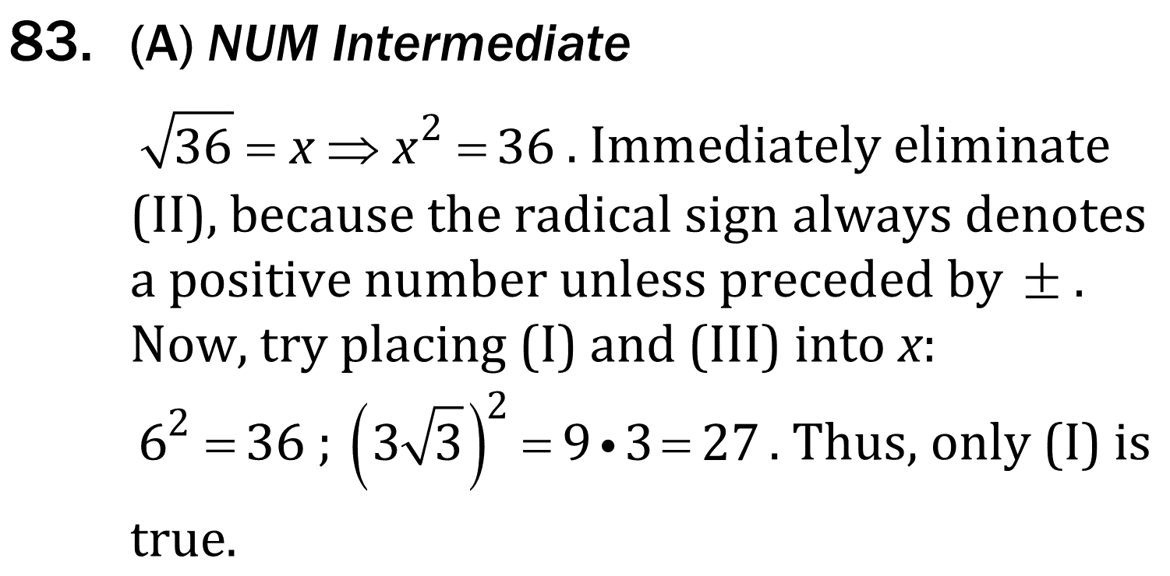
Exponents and Radicals

Slide 7
Exponents and Radicals

Slide 8
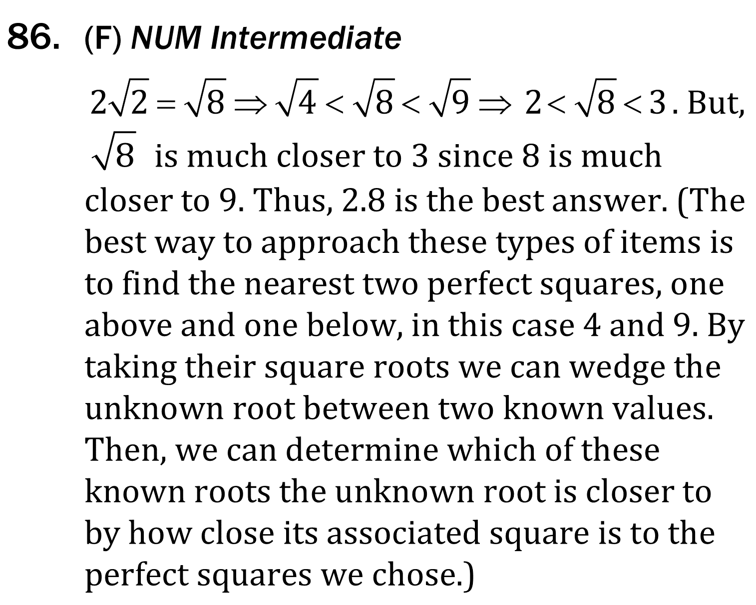
Exponents and Radicals

Slide 9
Exponents and Radicals

Slide 10
Exponents and Radicals

