Slide 1
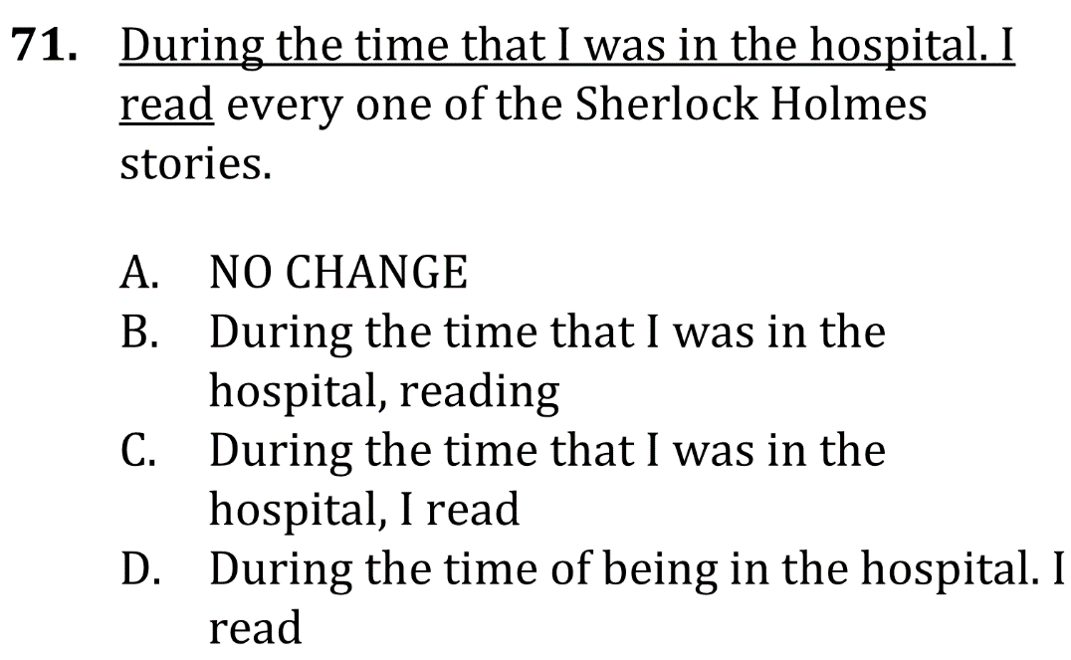
Eliminate fragments

Slide 2
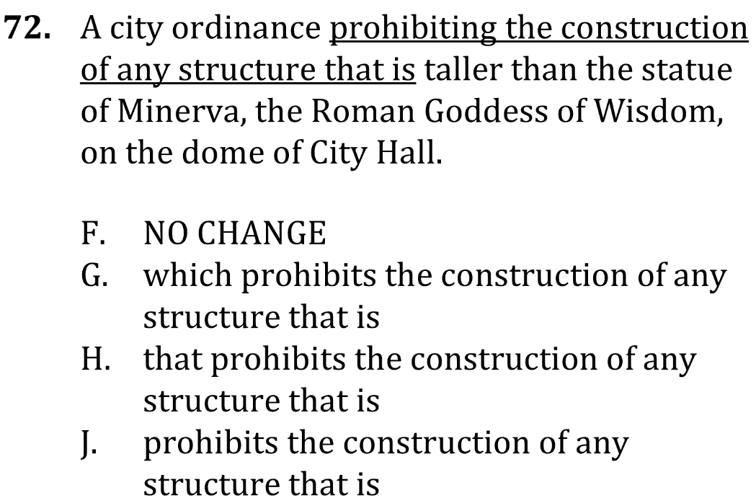
Eliminate fragments

Slide 3
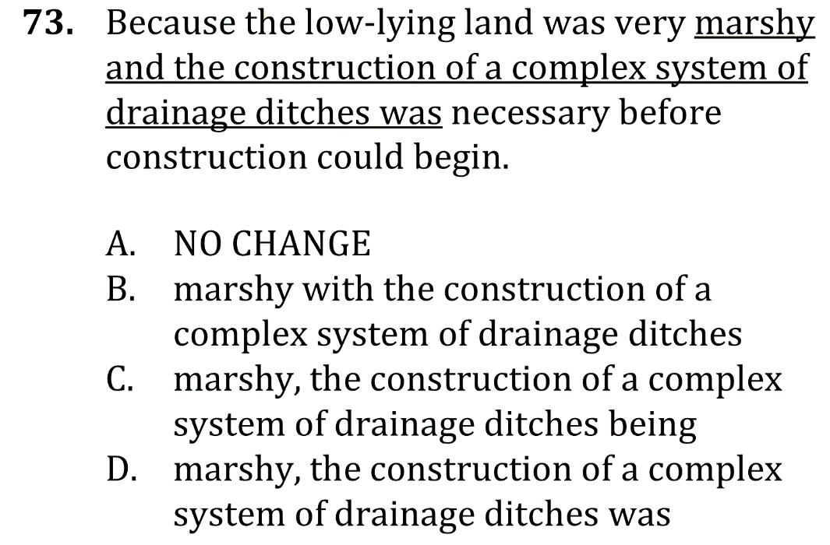
Eliminate fragments

Slide 4
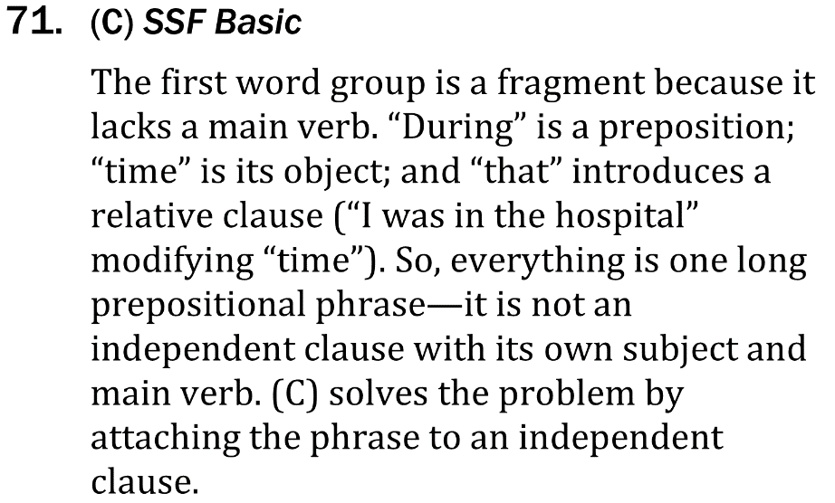
Eliminate fragments

Slide 5
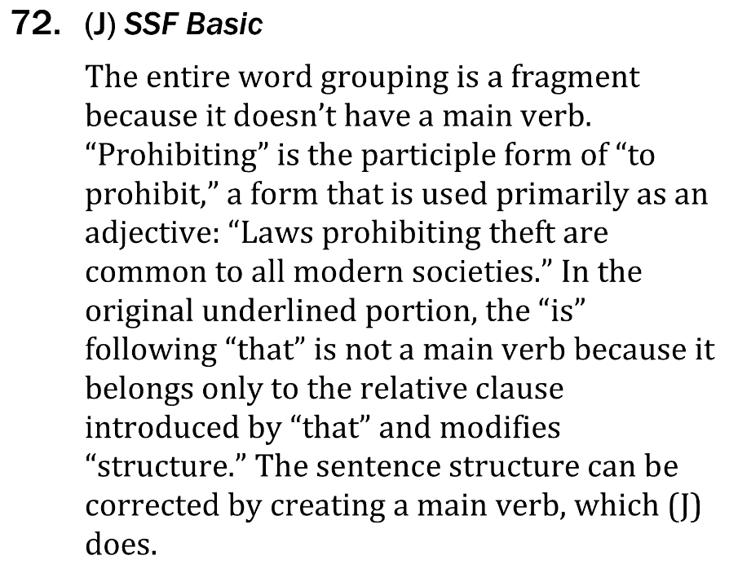
Eliminate fragments

Slide 6
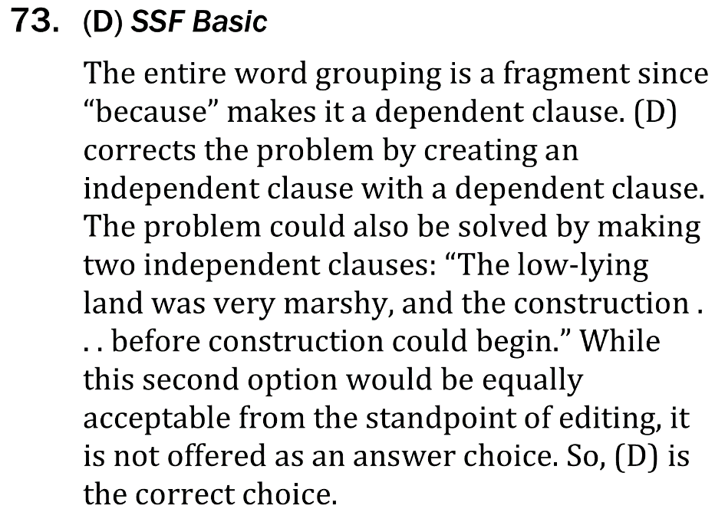
Eliminate fragments

