Slide 1
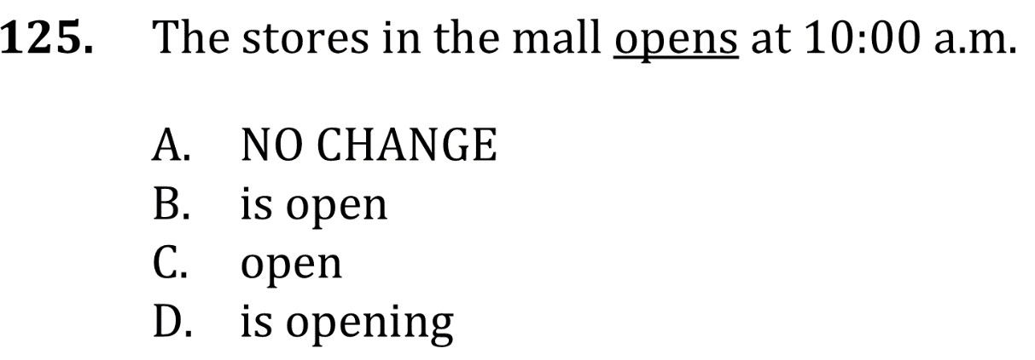
Subject-Verb Agreement

Slide 2
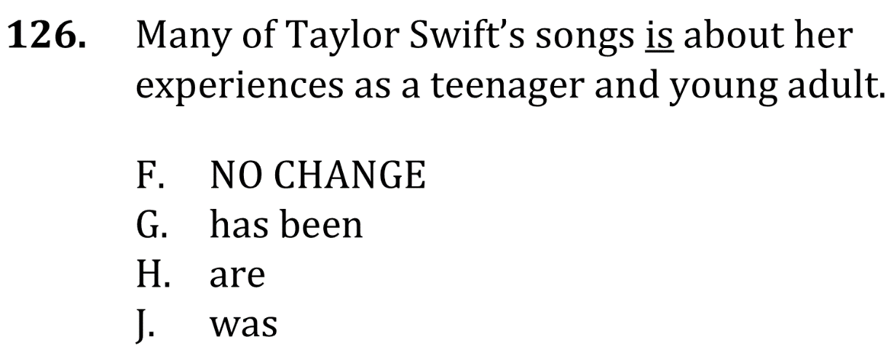
Subject-Verb Agreement

Slide 3
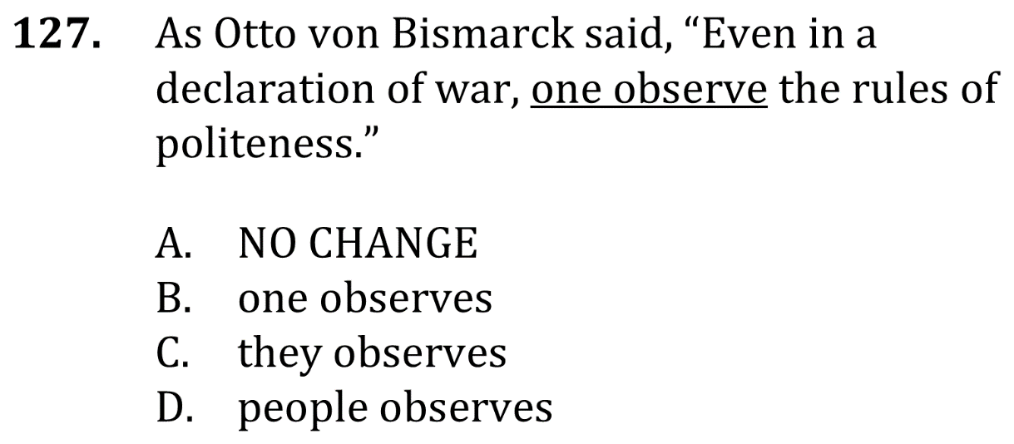
Subject-Verb Agreement

Slide 4
Subject-Verb Agreement

Slide 5
Subject-Verb Agreement

Slide 6
Subject-Verb Agreement

