Slide 2
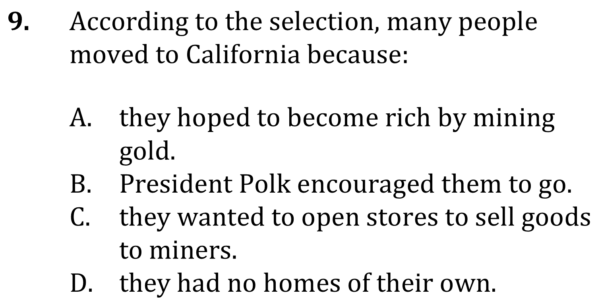
Cause and Effect

Slide 3
Cause and Effect

