Slide 1
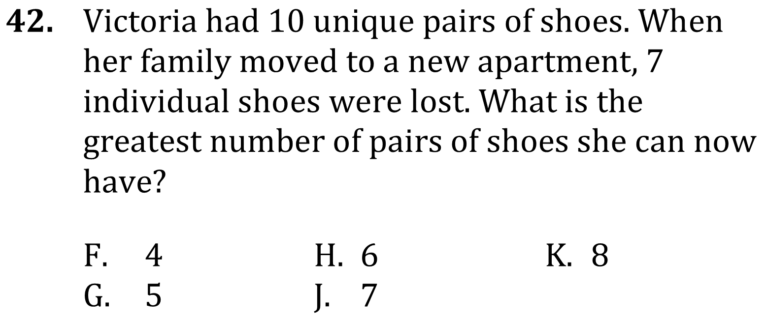
Permutations and Combinations

Slide 2
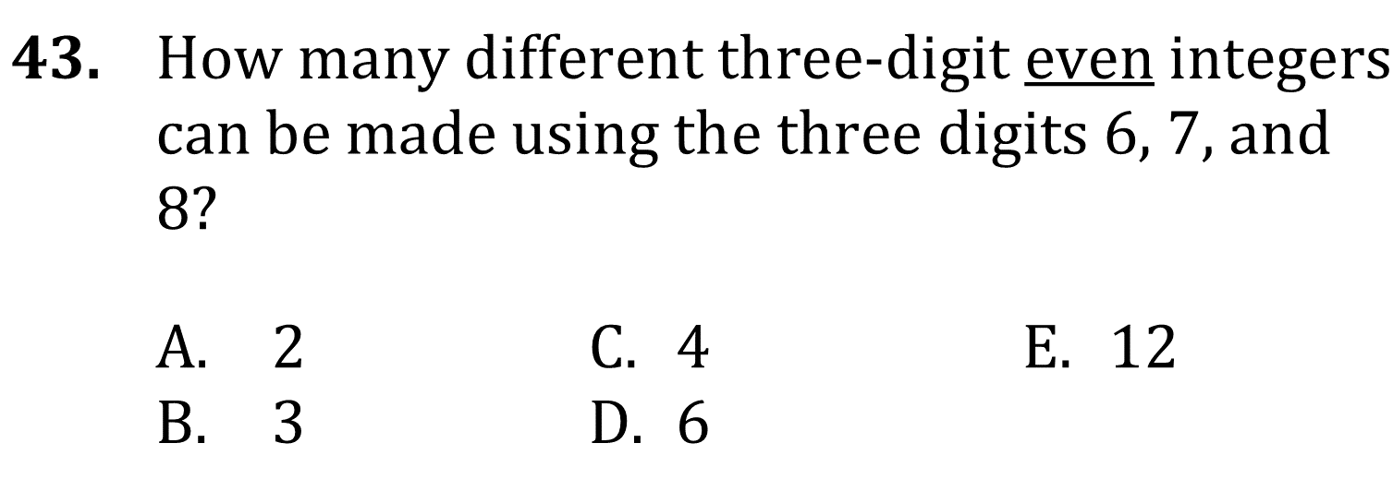
Permutations and Combinations

Slide 3
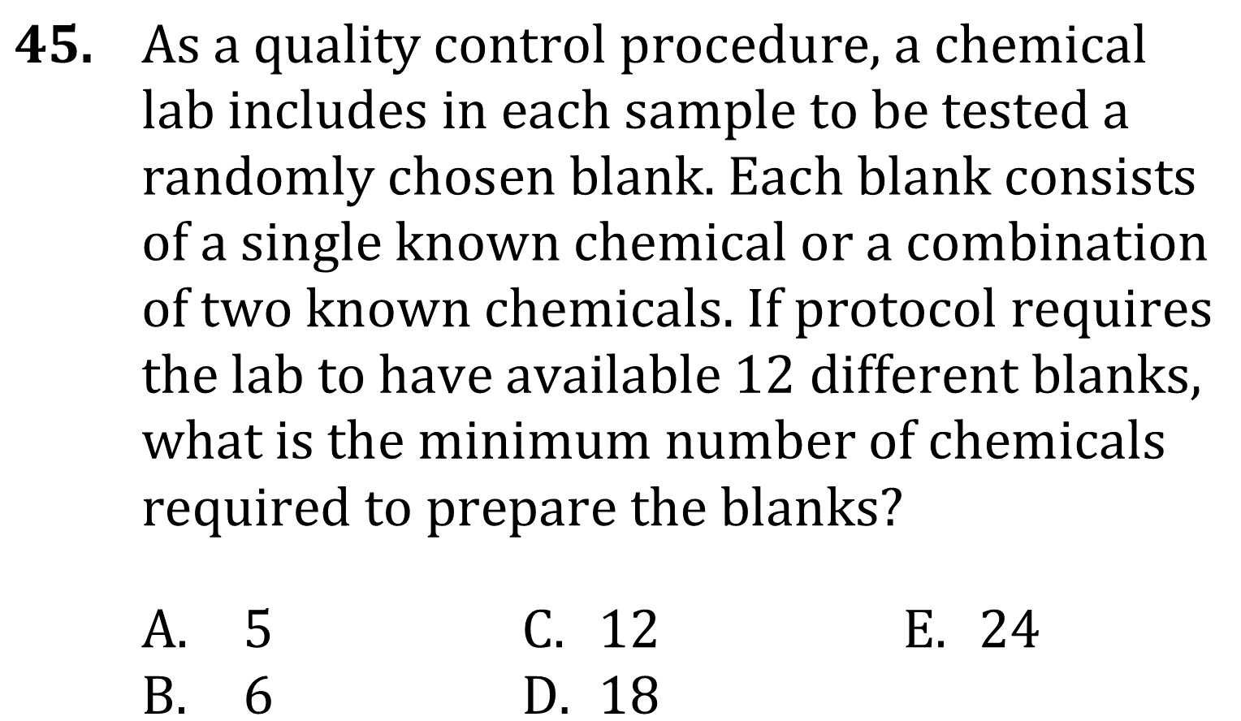
Permutations and Combinations

Slide 4
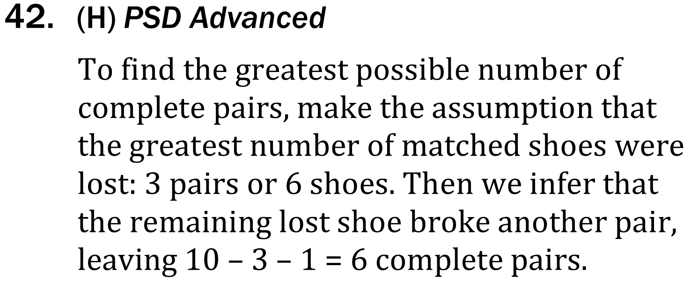
Permutations and Combinations

Slide 5
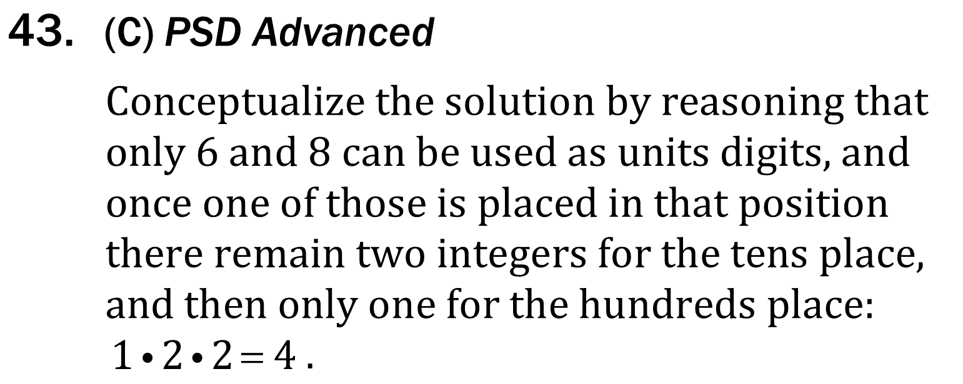
Permutations and Combinations

Slide 6
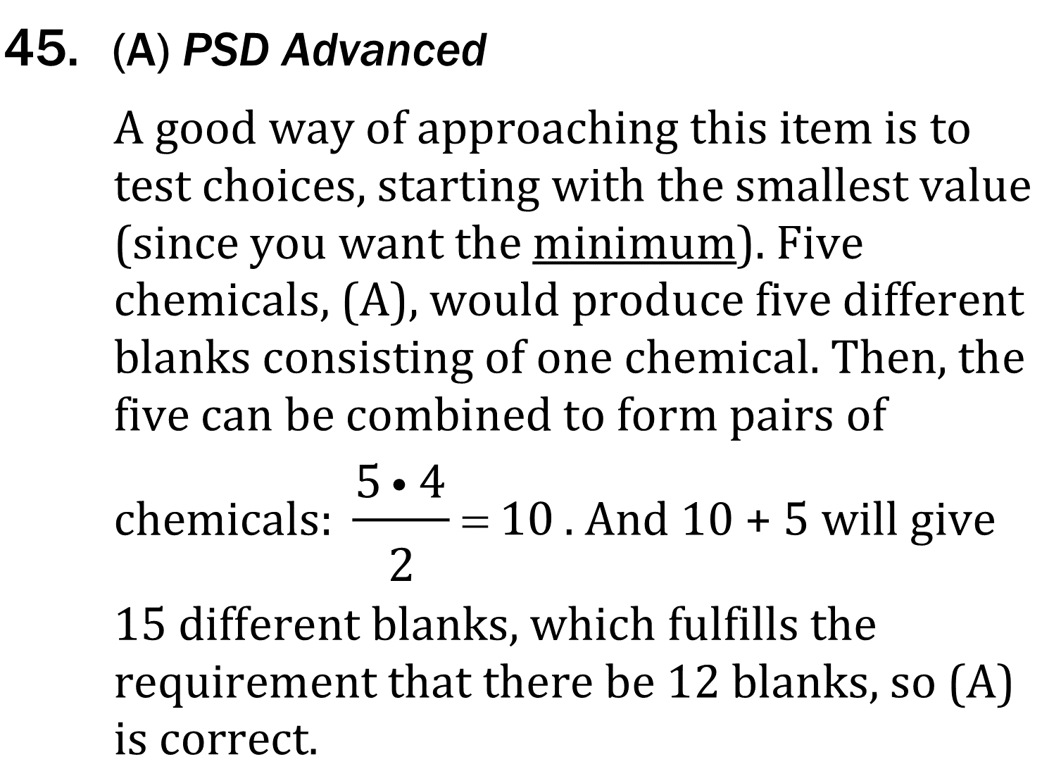
Permutations and Combinations

