Slide 1
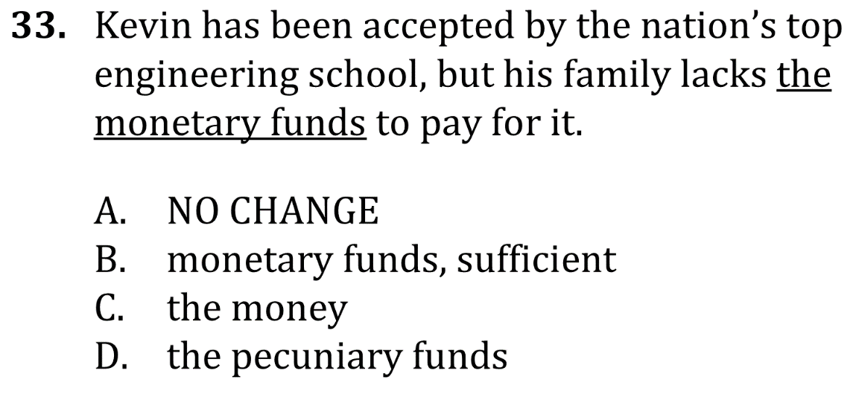
Eliminate Unnecessary Words

Slide 2
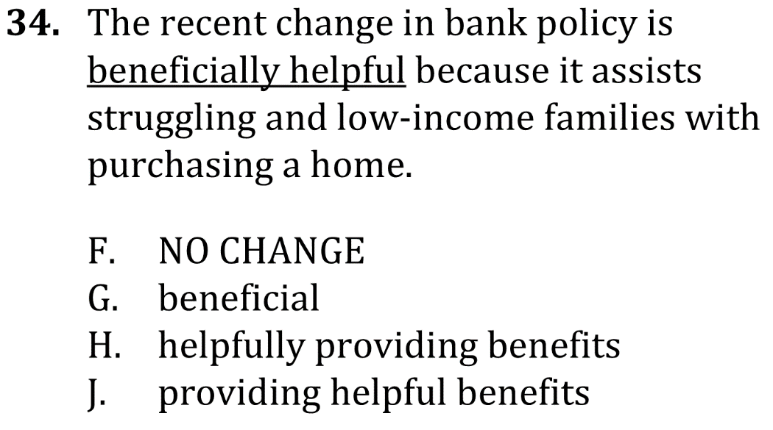
Eliminate Unnecessary Words

Slide 3
Eliminate Unnecessary Words

Slide 4
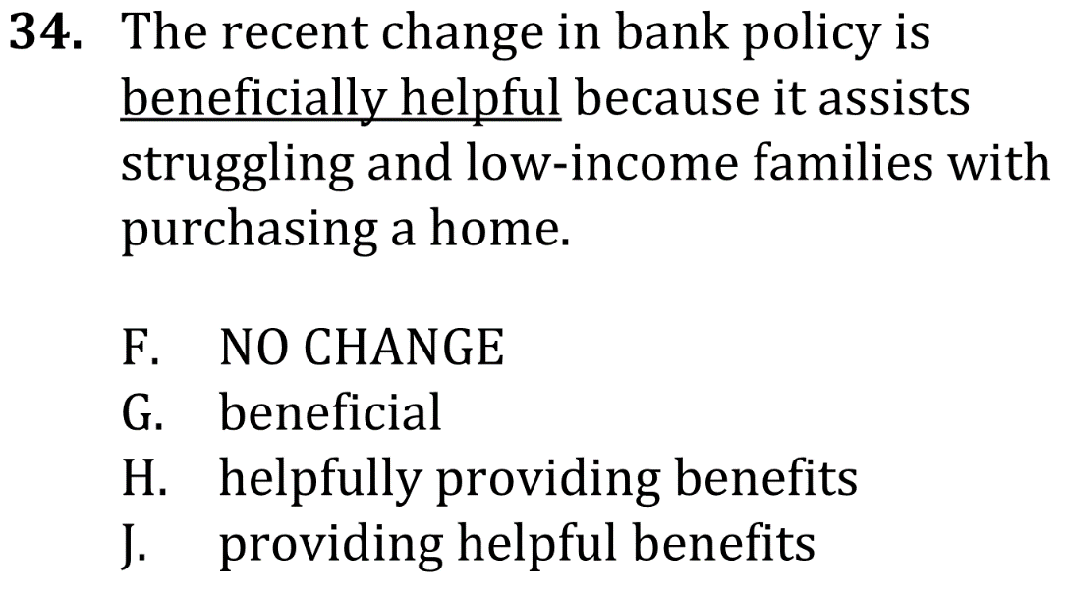
Eliminate Unnecessary Words

