Slide 1
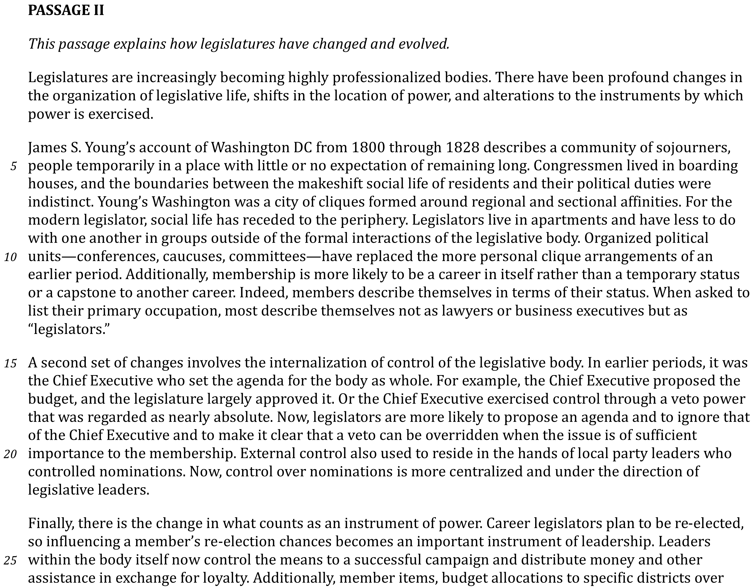

Slide 2
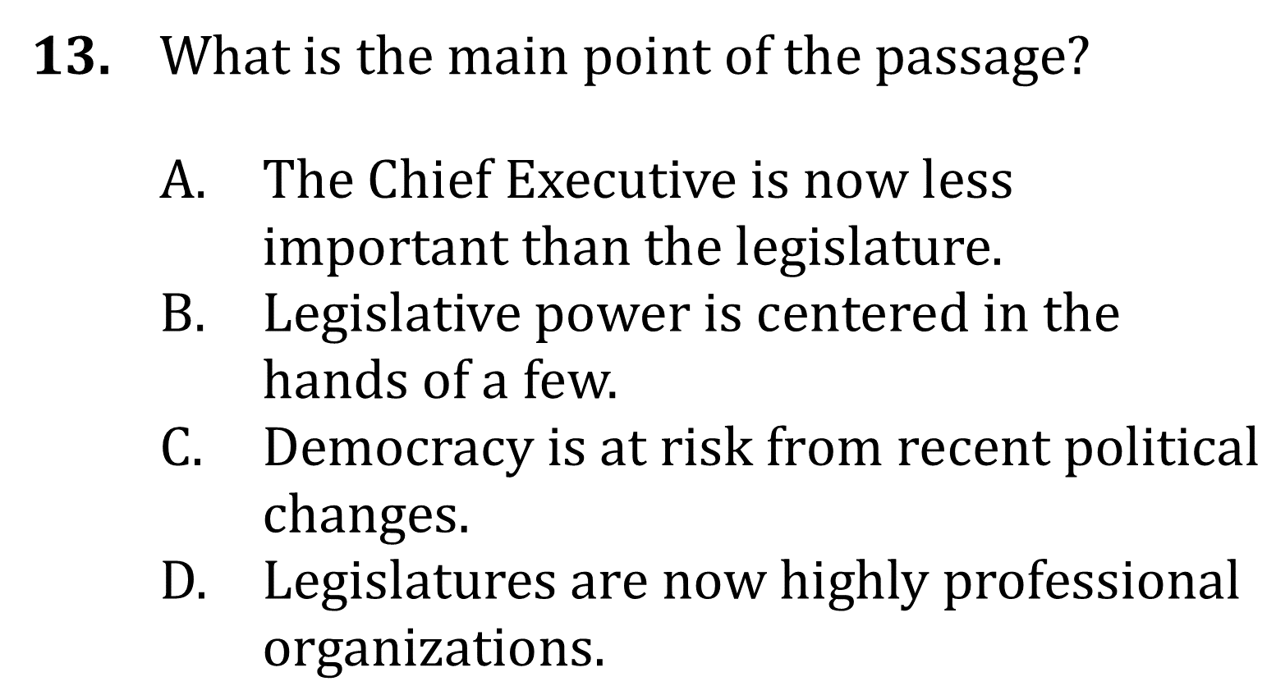
Summarize Events and ideas

Slide 3
Summarize Events and ideas

