Slide 1
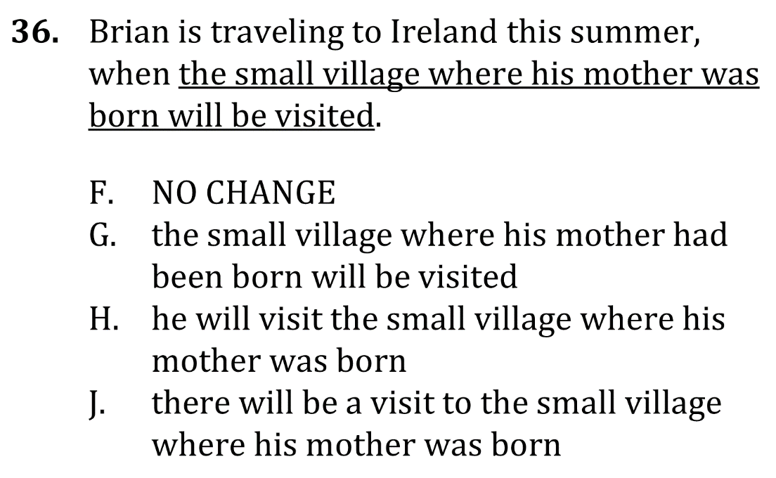
Use Correct Wording

Slide 2
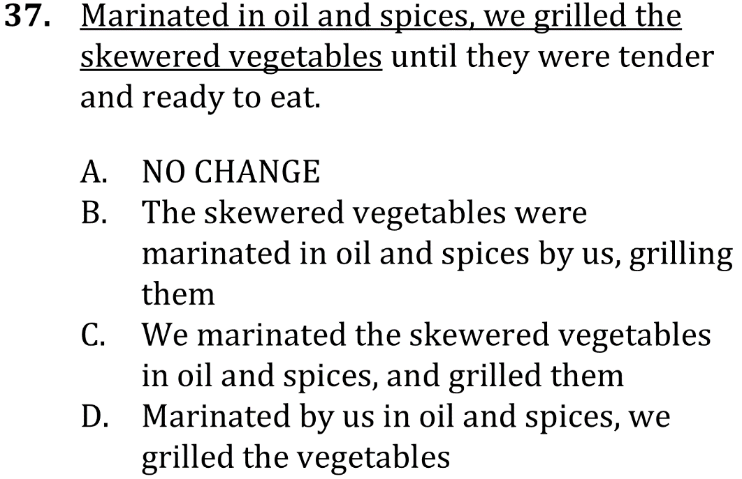
Use Correct Wording

Slide 3
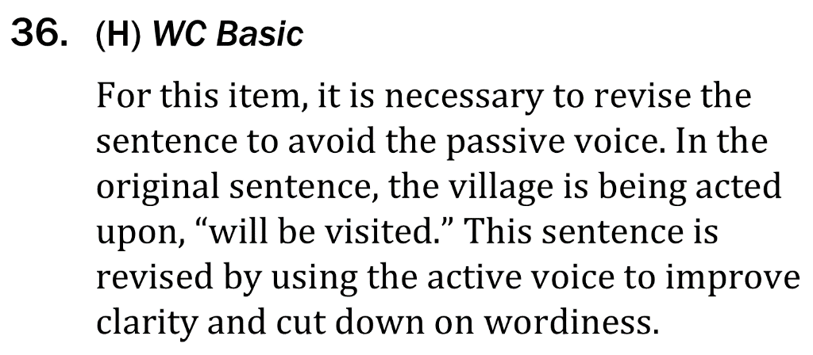
Use Correct Wording

Slide 4
Use Correct Wording

