Slide 1
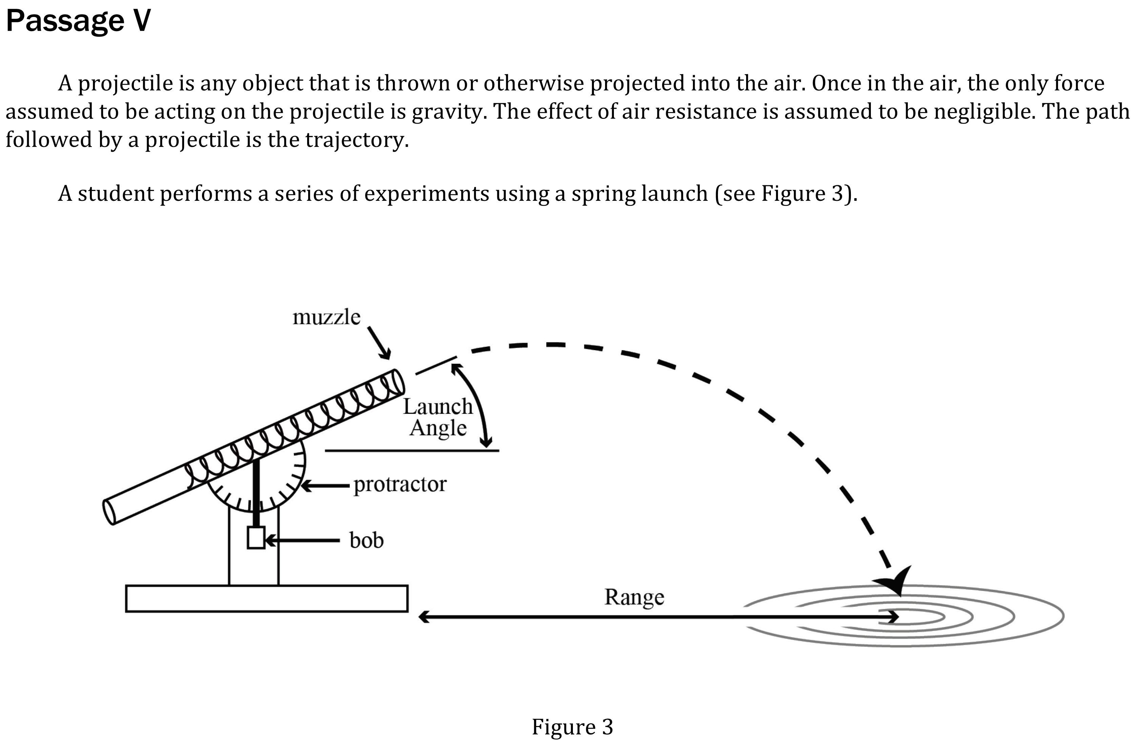
Notes:
Understand basic scientific terms; Identify a control in an experiment; Understand experimental design. Level: Intermediate Skill Group: Scientific Investigation.

Slide 2
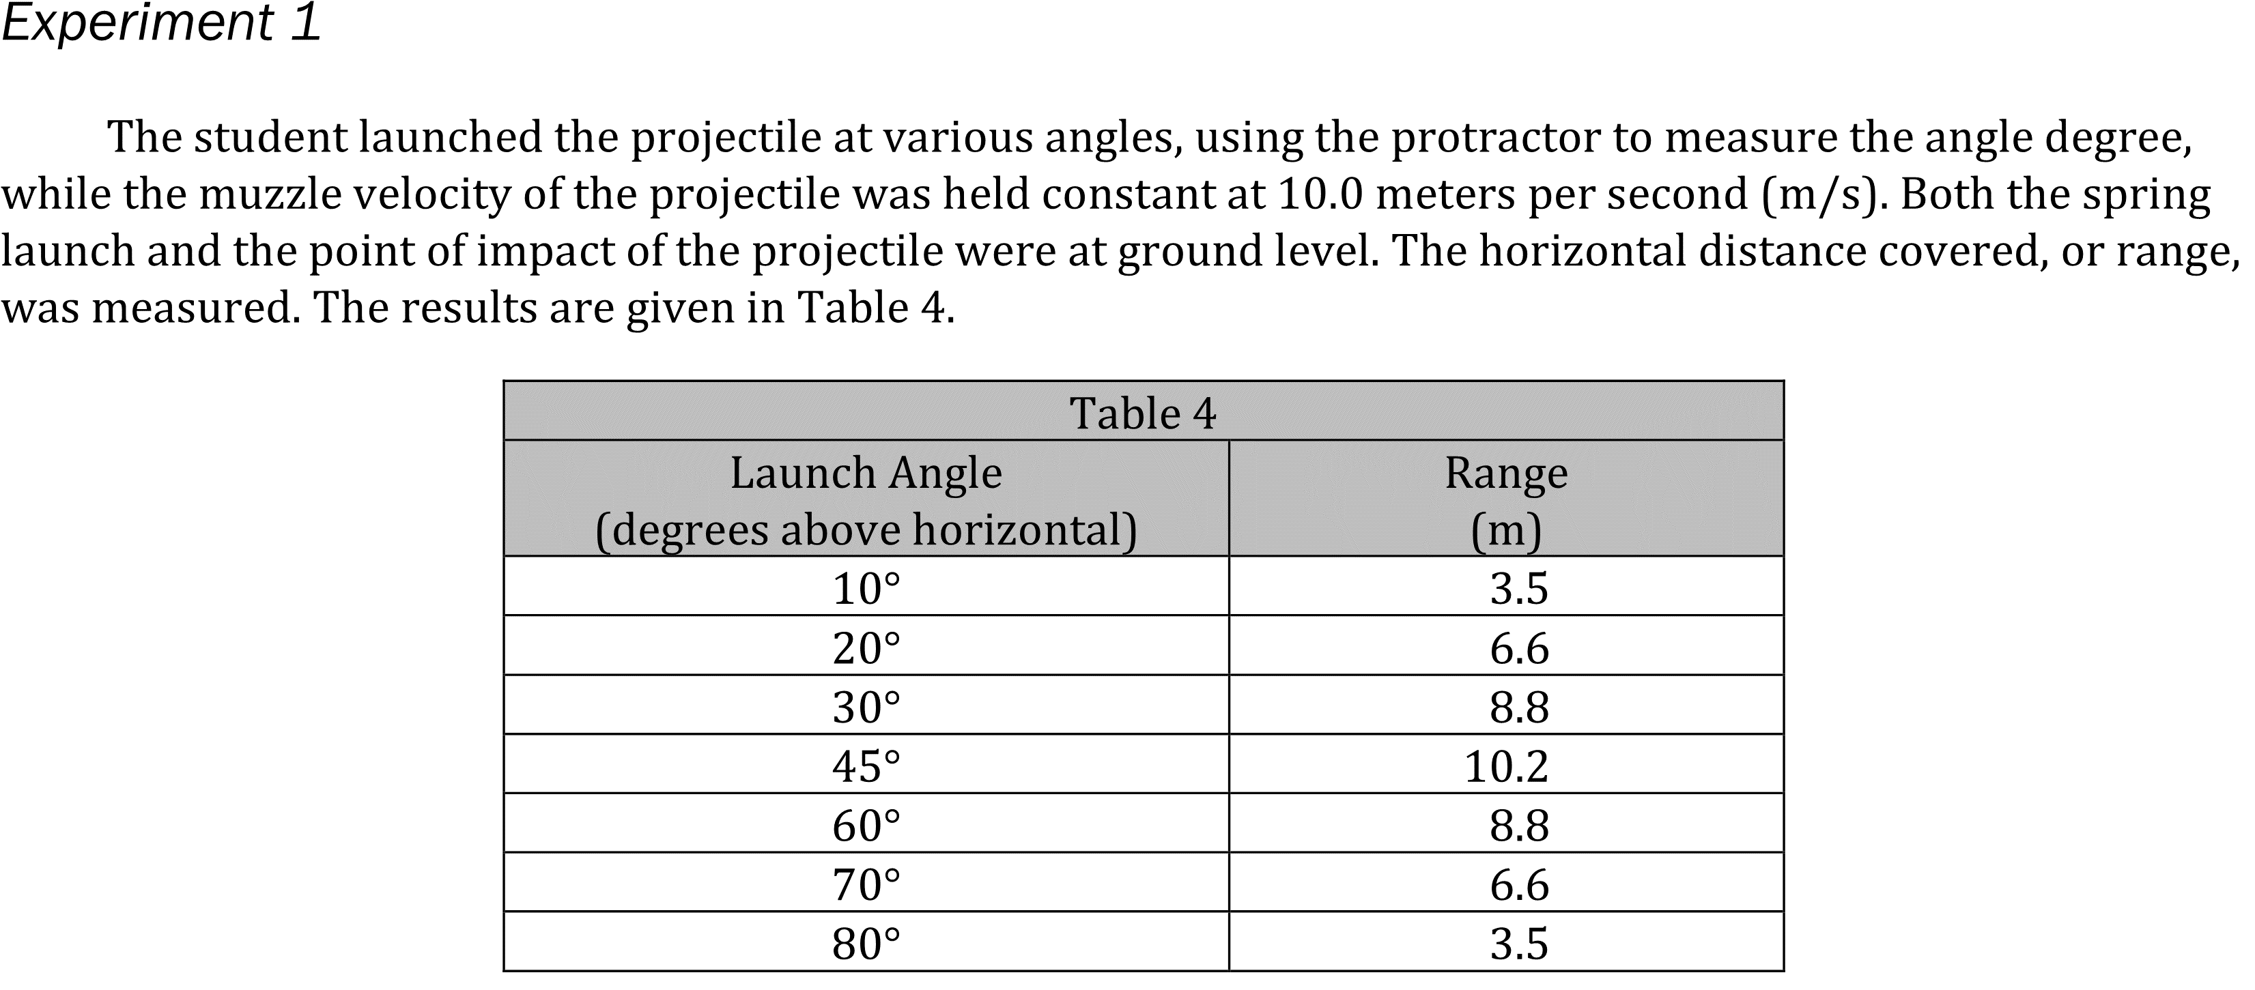
Notes:
Understand basic scientific terms; Identify a control in an experiment; Understand experimental design. Level: Intermediate Skill Group: Scientific Investigation.

Slide 3
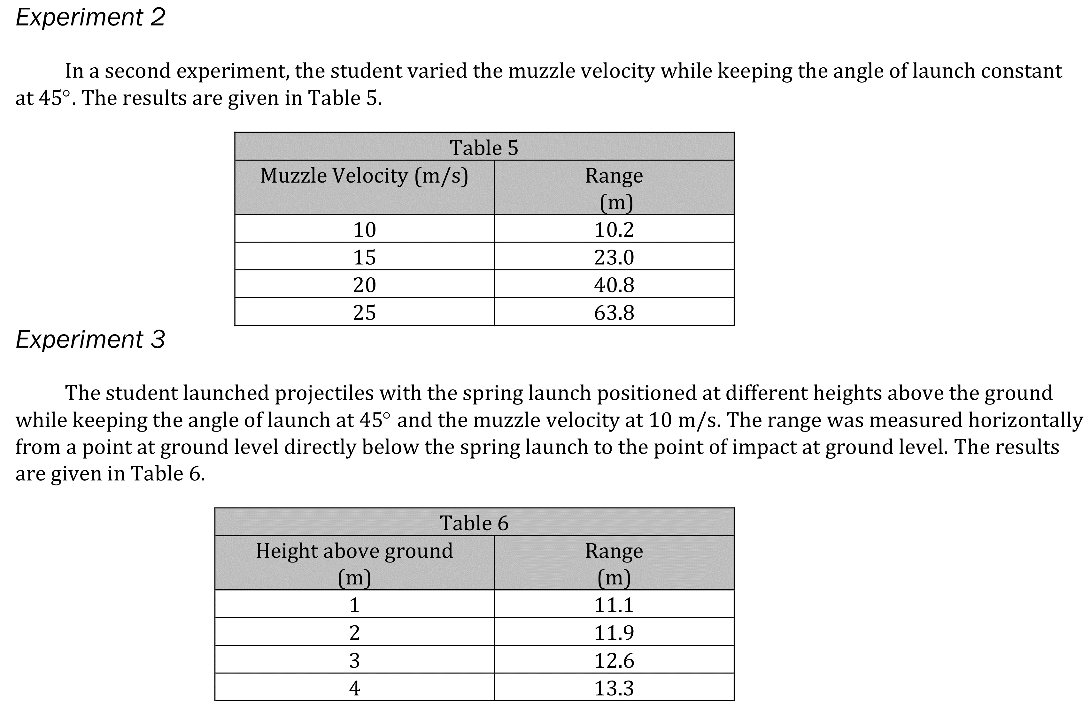
Notes:
Understand basic scientific terms; Identify a control in an experiment; Understand experimental design. Level: Intermediate Skill Group: Scientific Investigation.

Slide 4
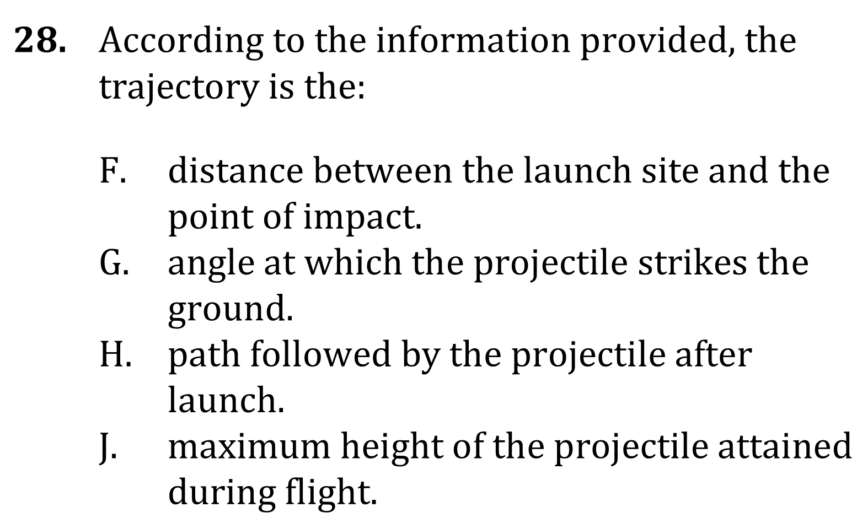
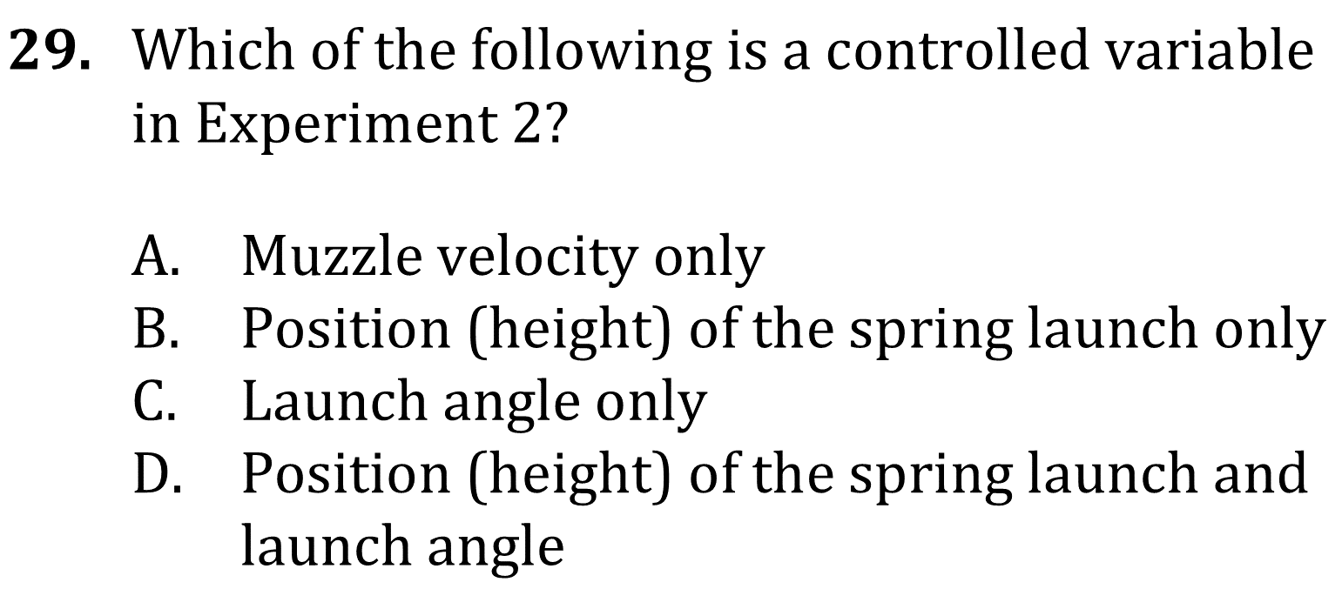
Notes:
Understand basic scientific terms; Identify a control in an experiment; Understand experimental design. Level: Intermediate Skill Group: Scientific Investigation.

Slide 5
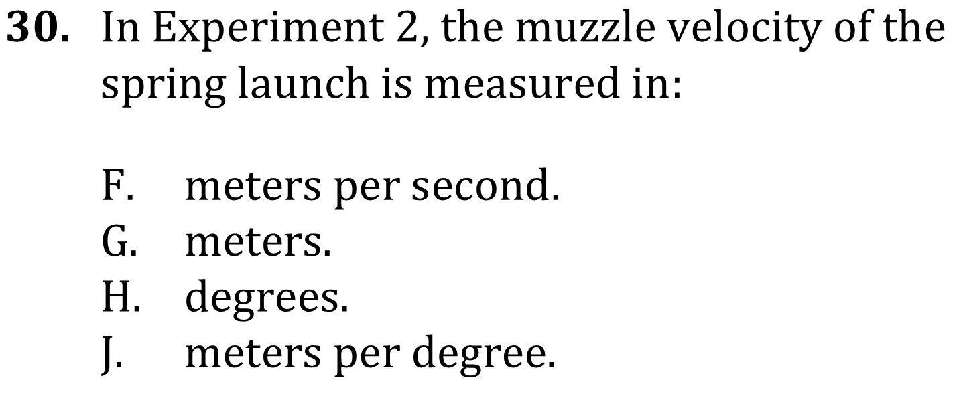
Notes:
Understand basic scientific terms; Identify a control in an experiment; Understand experimental design. Level: Intermediate Skill Group: Scientific Investigation.

Slide 6
Notes:
Understand basic scientific terms; Identify a control in an experiment; Understand experimental design. Level: Intermediate Skill Group: Scientific Investigation.

Slide 7
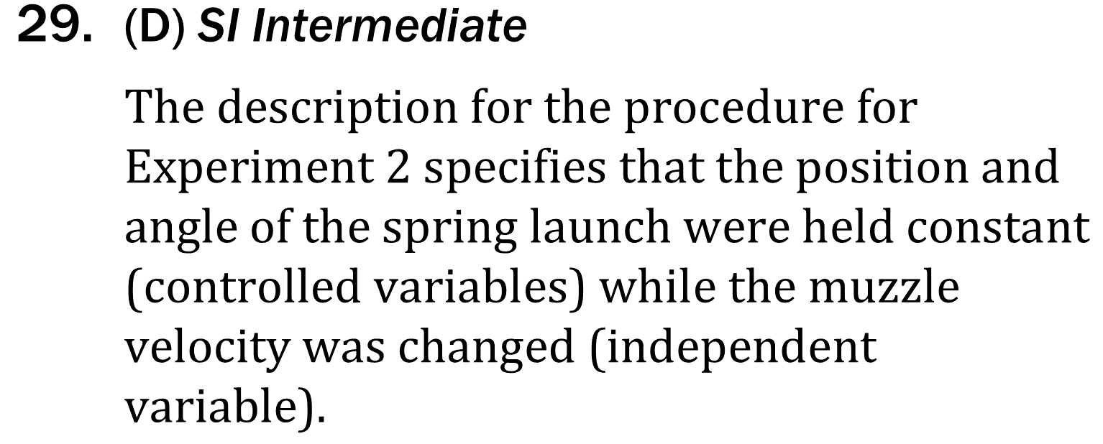
Notes:
Understand basic scientific terms; Identify a control in an experiment; Understand experimental design. Level: Intermediate Skill Group: Scientific Investigation.

Slide 8
Notes:
Understand basic scientific terms; Identify a control in an experiment; Understand experimental design. Level: Intermediate Skill Group: Scientific Investigation.

