Slide 1
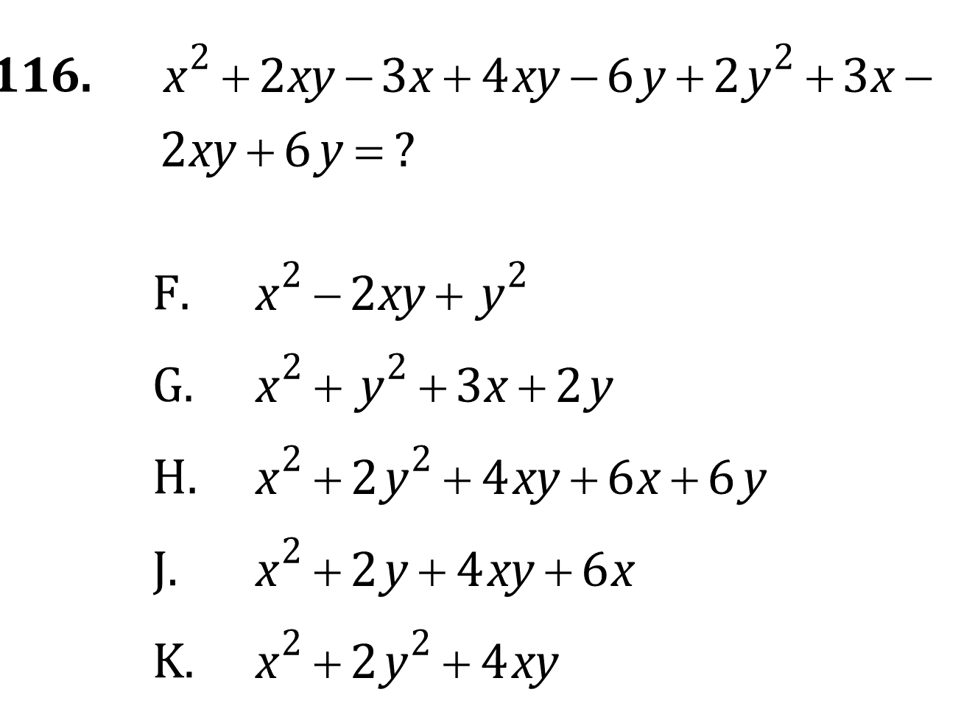
Algebra

Slide 2
Algebra

Slide 3
Algebra

Slide 4
Algebra

Slide 5
Algebra

Slide 6
Algebra

Slide 7
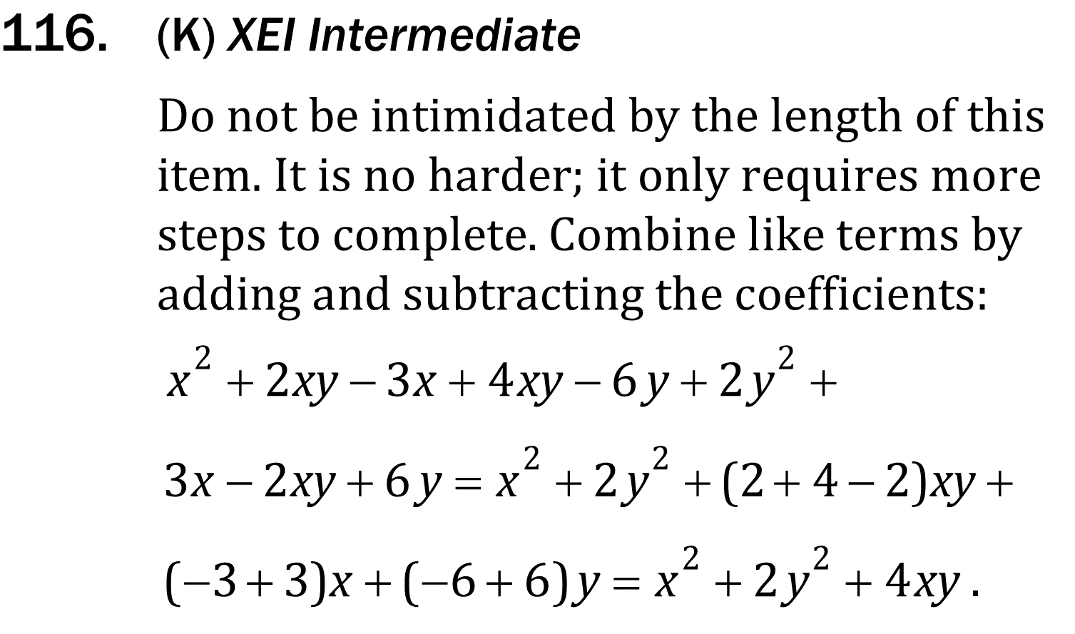
Algebra

Slide 8
Algebra

Slide 9
Algebra

Slide 10
Algebra

Slide 11
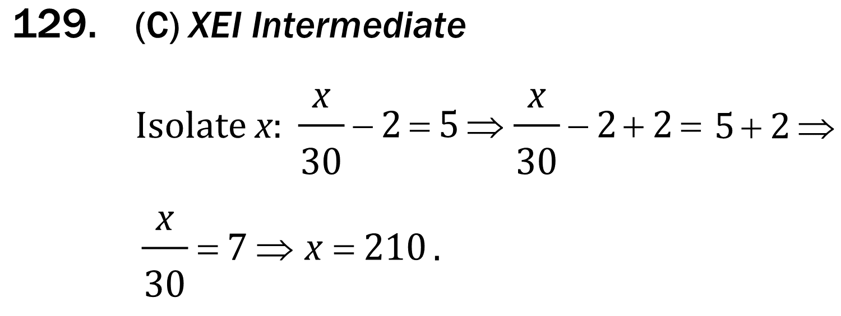
Algebra

Slide 12
Algebra

