Slide 1
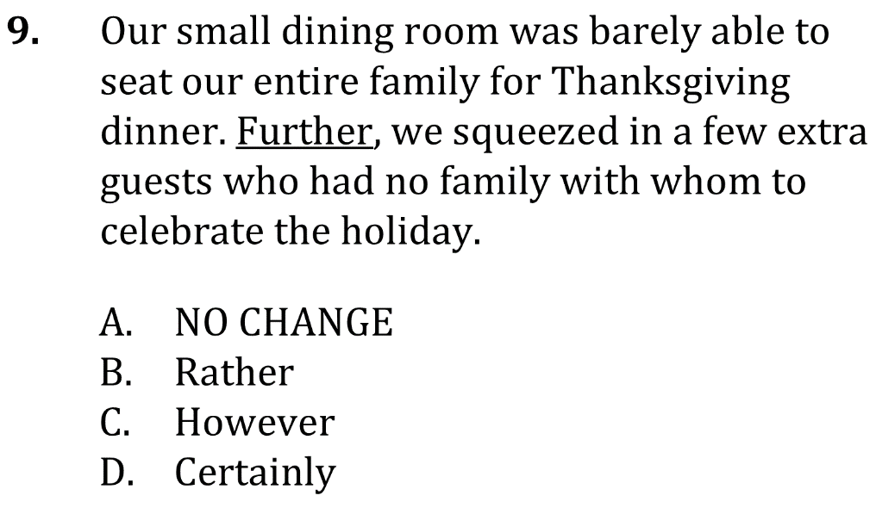
Conjunctive Adverbs

Slide 2
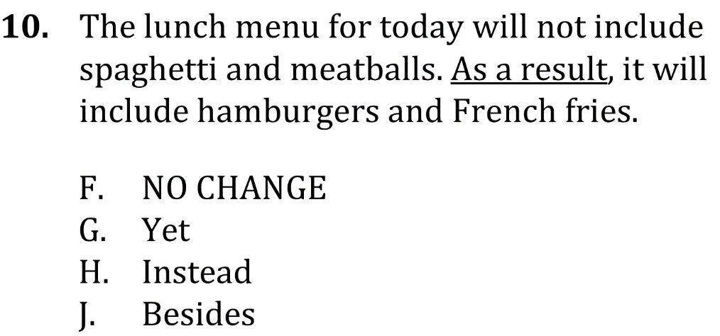
Conjunctive Adverbs

Slide 3
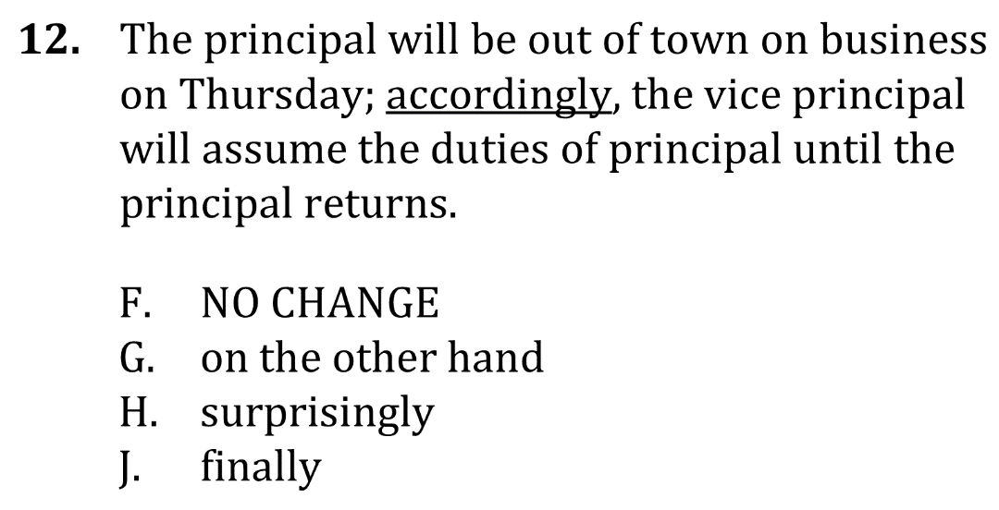
Conjunctive Adverbs

Slide 4
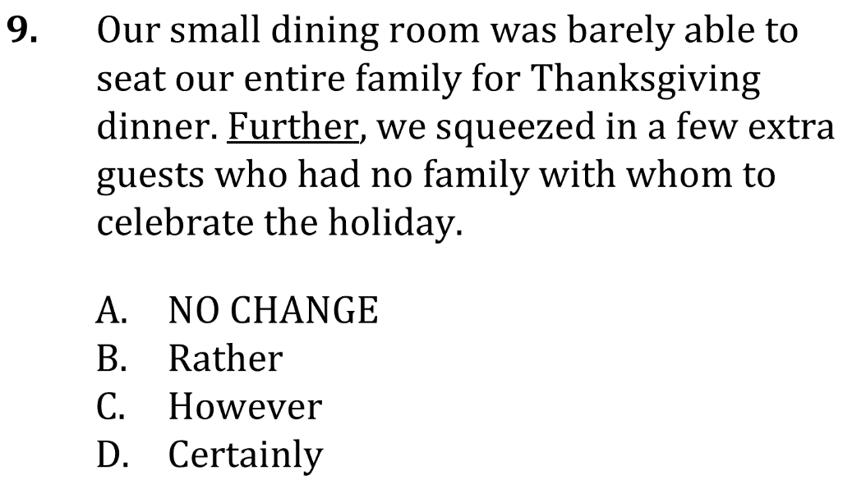
Conjunctive Adverbs

Slide 5
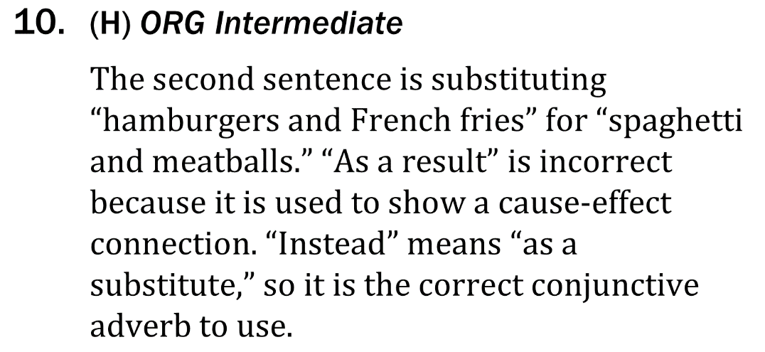
Conjunctive Adverbs

Slide 6
Conjunctive Adverbs

