Slide 1
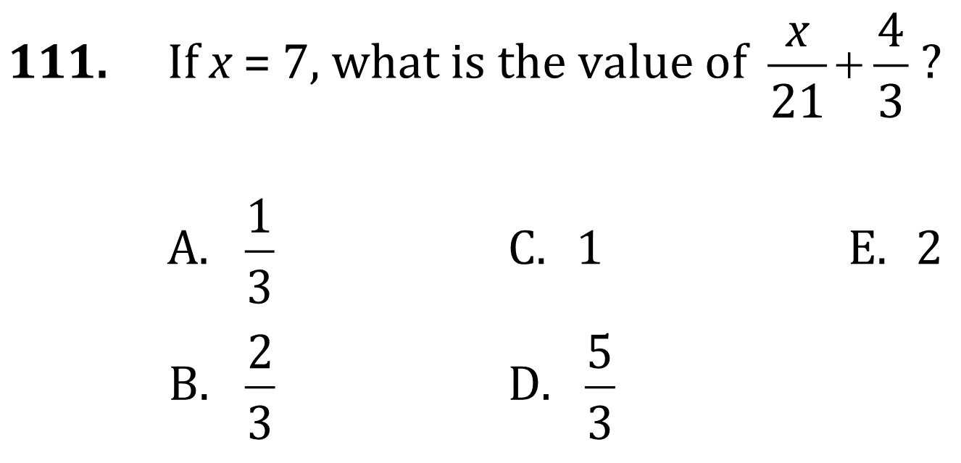
Algebra

Slide 2
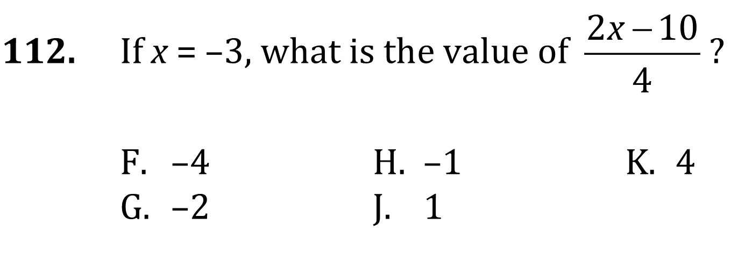
Algebra

Slide 3
Algebra

Slide 4
Algebra

Slide 5
Algebra

Slide 6
Algebra

Slide 7
Algebra

Slide 8
Algebra

Slide 9
Algebra

Slide 10
Algebra

