Slide 1
Number line and first quadrant

Slide 2
Number line and first quadrant

Slide 3
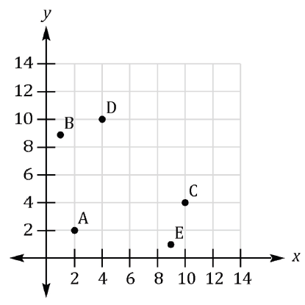
Number line and first quadrant

Slide 4
Number line and first quadrant

Slide 5
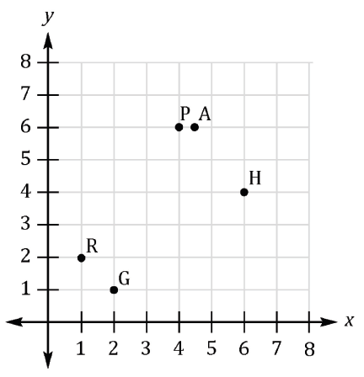
Number line and first quadrant

Slide 6
Number line and first quadrant

Slide 7
Number line and first quadrant

Slide 8
Number line and first quadrant

Slide 9
Number line and first quadrant

Slide 10
Number line and first quadrant

