Slide 1
Notes:
Understand experimental design; Compare and contrast experiments. Level: Intermediate Skill Group: Scientific Investigation

Slide 2
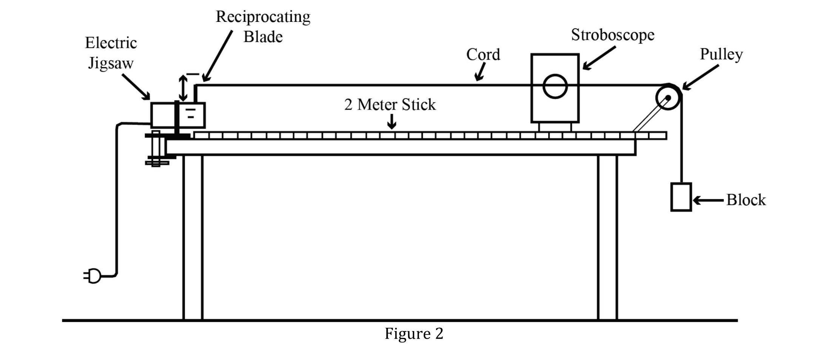
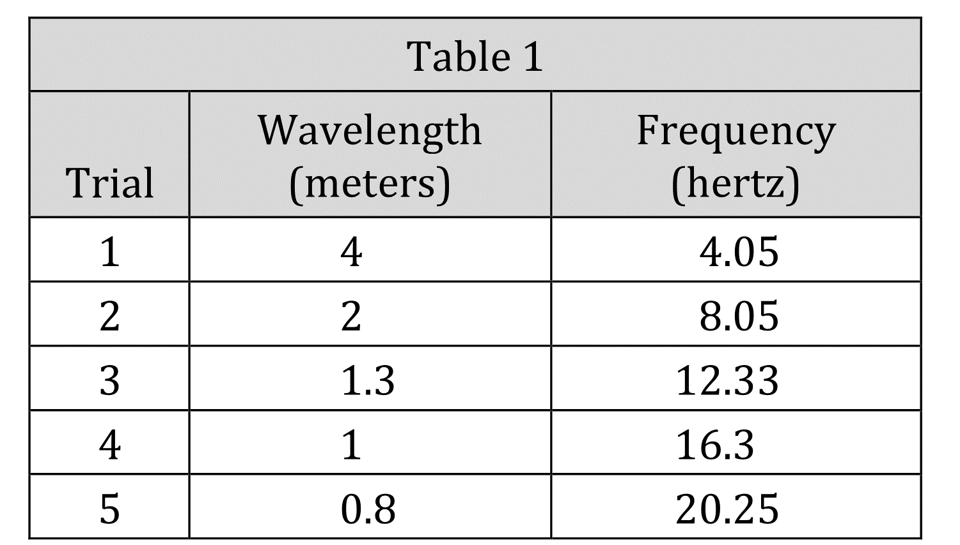
Notes:
Understand experimental design; Compare and contrast experiments. Level: Intermediate Skill Group: Scientific Investigation

Slide 3
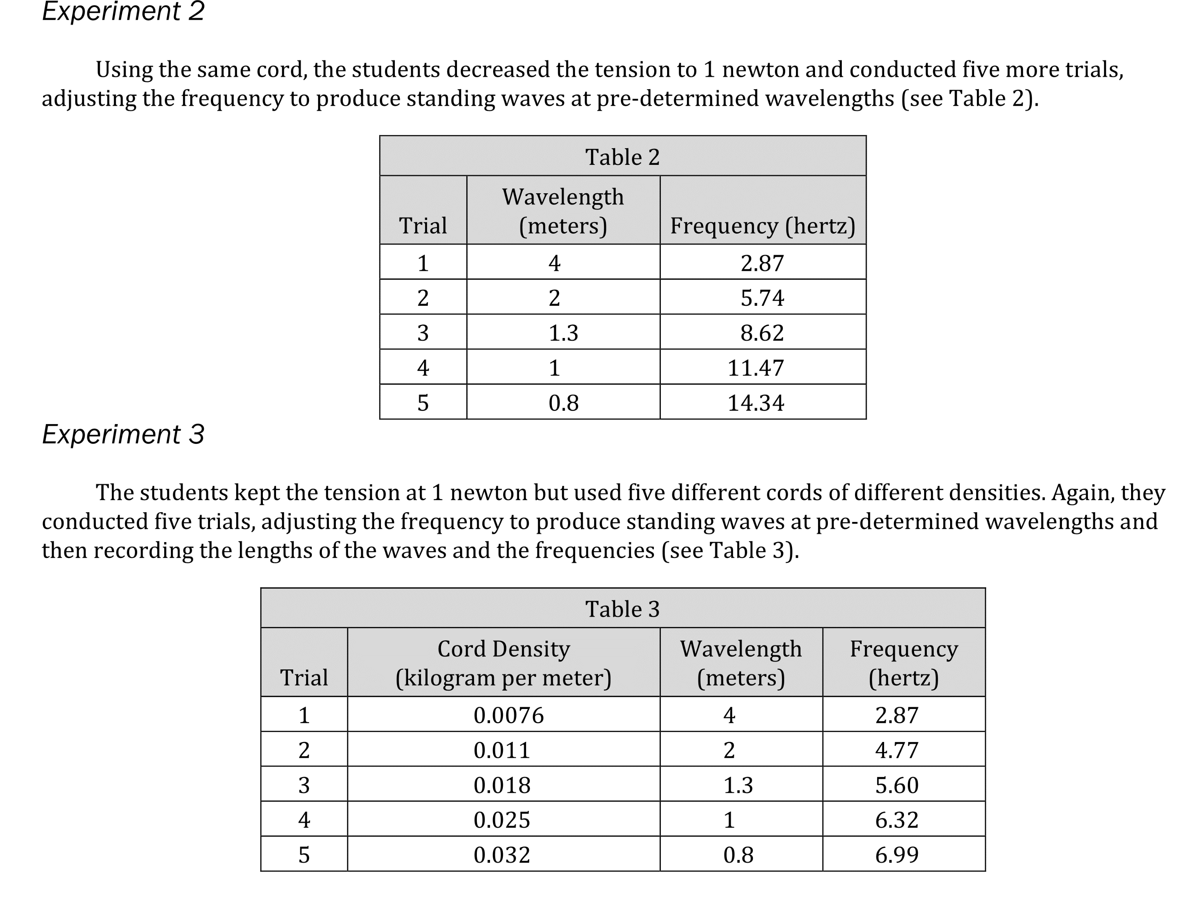
Notes:
Understand experimental design; Compare and contrast experiments. Level: Intermediate Skill Group: Scientific Investigation

Slide 4
Notes:
Understand experimental design; Compare and contrast experiments. Level: Intermediate Skill Group: Scientific Investigation

Slide 5
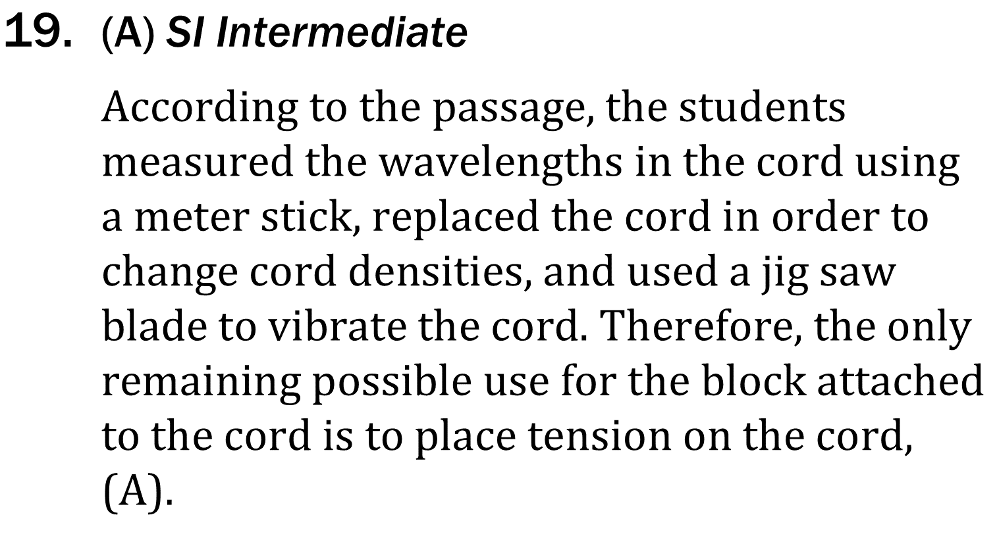
Notes:
Understand experimental design; Compare and contrast experiments. Level: Intermediate Skill Group: Scientific Investigation

Slide 6
Notes:
Understand experimental design; Compare and contrast experiments. Level: Intermediate Skill Group: Scientific Investigation

