Slide 1
Notes:
Understand experimental design. Level: Intermediate Skill Group: Scientific Investigation

Slide 2
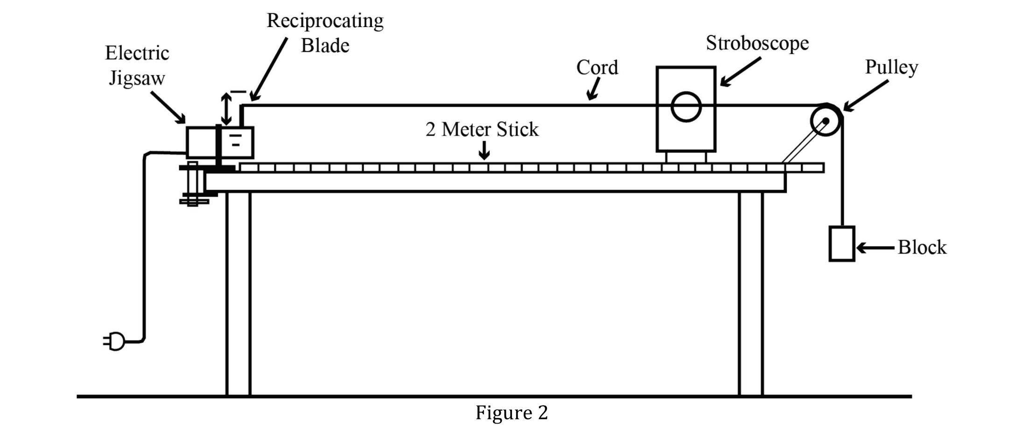
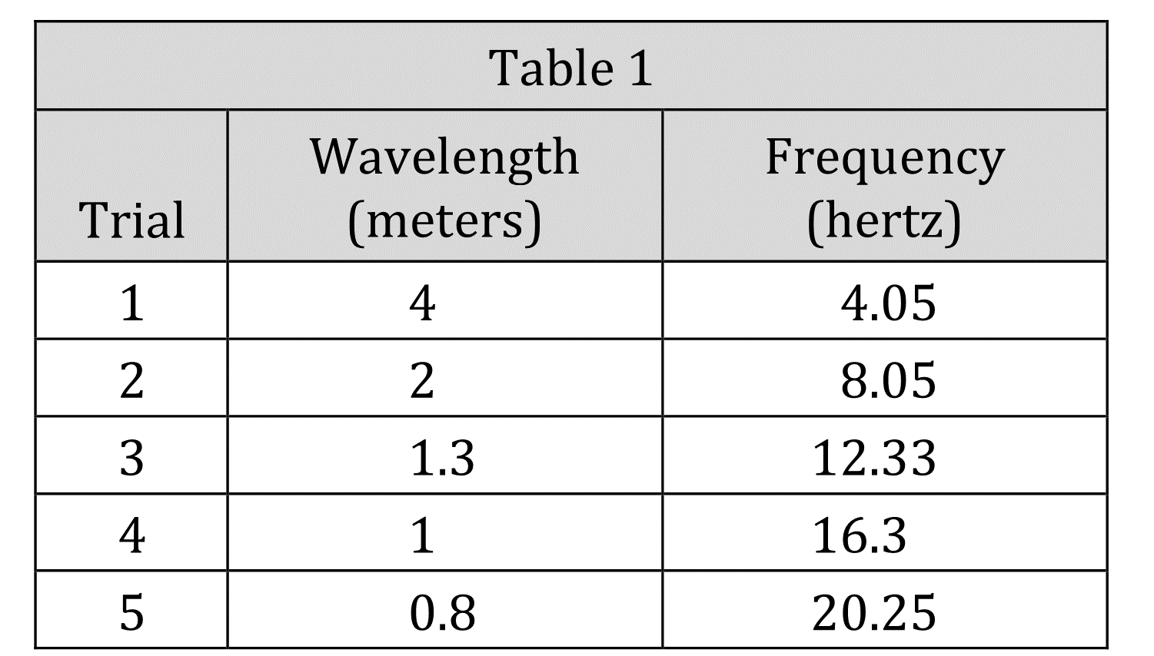
Notes:
Understand experimental design. Level: Intermediate Skill Group: Scientific Investigation

Slide 3
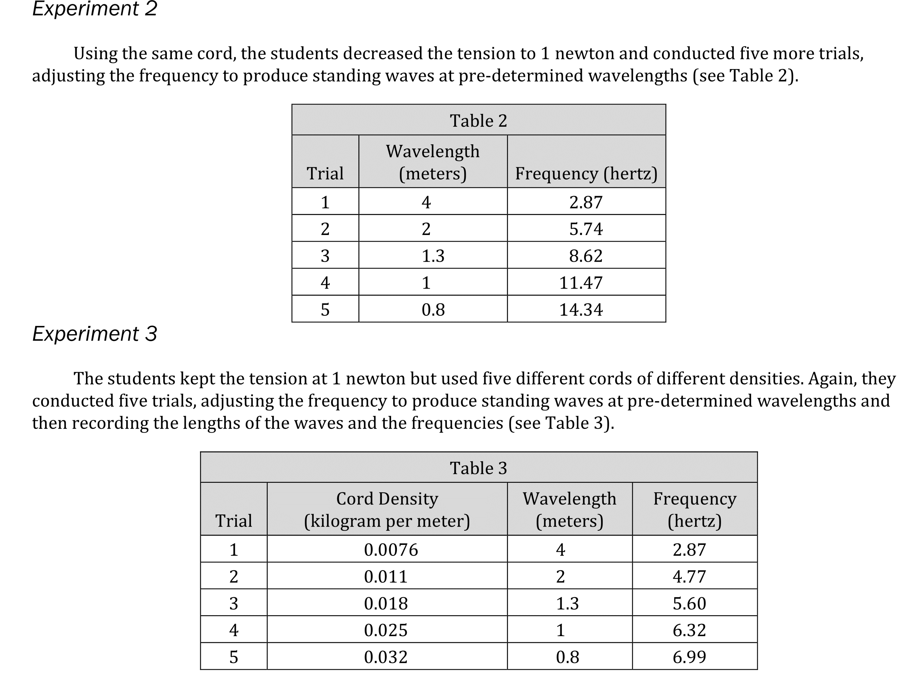
Notes:
Understand experimental design. Level: Intermediate Skill Group: Scientific Investigation

Slide 4
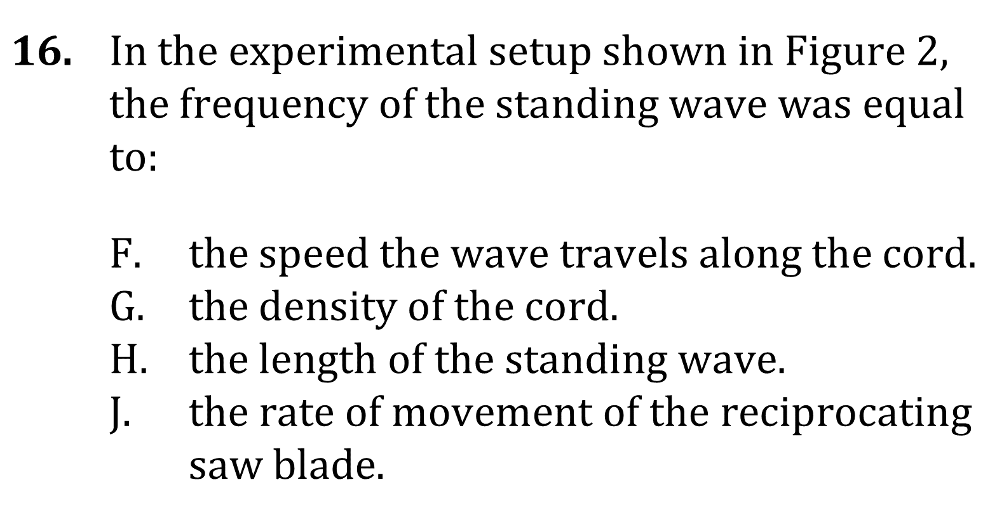
Notes:
Understand experimental design. Level: Intermediate Skill Group: Scientific Investigation

Slide 5
Notes:
Understand experimental design. Level: Intermediate Skill Group: Scientific Investigation

Slide 6
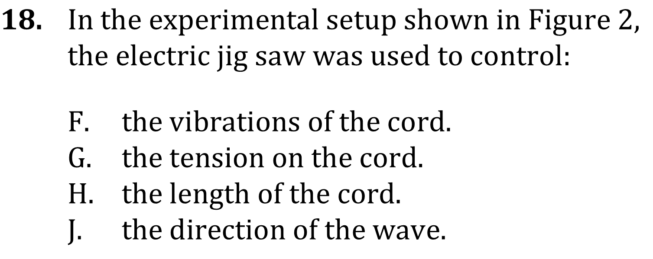
Notes:
Understand experimental design. Level: Intermediate Skill Group: Scientific Investigation

Slide 7
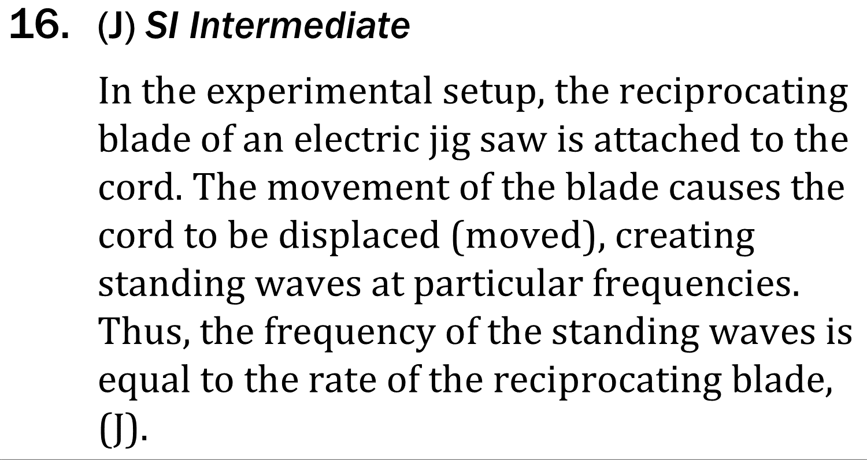
Notes:
Understand experimental design. Level: Intermediate Skill Group: Scientific Investigation

Slide 8
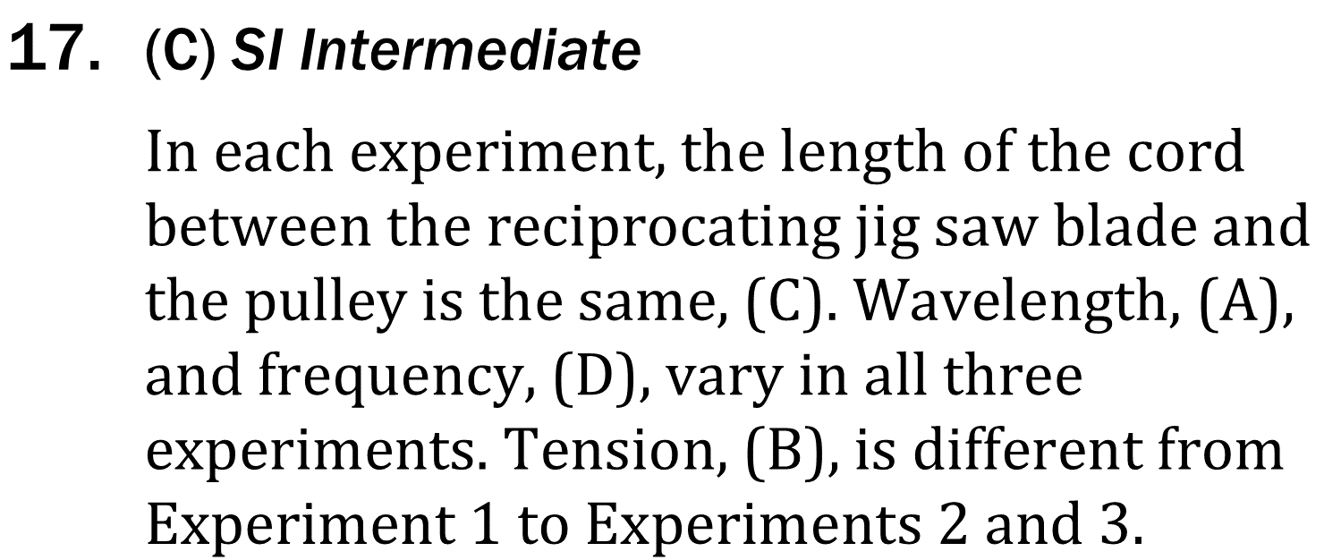
Notes:
Understand experimental design. Level: Intermediate Skill Group: Scientific Investigation

Slide 9
Notes:
Understand experimental design. Level: Intermediate Skill Group: Scientific Investigation

