Slide 1
algebra

Slide 2
algebra

Slide 3
algebra

Slide 4
algebra

Slide 5
algebra

Slide 6
algebra

Slide 7
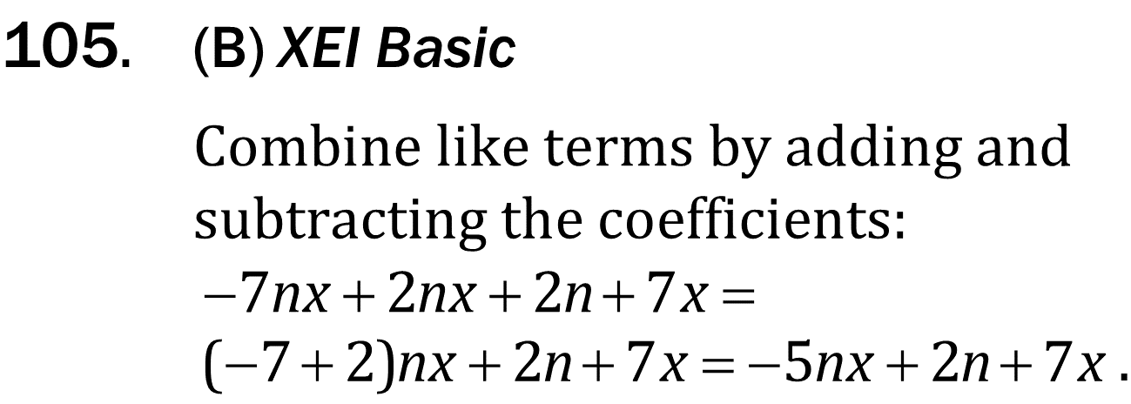
algebra

Slide 8
algebra

Slide 9
algebra

Slide 10
algebra

