Slide 1
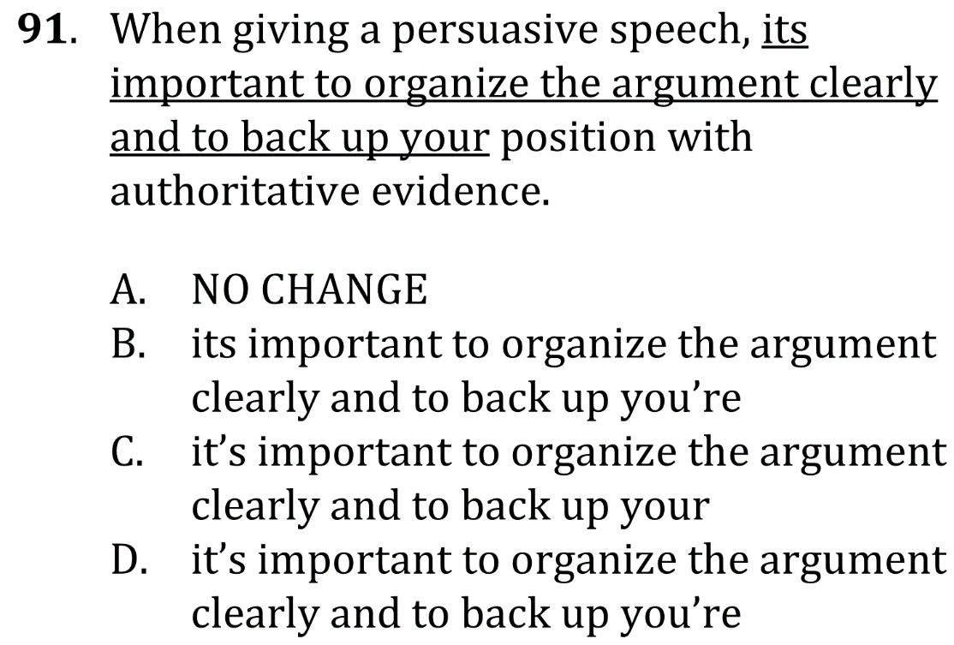
Use pronouns correctly

Slide 2
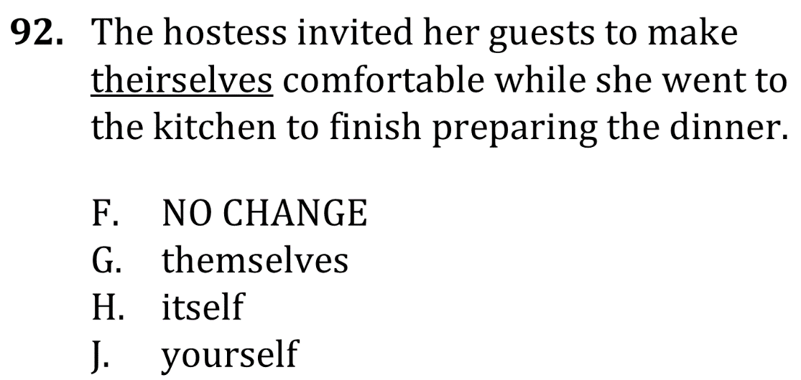
Use pronouns correctly

Slide 3
Use pronouns correctly

Slide 4
Use pronouns correctly

