Slide 1
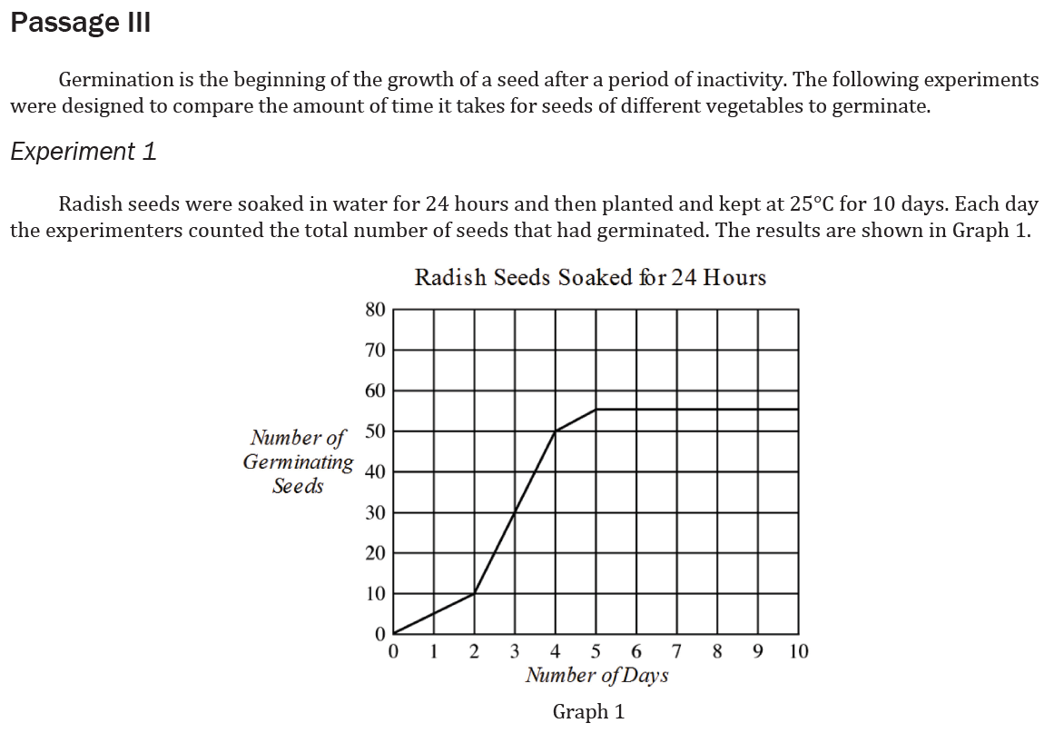
Notes:
Recognize features of basic data presentations such as headings and units; Read and interpret data in more complex data presentations. Level: Intermediate Skill Group: Interpretation of Data

Slide 2
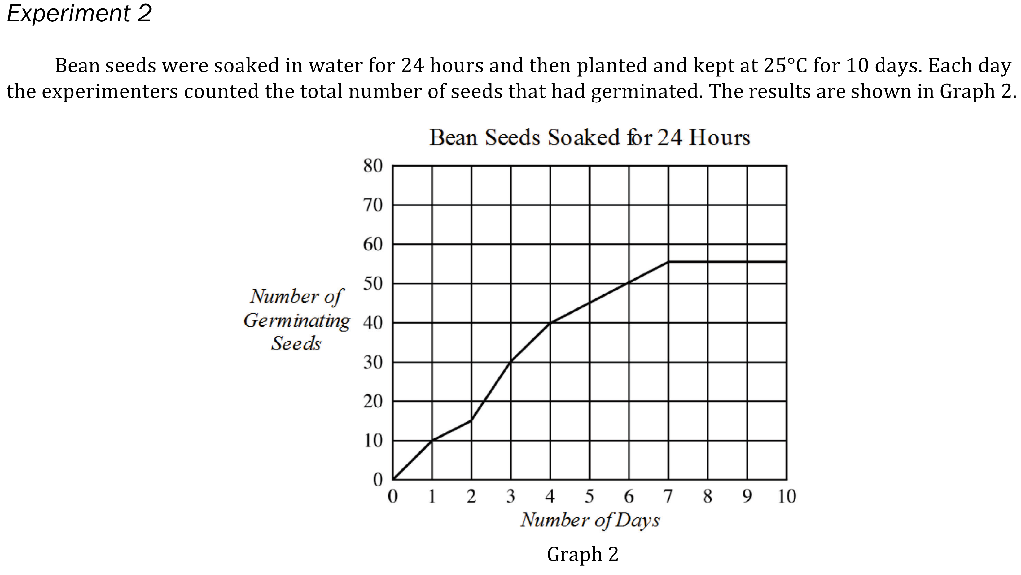
Notes:
Recognize features of basic data presentations such as headings and units; Read and interpret data in more complex data presentations. Level: Intermediate Skill Group: Interpretation of Data

Slide 3
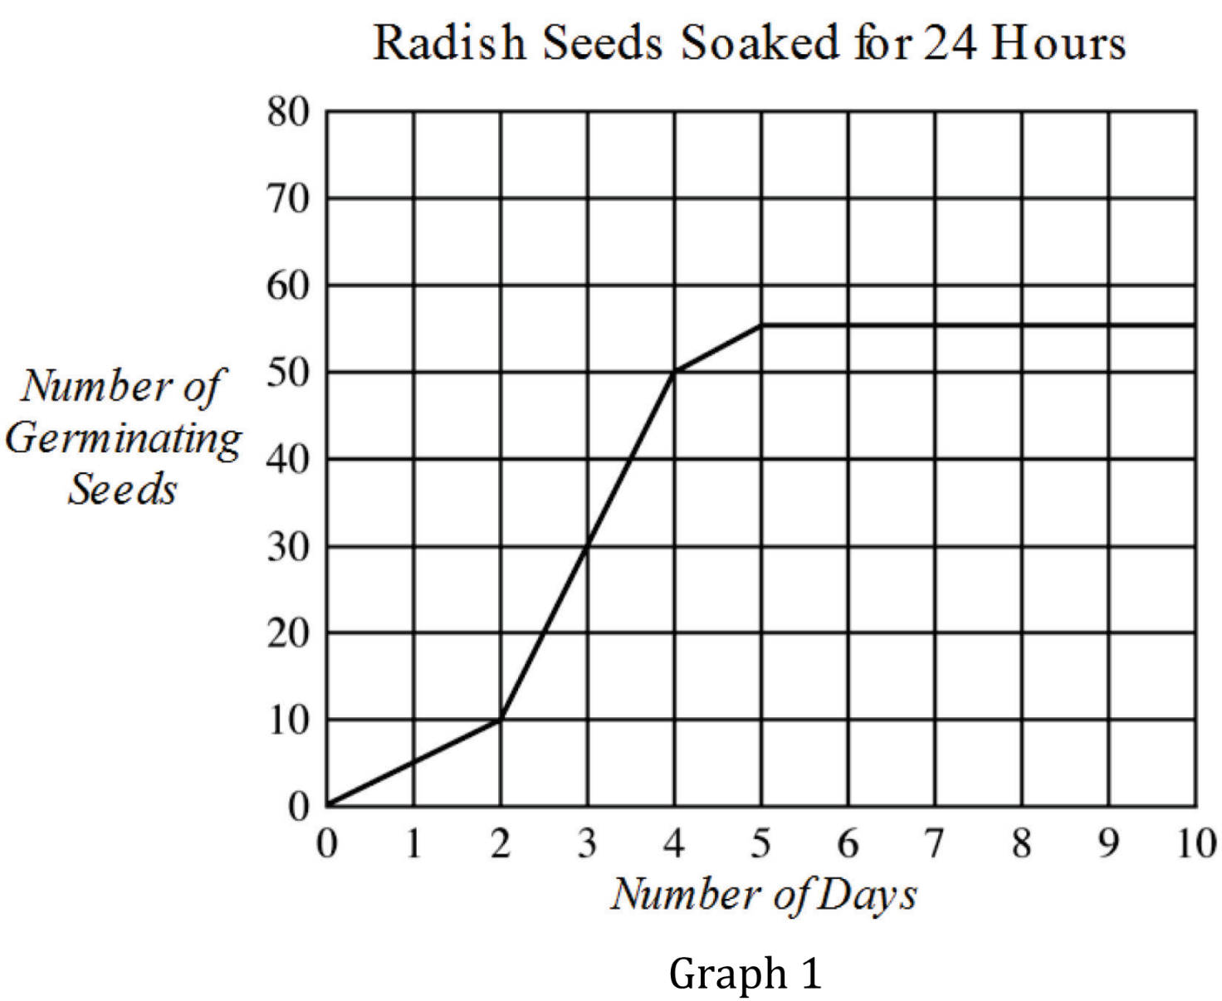
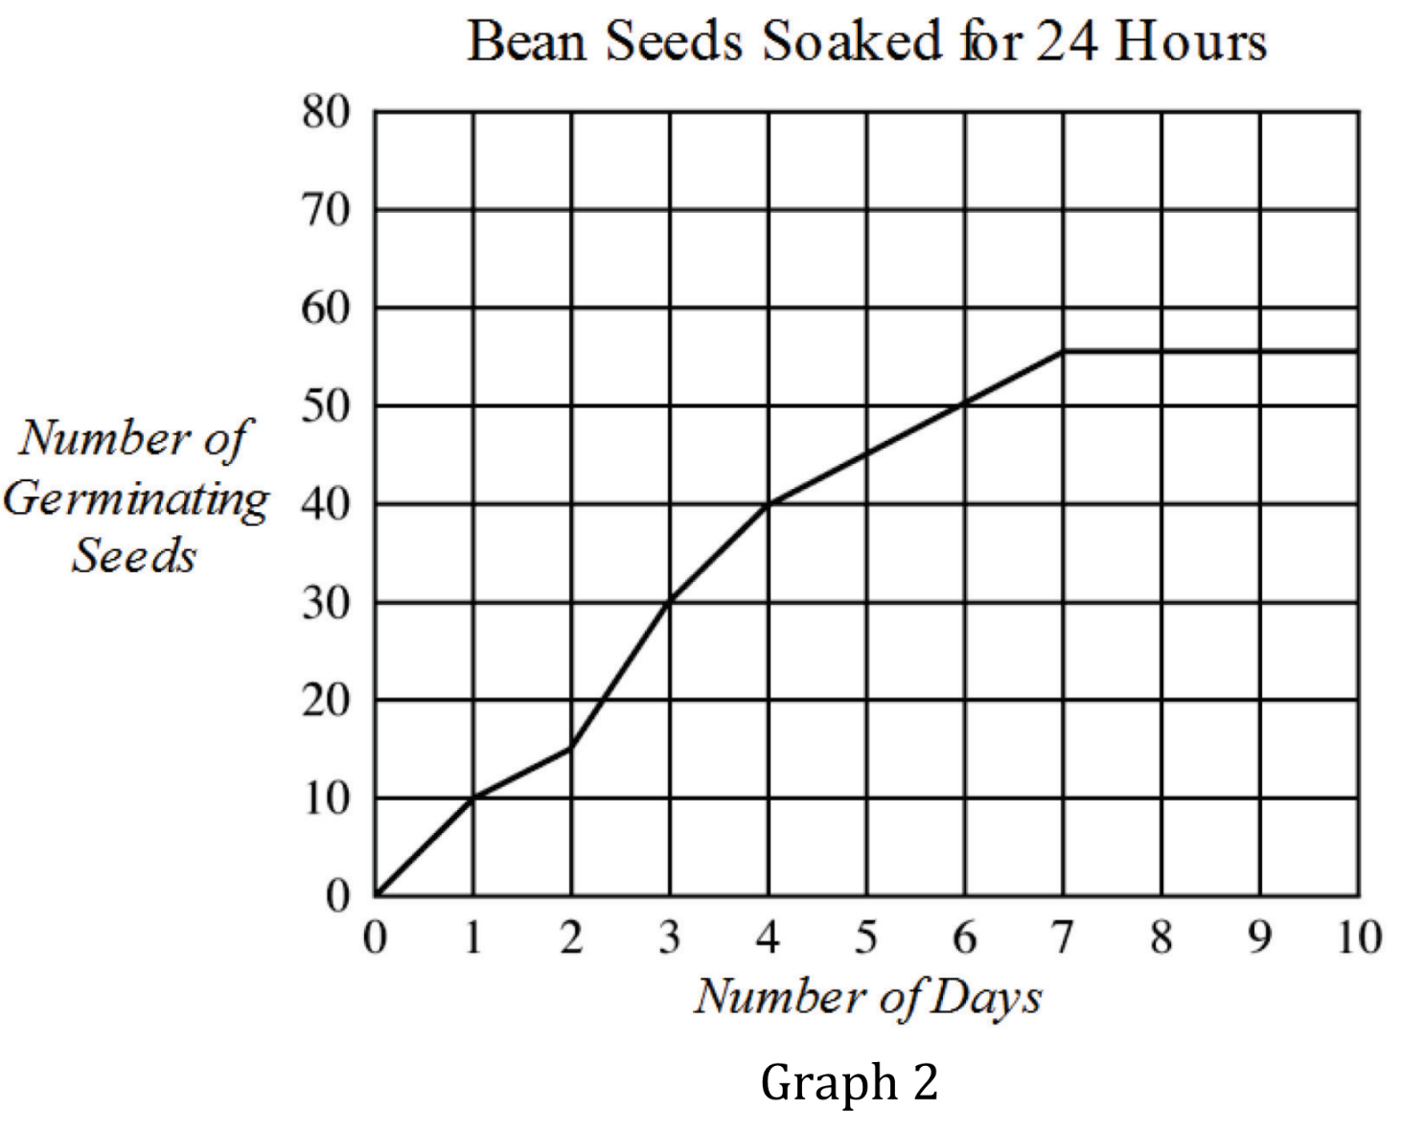
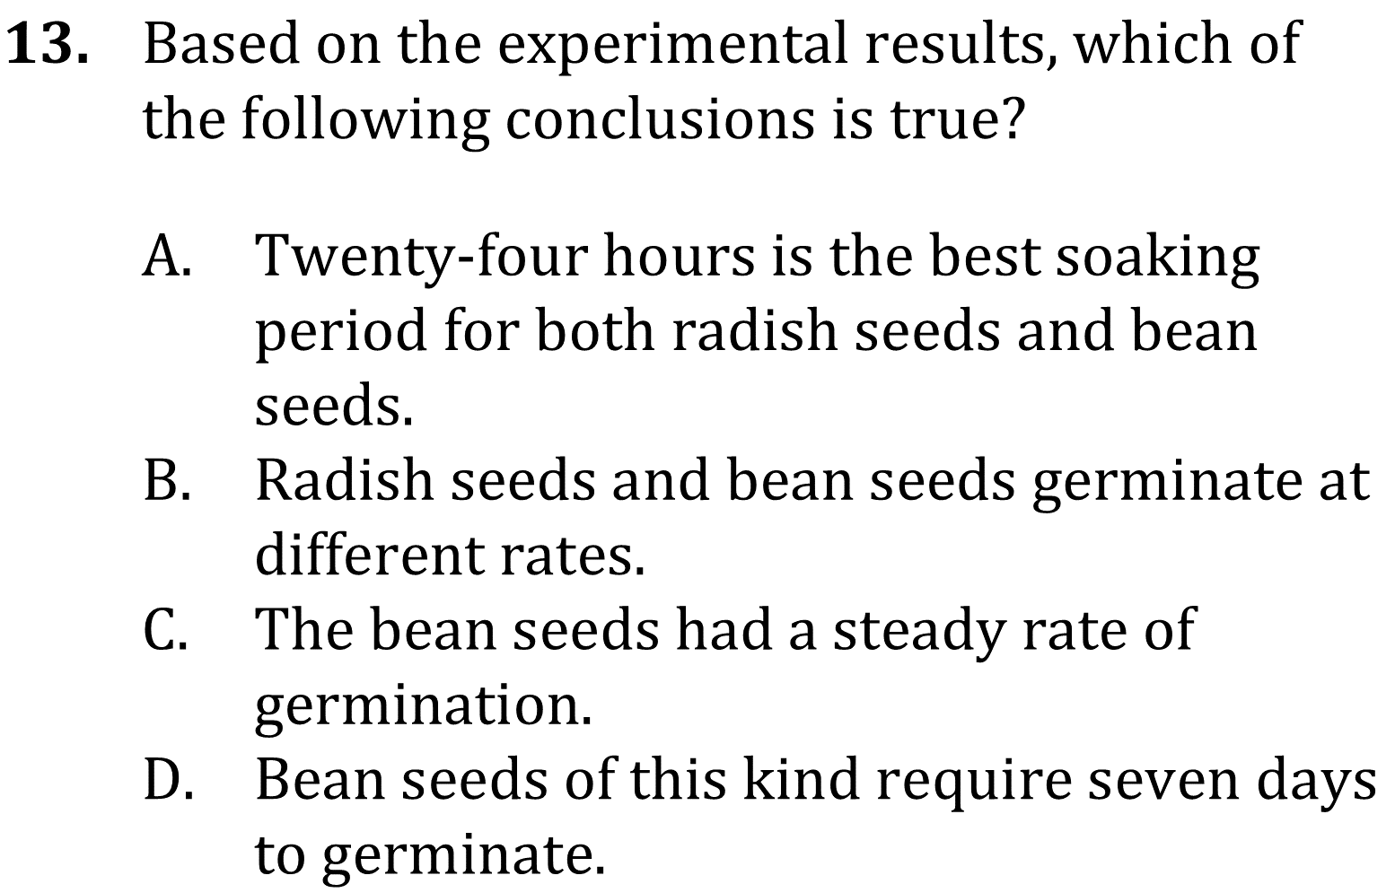

Slide 4
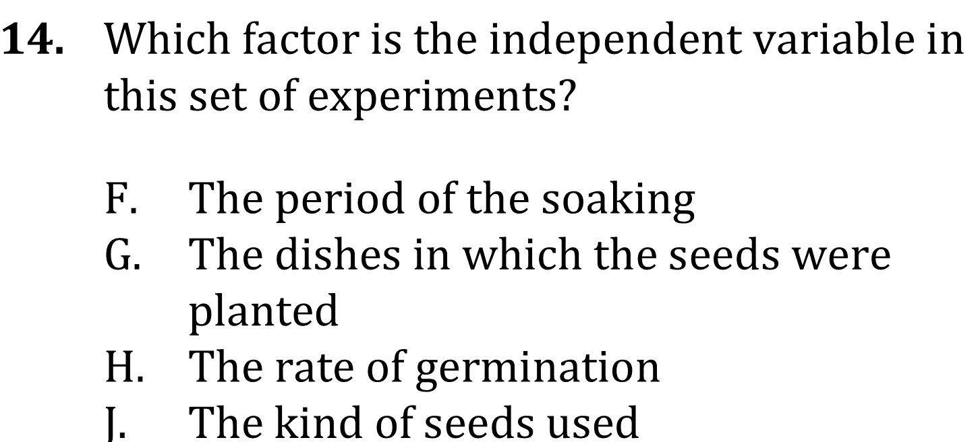

Slide 5
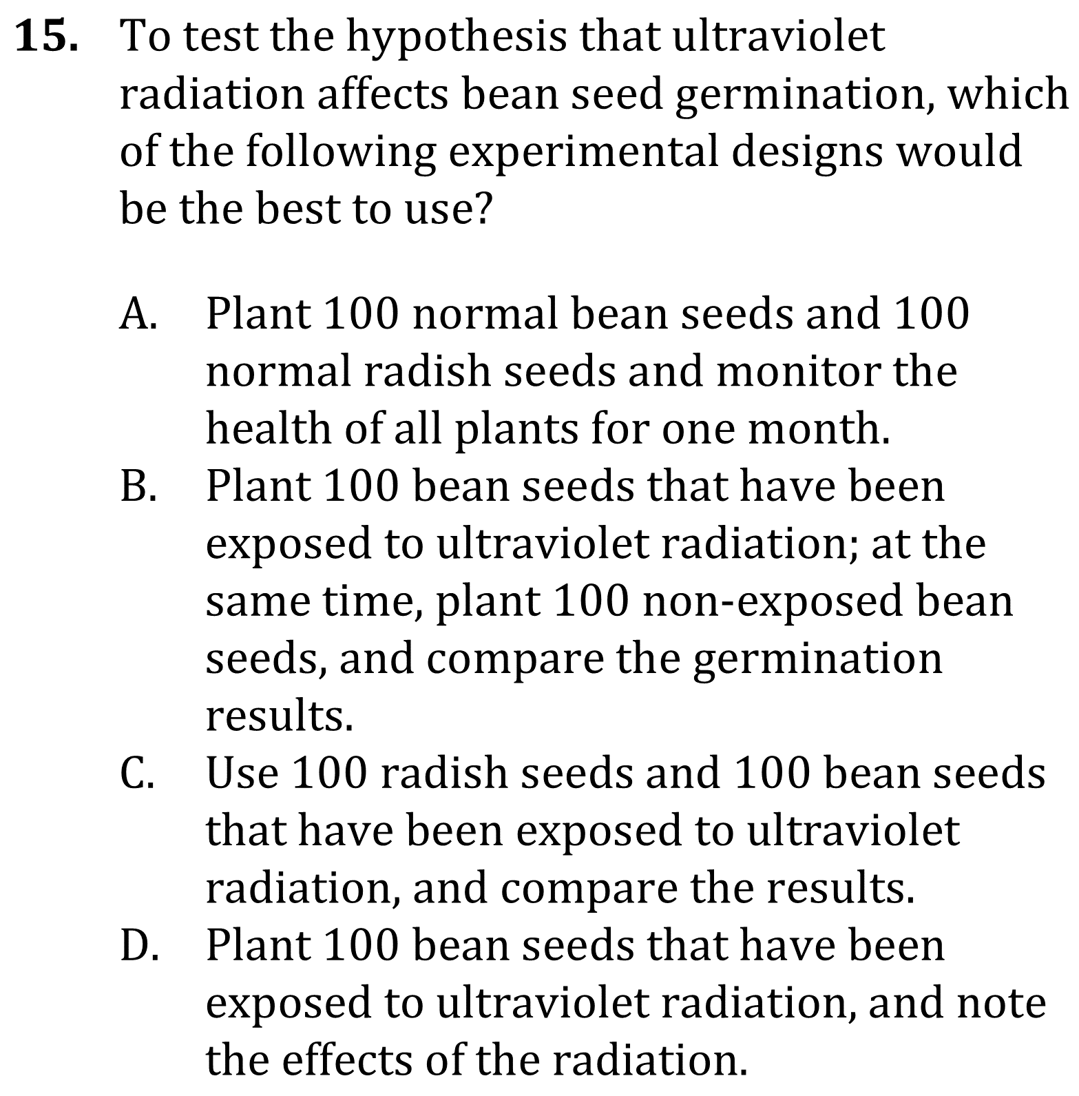
Notes:
Recognize features of basic data presentations such as headings and units; Read and interpret data in more complex data presentations. Level: Intermediate Skill Group: Interpretation of Data

Slide 6
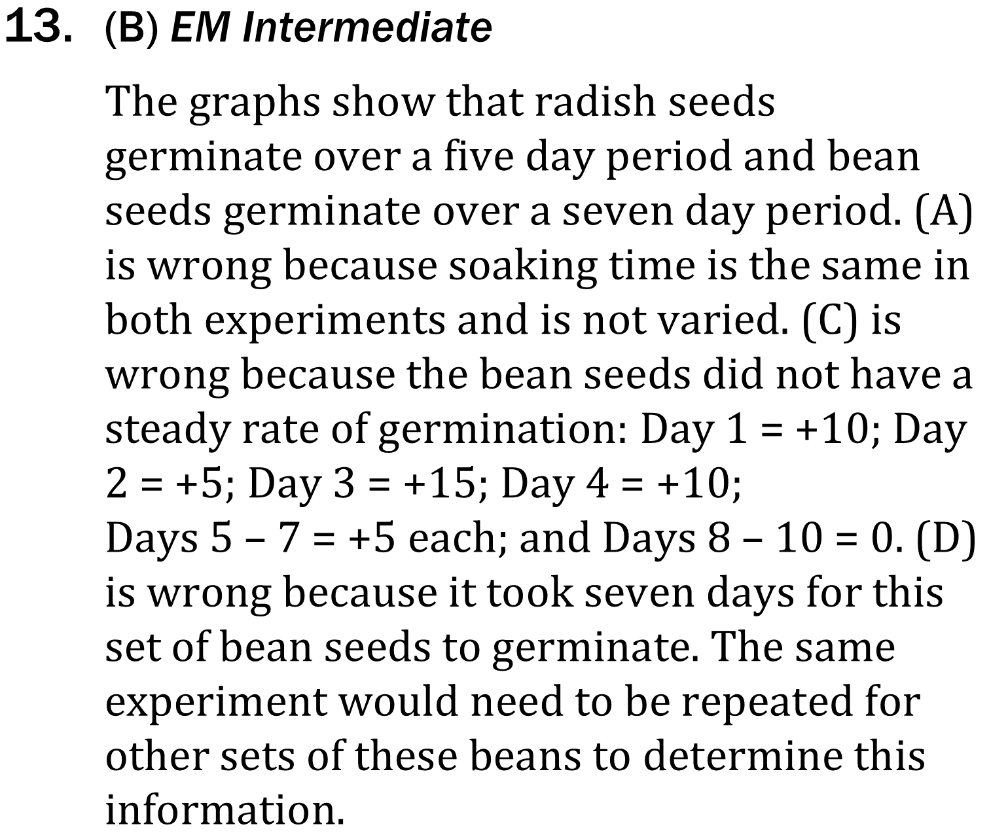
Notes:
Recognize features of basic data presentations such as headings and units; Read and interpret data in more complex data presentations. Level: Intermediate Skill Group: Interpretation of Data

Slide 7
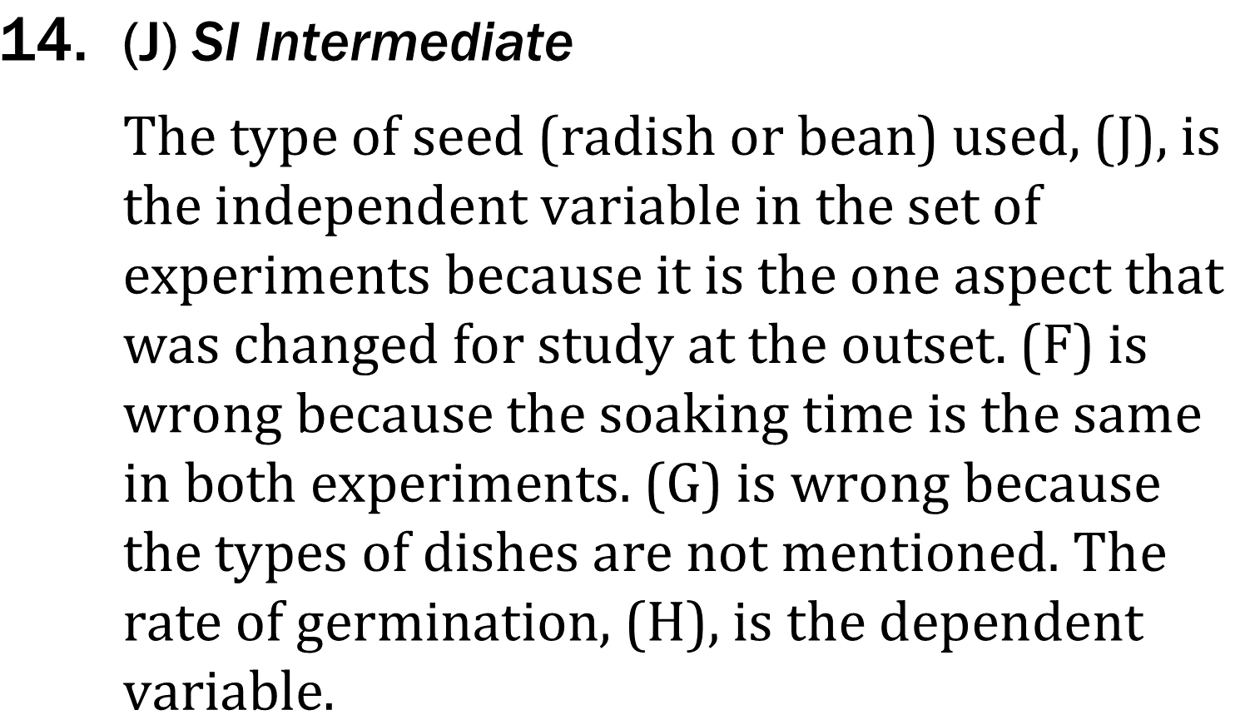
Notes:
Recognize features of basic data presentations such as headings and units; Read and interpret data in more complex data presentations. Level: Intermediate Skill Group: Interpretation of Data

Slide 8
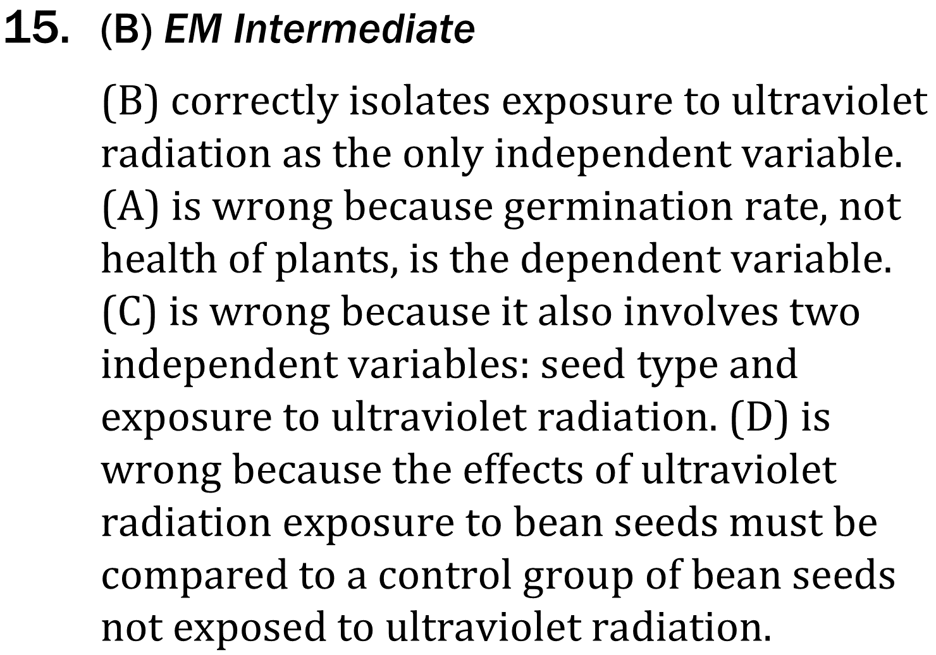
Notes:
Recognize features of basic data presentations such as headings and units; Read and interpret data in more complex data presentations. Level: Intermediate Skill Group: Interpretation of Data

