Slide 1
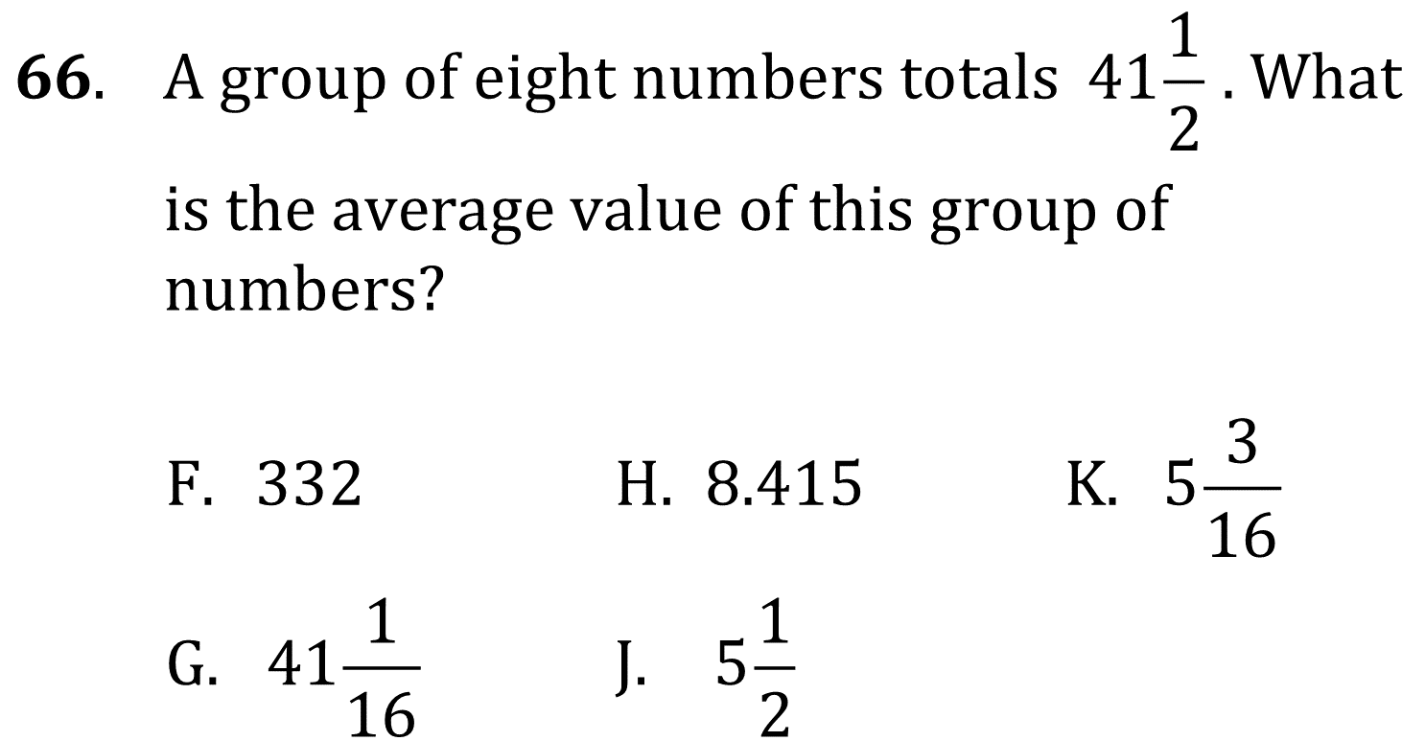
averages

Slide 2
averages

Slide 3
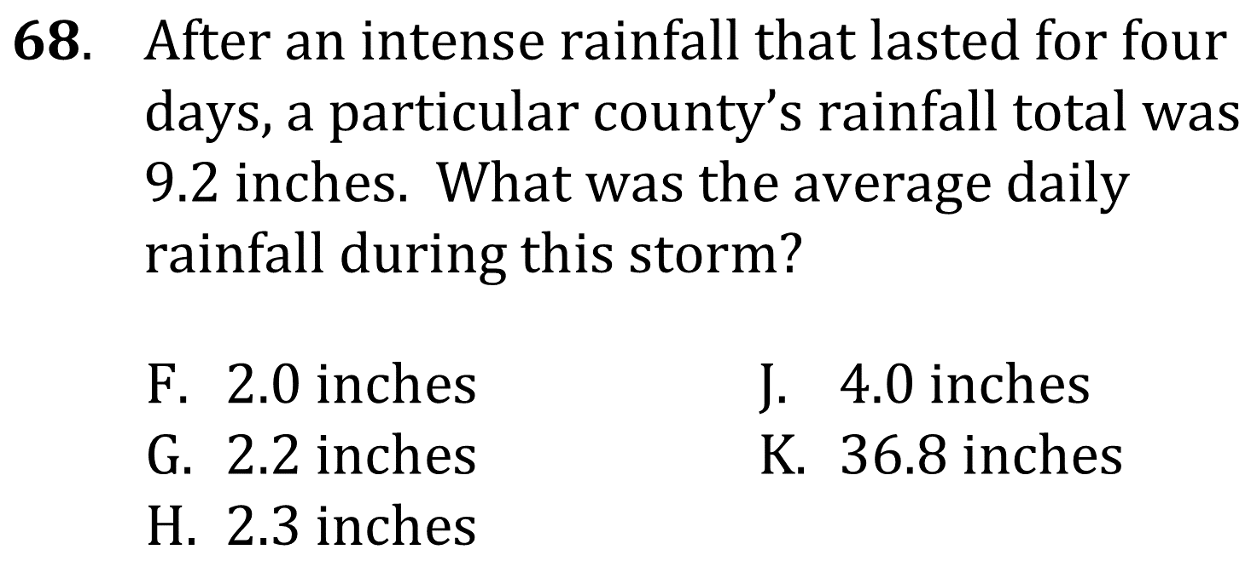
averages

Slide 4
averages

Slide 5
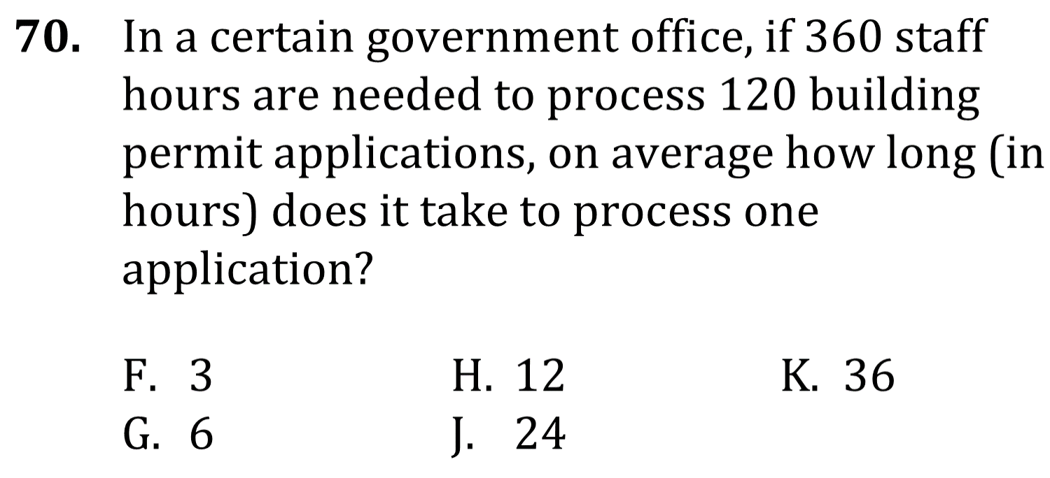
averages

Slide 6
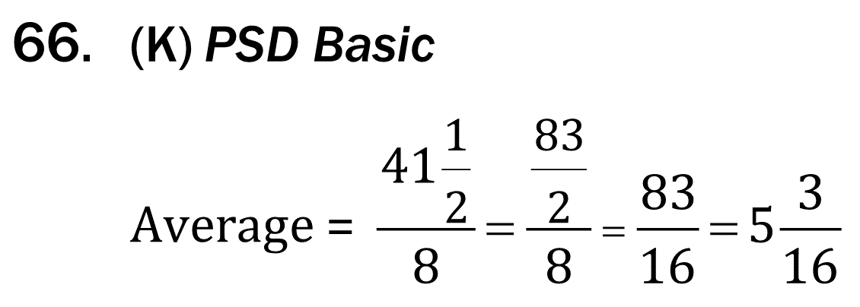
averages

Slide 7
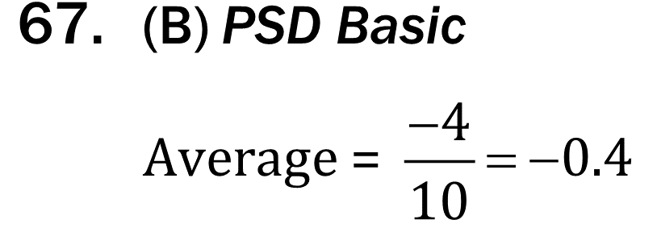
averages

Slide 8
averages

Slide 9
averages

Slide 10
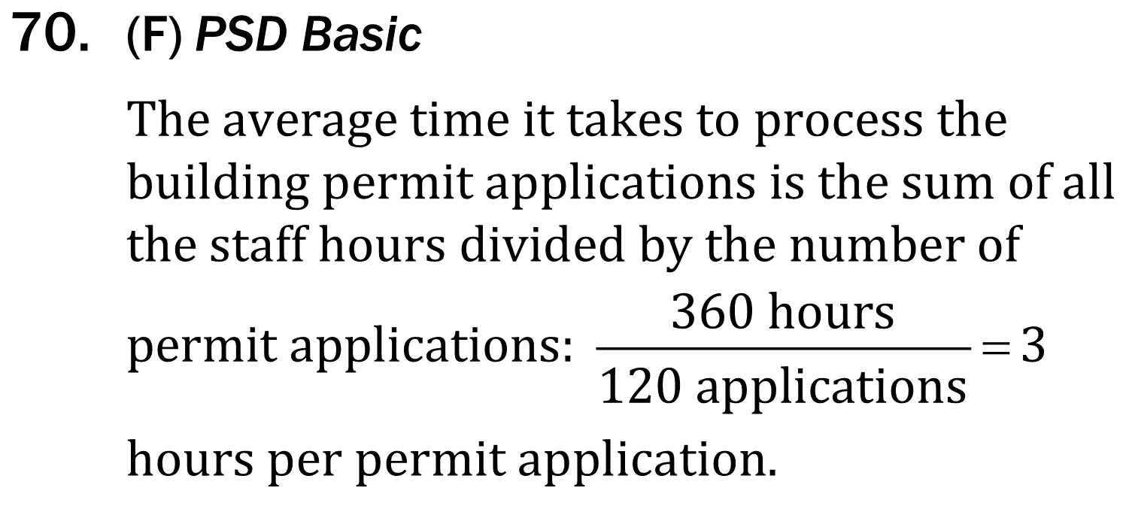
averages

