Slide 1
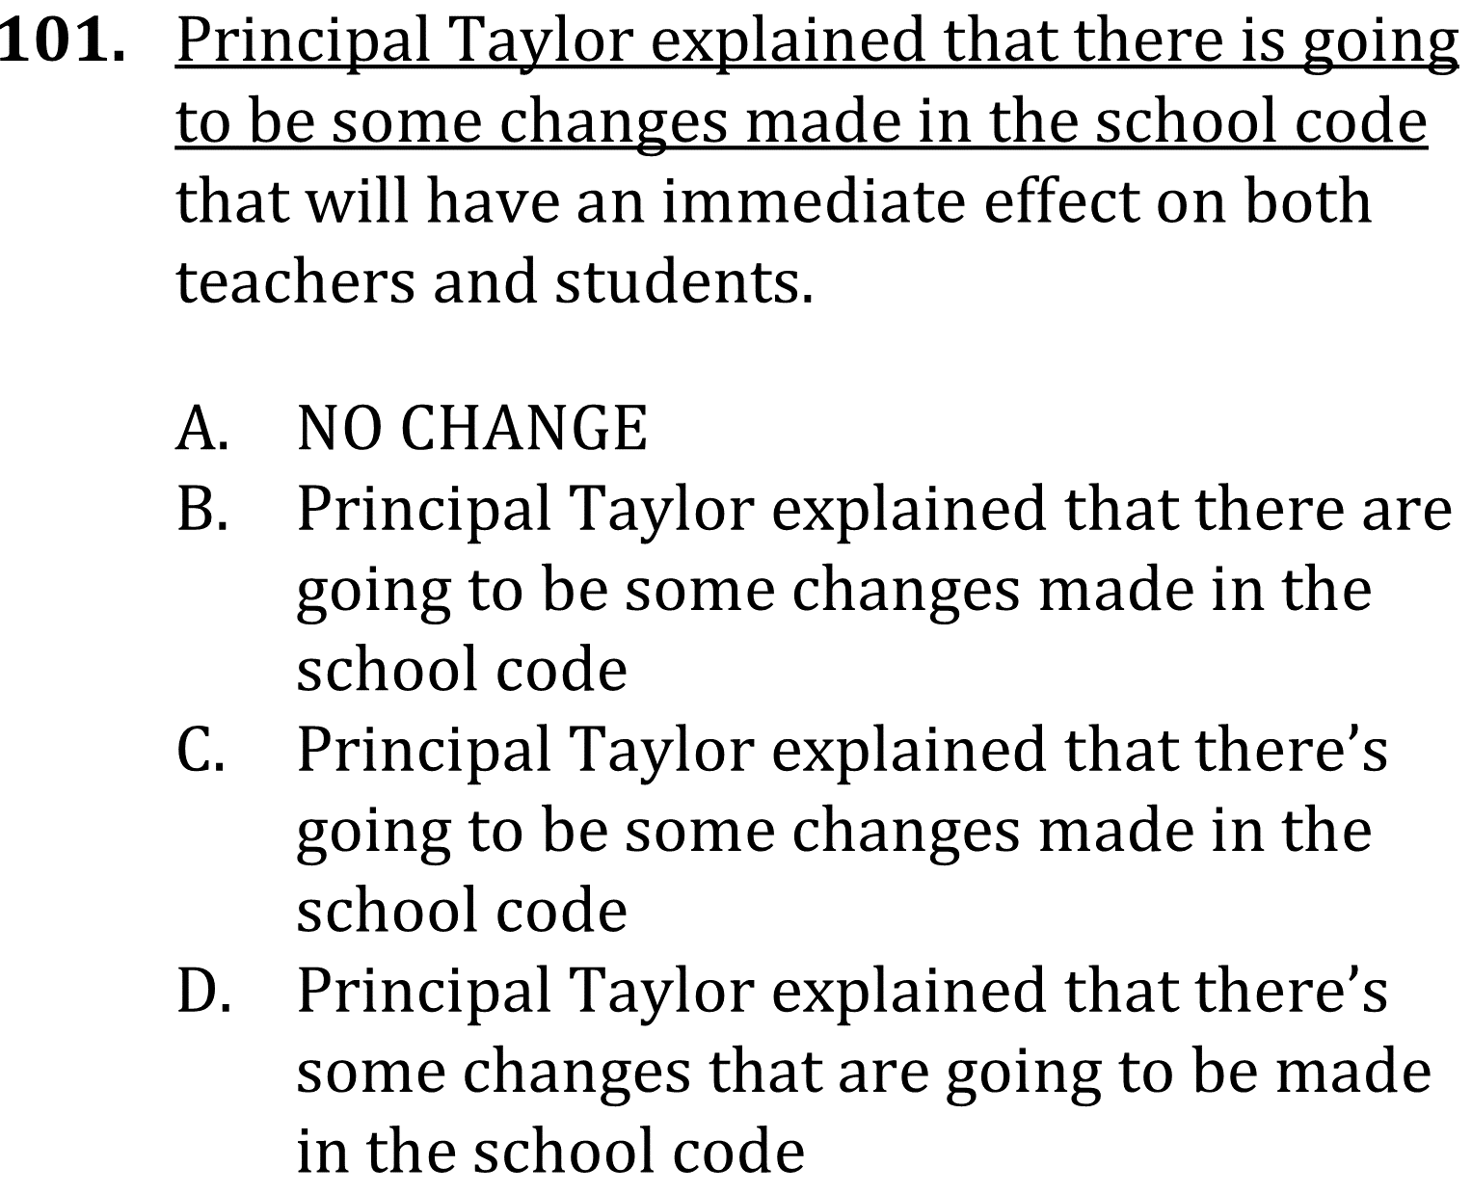
Subject-verb agreement

Slide 2
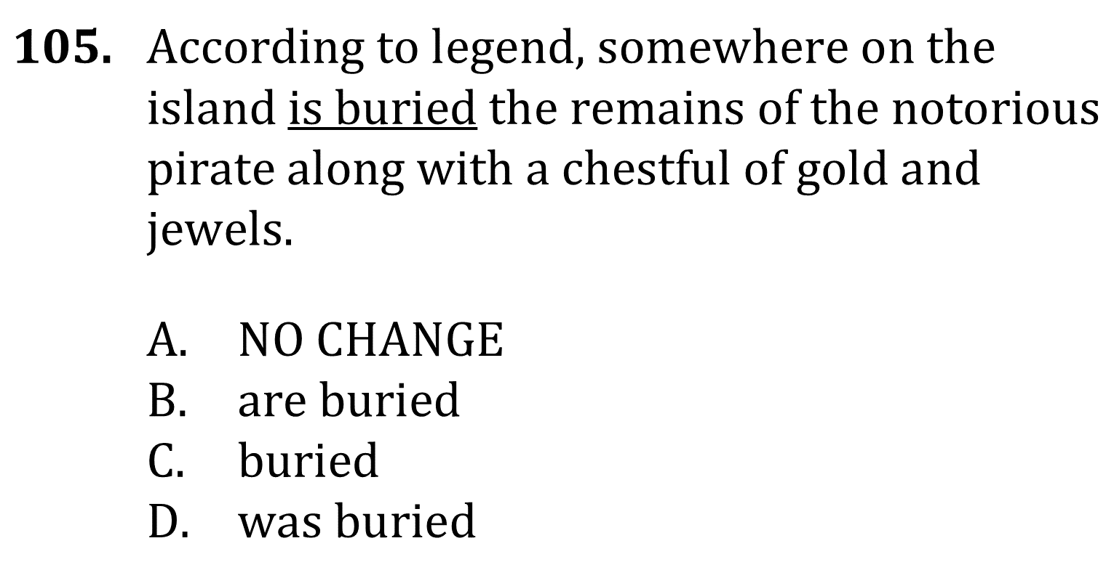
Subject-verb agreement

Slide 3
Subject-verb agreement

Slide 4
Subject-verb agreement

