Slide 1
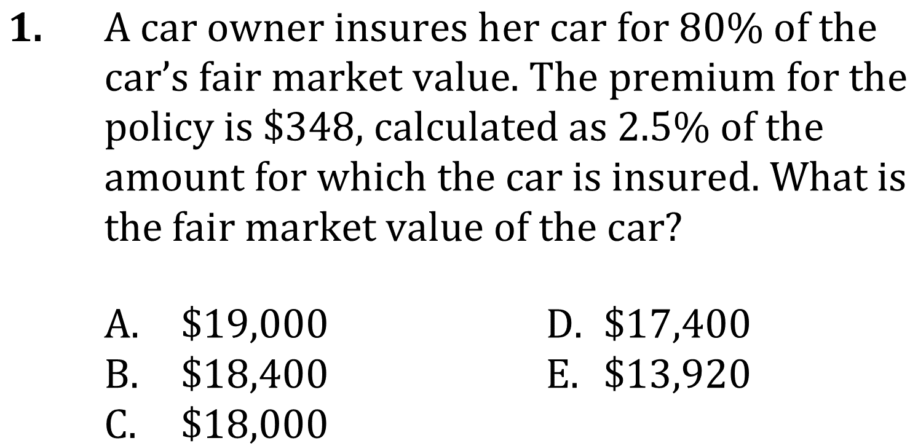
Fractions, proportions, and rates

Slide 2
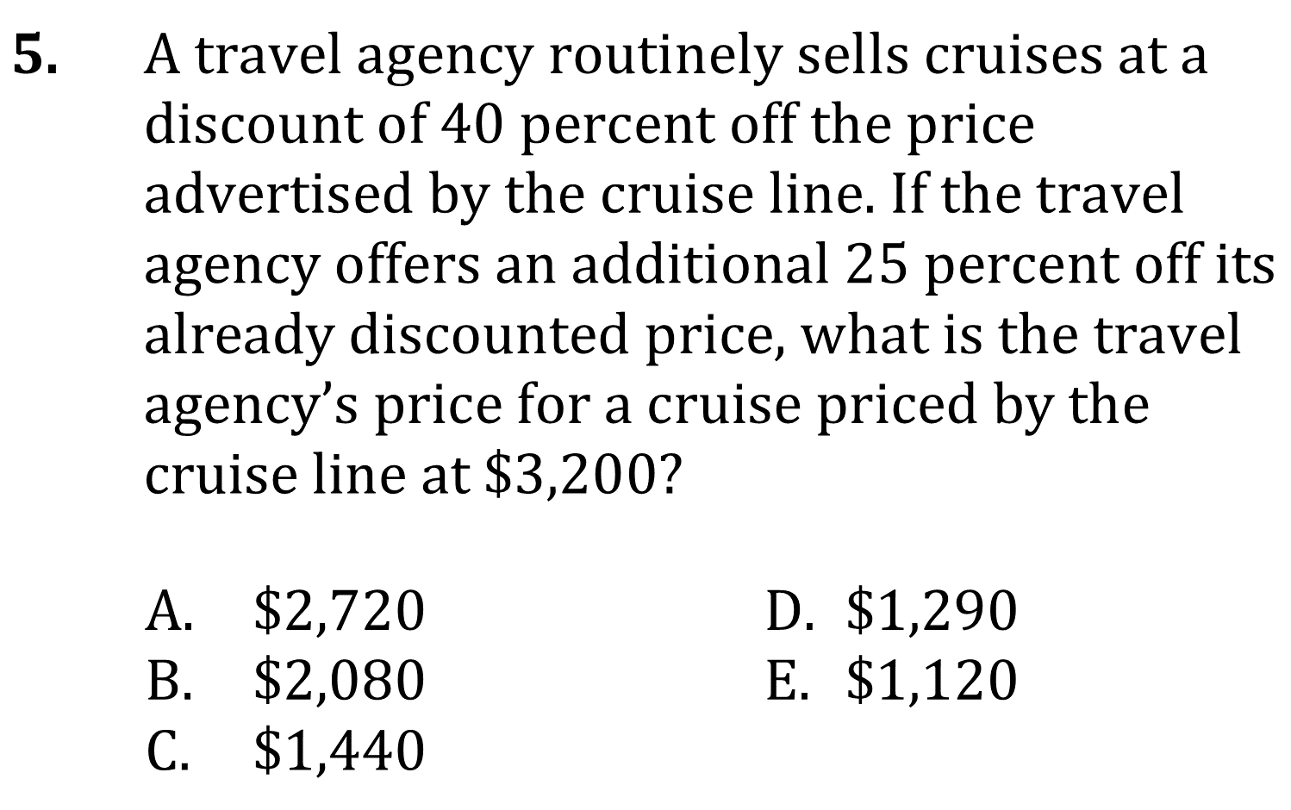
Fractions, proportions, and rates

Slide 3
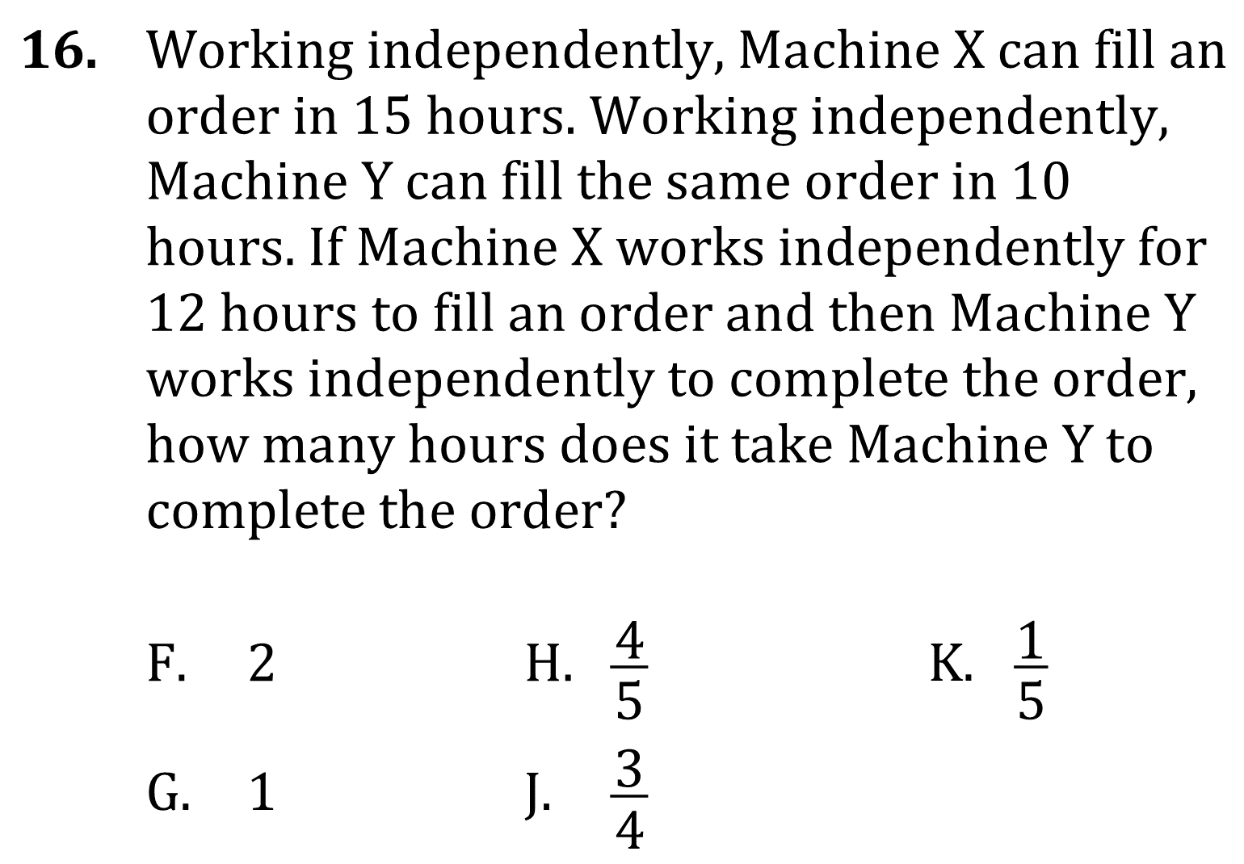
Fractions, proportions, and rates

Slide 4
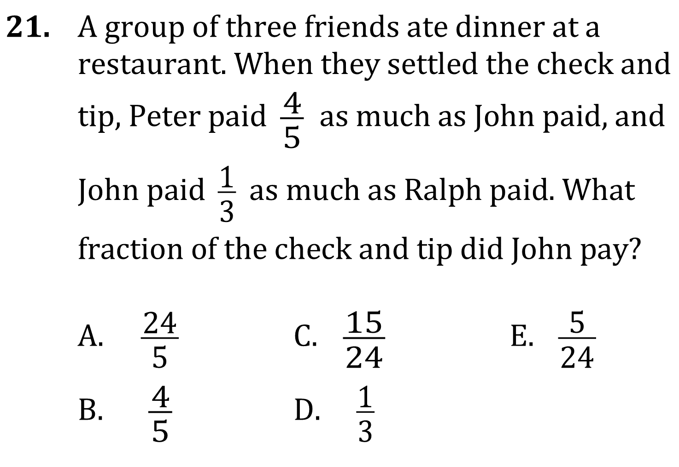
Fractions, proportions, and rates

Slide 5
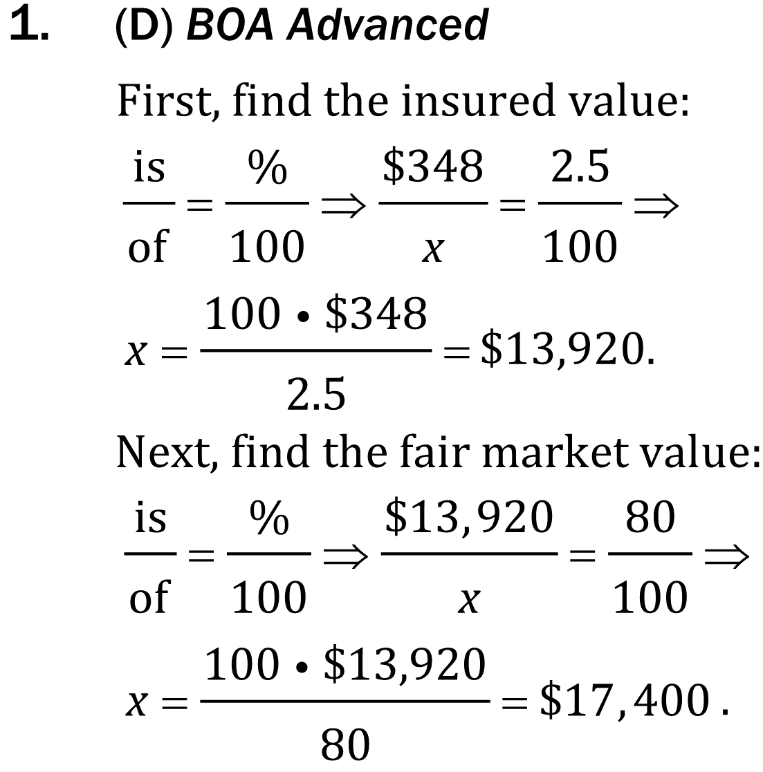
Fractions, proportions, and rates

Slide 6
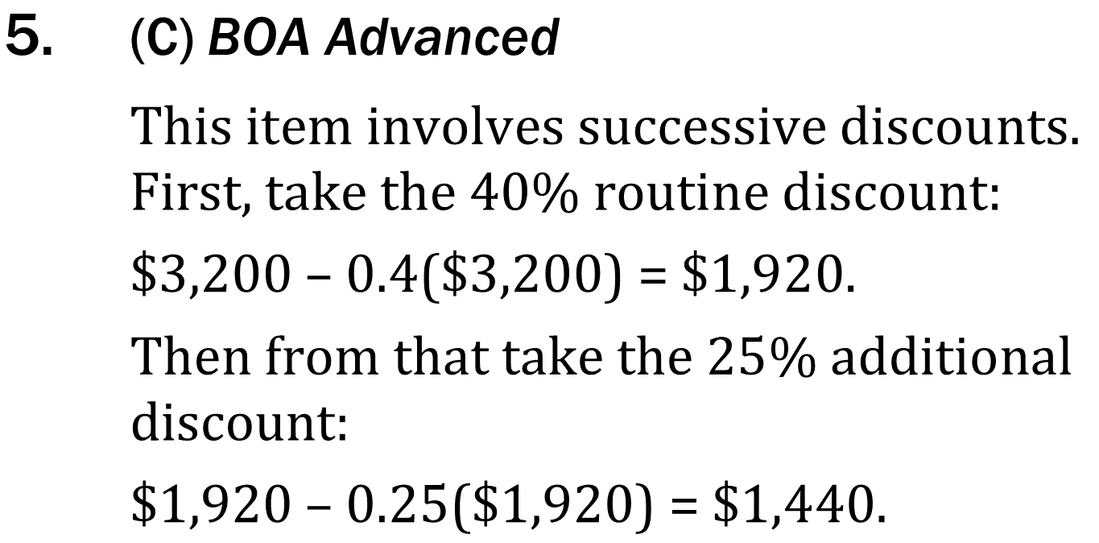
Fractions, proportions, and rates

Slide 7
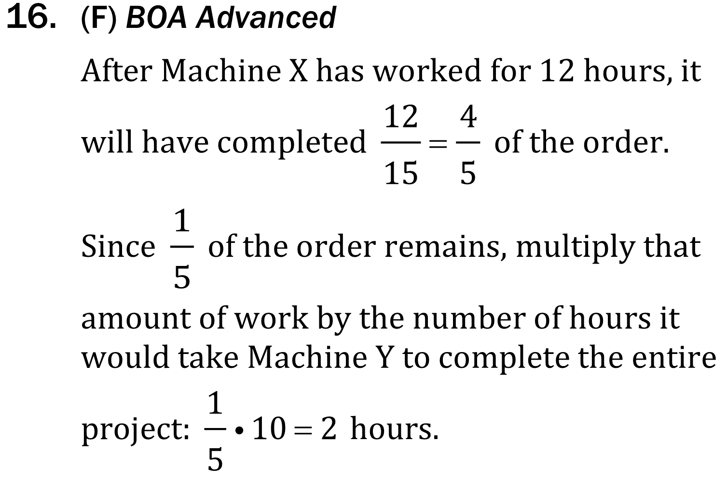
Fractions, proportions, and rates

Slide 8
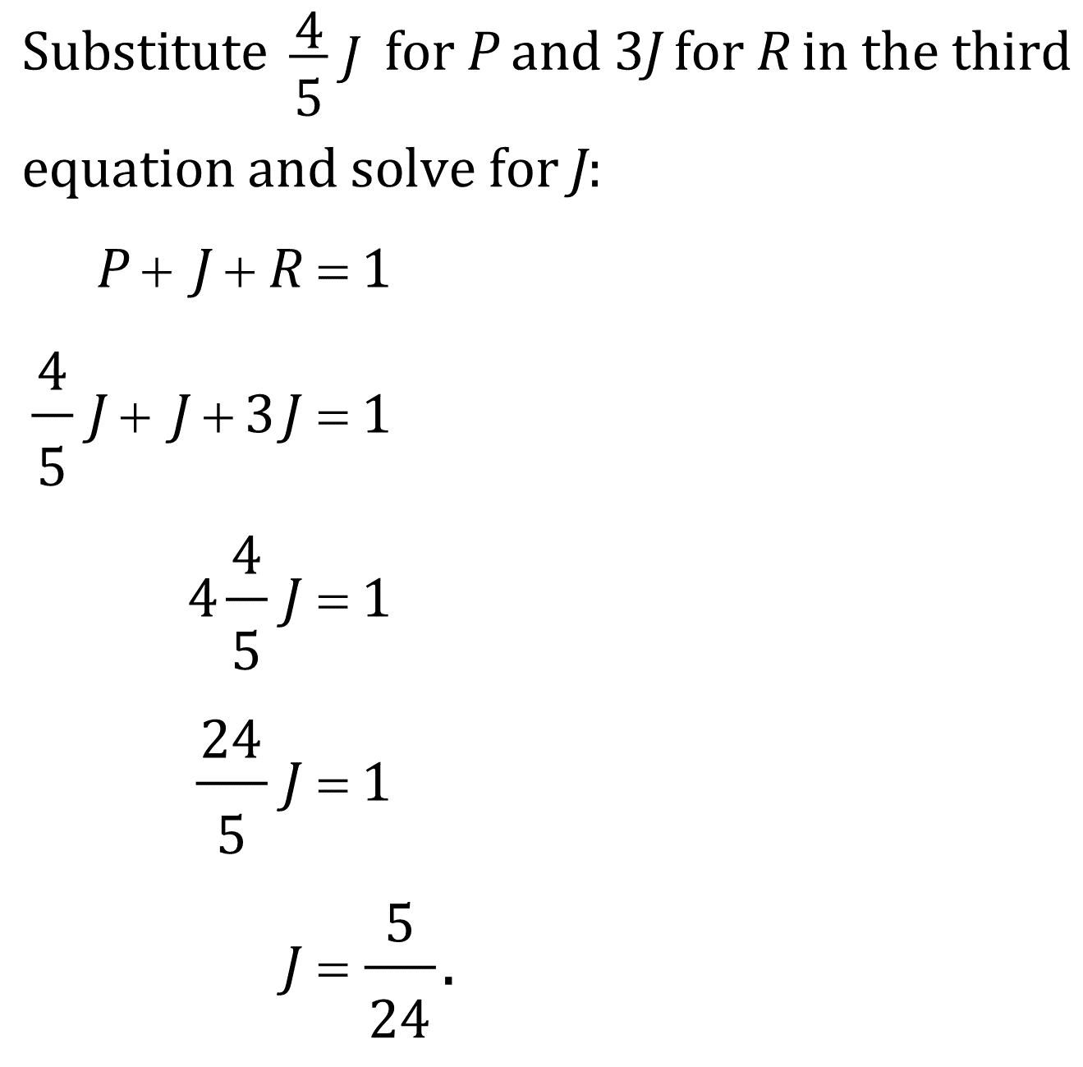
Fractions, proportions, and rates

