Slide 1
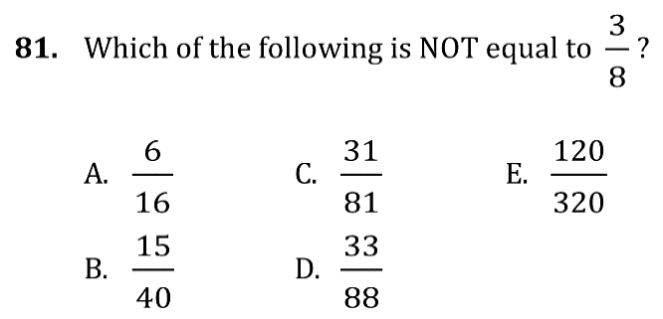
Fractions and Place Value

Slide 2
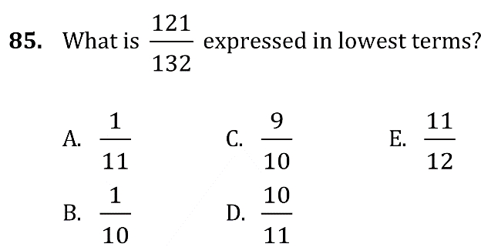
Fractions and Place Value

Slide 3
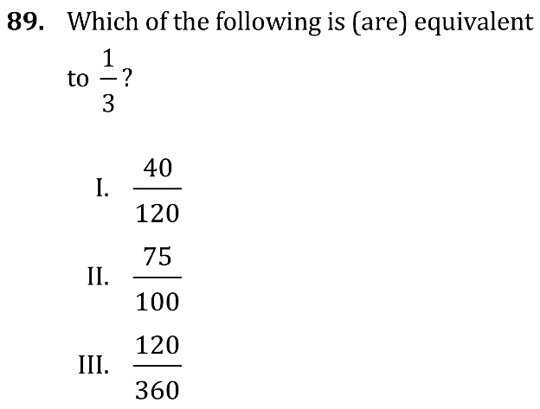
Fractions and Place Value

Slide 4
Fractions and Place Value

Slide 5
Fractions and Place Value

Slide 6
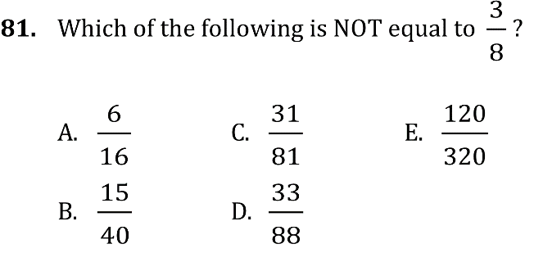
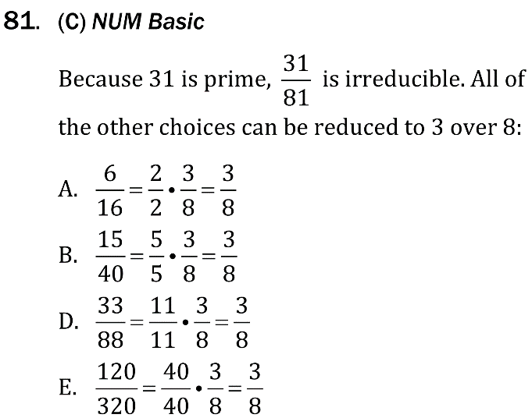
Fractions and Place Value

Slide 7
Fractions and Place Value

Slide 8
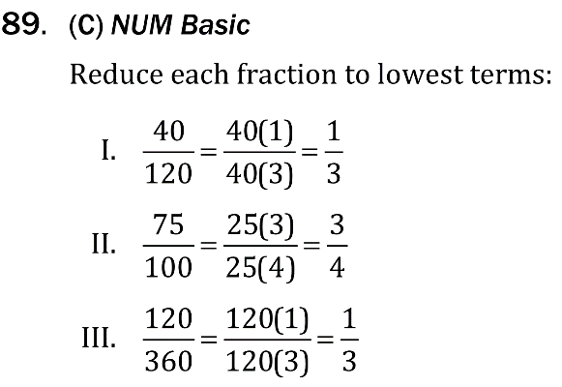
Fractions and Place Value

Slide 9
Fractions and Place Value

Slide 10
Fractions and Place Value

